Slide 1
Digital image semantic segmentation based on deep learning artificial neural network
He Yiming

Slide 2
Introduce
Image semantic segmentation is the cornerstone of image understanding. It plays a key role in autonomous driving systems, drone applications, and wearable device applications.
Before the application of deep learning in image semantic segmentation, image segmentation is mostly based on the low-order visual information of image pixels themselves.
After deep learning is applied to image semantic segmentation, Full Convolutional Networks developed based on convolutional neural network has become one of the commonly used methods.

Slide 3
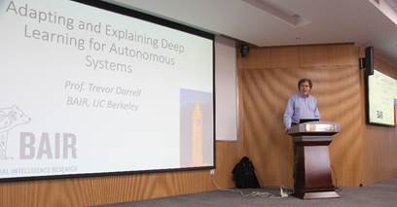
Full Convolutional Networks (FCN) is a framework for semantic segmentation of images proposed by Jonathan Long. in 2015 in the article Fully Convolutional Networks for Semantic Segmentation. It is the pioneering work in the field of deep learning for semantic segmentation.

Slide 4
The FCN network structure is mainly divided into two parts: the full convolutional part and the inverse convolutional part. Among them, the full convolutional part is some classical CNN networks for feature extraction; the inverse convolutional part is to get the semantic segmentation image of the original size by sampling.The input of FCN can be a colour image of any size, and the output is of the same size as the input, with the number of channels as n (the number of target categories) + 1 (the background).

Slide 5
T h a n k s

