Slide 1
Digital image semantic segmentation based on deep learning artificial neural network
He Yiming

Slide 2
FNC network
1.Network structure
2.Upsampling
3.Skip structure

Slide 3
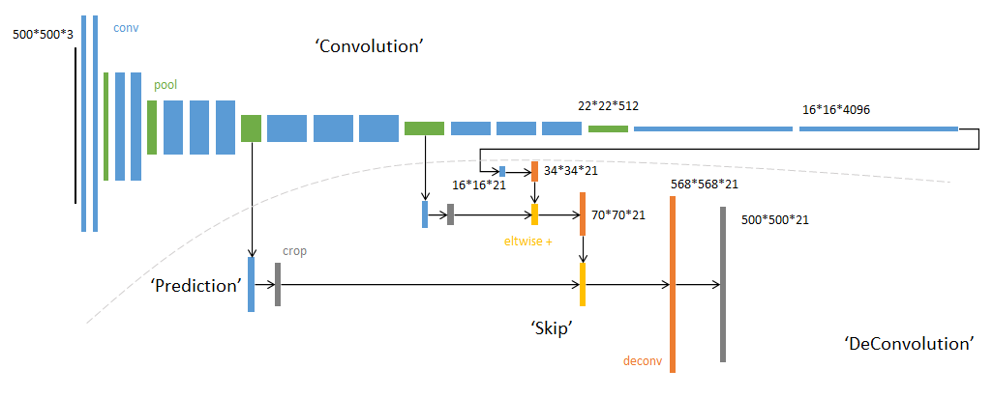
Network structure
The FCN network structure is mainly divided into two parts: the full convolution part and the deconvolution part. The full convolution part is used to extract features, and the deconvolution part is used to get the semantic segmentation image of full size by upsampling. The input of FCN can be a color image of any size, the output is the same size as the input, and the number of channels is n (number of target categories) +1 (background). The FCN network structure is as follows:

Slide 4
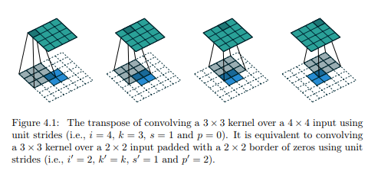
Upsampling
The convolution operation and pooling operation in the convolution process will reduce the size of the feature map. In order to obtain the dense pixel prediction of the original image size, the resulting feature map needs to be up-sampled. The upsampling can be realized by bilinear interpolation, and the bilinear interpolation is easy to be realized by the transposed convolution of the fixed convolution kernel, which is called deconvolution. The transposed convolution operation is as follows:

Slide 5
Skip structure
If only the feature map of the last layer is upsampled to get the segmentation of the original image size, the final segmentation effect is often not ideal. Because the feature map of the last layer is too small, it means too much detail is missing. Therefore, the prediction of the last layer and the shallower layer are combined through a step-down structure, and the local prediction is made while the global prediction is observed.

Slide 6
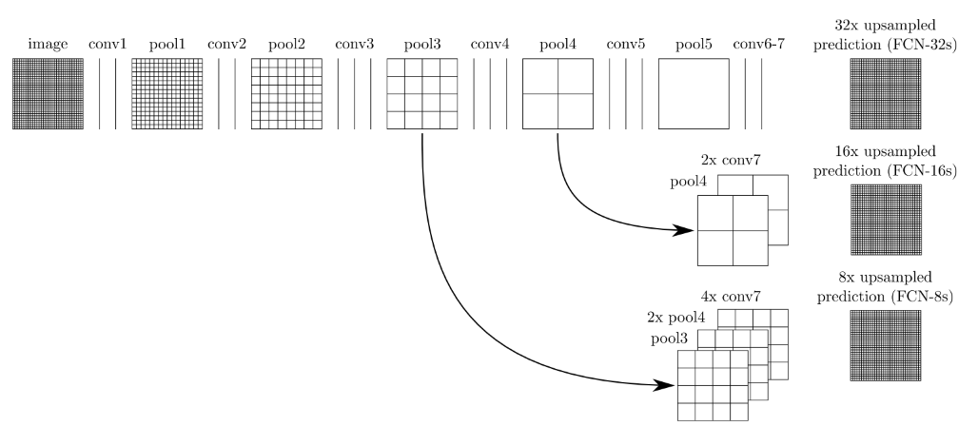
Skip structure
The bottom-layer prediction (FCN-32s) is upsampled twice to get the full-size image, and the prediction from the pool4 layer (stride 16) is fused (added), and this part of the network is called FCN-16s. This part of the network is then called FCN-8s after a double up-sampling and fusion with the prediction obtained from the pool3 layer. The picture is as follows:

Slide 7
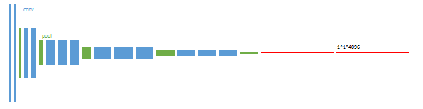
FCN training
1.The classical classification network is initialized, the last two levels are fully connected (red), and the parameters are discarded.

Slide 8
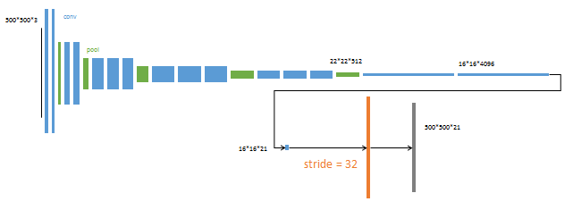
FCN training
2.FCN-32s network - Split the small map from the feature small map prediction, and then directly raise the sample to the large map.

Slide 9
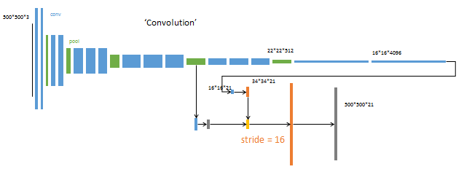
FCN training
3.FCN-16s Network - Up-sampling is done in two sessions. Before the second upsampling, the prediction result of the fourth pooling layer is integrated and the stepwise structure is used to improve the accuracy.

Slide 10
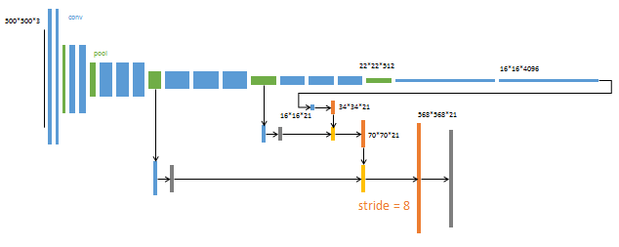
FCN training
4.FCN-8s network - The up-sampling is completed in three steps. The prediction results of the third pooling layer are further integrated.

Slide 11
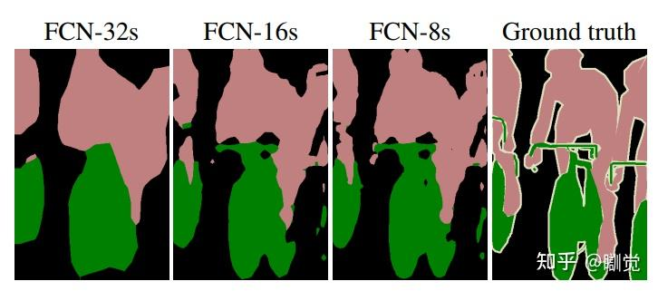
Skip structure
This is the result of each training session

Slide 12
Thanks

