Slide 1

Image extraction
The object detection and recognition based on deep learning mainly uses image semantic segmentation.Image semantic segmentation is the cornerstone of image understanding.
After deep learning is applied to image semantic segmentation, Full Convolutional Networks developed based on convolutional neural network has become one of the commonly used methods
The FCN network structure is mainly divided into two parts: the full convolutional part and the inverse convolutional part.
1. the full convolutional part is some classical CNN networks for feature extraction.
2. the inverse convolutional part is to get the semantic segmentation image of the original size by sampling.

Slide 2
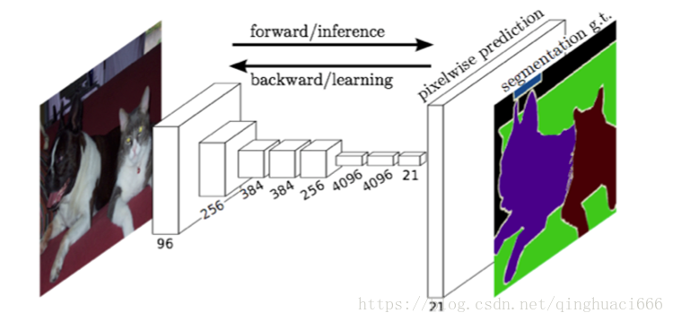
This picture shows the Network structure and Effect drawing of FNC

