Slide 1
Report
heyiming

Slide 2
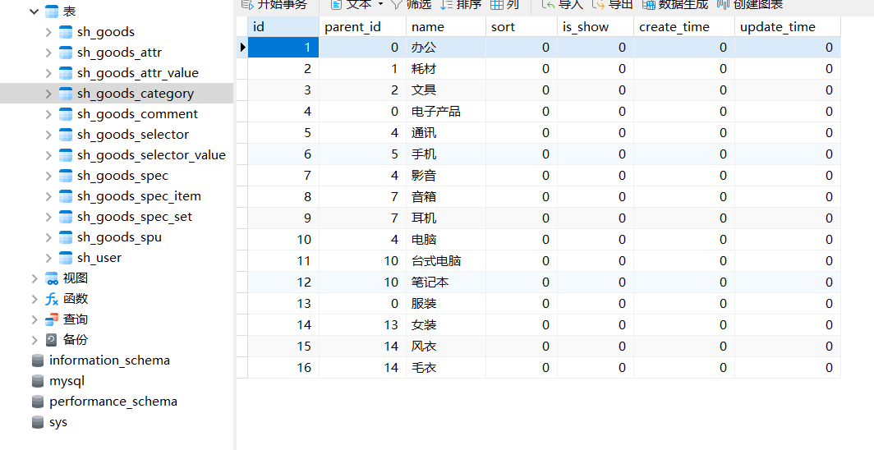
Commodity classification list

Slide 3
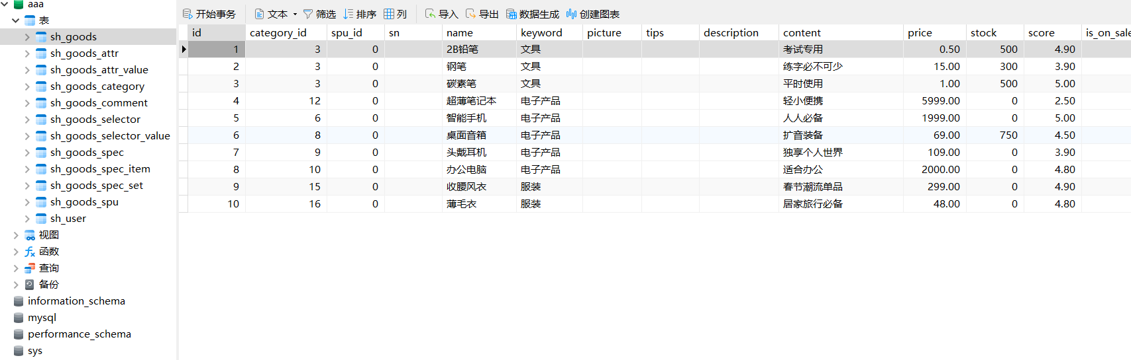
Commodity list

Slide 4
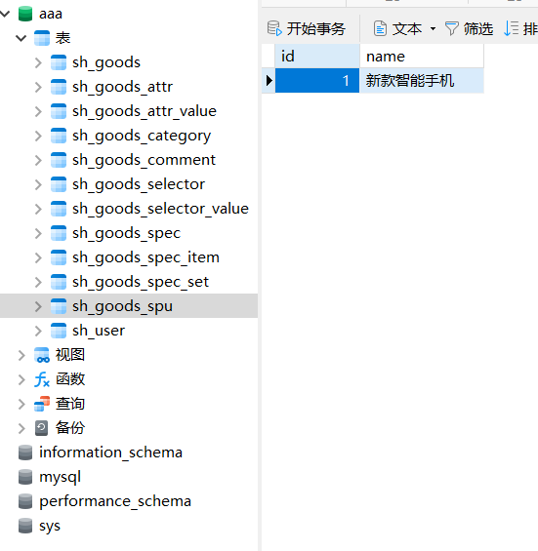
Commodity spu list
SPU is the smallest unit of product information aggregation

Slide 5
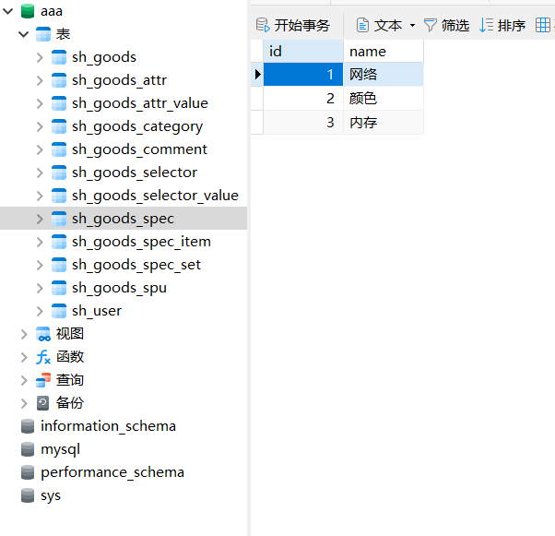
Commodity specification list

Slide 6
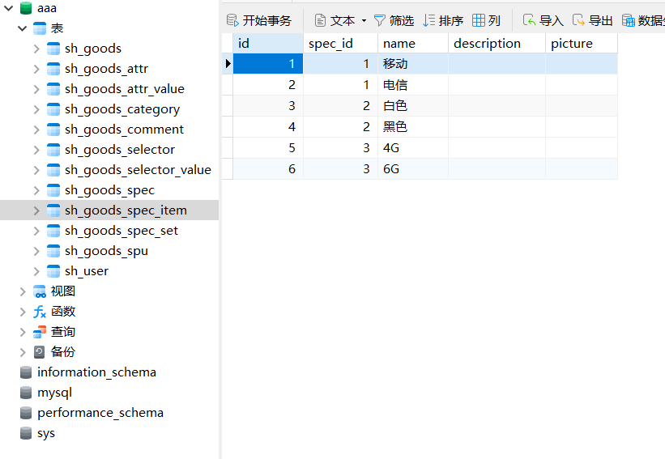
Commodity specification item list

Slide 7
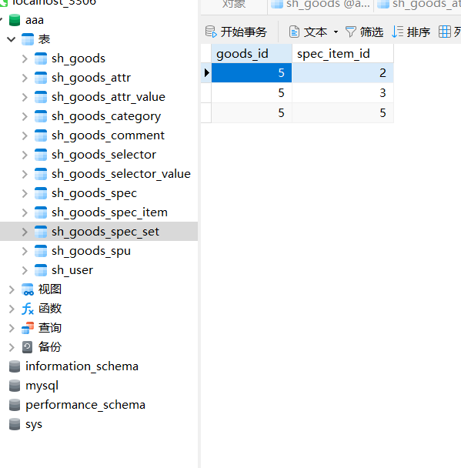
Commodity specification item combination list

Slide 8
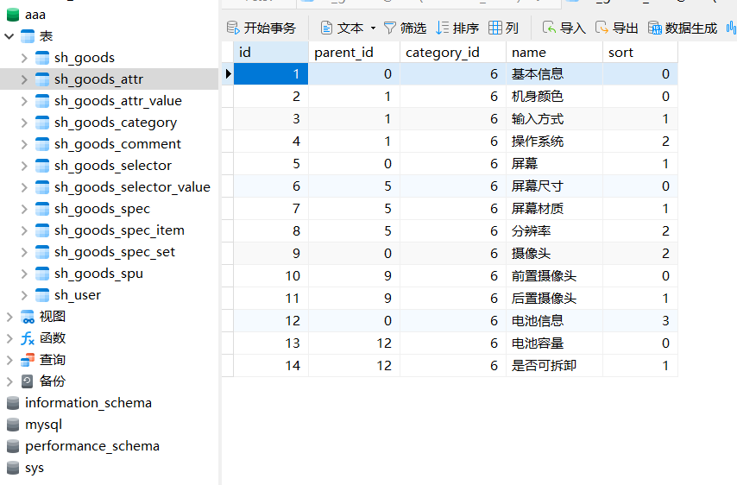
Commodity attribute list

Slide 9
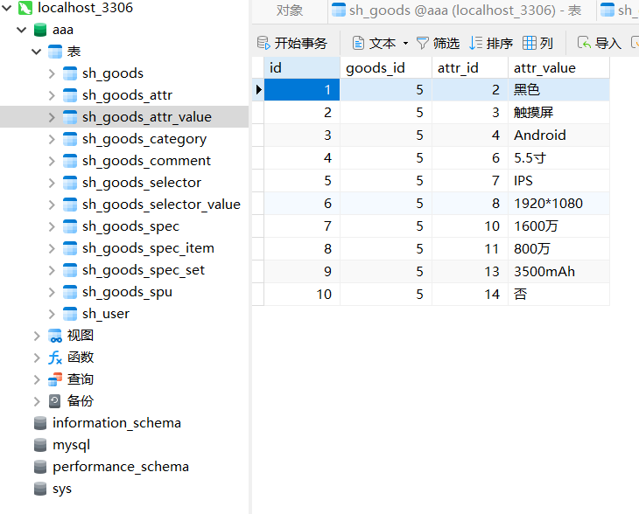
Commodity attribute value tlist

Slide 10
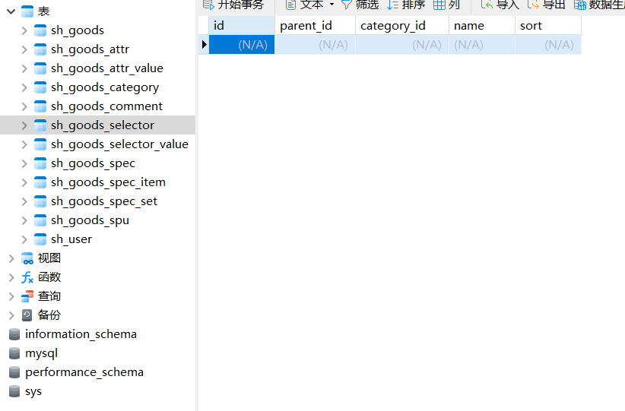
Commodity screening list

Slide 11
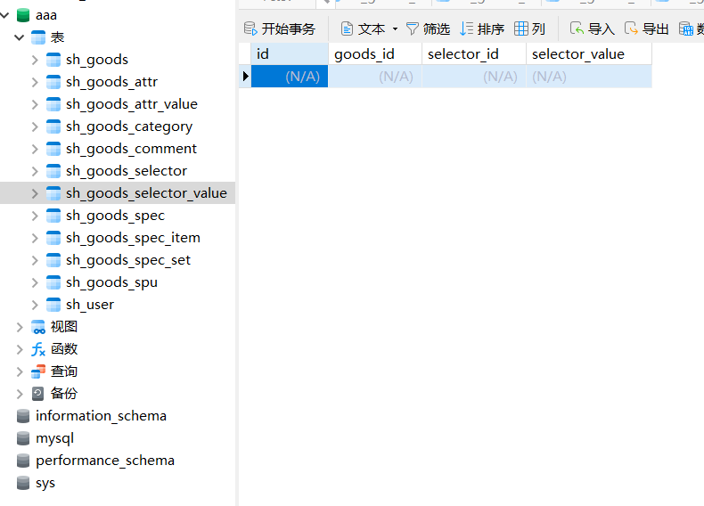
Commodity screening value list

Slide 12
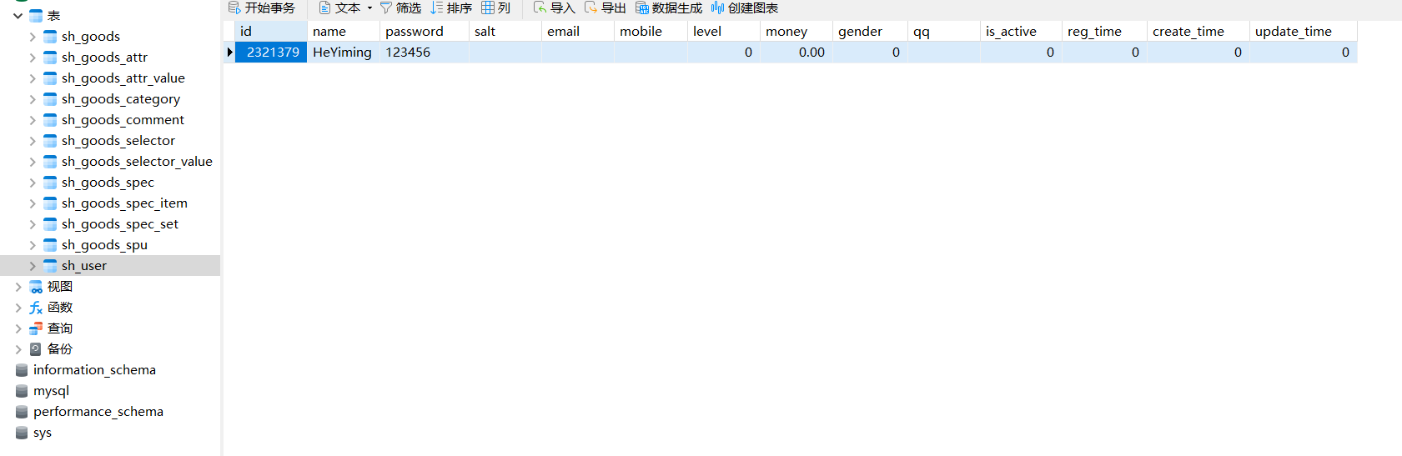
User list

Slide 13
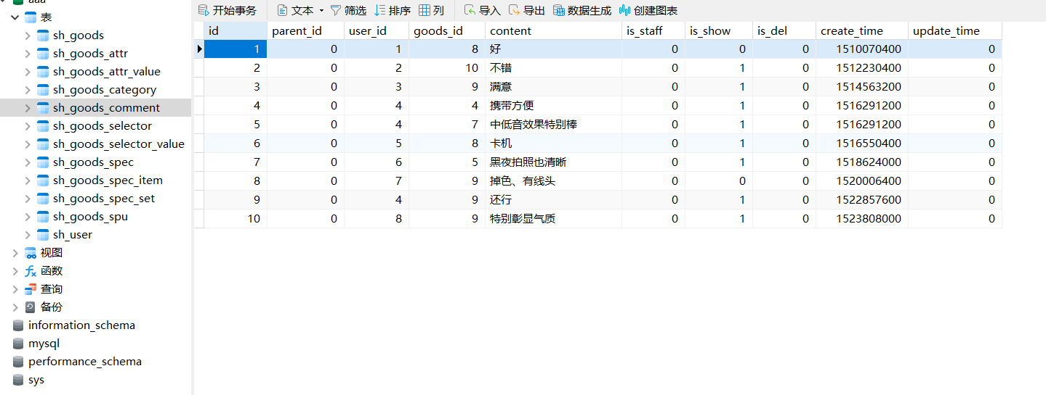
Commodity review list

Slide 14
Thanks

