Slide 1
Robot vacuum cleaner
He Yiming

Slide 2
Sweeping robot is a kind of service robot, which can replace people to clean rooms, workshops, walls and so on. The main task of indoor cleaning robot is to be able to replace people for cleaning work, so it needs to have a certain intelligence. Cleaning robots should have the following capabilities: be able to self-navigate, detect and avoid obstacles in walls and rooms.

Slide 3
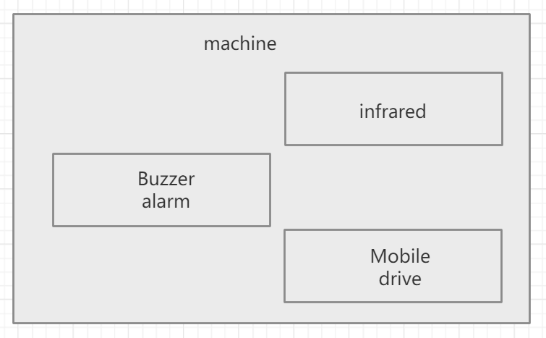
frame

Slide 4
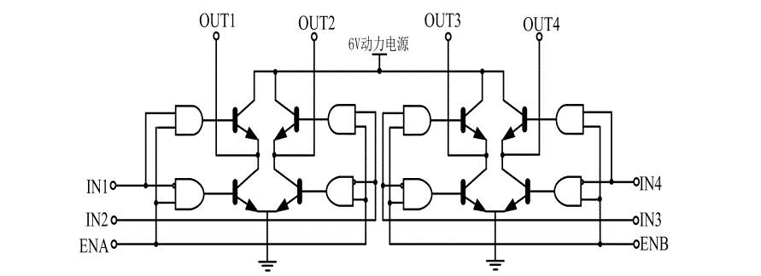
Mobile drive circuit

Slide 5
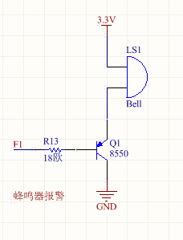
Buzzer alarm circuit

Slide 6
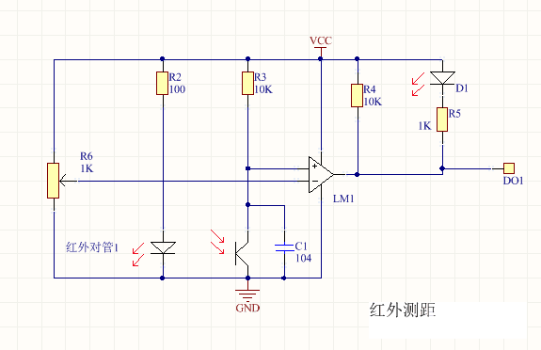
Infrared ranging and infrared receiving module`
The advantages of infrared detection technology: mature technology, low cost, long service life and high reliability. A pair of high-quality infrared tube is cheap, and has the advantages of long working life and stable electrical performance.

Slide 7
Thanks

