Slide 1
Combinatorial Test Tool
DVA313 - Group 2

Slide 2
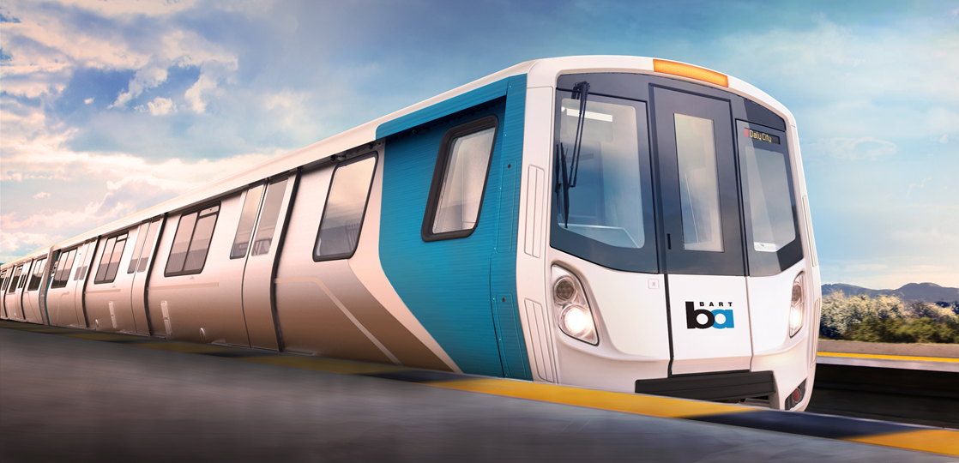
Client Details
Bombardier in Sweden is focused on development and manufacturing of trains and railway equipment

Slide 3
Combinatorial test tool
A tool for automatic generation of test inputs for Train Control Management System (TCMS) in Bombardier.
Train Control Management System (TCMS) manages and controls whole operations in a train like the braking system, heating, opening and closing of doors etc.
The tool should run as a GUI tool written in C# and running on Windows.

Slide 4
Basic Functionality
The tool should be written in C# and be able to run on Windows
Tool
Inputs
Data Types
Show Tests
XML File
XML Parser
Test Generation
Save tests
CSV file
Random
Base Choice
Add
Move
Remove

Slide 5
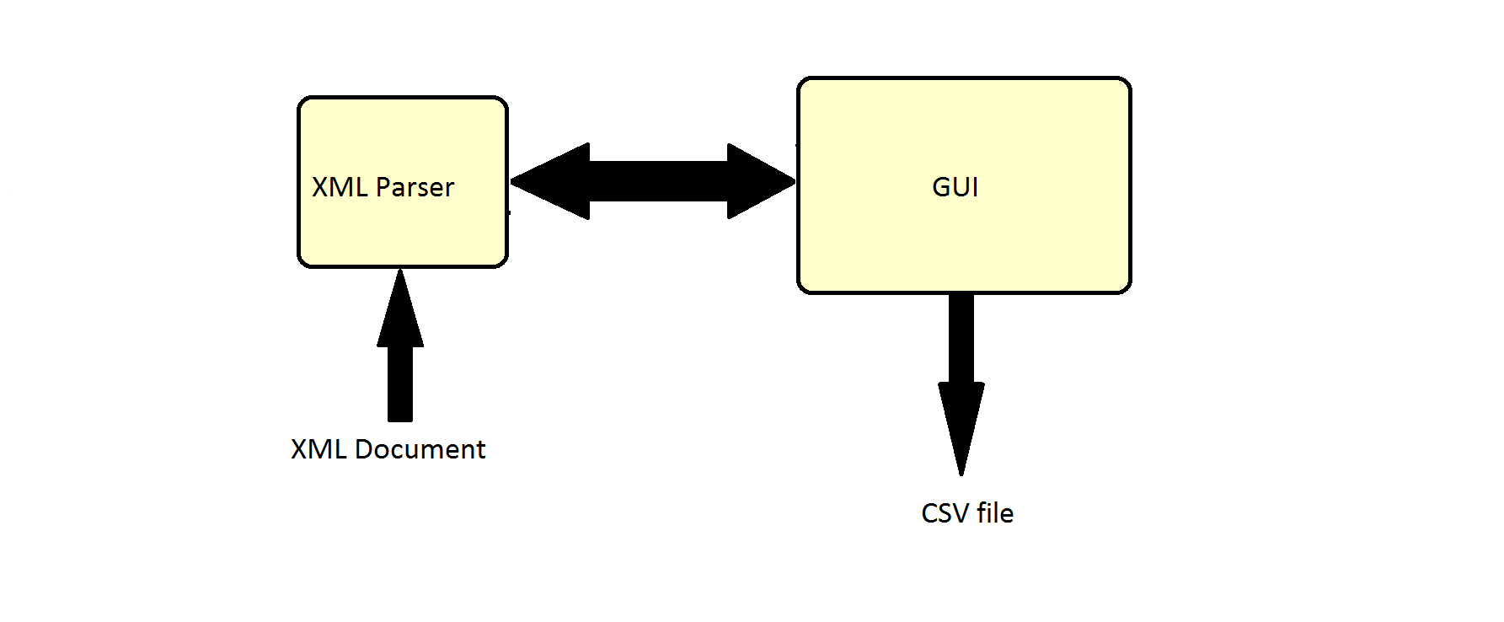
High-level design

Slide 6
Client Requirements
Fulfilled:
Written in C# and running on Windows
Can parse XML files
Support for INT, REAL and BOOL
Random- and Base choice algorithms
Save Tests to CSV file (Comma-separated values)
Add, move and remove test cases
Tree View
Save/load project state
Use tool without XML (Create your own inputs)
Not fulfilled:
Run tool as DLL callable by other applications
Suggest base values from XML file

Slide 7
Client Requirements - Priority
Graphical User Interface | VERY HIGH
XML Parser | VERY HIGH
Random & Base Choice Algorithms | VERY HIGH
Save to CSV file | HIGH
Add/Move/Remove test cases | HIGH
Tree view | MEDIUM
Use tool without XML file | MEDIUM
Save project state | MEDIUM
Suggest base value | LOW
Run as DLL callable by other applications | LOW

Slide 8
Live demo
……………..

Slide 9
Activities
Development & Implementation
GUI
Random and base algorithm
XML Parser
Error handling
XML files treeview
Save to CSV file
Use tool without XML
Save and load project state
Documentation
Presentation slides
Project plan
Design document
Final report
Presentations
Project plan and requirements
Weekly meetings & Presentations
Preliminary design and implementation
Final presentation

Slide 10
Activities - Hours Worked
Development & Implementation: 50%
Documentation: 35%
Presentations: 15%

Slide 11
Initial Plan
Responsibilities:
Meera - Project manager
Simon - Client contact
Henning - SVN/GIT
Adeel - Document manager
Division of work:
Henning & Juan - XML Parser
Simon & Linus - GUI and error handling
Sara, Meera & Adeel - Random & Base Choice algorithms and Save to CSV

Slide 12
Initial Plan - Outcome
Responsibilities:
Meera - Project manager
Simon - Client contact
Juan - SVN/GIT
Division of work:
Henning & Juan - XML Parser
Simon & Linus - GUI and error handling
Sara, Meera & Adeel - Random & Base Choice algorithms and Save to CSV + Add/Move/Remove
Linus - Tree View
Simon - Use tool without XML
Sara - Save project state

Slide 13
NO: | Deliverables & milestones | Deadlines
1. | Deliverables
1.1 | Project plan | 19/11/2015
1.2 | Presentation-Project plan and requirements | 25/11/2015
1.3 | Design description (1st version) | 03/12/2015
1.4 | Product (1st version) | 03/12/2015
1.5 | Presentation-Preliminary design and implementation | 09/12/2015
1.6 | Final presentation | 13/01/2016
1.7 | Design description (Final version) | 14/01/2016
1.8 | Product (Final version) | 14/01/2016
1.9 | Project report | 14/01/2016
2. | Milestones
2.1 | Completion of Requirement Specification | 17/11/2015
2.2 | Completion of design | 24/11/2015
2.3 | Completion of implementation | 08/12/2015
2.4 | Completion of Preliminary testing | 10/12/2015
2.5 | Final product delivery | 07/01/2016

Slide 14
NO: | Deliverables & milestones | Deadlines
1. | Deliverables
1.1 | Project plan | 19/11/2015
1.2 | Presentation-Project plan and requirements | 25/11/2015
1.3 | Design description (1st version) | 03/12/2015
1.4 | Product (1st version) | 03/12/2015
1.5 | Presentation-Preliminary design and implementation | 09/12/2015
1.6 | Final presentation | 13/01/2016
1.7 | Design description (Final version) | 14/01/2016
1.8 | Product (Final version) | 14/01/2016
1.9 | Project report | 14/01/2016
2. | Milestones
2.1 | Completion of Requirement Specification | 17/11/2015
2.2 | Completion of design | 24/11/2015
2.3 | Completion of implementation | 08/12/2015
2.4 | Completion of Preliminary testing | 10/12/2015
2.5 | Final product delivery | 13/01/2016

Slide 15
Planned effort per member for each week
Members | W.46 | W.47 | W.48 | W.49 | W.50 | W.51 | W.52 | W.53 | W.01 | W.02 | Total
Meera | 20 | 20 | 22 | 20 | 18 | 10 | 10 | 10 | 10 | 5 | 150
Linus | 20 | 20 | 20 | 20 | 20 | 10 | 10 | 10 | 20 | 10 | 150
Adeel | 20 | 20 | 20 | 20 | 20 | 20 | 10 | 5 | 20 | 5 | 150
Simon | 20 | 20 | 20 | 20 | 20 | 20 | 10 | 5 | 20 | 5 | 150
Henning | 20 | 20 | 20 | 20 | 20 | 20 | 10 | 5 | 20 | 5 | 150
Juan | 20 | 20 | 20 | 20 | 20 | 20 | 10 | 5 | 10 | 5 | 150
Sara | 20 | 20 | 20 | 20 | 20 | 20 | 10 | 5 | 20 | 5 | 150

Slide 16
Outcome
Members | W.46 | W.47 | W.48 | W.49 | W.50 | W.51 | W.52 | W.53 | W.01 | W.02 | Total
Adeel | 18 | 20 | 17 | 17 | 18 | 8 | 7 | 0 | 3 | 20 | 128
Henning | 18 | 18 | 16 | 17 | 19 | 13 | 6 | 0 | 7 | 14 | 128
Juan | 18 | 18 | 18 | 17 | 19 | 6 | 8 | 0 | 3 | 16 | 123
Linus | 18 | 18 | 22 | 17 | 19 | 7 | 3 | 0 | 5 | 20 | 129
Meera | 18 | 22 | 20 | 21 | 19 | 5 | 0 | 0 | 3 | 20 | 128
Sara | 18 | 18 | 21 | 17 | 19 | 11 | 2 | 0 | 5 | 20 | 131
Simon | 18 | 18 | 17 | 17 | 19 | 9 | 4 | 0 | 4 | 14 | 120

Slide 17
How did you divide and synchronize the work?
Division of work:
Preferences and discussions during meetings
Synchronization of work:
Google Docs for documentation (reports and worked hours)
Communicated through facebook chat
Shared presentation documents and code via email
Weekly group meetings

Slide 18
Experiences
Problems
Sharing project
Schedule group meetings
What did we learn?
How to gather requirements
How to write documentation
Organize and work with a team
Improvements
A better way of sharing (codes, documents etc)
Divide work based on previous experience
More structured time reports

Slide 19
Thank you!

