Slide 1
Design & Implementation
DVA313 - Group 2
- Henning Bergström & Juan Antonio Lopez Muntaner

Slide 2
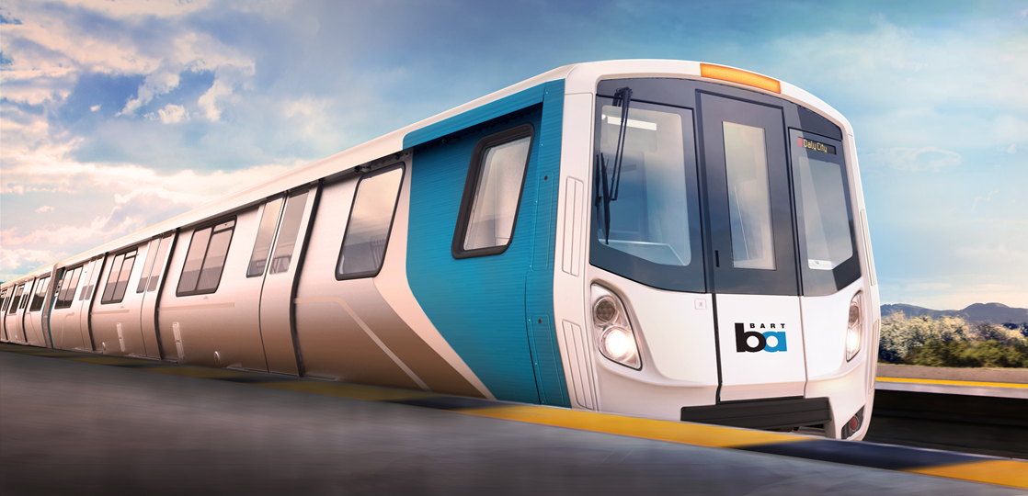
Client Details
Bombardier in Sweden is focused on development and manufacturing of trains and railway equipment

Slide 3
Combinatorial test tool
A tool for automatic generation of test inputs for Train Control Management System (TCMS) in Bombardier
Train Control Management System (TCMS) manages and controls whole operations in a train like the braking system, heating, opening and closing of doors etc.
The tool should run as a GUI tool written in C# and running on Windows.

Slide 4
Basic Functionality
Tool
Inputs
Data Types
XML Parser
Show Tests
XML File
Test Generation
Save tests
CSV file
Random
Base Choice
Add
Move
Remove

Slide 5
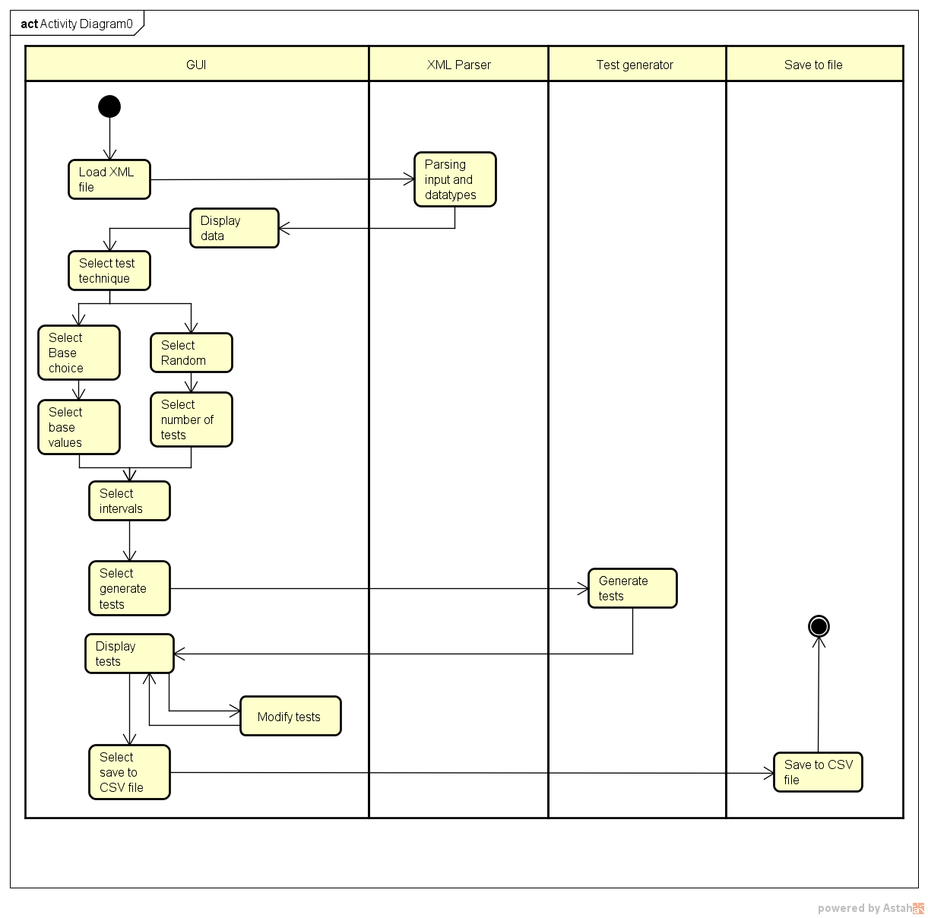
Activity diagram overview for TCMS

Slide 6
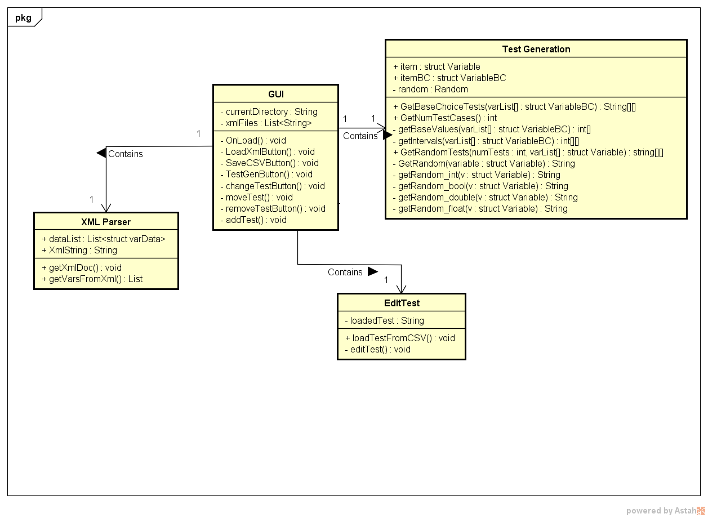
Class diagram snippet

Slide 7
Live demo!
………………………………………………..

Slide 8
Client feedback
Change how the Parser reads the XML files
How an interval between two floats should be calculated (infinity?)
Opening XML files in a tree structure
Saving inputs/outputs as entire projects

Slide 9
Future prospects
Error handling
Re-visiting the XML Parser
Add multiple intervals
Modifying test cases
DLL version

Slide 10
Thank you!

