Slide 1
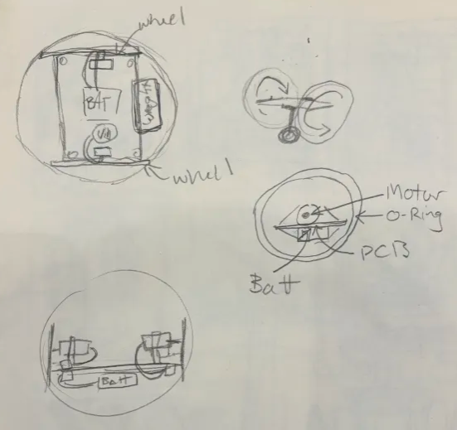
Velcro Ball Robots
Tiffany Jiang
Project Goal: Create spherical ball robots that can interact and connect with each other
Highlights from past week
Drafted robot internals based on current PCB board
Goals for next week
CAD internals
Think about sensors
Think about new PCB board
Make a GitHub for code.

