Slide 1
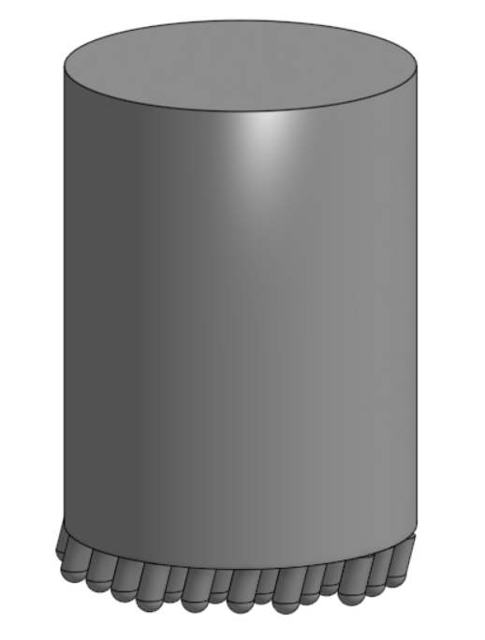
Velcro Ball Robots
Tiffany Jiang
Project Goal: Create spherical ball robots that can interact and connect with each other
Highlights from past week
Started CAD for new robot body
Conducted some carbon nanotube and silicon testing:
Silicone will not cure properly when silicon to carbon nanotubes (by volume) is greater than 1:1 and when left out in the air
Goals for next week
Finish and print new body and conduct some testing
Make a GitHub for code.

