Slide 1
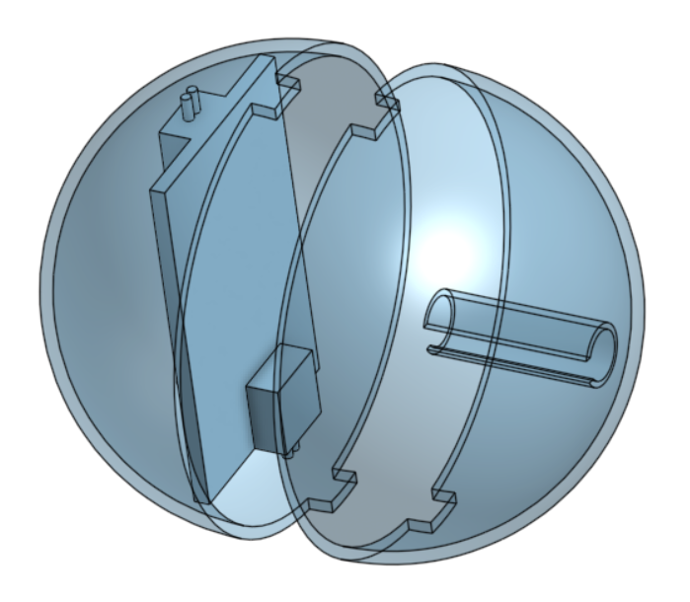
Velcro Ball Robots
Tiffany Jiang
Project Goal: Create spherical ball robots that can interact and connect with each other
Highlights from past week
  Started CAD for new inner shell
Goals for next week
  Finish CAD
  Think about sensors
  Think about new PCB board
  Make a GitHub for code.

