Slide 1
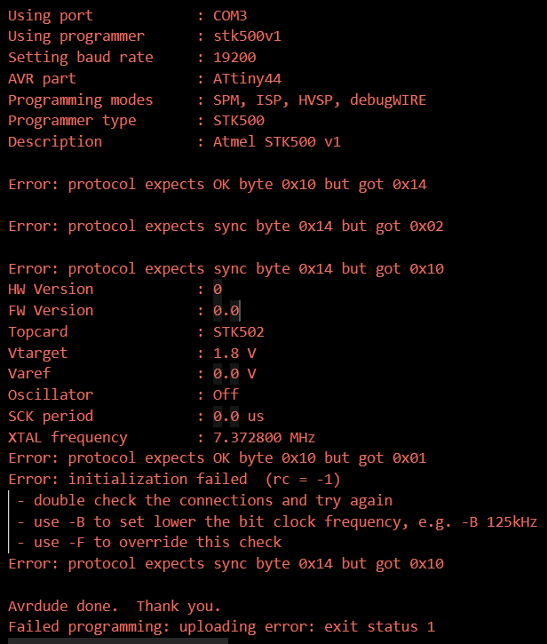
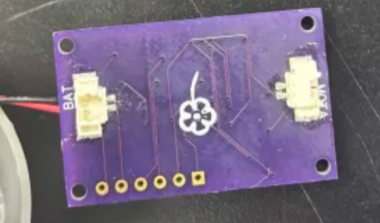
Velcro Ball Robots
Tiffany Jiang
Project Goal: Create spherical ball robots that can interact and connect with each other
Highlights from past week
Motor A is back on the PCB
Hit an error when trying to upload code ;-;
Goals for next week
Balance the robot
Upload Code
Get the robot rolling
Think about sensors
Think about new PCB board
Make a GitHub for code.

