Slide 1
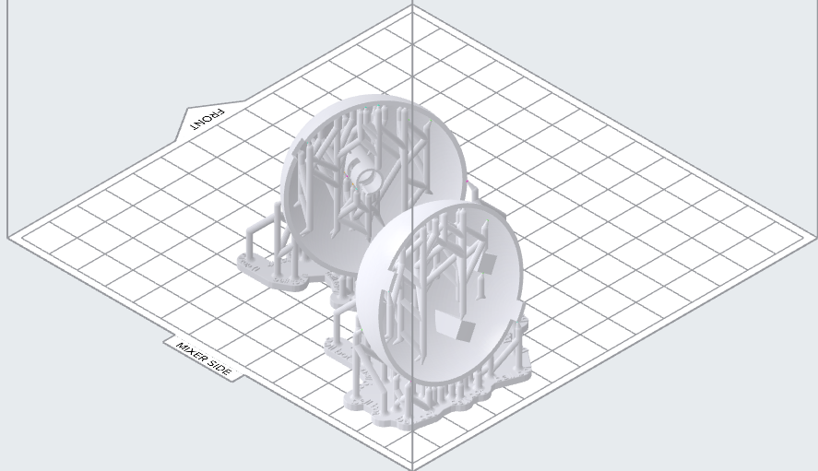
Velcro Ball Robots
Tiffany Jiang
Project Goal: Create spherical ball robots that can interact and connect with each other
Highlights from past week
  Finished CAD, Currently printing in the lab.
Goals for next week
  Figure out a pendulum that connects to the motor
  Think about sensors
  Think about new PCB board
  Make a GitHub for code.

