Slide 1
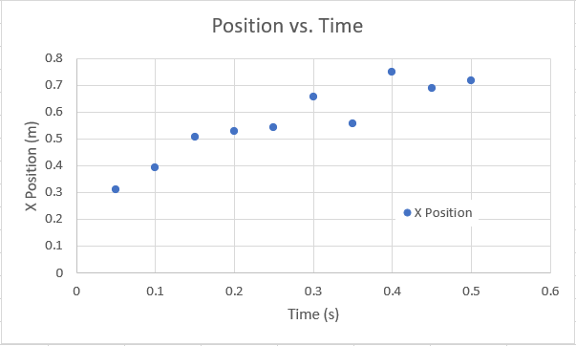
Plot Title
Plotted Data Series
y-Axis Label
Legend
x-Axis Label

