Slide 1
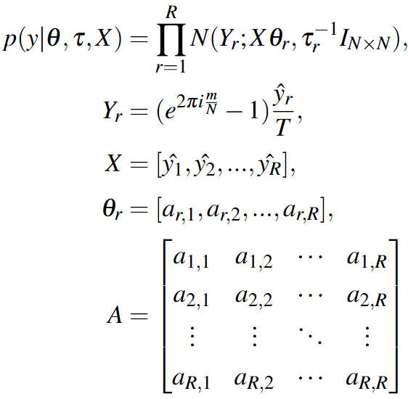
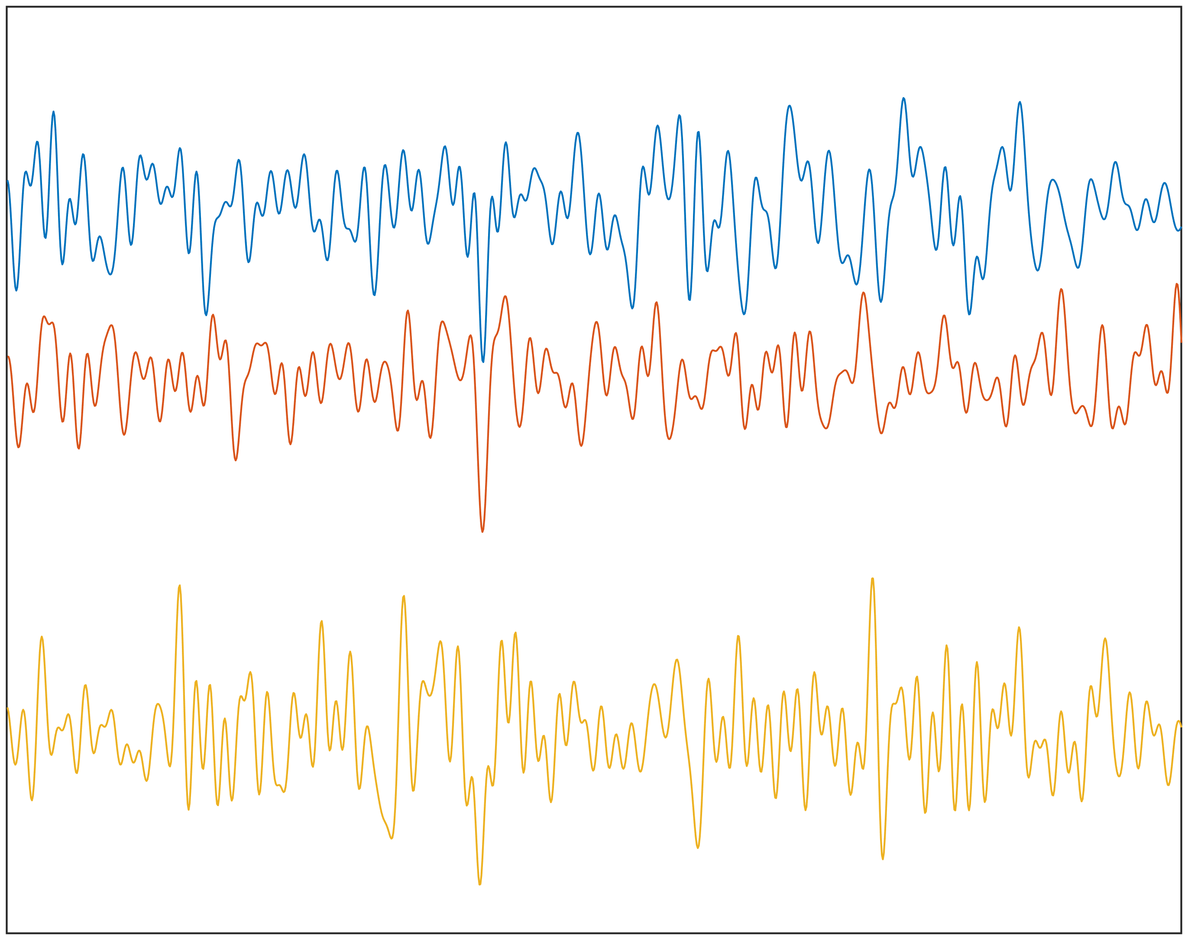
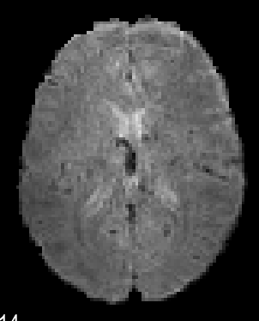
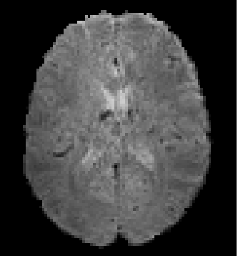
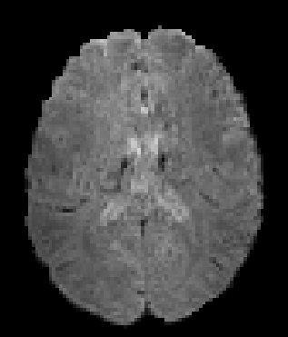
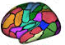
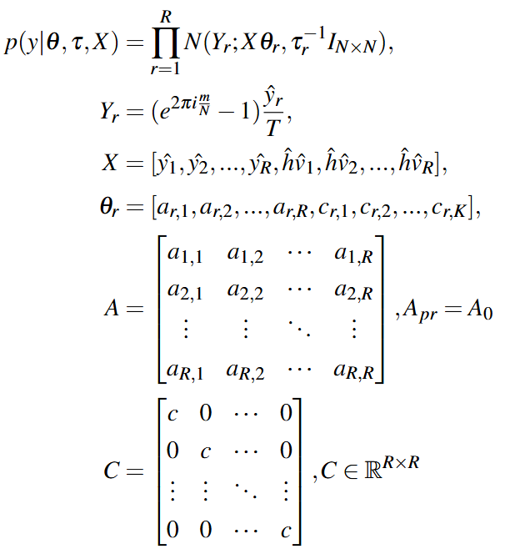
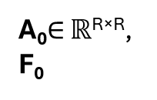



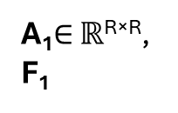








1
As
Subject 1
R×T
SCH
ROI 1
y $∈$ ℝ^{R×T}
ROI 2
.
A₀$∈$ ℝ^{R×R},
F₀
.
.
Time
ROI R
rs-fMRI
2
v_{est}=G$\left(w_{i},β_{i}\right)$
$$\frac{dx_{est} }{dt}=\text{A}\text{0}x_{est}+v_{est}$$
FFT
$V_{est}$=W₀×$\frac{1}{f^{β_{0}}}$
ΙFFT
w₀ ~ N(0,1) $∈$ ℝ^{R×16T}
W₀
$$v_{est}$$
$$x_{est}$$
$$y_{est}=x_{est}∗h$$
Euler
$$x_{t}= x_{t−1}+τ_{s}Ax_{t−1}+v_{t−1}$$
Sampling
Back propagation
$loss=MSE(y,$ $y_{est})$
w₀, β₀
3
4
A₁, w₀, β₀, F₁, F₀
Initializations:
Α_{pr}=A_{i}, v=v_{est}=G(w_{i},β_{i})
2
A_{i+1}, F_{i+1}
While
F_{i} > F_{i-1}
A₁$∈$ ℝ^{R×R},
F₁
3
i=i+1
y $∈$ ℝ^{R×T}
True
Initializations:
w_{i}=w_{i-1}, β_{i}=β_{i-1}, Α_{i}
2
w_{i}, β_{i}
2

Slide 2
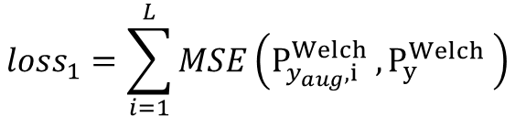


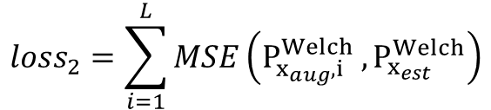



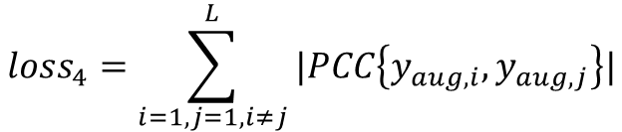
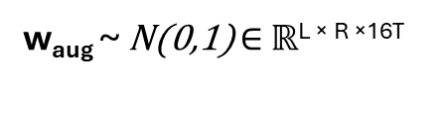
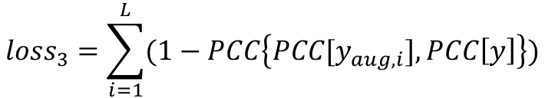
$$Type equation here.$$
w_{aug} ~ N(0,1) $∈$ ℝ^{L × R ×16T}
v_{aug}=G$\left(w_{aug},β\right)$
$$\frac{dx_{aug}}{dt}=Ax_{aug}+v_{aug}$$
Euler
$$y_{aug}=x_{aug}∗h$$
Sampling
$${loss}_{1}=\sum_{i=1}^{L}{MSE\left(P_{y_{aug},i}^{Welch} ,P_{y}^{Welch} \right)}$$
$${loss}_{2}=\sum_{i=1}^{L}{MSE\left(P_{x_{aug},i}^{Welch} ,P_{x_{est}}^{Welch}\right)}$$
Back propagation
$loss= {loss}_{1}$+ ${loss}_{2}$+ ${loss}_{3}$+ ${loss}_{4}$
$${loss}_{3}=\sum_{i=1}^{L}{(1−PCC\left\{PCC[y_{aug,i}], PCC\left[y\right]\right\})}$$
y : original BOLD signal
x_{est}: latent neural states estimated from Module 1
β : spectral exponent estimated from Module 1
$${loss}_{4}=\sum_{i=1,j=1,i≠j}^{L}{|PCC\left\{y_{aug,i},y_{aug,j}\right\}|}$$

Slide 3
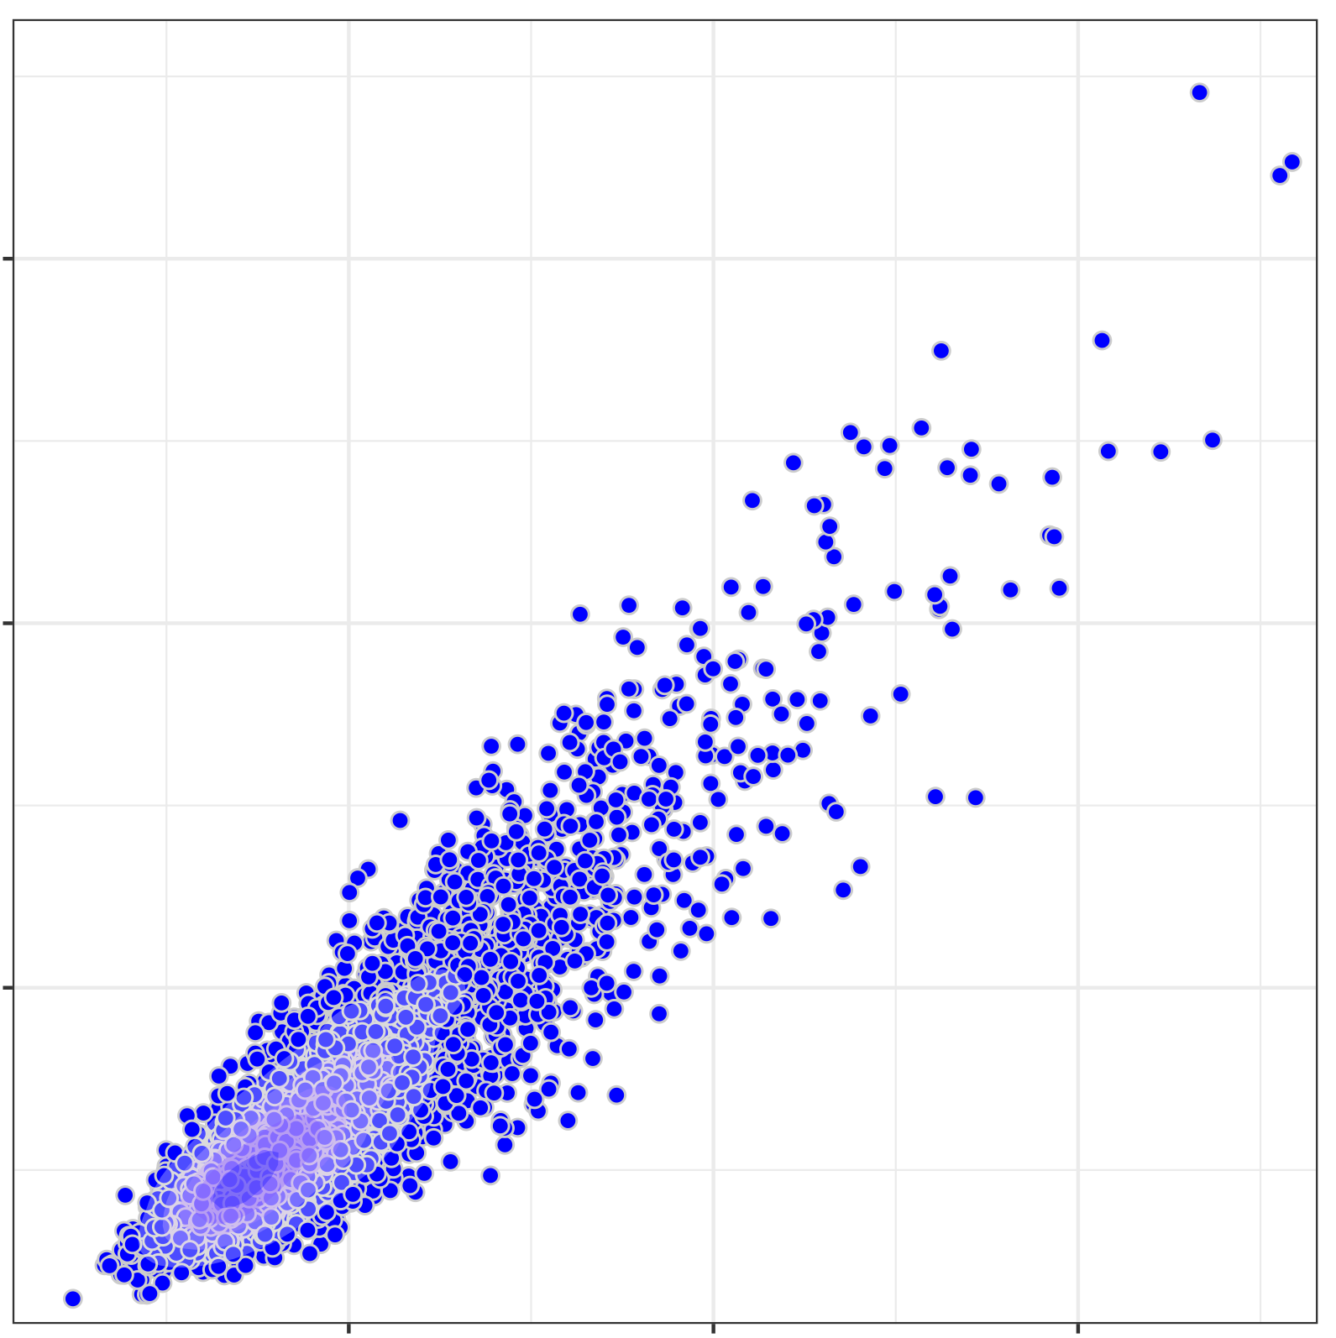
Crvae 0.1
ICC=0.8
ICC=0.6
ICC=0.5
0.075
ICC=0.4
0.05
Between-Subject Variation
0.025
ICC=0.2
0.025
0.05
0.075
Within-Subject Variation

Slide 4
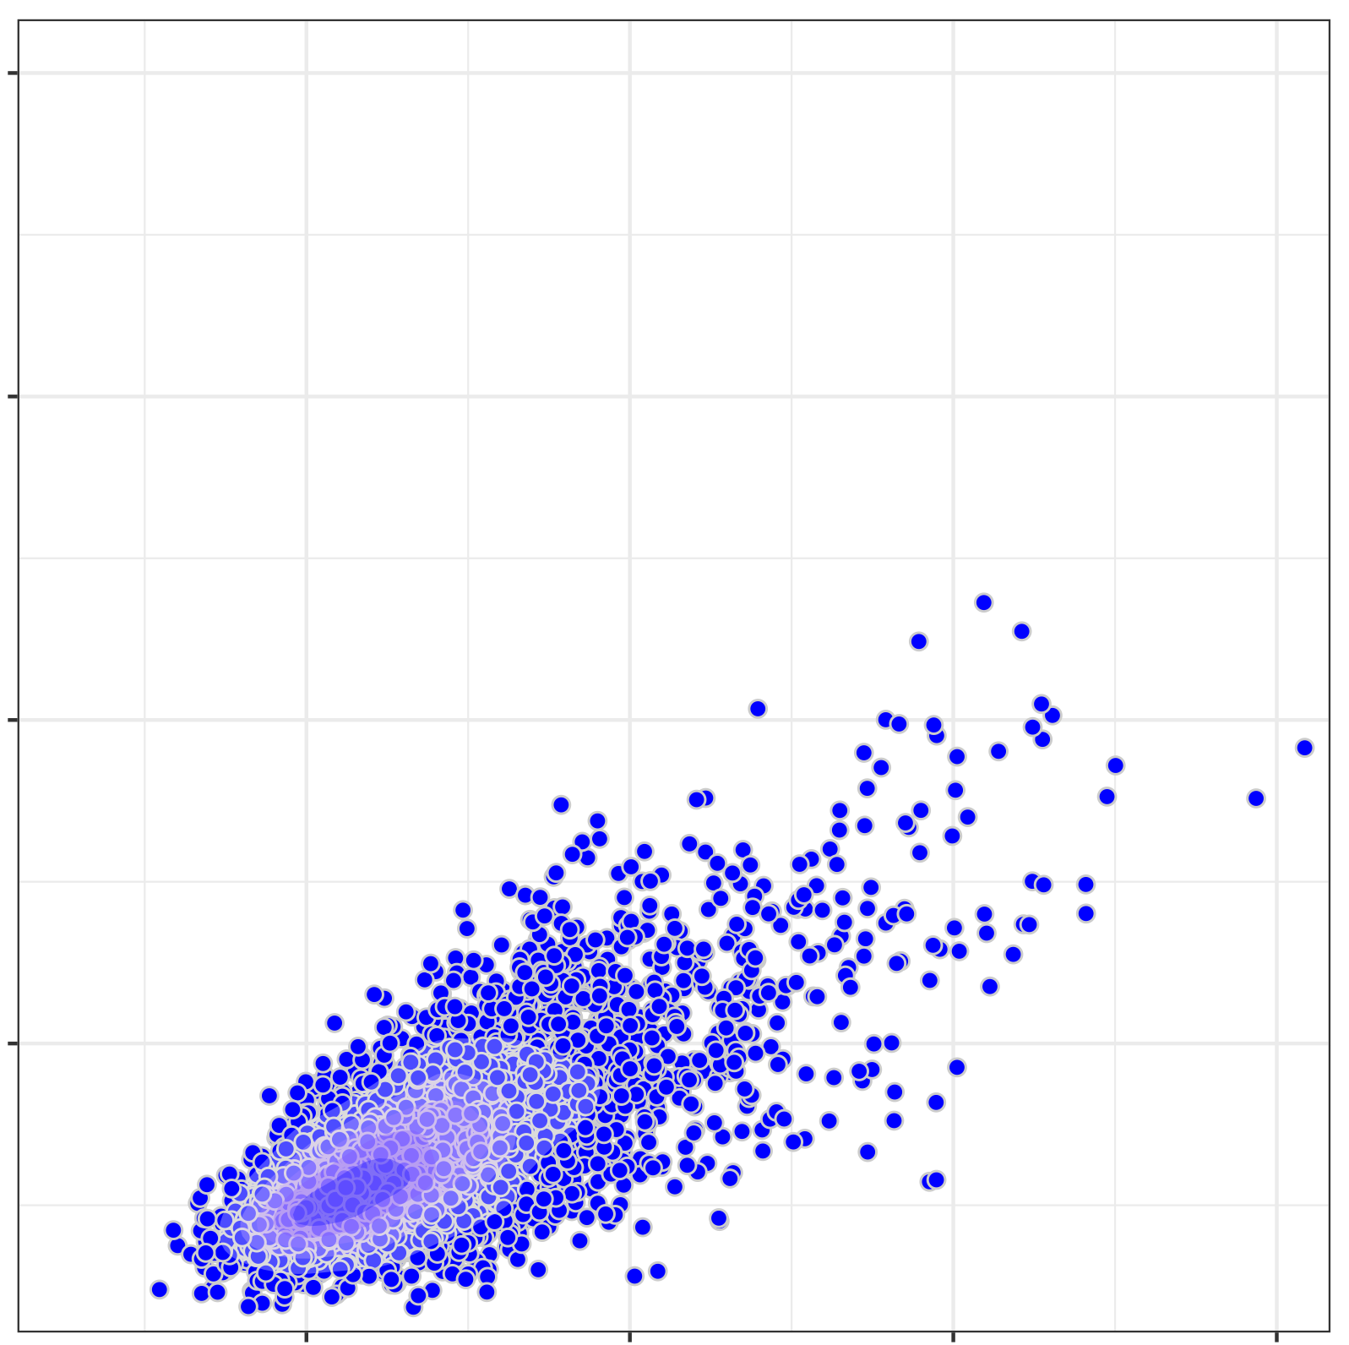
Crvae 0.05
0.08
ICC=0.8
ICC=0.6
ICC=0.5
0.06
ICC=0.4
Between-Subject Variation
0.04
0.02
ICC=0.2
0.02
0.04
0.06
0.08
Within-Subject Variation

Slide 5
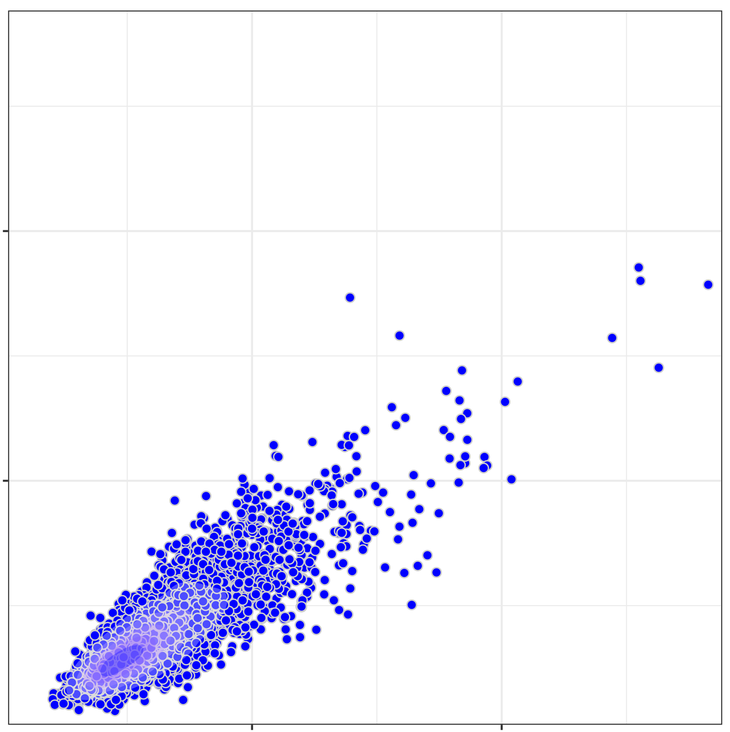
Crvae 0.15
ICC=0.8
ICC=0.6
ICC=0.5
0.10
ICC=0.4
Between-Subject Variation
0.05
ICC=0.2
0.05
0.10
Within-Subject Variation

Slide 6
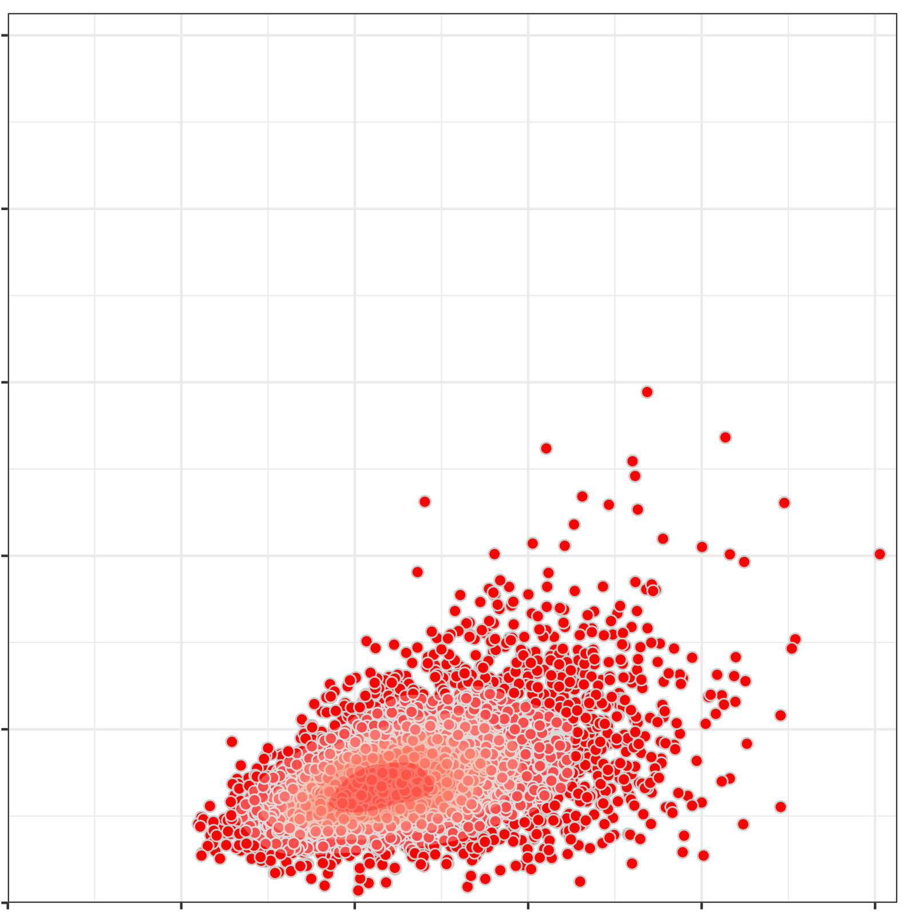
Noise 6 dB 0.1
0.25
ICC=0.8
ICC=0.6
ICC=0.5
0.20
0.15
ICC=0.4
Between-Subject Variation
0.10
0.05
ICC=0.2
0.00
0.00
0.05
0.10
0.15
0.20
0.25
Within-Subject Variation

Slide 7
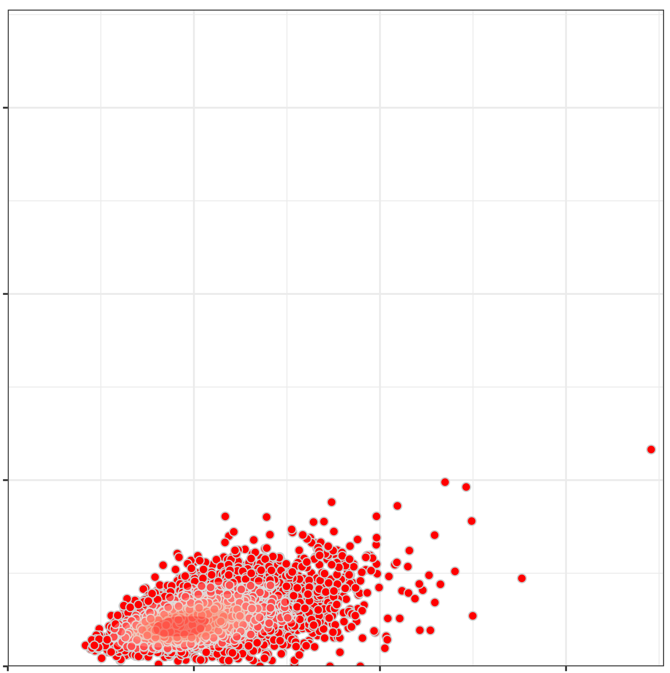
Noise 6 dB 0.05
ICC=0.8
ICC=0.6
0.6
ICC=0.5
0.4
ICC=0.4
Between-Subject Variation
0.2
ICC=0.2
0.0
0.0
0.2
0.4
0.6
Within-Subject Variation

Slide 8
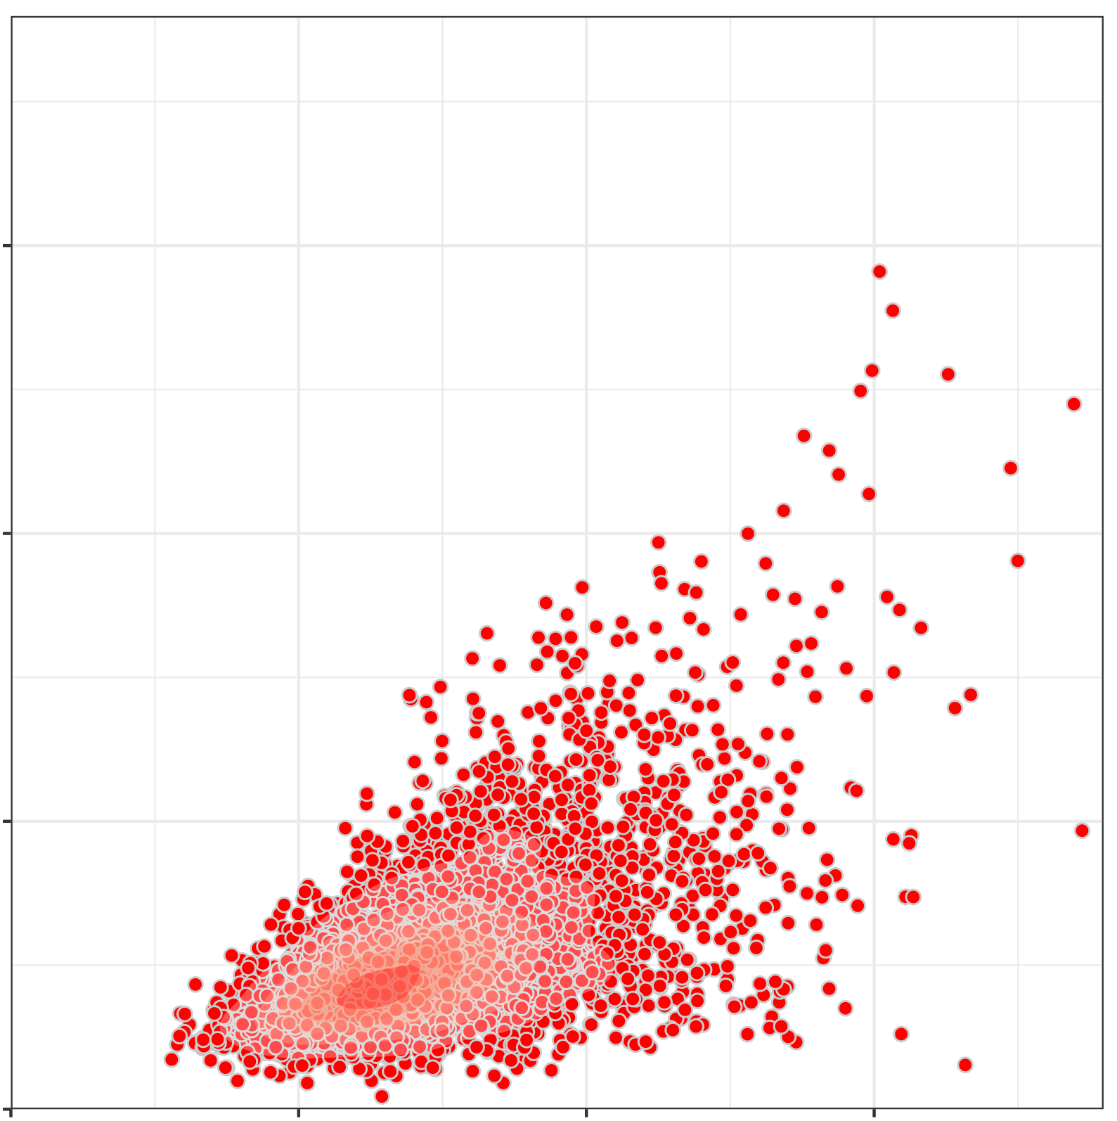
Noise 6 dB 0.15
ICC=0.8
ICC=0.6
ICC=0.5
0.3
ICC=0.4
Between-Subject Variation
0.2
0.1
ICC=0.2
0.0
0.0
0.1
0.2
0.3
Within-Subject Variation

Slide 9
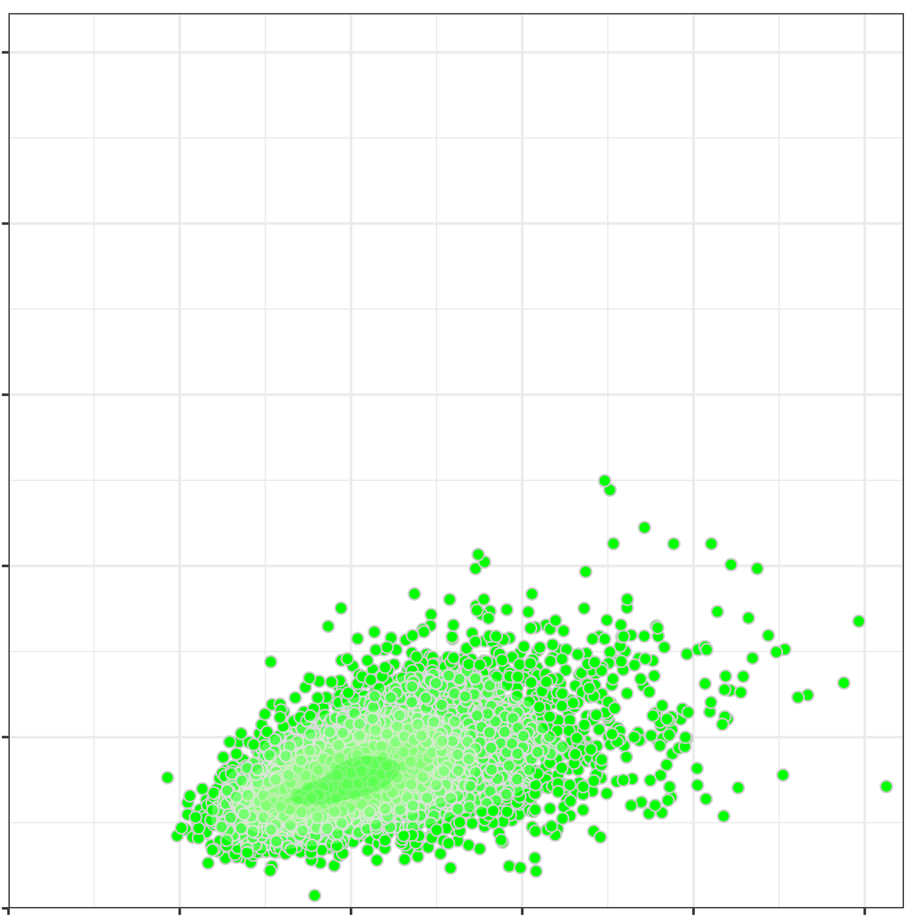
Noise 3 dB 0.1
0.25
ICC=0.8
ICC=0.6
ICC=0.5
0.20
0.15
ICC=0.4
Between-Subject Variation
0.10
ICC=0.2
0.05
0.00
0.00
0.05
0.10
0.15
0.20
0.25
Within-Subject Variation

Slide 10
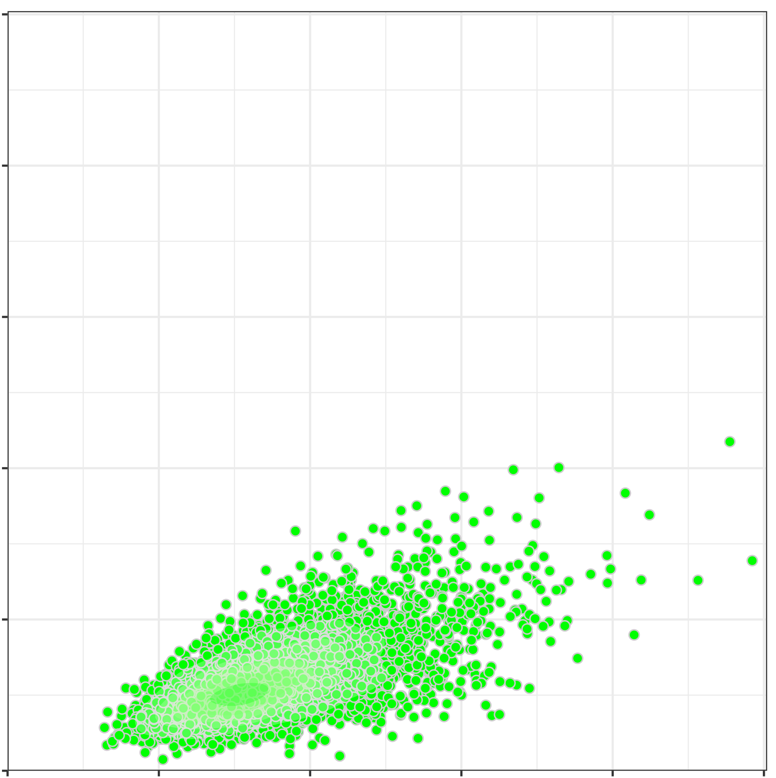
Noise 3 dB 0.05
0.5
ICC=0.8
ICC=0.6
ICC=0.5
0.4
0.3
ICC=0.4
Between-Subject Variation
0.2
0.1
ICC=0.2
0.0
0.0
0.1
0.2
0.3
0.4
0.5
Within-Subject Variation

Slide 11
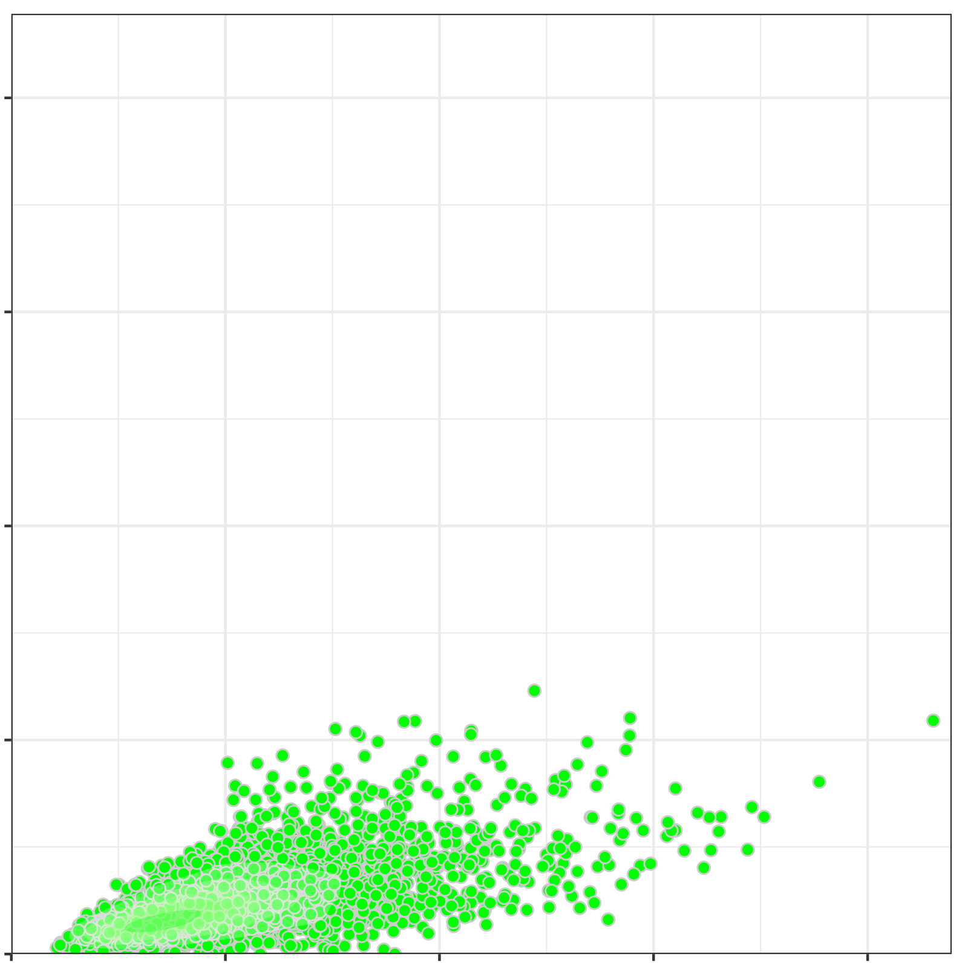
Noise 3 dB 0.15
1.0
ICC=0.8
ICC=0.6
ICC=0.5
0.75
ICC=0.4
Between-Subject Variation
0.50
0.25
ICC=0.2
0.00
0.00
0.50
0.75
1.0
Within-Subject Variation

Slide 12
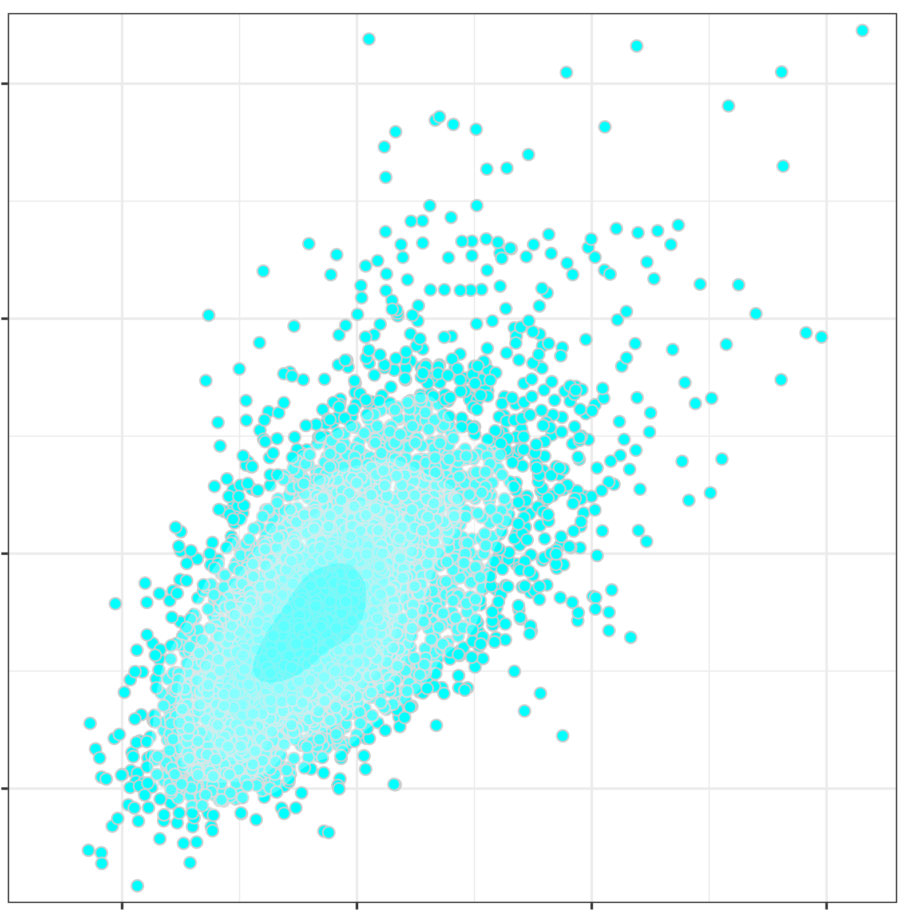
rDCM-GEN 0.1
0.04
ICC=0.8
ICC=0.6
ICC=0.5
0.03
Between-Subject Variation
ICC=0.4
0.02
0.01
ICC=0.2
0.01
0.02
0.03
0.04
Within-Subject Variation

Slide 13
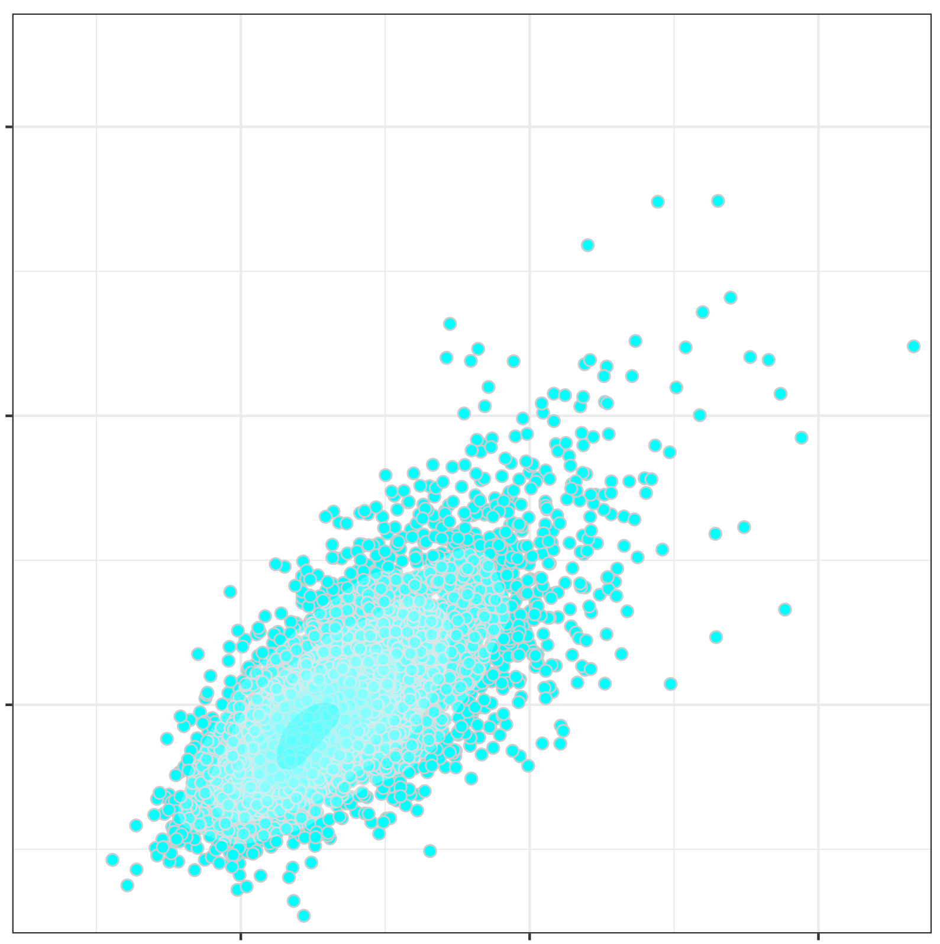
rDCM-GEN 0.05
0.06
ICC=0.8
ICC=0.6
ICC=0.5
0.04
ICC=0.4
Between-Subject Variation
0.02
ICC=0.2
0.02
0.04
0.06
Within-Subject Variation

Slide 14

rDCM-GEN 0.15
0.08
ICC=0.6
ICC=0.8
ICC=0.5
0.06
Between-Subject Variation
ICC=0.4
0.04
0.02
ICC=0.2
0.02
0.04
0.06
0.08
Within-Subject Variation

Slide 15
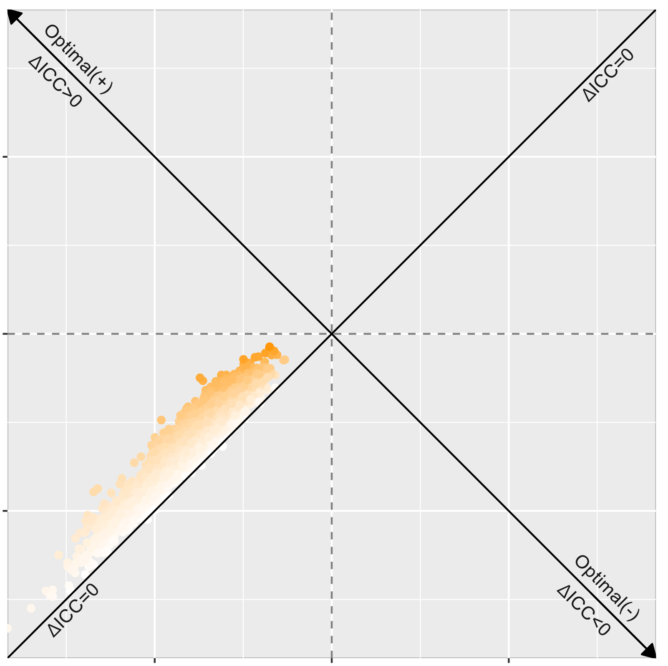
Noise 6 dB 0.1
0.10
0.0
Relative Change of Between-Subject Variation
-0.1
-0.1
0.0
0.1
Relative Change of Within-Subject Variation

Slide 16
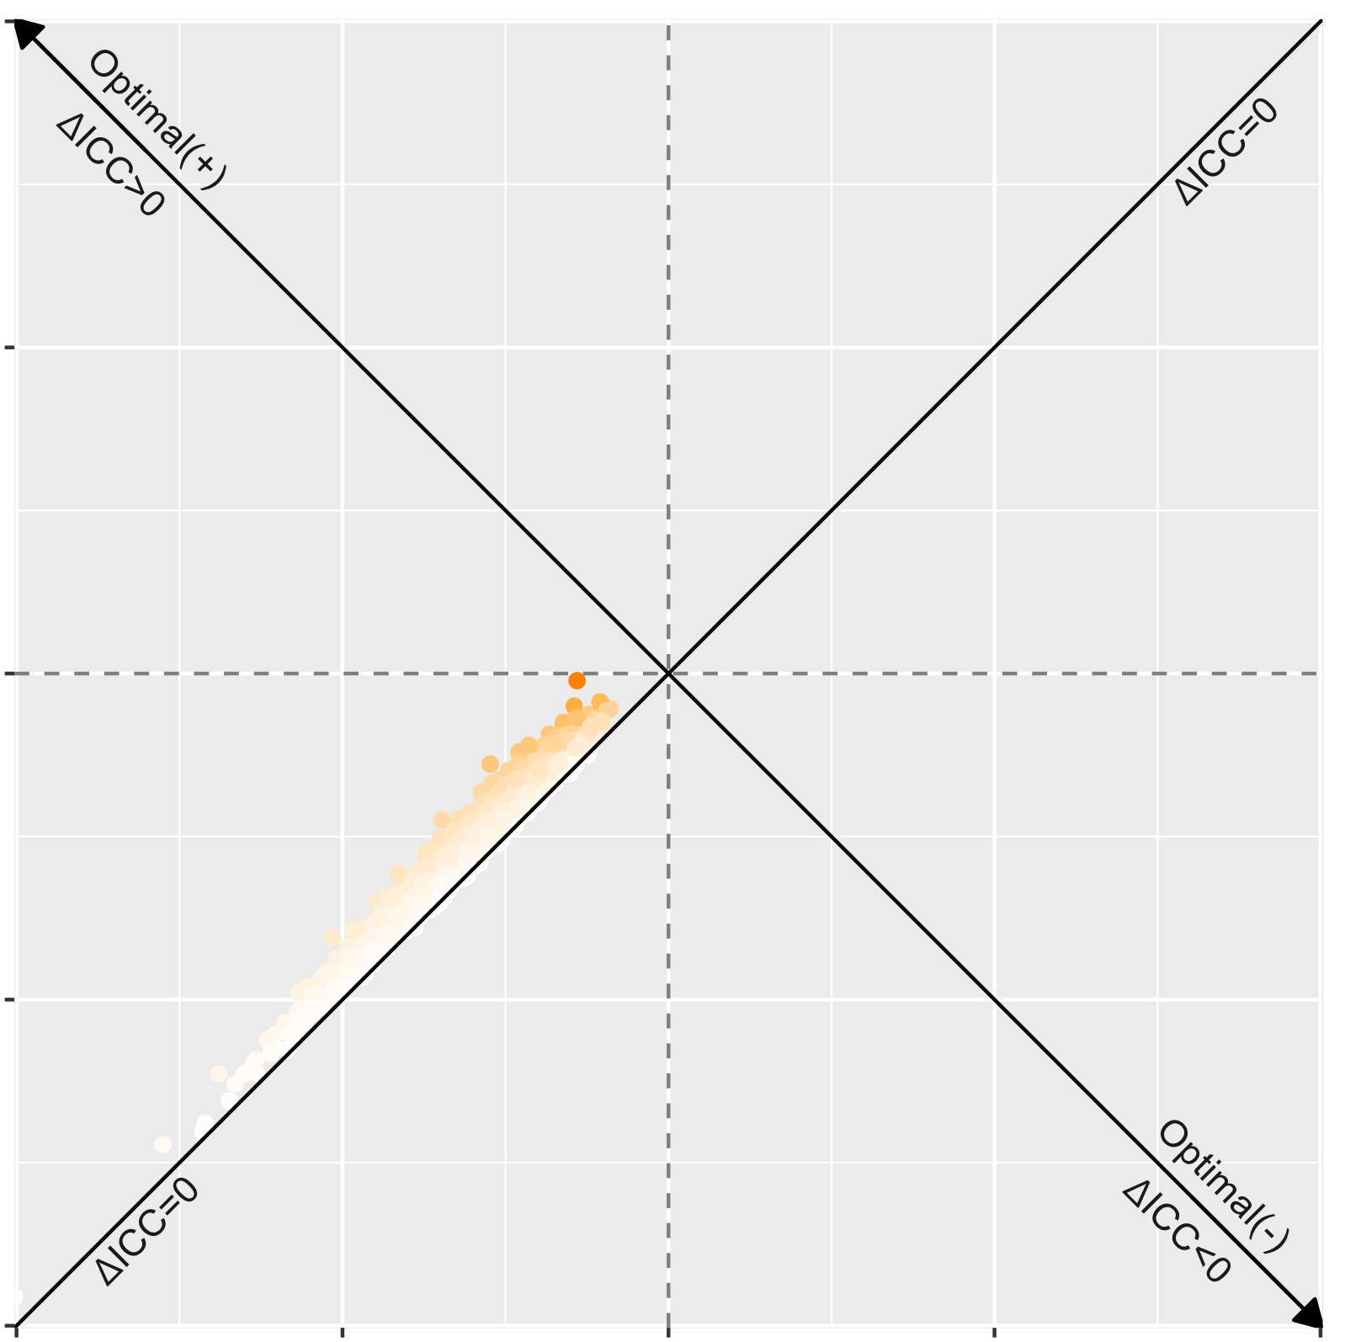
0.50
Noise 6 dB 0.05
0.25
0.00
Relative Change of Between-Subject Variation
-0.25
-0.50
-0.50
-0.25
0.00
0.25
0.50
Relative Change of Within-Subject Variation

Slide 17

Noise 6 dB 0.15
0.2
0.1
0.0
Relative Change of Between-Subject Variation
-0.1
-0.2
-0.2
-0.1
0.0
0.1
0.2
Relative Change of Within-Subject Variation

Slide 18

Noise 3 dB 0.1
0.1
0.0
Relative Change of Between-Subject Variation
-0.1
-0.1
0.0
0.1
Relative Change of Within-Subject Variation

Slide 19

Noise 3 dB 0.05
0.2
0.0
Relative Change of Between-Subject Variation
-0.2
-0.25
0.0
0.2
Relative Change of Within-Subject Variation

Slide 20

Noise 3 dB 0.15
0.4
0.0
Relative Change of Between-Subject Variation
-0.4
-0.4
0.0
0.4
Relative Change of Within-Subject Variation

Slide 21
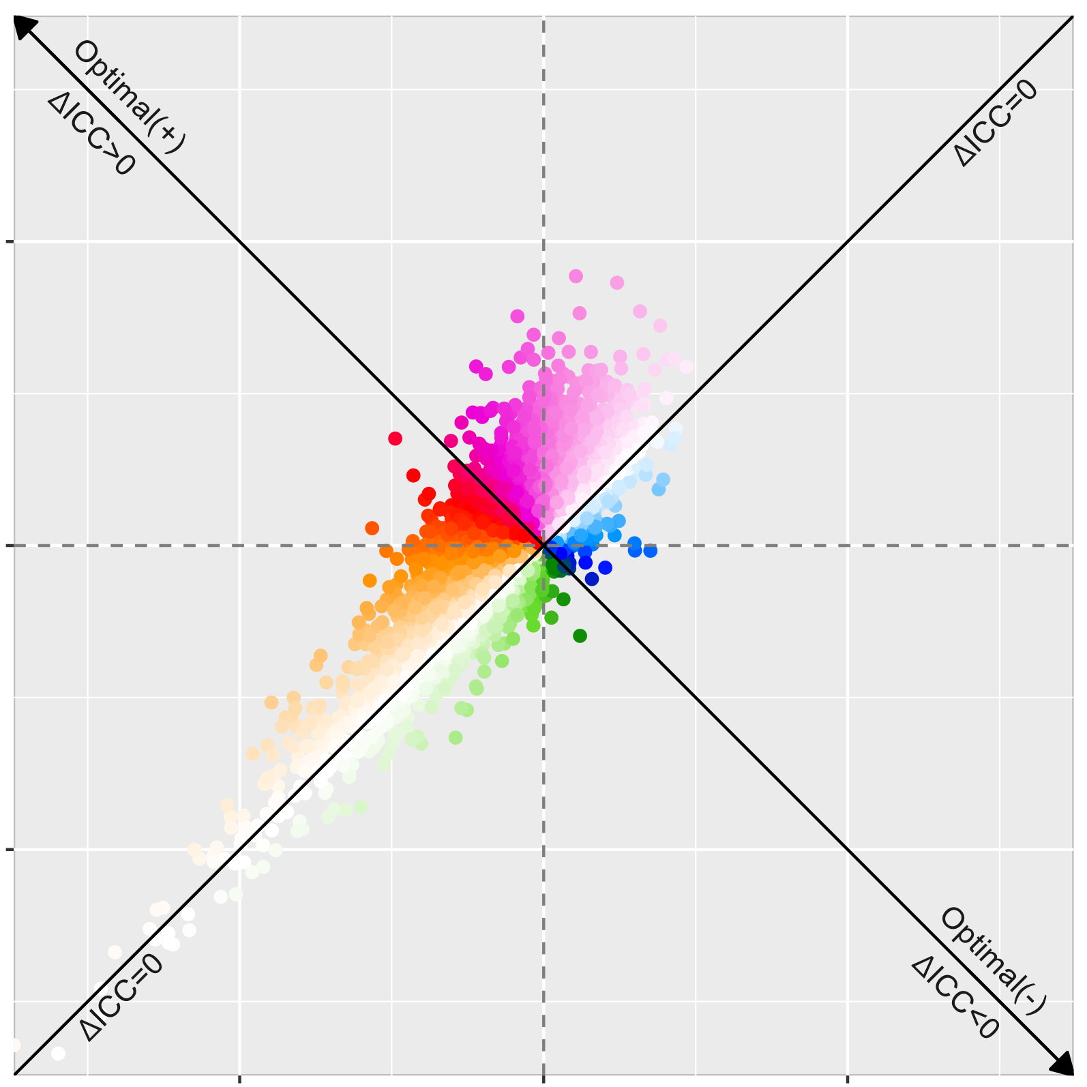
CRVAE 0.1
0.04
0.00
Relative Change of Between-Subject Variation
-0.04
-0.04
0.00
0.04
Relative Change of Within-Subject Variation

Slide 22
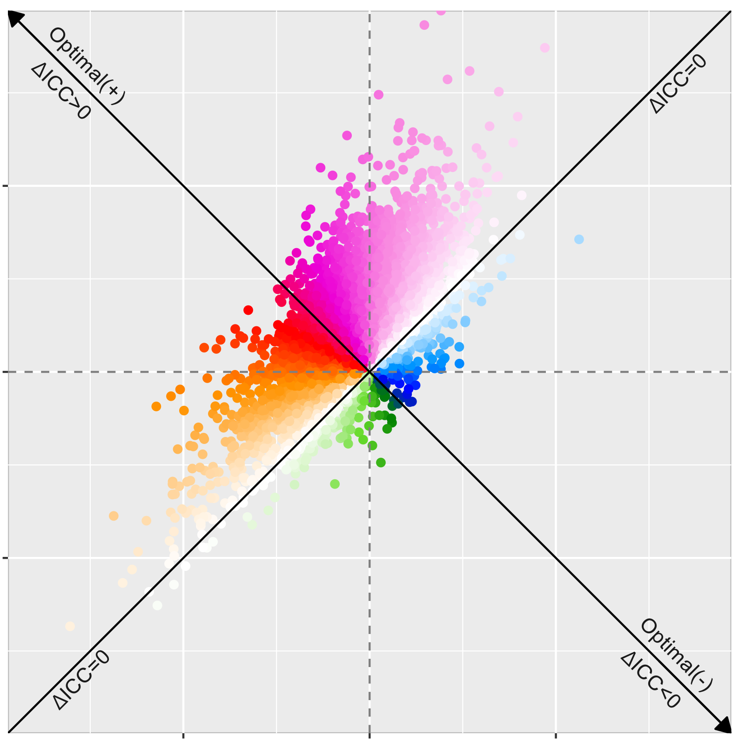
CRVAE 0.05
0.03
0.00
Relative Change of Between-Subject Variation
-0.03
-0.03
0.00
0.03
Relative Change of Within-Subject Variation

Slide 23
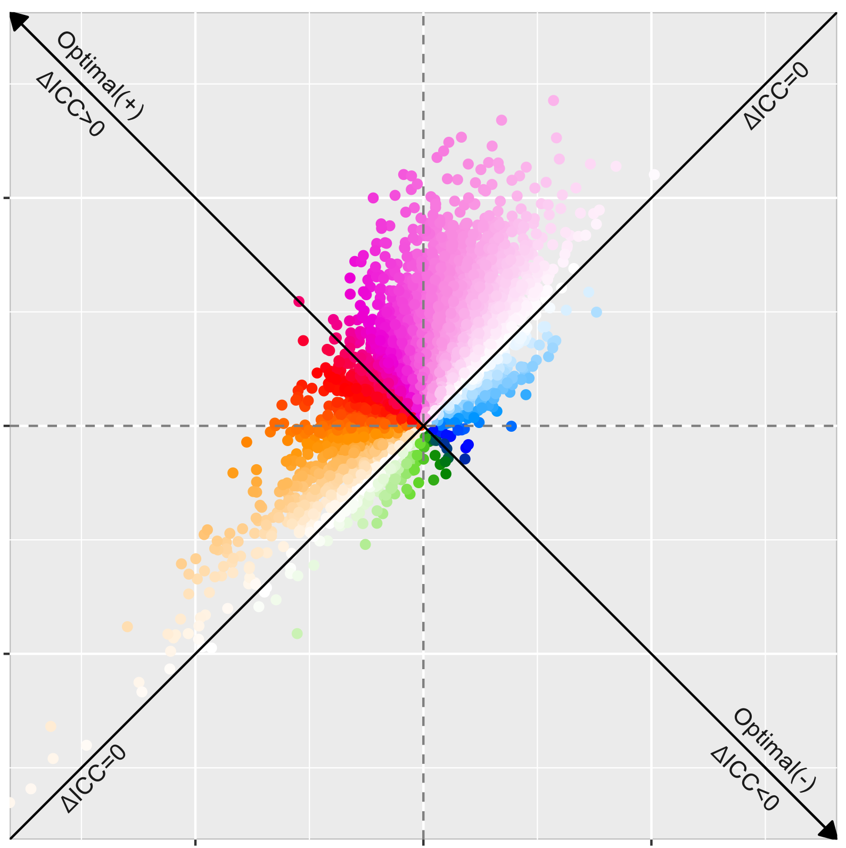
CRVAE 0.15
0.05
0.00
Relative Change of Between-Subject Variation
-0.05
-0.05
0.00
0.05
Relative Change of Within-Subject Variation

