Slide 1
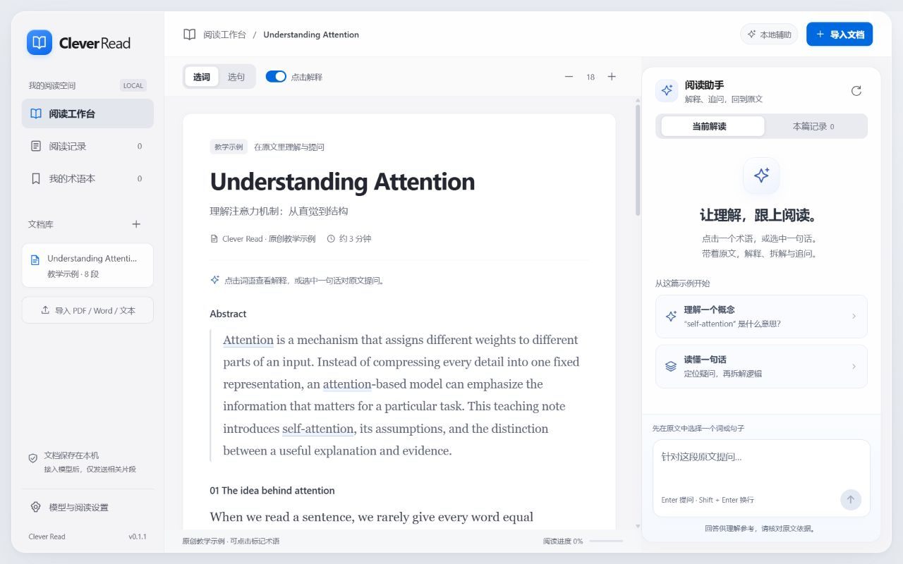
PPT Reading Test
Self-attention uses queries, keys and values.
An assumption is a premise, not an observed conclusion.
<img src=x onerror=alert(1)> must remain text.

Slide 2
