Slide 1


Slide 2
How to use Python?

Slide 3
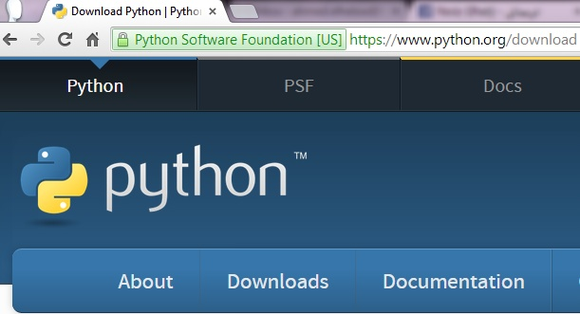
Download Python
The current production versions are Python 3.4.2 and Python 2.7.8.
https://www.python.org/download
https://www.python.org/download/releases/2.7.8/

Slide 4
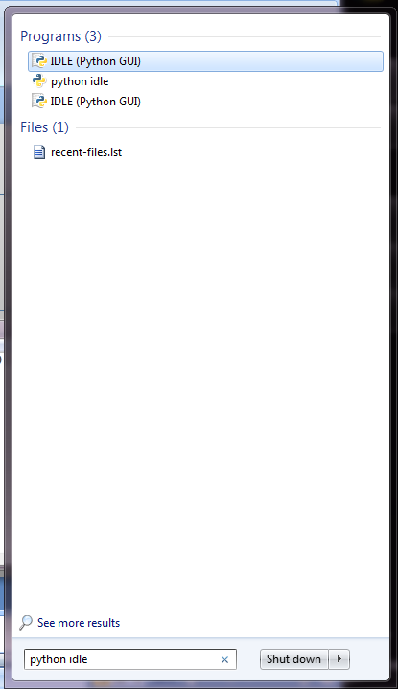
Open Python IDLE
IDLE
(Integrated DeveLopment Environment)

Slide 5
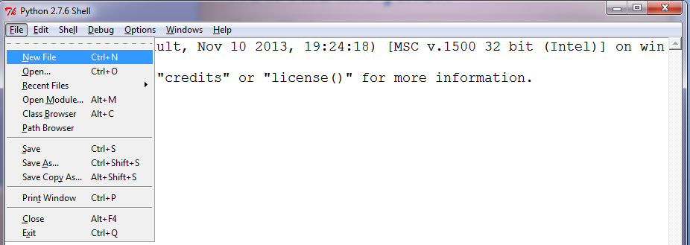
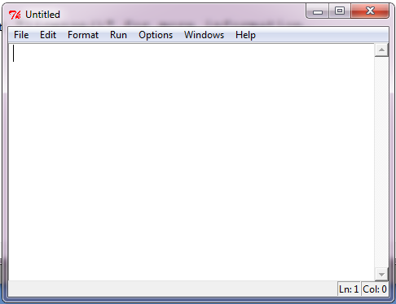
New File in Python
IDLE has two window types, the Shell window and the Editor window.
It is possible to have multiple editor windows simultaneously.

Slide 6
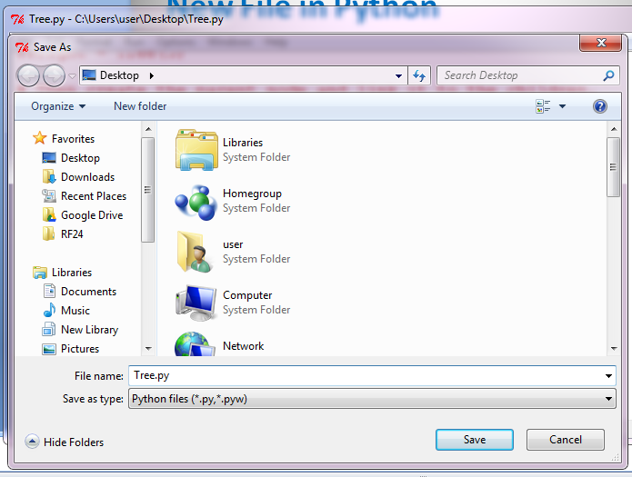
Save File in Python
File is saved with extension .py

Slide 7
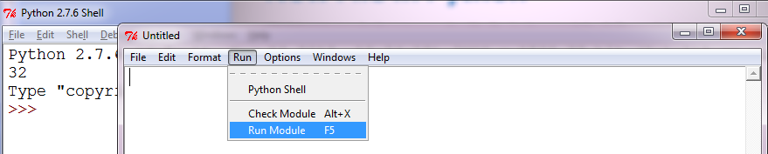
Run program in Python
Run menu
- Editor window only
- Run module F5:
Restart the shell to clean the environment, then execute the currently open module.

Slide 8
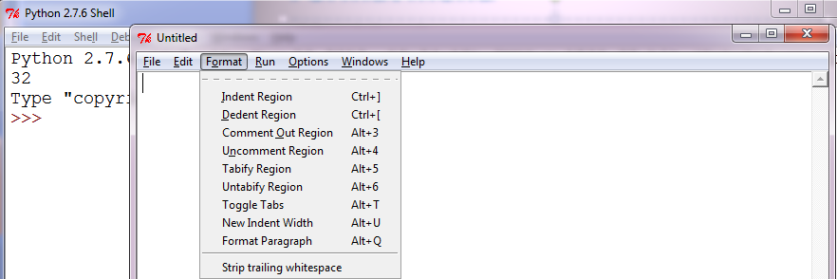
Format menu
Editor window only
Indent region : Shift selected lines right by the indent width (default 4 spaces)
Dedent region : Shift selected lines left by the indent width (default 4 spaces)
Comment out region : Insert ## in front of selected lines
Uncomment region : Remove leading # or ## from selected lines

Slide 9
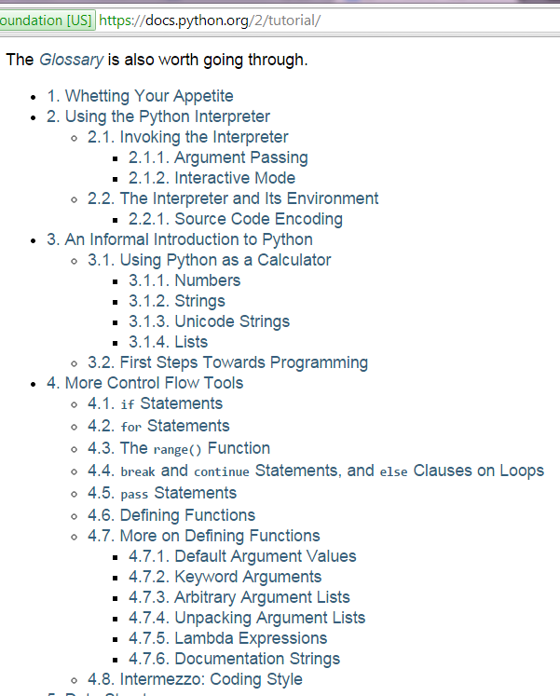
Python Tutorial
Python Complete Tutorial :
https://docs.python.org/2/tutorial/

Slide 10
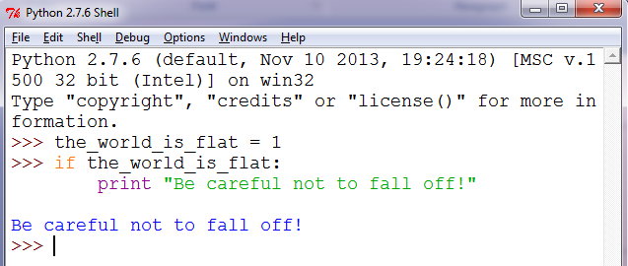
Interactive Mode
>>> the_world_is_flat = 1
>>> if the_world_is_flat:
... print "Be careful not to fall off!"
...
Be careful not to fall off!

Slide 11
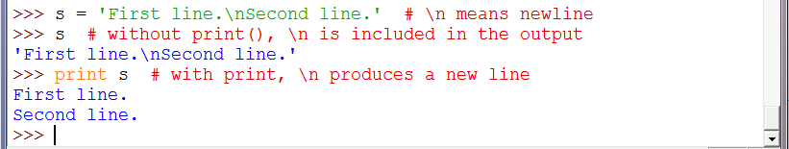
Print
>>> s = 'First line.\nSecond line.' # \n means newline
>>> s # without print(), \n is included in the output
'First line.\nSecond line.'
>>> print s # with print, \n produces a new line
First line.
Second line.

Slide 12
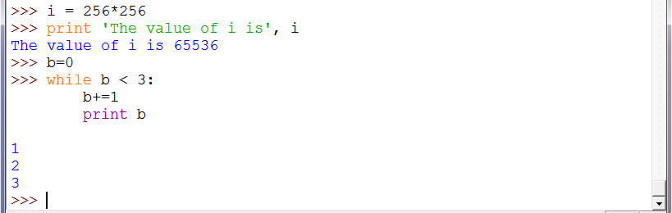
Print
>>> i = 256*256
>>> print 'The value of i is', i
The value of i is 65536
>>> b=0
>>> while b < 10:
b+=1
print b
1
2
3

Slide 13
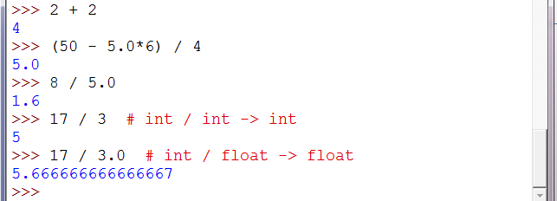
Python as a Calculator
>>> 2 + 2
4
>>> (50 - 5.0*6) / 4
5.0
>>> 8 / 5.0
1.6
>>> 17 / 3 # int / int -> int
5
>>> 17 / 3.0 # int / float -> float
5.666666666666667

Slide 14

Comments
# this is the first comment
spam = 1 # and this is the second comment
text = "# This is not a comment because it's inside quotes."

Slide 15
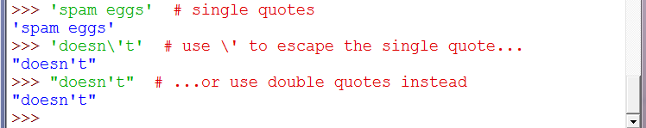
Strings
>>> 'spam eggs' # single quotes
'spam eggs'
>>> 'doesn\'t' # use \' to escape the single quote...
"doesn't“
>>> "doesn't" # ...or use double quotes instead
"doesn't"

Slide 16
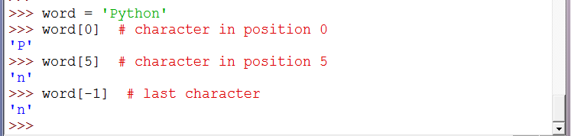
Strings
>>> word = 'Python'
>>> word[0] # character in position 0
'P'
>>> word[5] # character in position 5
'n‘
>>> word[-1] # last character
'n‘

Slide 17
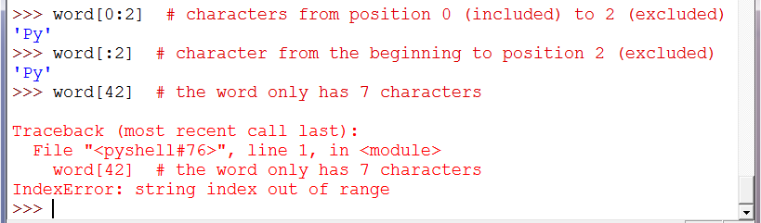
Strings
>>> word[0:2] # characters from position 0 (included) to 2 (excluded)
'Py‘
>>> word[:2] # character from the beginning to position 2 (excluded)
'Py‘
>>> word[42] # the word only has 7 characters
Traceback (most recent call last):
File "<stdin>", line 1, in <module>
IndexError: string index out of range

Slide 18
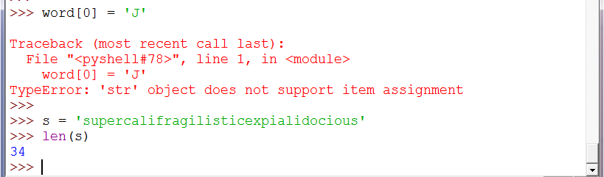
Strings
>>> word[0] = 'J'
...
TypeError: 'str' object does not support item assignment
>>> s = 'supercalifragilisticexpialidocious'
>>> len(s)
34

Slide 19
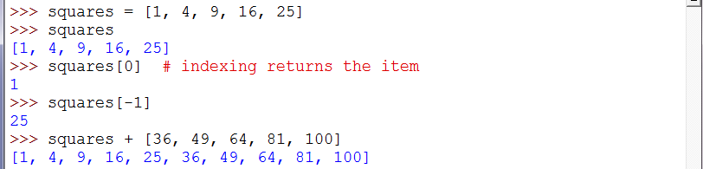
List
>>> squares = [1, 4, 9, 16, 25]
>>> squares
[1, 4, 9, 16, 25]
>>> squares[0] # indexing returns the item
1
>>> squares[-1]
25
>>> squares + [36, 49, 64, 81, 100]
[1, 4, 9, 16, 25, 36, 49, 64, 81, 100]

Slide 20
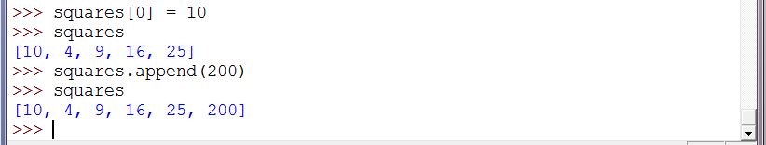
List
>>> squares[0] = 10
>>> squares
[10, 4, 9, 16, 25]
>>> squares.append(200)
>>> squares
[10, 4, 9, 16, 25, 200]

Slide 21
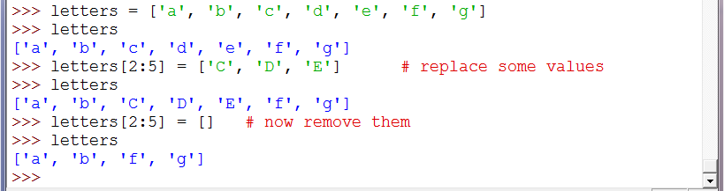
List
>>> letters = ['a', 'b', 'c', 'd', 'e', 'f', 'g']
>>> letters
['a', 'b', 'c', 'd', 'e', 'f', 'g']
>>> letters[2:5] = ['C', 'D', 'E'] # replace some values
>>> letters
['a', 'b', 'C', 'D', 'E', 'f', 'g']
>>> letters[2:5] = [] # now remove them
>>> letters
['a', 'b', 'f', 'g']

Slide 22
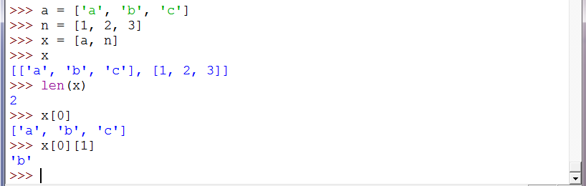
List
>>> a = ['a', 'b', 'c']
>>> n = [1, 2, 3]
>>> x = [a, n]
>>> x
[['a', 'b', 'c'], [1, 2, 3]]
>>> x[0]
['a', 'b', 'c']
>>> x[0][1]
'b‘
>>> len(x)
2

Slide 23
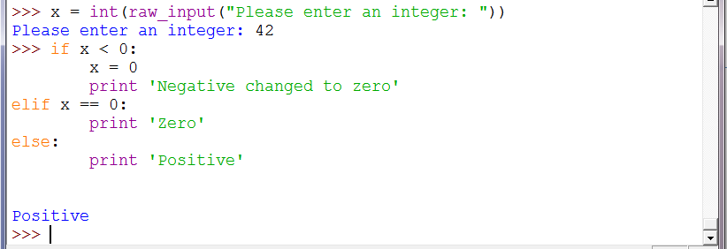
If statement
>>> x = int(raw_input("Please enter an integer: "))
Please enter an integer: 42
>>> if x < 0:
x = 0
print 'Negative changed to zero'
elif x == 0:
print 'Zero'
else:
print ' Positive'
Positive

Slide 24
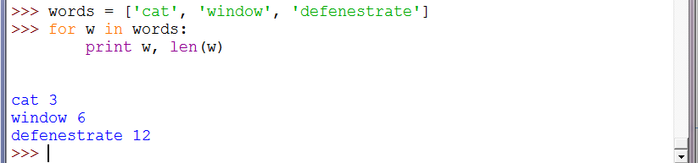
For statement
>>> words = ['cat', 'window', 'defenestrate']
>>> for w in words:
print w, len(w)
cat 3
window 6
defenestrate 12

Slide 25
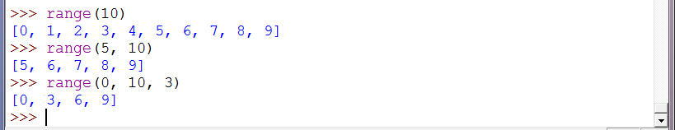
Range() function
>>> range(10)
[0, 1, 2, 3, 4, 5, 6, 7, 8, 9]
>>> range(5, 10)
[5, 6, 7, 8, 9]
>>> range(0, 10, 3)
[0, 3, 6, 9]

Slide 26
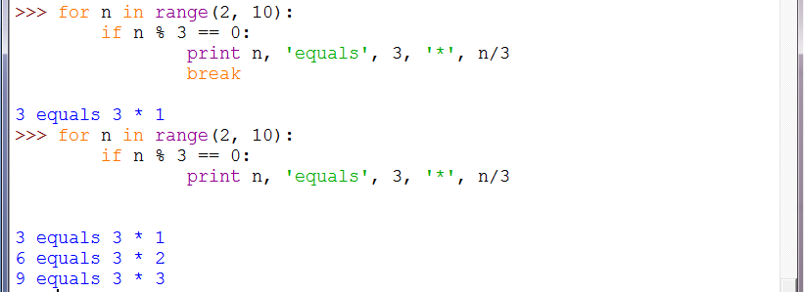
Break statement
>>> for n in range(2, 10):
if n % 3 == 0:
print n, 'equals', 3, '*', n/3
break
3 equals 3 * 1

Slide 27
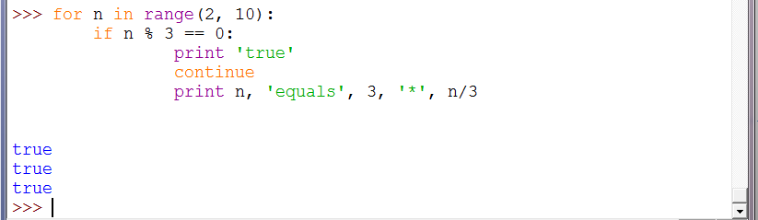
Continue statement
>>> for n in range(2, 10):
if n % 3 == 0:
print 'true'
continue
print n, 'equals', 3, '*', n/3
true
true
true

Slide 28
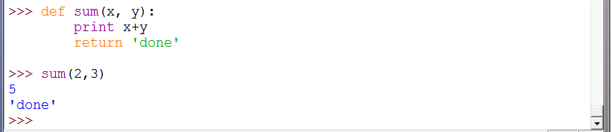
Defining function
>>> def sum(x, y):
print x+y
return 'done‘
>>> sum(2,3)
5
'done‘

Slide 29
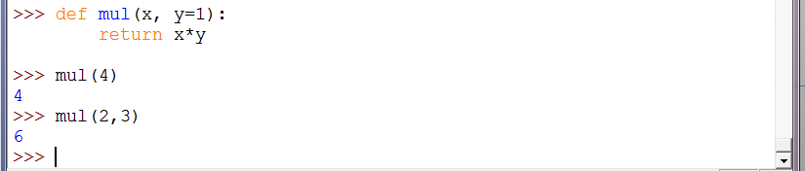
Defining function
>>>def mul(x, y=1):
return x*y
>>> mul(4)
4
>>> mul(2,3)
6

Slide 30
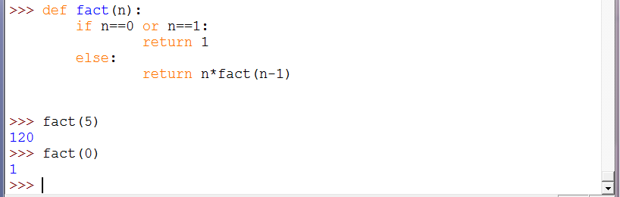
Function Recursion
>>> def fact(n):
if n==0 or n==1:
return 1
else:
return n*fact(n-1)
>>> fact(5)
120
>>> fact(0)
1

Slide 31
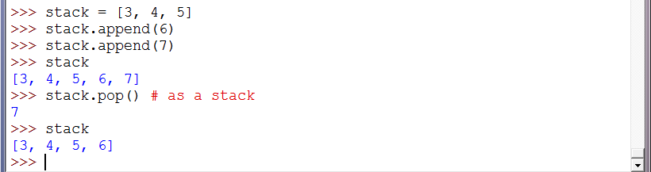
Using Lists as Stack
>>> stack = [3, 4, 5]
>>> stack.append(6)
>>> stack.append(7)
>>> stack
[3, 4, 5, 6, 7]
>>> stack.pop() # as a stack
7

Slide 32
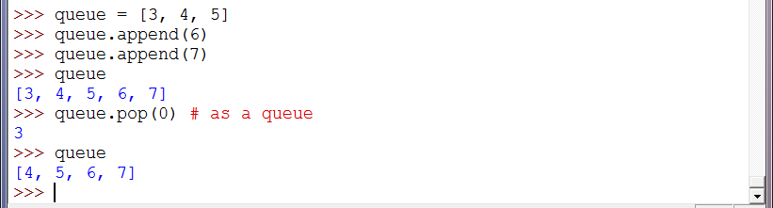
Using Lists as Queue
>>> queue = [3, 4, 5]
>>> queue.append(6)
>>> queue.append(7)
>>> queue
[3, 4, 5, 6, 7]
>>> queue.pop(0) # as a queue
3

Slide 33
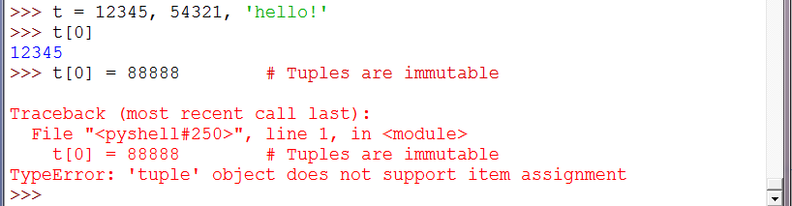
Tuples
>>> t = 12345, 54321, 'hello!'
>>> t[0]
12345
>>> t[0] = 88888 # Tuples are immutable
Traceback (most recent call last):
File "<pyshell#26>", line 1, in <module>
t[0] = 88888
TypeError: 'tuple' object does not support item assignment

Slide 34
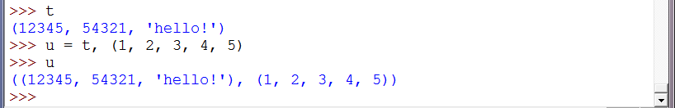
Tuples
>>> t
(12345, 54321, 'hello!')
>>> u = t, (1, 2, 3, 4, 5)
>>> u
((12345, 54321, 'hello!'), (1, 2, 3, 4, 5))

Slide 35
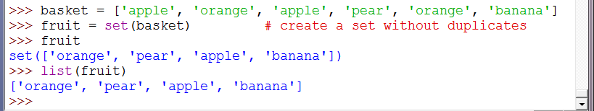
Sets
>>> basket = ['apple', 'orange', 'apple', 'pear', 'orange', 'banana']
>>> fruit = set(basket) # create a set without duplicates
>>> fruit
set(['orange', 'pear', 'apple', 'banana'])
>>> list(fruit)
['orange', 'pear', 'apple', 'banana']

Slide 36
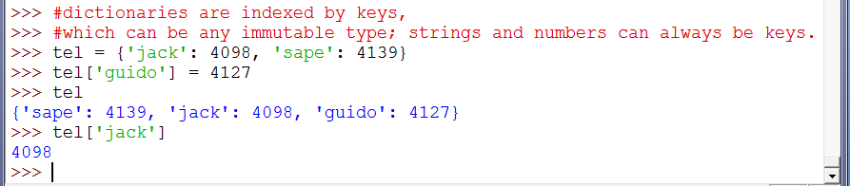
Dictionaries
>>> #dictionaries are indexed by keys,
>>> #which can be any immutable type; strings and numbers can always be keys.
>>> tel = {'jack': 4098, 'sape': 4139}
>>> tel['guido'] = 4127
>>> tel
{'sape': 4139, 'jack': 4098, 'guido': 4127}
>>> tel['jack']
4098

Slide 37
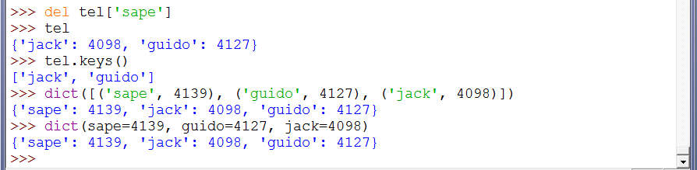
Dictionaries
>>> del tel['sape']
>>> tel
{'jack': 4098, 'guido': 4127}
>>> tel.keys()
['jack', 'guido']
>>> dict([('sape', 4139), ('guido', 4127), ('jack', 4098)])
{'sape': 4139, 'jack': 4098, 'guido': 4127}
>>> dict(sape=4139, guido=4127, jack=4098)
{'sape': 4139, 'jack': 4098, 'guido': 4127}

Slide 38
Quiz
>>> def quiz(n):
if n==0:
return 0
print n
return quiz(n-1)
>>> quiz(5)

Slide 39
E-mail
E-mail: Ahmed.elhelow@90daraga.com

