Slide 1


Slide 2
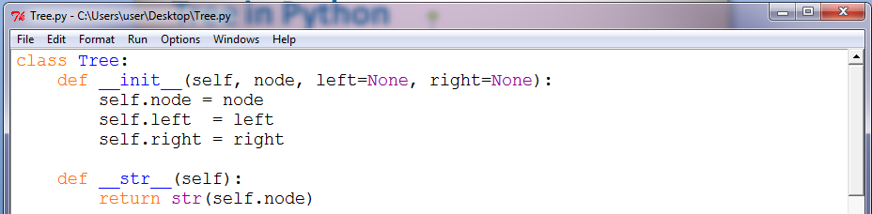
Tree in Python
class Tree:
def __init__(self, node, left=None, right=None):
self.node = node
self.left = left
self.right = right
def __str__(self):
return str(self.node)

Slide 3
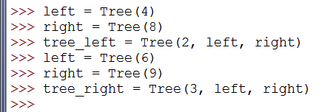
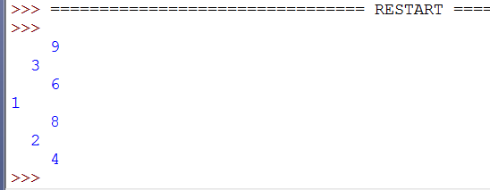
Tree in Python
left = Tree(4)
right = Tree(8)
tree_left = Tree(2, left, right)
left = Tree(6)
right = Tree(9)
tree_right = Tree(3, left, right)
tree = Tree(1, tree_left, tree_right)

Slide 4
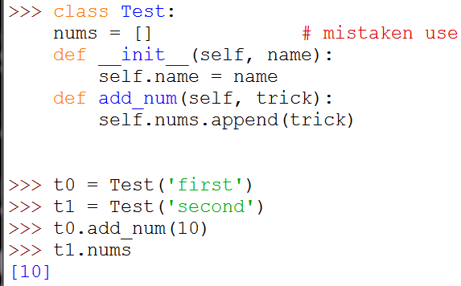
Tree in Python
Why self is important?

Slide 5
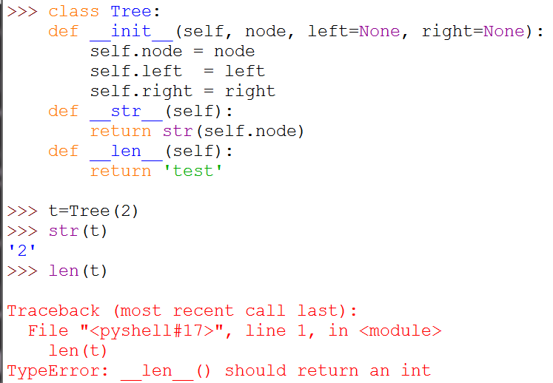
Tree in Python
How to use __ ?

Slide 6
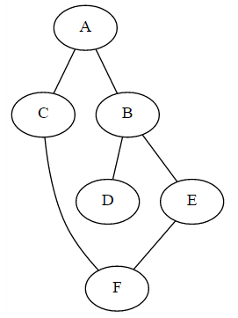
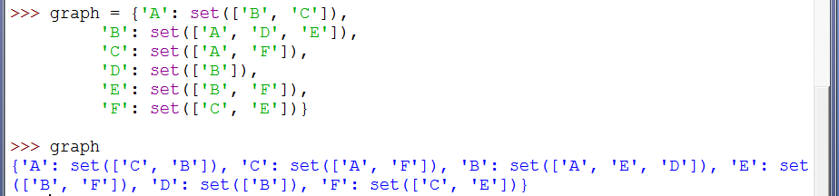
Graph in Python
Graphs are easily built out of lists and dictionaries.
graph = {'A': set(['B', 'C']),
'B': set(['A', 'D', 'E']),
'C': set(['A', 'F']),
'D': set(['B']),
'E': set(['B', 'F']),
'F': set(['C', 'E'])}

Slide 7
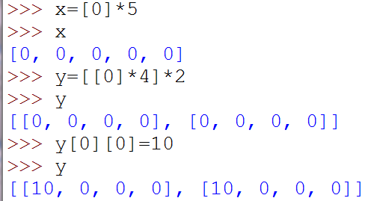
List assignment
>>> x=[0]*5
>>> x
[0, 0, 0, 0, 0]
>>> y=[[0]*4]*2
>>> y
[[0, 0, 0, 0], [0, 0, 0, 0]]
>>> y[0][0]=10
>>> y
[[10, 0, 0, 0], [10, 0, 0, 0]]

Slide 8
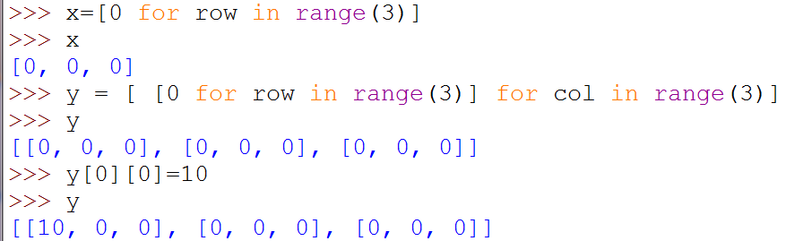
List assignment with for loop
>>> x=[0 for row in range(3)]
>>> x
[0, 0, 0]
>>> y = [ [0 for row in range(3)] for col in range(3)]
>>> y
[[0, 0, 0], [0, 0, 0], [0, 0, 0]]
>>> y[0][0]=10
>>> y
[[10, 0, 0], [0, 0, 0], [0, 0, 0]]

Slide 9
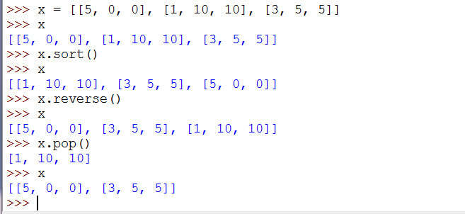
List sorting
>>> x = [[5, 0, 0], [1, 10, 10], [3, 5, 5]]
>>> x
[[5, 0, 0], [1, 10, 10], [3, 5, 5]]
>>> x.sort()
>>> x
[[1, 10, 10], [3, 5, 5], [5, 0, 0]]
>>> x.reverse()
>>> x
[[5, 0, 0], [3, 5, 5], [1, 10, 10]]

Slide 10
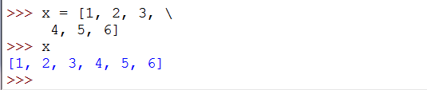
Complete coding in next line
>>> x = [1, 2, 3, \
4, 5, 6]
>>> x
[1, 2, 3, 4, 5, 6]

Slide 11
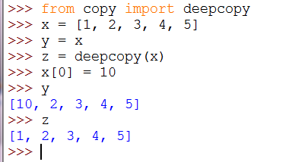
Deep copy
>>> from copy import deepcopy
>>> x = [1, 2, 3, 4, 5]
>>> y = x
>>> z = deepcopy(x)
>>> x[0] = 10
>>> y
[10, 2, 3, 4, 5]
>>> z
[1, 2, 3, 4, 5]

Slide 12
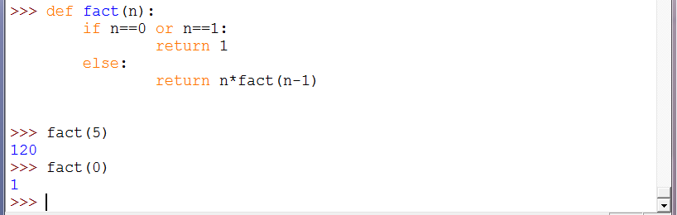
Function Recursion
>>> def fact(n):
if n==0 or n==1:
return 1
else:
return n*fact(n-1)
>>> fact(5)
120
>>> fact(0)
1

Slide 13
Iteration vs. Recursion
Iteration | Recursion
Solve a complicated task one piece at a time, and combine the results.
keep repeating until a task is "done". | Solve a large problem by breaking it up into smaller and smaller pieces until you can solve it; combine the results.
"Programmers" often prefer iterative solutions. | "Mathematicians" often prefer recursive approach.

Slide 14
Why recursion?
Because Recursion is the natural method of implementing Divide and Conquer Algorithm.

Slide 15
Divide and Conquer
Divide and Conquer algorithms works by breaking down a problem into two or more sub-problems of the same (or related) type, until these become simple enough to be solved directly.
The solutions to the sub-problems are combined to give a solution to the original problem.
Divide and Conquer algorithms are naturally adapted for execution in multi-processor machines, because distinct sub-problems can be executed on different processors.

Slide 16
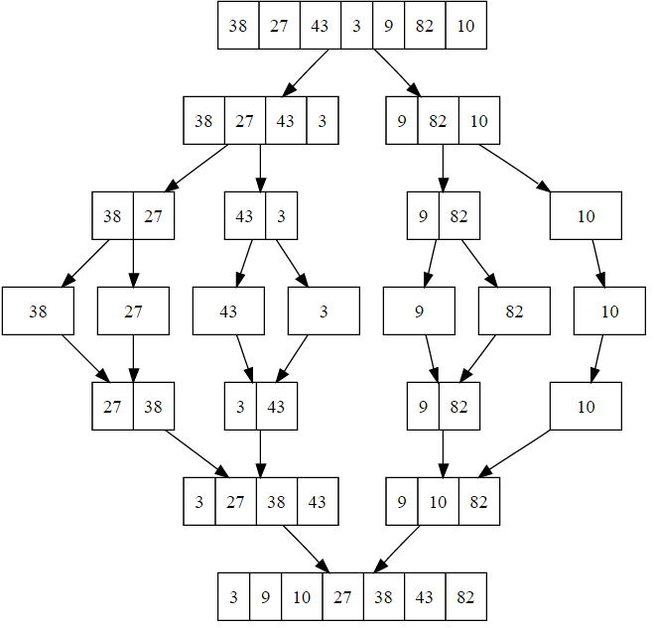
Example: Merge-sort

Slide 17
How merging?
Steps | Result | First list | Second list
 | [] | [ 2, 4, 6] | [1, 3, 5]
Compare 2, 1 | [1] | [2, 4, 6] | [3, 5]
Compare 2, 3 | [1, 2] | [4, 6] | [3, 5]
Compare 4, 3 | [1, 2, 3] | [4, 6] | [5]
Compare 4, 5 | [1, 2, 3, 4] | [6] | [5]
Compare 6, 5 | [1, 2, 3, 4, 5] | [6] | []
Compare 6, None | [1, 2, 3, 4, 5, 6] | [] | []

Slide 18
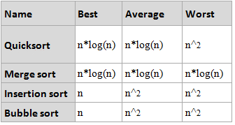
Sorting algorithms Complexity

Slide 19
Big O notation
Big O notation is used in Computer Science to describe the performance or complexity of an algorithm.
Big O specifically describes the worst-case scenario.
Big O can be used to describe the execution time required or the space used by an algorithm.

Slide 20

O(1)
O(1) describes an algorithm that will always execute in the same time (or space) regardless of the size of the input data set.
Ex.:
def IsFirstElementNull(list):
if list[0] == None:
return True
return False

Slide 21
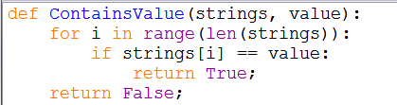
O(N)
O(N) describes an algorithm whose complexity will grow linearly and in direct proportion to the size of the input data set.
Ex.:
def ContainsValue(strings, value):
for i in range(len(strings)):
if strings[i] == value:
return True;
return False;

Slide 22
How do we write a small game agent?

Slide 23
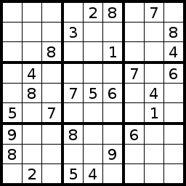
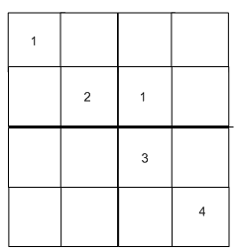
Ex.: Sudoku game
4*4 Sudoku game
9*9 Sudoku game

Slide 24
Constraint Satisfaction Problem
Constraint satisfaction problems (CSPs) are mathematical problems defined as a set of objects whose state must satisfy a number of constraints or limitations.
Examples:
Sudoku
Eight queen puzzle
Solution: Constraint Propagation

Slide 25
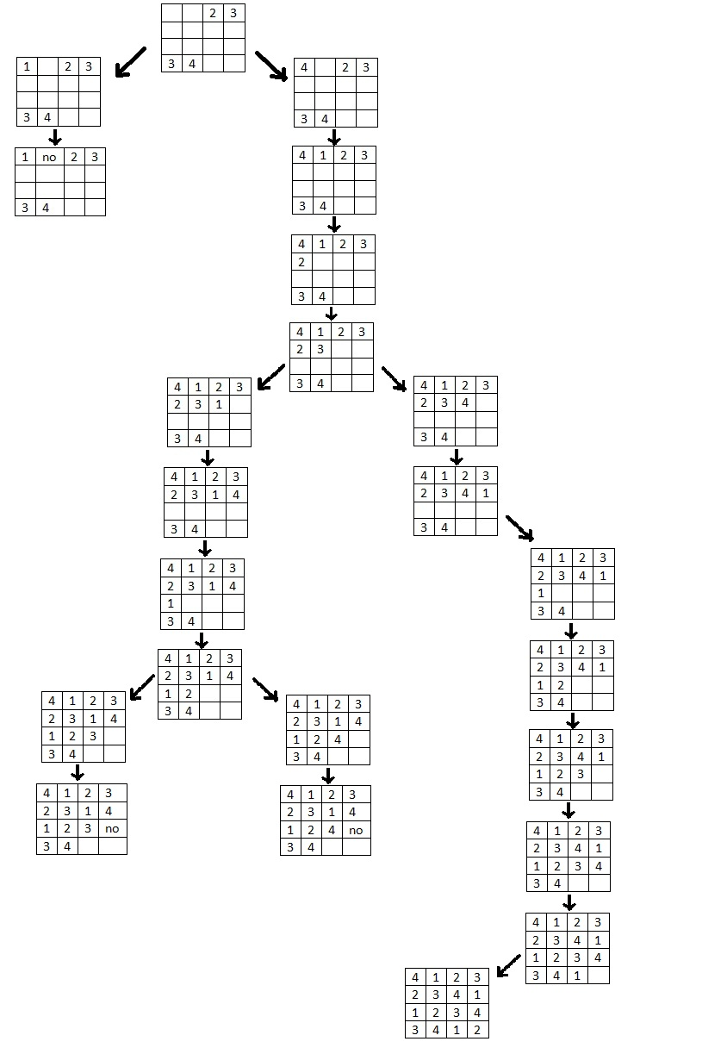
Ex.: Sudoku game
Notes:
Check outside the presentation

Slide 26
E-mail
E-mail: Ahmed.elhelow@90daraga.com

