Slide 1


Slide 2
How does an agent make decisions?

Slide 3
Search
Search is a universal problem solving mechanism in artificial intelligence
Search algorithms:
Uninformed search or Brute force search
Heuristic search or informed search

Slide 4
Search
Heuristic search or informed search
Heuristic is a technique designed for solving a problem more quickly when classic methods are too slow.
Including:
A* algorithm
Iterative deepening a*

Slide 5
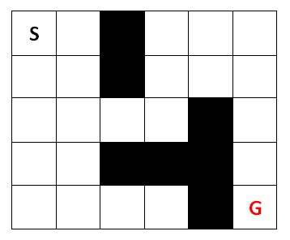
A star algorithm
Planning problem
Given:
Map
Start
Goal
Cost
Goal:
Find minimum cost path

Slide 6
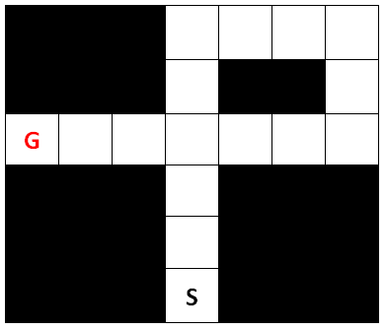
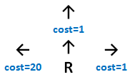
Compute Cost
Rush hour optimal path ?

Slide 7
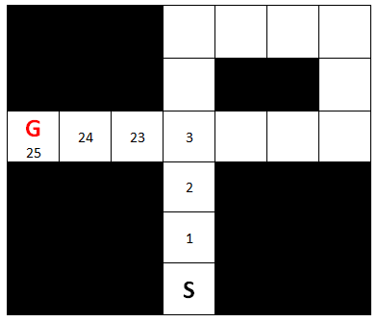
Compute Cost
First Solution

Slide 8
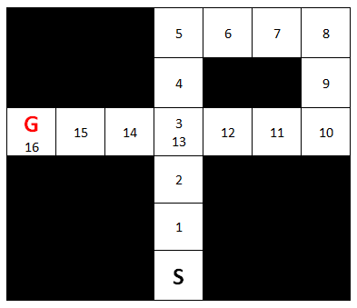
Compute Cost
Second Solution
(Better Solution)

Slide 9


Robot Maze
Ex.: Parking lot
Cost for any action = 1

Slide 10
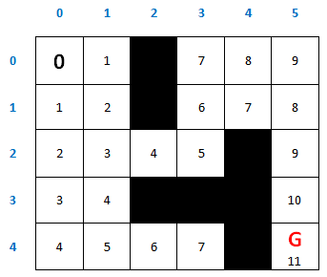
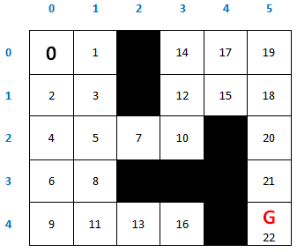
Get g-value
G-value matrix:
G-value is the path cost from the start point to the chosen cell.
All this in Robot’s mind.
Robot will not move until it has the complete path.
Expansion order:

Slide 11
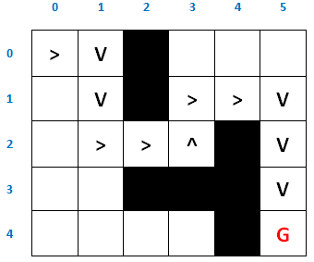
Get g-value
Container: [g, (x, y), [path]]
[[0, (0, 0), [(0, 0)]]]
[[1, (1, 0), [(0, 0), (1, 0)]], [1, (0, 1), [(0, 0), (0, 1)]]]
[[1, (1, 0), [(0, 0), (1, 0)]], [2, (1, 1), [(0, 0), (0, 1), (1, 1)]]]
Path to Goal:
Expansion order: (pop order)

Slide 12
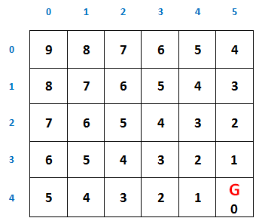
A star (Heuristic Fn)
A-star uses a so called heuristic function.
If we call the heuristic function h, then for each cell it results into a value.
Here is one: It is the number of steps it takes to the goal if there were no obstacles.

Slide 13
Heuristic Function
The heuristic function doesn't have to be accurate.
If it was accurate, you already solved the planning problem and no need for search.
You can use two heuristic functions in one problem.

Slide 14
Heuristic Function
The heuristic function is an idea more than a static formula.
In Maze Search Example:
f = g + h.
g is G-value.
h is Heuristic value.

Slide 15
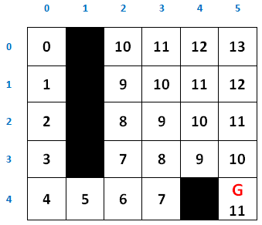

A star (Maze Search)
G-value matrix:
f-value matrix:
H-value matrix:
Container: [f, g, (x, y)]
[[9, 6, (4, 2)] ]
[[11, 7, (3, 2)], [9, 7, (4, 3)] ]
[[11, 7, (3, 2)], [11, 8, (3, 3)] ]

Slide 16
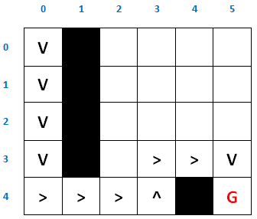
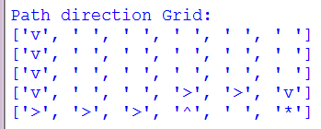

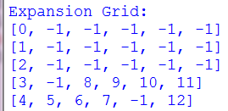
A star (Maze Search)
Expansion order: (pop order)

Slide 17

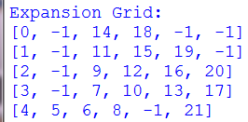
Without Heuristic
Expansion order: (pop order)

Slide 18
Sudoku Game
(Using A star)

Slide 19
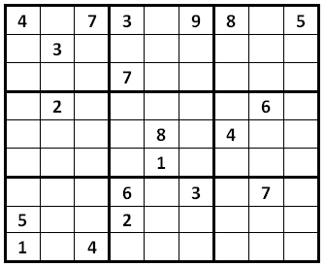
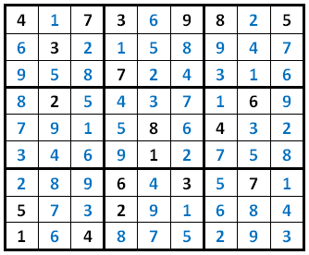
A star (Sudoku game)
9*9 Sudoku game
Solution

Slide 20
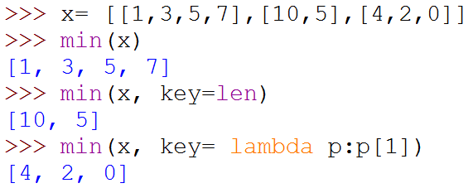
Python (key=lambda)
>>> x= [[1,3,5,7],[10,5],[4,2,0]]
>>> min(x)
[1, 3, 5, 7]
>>> min(x, key=len)
[10, 5]
>>> min(x, key= lambda p:p[1])
[4, 2, 0]

Slide 21
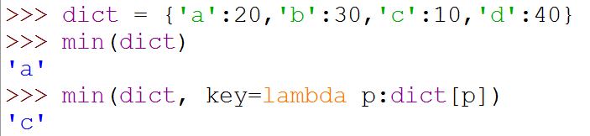
Python (key=lambda)
>>> dict = {'a':20,'b':30,'c':10,'d':40}
>>> min(dict)
'a'
>>> min(dict, key=lambda p:dict[p])
'c'

Slide 22
A star (Sudoku game)
from copy import deepcopy
Grid = [['4', '.', '7', '3', '.', '9', '8', '.', '5'],
['.', '3', '.', '.', '.', '.', '.', '.', '.'],
['.', '.', '.', '7', '.', '.', '.', '.', '.'],
['.', '2', '.', '.', '.', '.', '.', '6', '.'],
['.', '.', '.', '.', '8', '.', '4', '.', '.'],
['.', '.', '.', '.', '1', '.', '.', '.', '.'],
['.', '.', '.', '6', '.', '3', '.', '7', '.'],
['5', '.', '.', '2', '.', '.', '.', '.', '.'],
['1', '.', '4', '.', '.', '.', '.', '.', '.']]

Slide 23
A star (Sudoku game)
square_indx = [[(0,3),(0,3)],
[(0,3),(3,6)],
[(0,3),(6,9)],
[(3,6),(0,3)],
[(3,6),(3,6)],
[(3,6),(6,9)],
[(6,9),(0,3)],
[(6,9),(3,6)],
[(6,9),(6,9)]]
elements = ['1','2','3','4','5','6','7','8','9']

Slide 24
A star (Sudoku game)
def get_rows(new_Grid):
rows = []
for i in range(0,9):
row = {}
for y in range(0,9):
row[(i,y)] = new_Grid[i][y]
rows.append(row)
return rows
def get_cols(new_Grid):
cols = []
for i in range(0,9):
col = {}
for x in range(0,9):
col[(x,i)] = new_Grid[x][i]
cols.append(col)
return cols

Slide 25
A star (Sudoku game)
def get_squares(new_Grid):
squares = []
for i in range(0,9):
square = {}
for x in range(square_indx[i][0][0],square_indx[i][0][1]):
for y in range(square_indx[i][1][0],square_indx[i][1][1]):
square[(x,y)] = new_Grid[x][y]
squares.append(square)
return squares
def get_all_related_cells(new_Grid):
squares = get_squares(new_Grid)
rows = get_rows(new_Grid)
cols = get_cols(new_Grid)
all_vec = squares + rows + cols
return all_vec

Slide 26
A star (Sudoku game)
def get_legal_for_cell(cell_r, cell_c, new_Grid):
map = {}
all_vec = get_all_related_cells(new_Grid)
for a in all_vec:
if (cell_r, cell_c) in a.keys():
map.update(a)
exist = []
for m in map:
if not map[m]=='.':
exist.append(map[m])
rest = list(set(elements) - set(exist))
return rest

Slide 27
A star (Sudoku game)
def get_legal_for_all(new_Grid):
legal_for_all = {}
for r in range(0,9):
for c in range(0,9):
if new_Grid[r][c]=='.':
legal_for_all[(r,c)] = get_legal_for_cell(r, c, new_Grid)
return legal_for_all
def get_next_cell(new_Grid):
legal_for_all = get_legal_for_all(new_Grid)
if len(legal_for_all)>0:
key = min(legal_for_all, key=lambda p:len(legal_for_all[p]))
else:
key=(None,None) # only when grid completed
return key

Slide 28
A star (Sudoku game)
def is_complete(new_Grid):
grid_complete = True
for r in new_Grid:
grid_complete = grid_complete and not ('.' in r)
return grid_complete
def print_grid(new_Grid):
for item in new_Grid:
print item
print

Slide 29
A star (Sudoku game)
def solve_step_in_sudoko(last_Grid):
if is_complete(last_Grid):
print 'Complete:'
print_grid(last_Grid)
return 0
r,c = get_next_cell(last_Grid)
legal_for_cell = get_legal_for_cell(r, c, last_Grid)
for item in legal_for_cell:
new_Grid = deepcopy(last_Grid)
new_Grid[r][c] = item
solve_step_in_sudoko(new_Grid)
solve_step_in_sudoko(Grid)

Slide 30
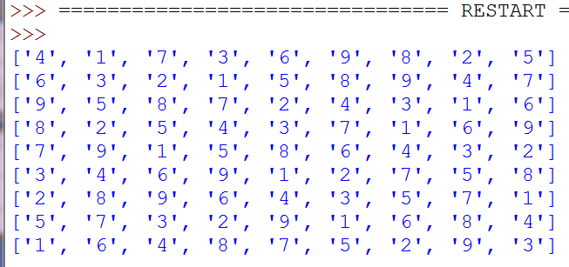
A star (Sudoku game)

Slide 31
Maze Search Program

Slide 32
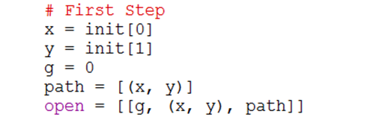
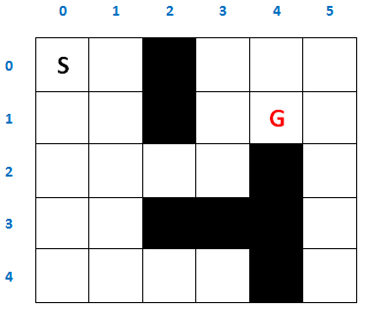


Maze Search Program
Moves order:
Up -> Left -> Down -> Right

Slide 33

Maze Search Program

Slide 34
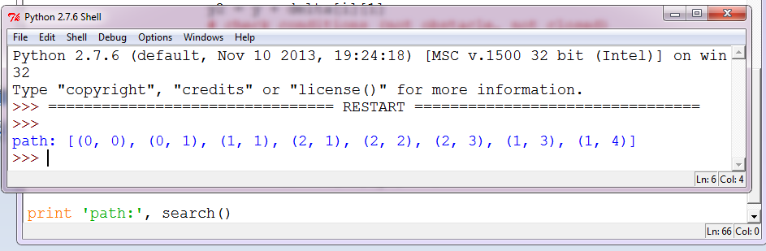
Maze Search Program

Slide 35
Maze Search Program
(Using A star)

Slide 36
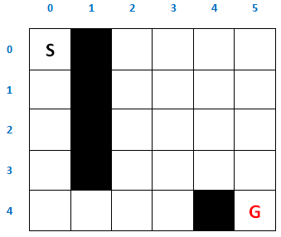
A star (Maze Search)
Heuristic Function
A-star Maze

Slide 37
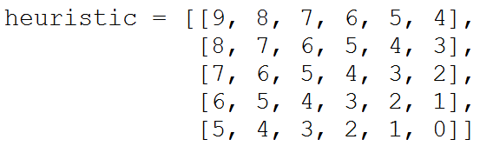
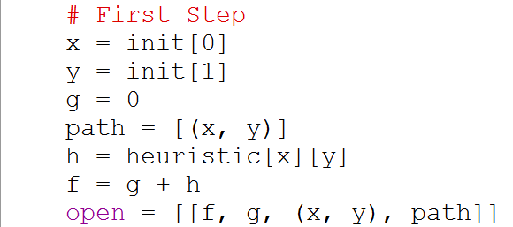
Maze Search (A star)

Slide 38
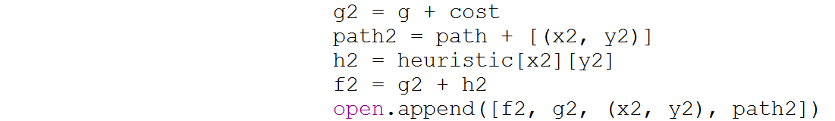
Maze Search (A star)

Slide 39
Maze Search (A star)

Slide 40
Code
The complete code at
https://github.com/ahmed-elhelow/AI-class
E-mail: Ahmed.elhelow@90daraga.com

