Slide 1


Slide 2
How does an agent make decisions?

Slide 3
Search
Search is a universal problem solving mechanism in artificial intelligence
Search algorithms:
Uninformed search or Brute force search
Heuristic search or informed search

Slide 4
Search
Heuristic search or informed search
Heuristic is a technique designed for solving a problem more quickly when classic methods are too slow.
Including:
A* algorithm
Iterative deepening a*

Slide 5
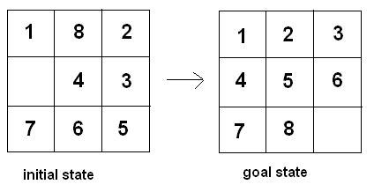
Heuristic Function
Heuristic functions for N-puzzle:
Manhattan Distance
Linear Conflict
Misplaced Tiles
N-Max Swap
Tiles out of row and column

Slide 6

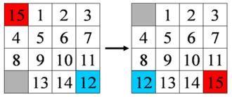
Heuristic Function
Manhattan Distance for N-puzzle:
The Manhattan Distance is 3+6=9 moves

Slide 7
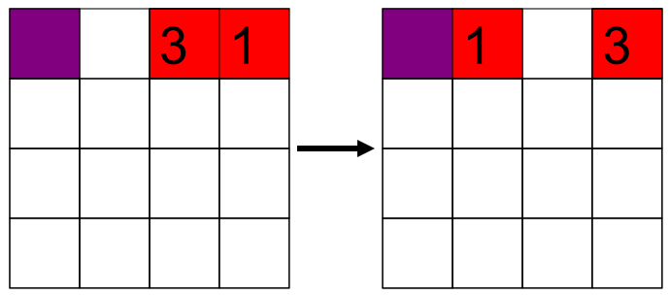
Heuristic Function
Linear Conflict for N-puzzle
Two tiles tj and tk are in a linear conflict if:
tj and tk are in the same line.
The goal positions of tj and tk are both in that line.
tj is to the right of tk and goal position of tj is to the left of the goal position of tk.
the heuristic function will add a cost of 2 moves for each pair of conflicting tiles.

Slide 8

Heuristic Function
Misplaced Tiles for N-puzzle:
h = Number of tiles that are not in the final position (not counting the blank)
The Misplaced Distance is 1+1=2 moves

Slide 9
Heuristic Function
N-Max Swap for N-puzzle:
h = The number of steps it would take to solve the problem if it was possible to swap any tile with the "space".
N-Max Swap is 1+1=2 moves

Slide 10
Heuristic Function
Tiles out of row and column for N-puzzle:
h = Number of tiles out of row + number of tiles out of column.
2 tiles out of column + 1 tile out of row = 3

Slide 11
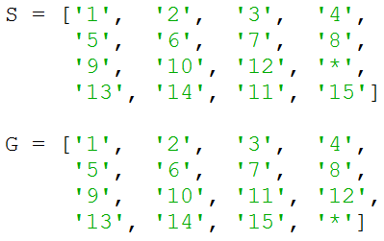
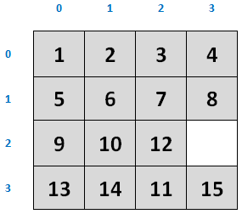
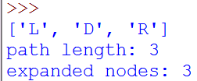
A star (15-puzzle)

Slide 12
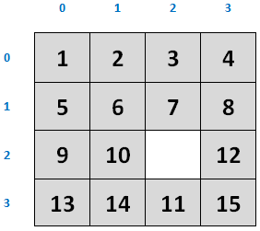
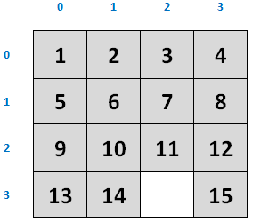
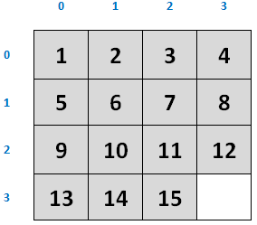
A star (15-puzzle)

Slide 13
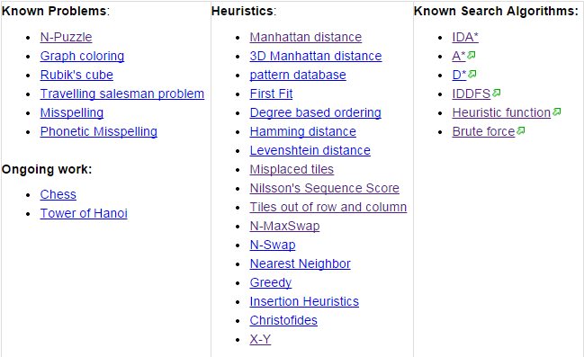
Heuristics wiki
http://heuristicswiki.wikispaces.com/

Slide 14
Code
The complete code at
https://github.com/ahmed-elhelow/AI-class
E-mail: Ahmed.elhelow@90daraga.com

