Slide 1


Slide 2
How does an agent make decisions?

Slide 3
Search
Search is a universal problem solving mechanism in artificial intelligence
Search algorithms:
Uninformed search or Brute force search
Heuristic search or informed search

Slide 4
Search
Heuristic search or informed search
Heuristic is a technique designed for solving a problem more quickly when classic methods are too slow.
Including:
A* algorithm
Iterative deepening a*

Slide 5
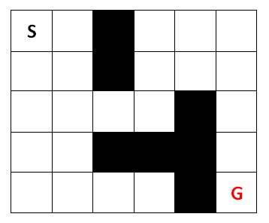
A star algorithm
Planning problem
Given:
Map
Start
Goal
Cost
Goal:
Find minimum cost path

Slide 6
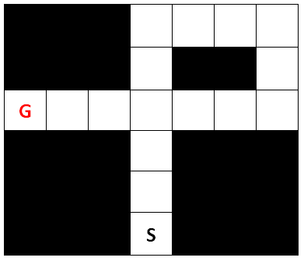
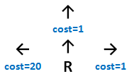
Compute Cost
Rush hour optimal path ?

Slide 7
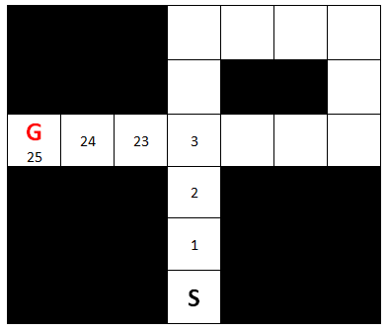
Compute Cost
First Solution

Slide 8
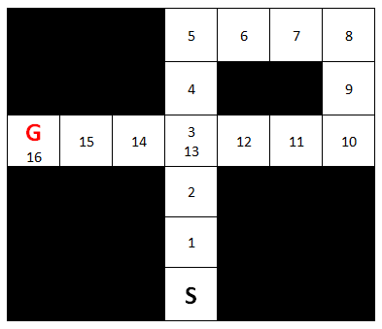
Compute Cost
Second Solution
(Better Solution)

Slide 9


Robot Maze
Ex.: Parking lot
Cost for any action = 1

Slide 10
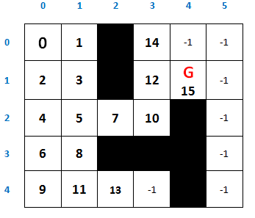
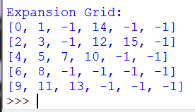
Get g-value
G-value is the path cost from the start point to the chosen cell.
All this in Robot’s mind.
Robot will not move until it has the complete path.

Slide 11
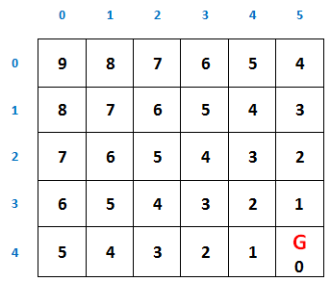
A star (Heuristic Fn)
A-star uses a so called heuristic function.
If we call the heuristic function h, then for each cell it results into a value.
Here is one: It is the number of steps it takes to the goal if there were no obstacles.

Slide 12
Heuristic Function
The heuristic function doesn't have to be accurate.
If it was accurate, you already solved the planning problem and no need for search.
You can use two heuristic functions in one problem.

Slide 13
Heuristic Function
The heuristic function is an idea more than a static formula.
In Maze Search Example:
f = g + h.
g is G-value.
h is Heuristic value.

Slide 14
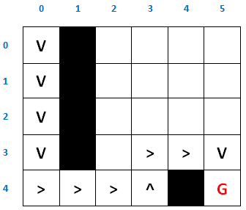
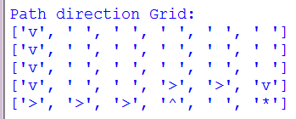
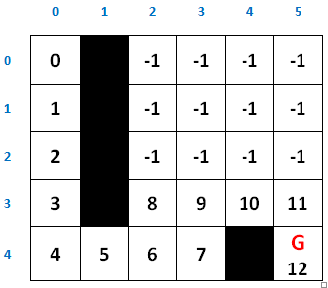
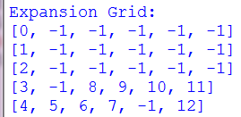
A star (Maze Search)

Slide 15

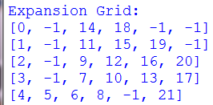
Without Heuristic

Slide 16
Sudoku Game
(Using A star)

Slide 17
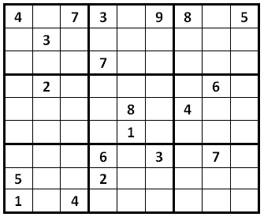
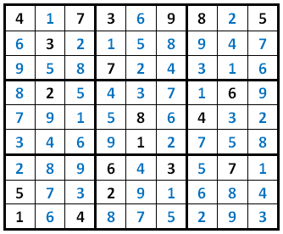
A star (Sudoku game)
9*9 Sudoku game
Solution

Slide 18
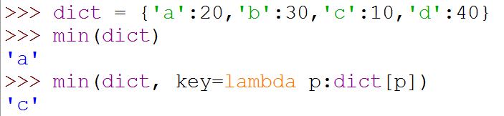
Python (key=lambda)
>>> dict = {'a':20,'b':30,'c':10,'d':40}
>>> min(dict)
'a'
>>> min(dict, key=lambda p:dict[p])
'c'

Slide 19
A star (Sudoku game)
from copy import deepcopy
Grid = [['4', '.', '7', '3', '.', '9', '8', '.', '5'],
['.', '3', '.', '.', '.', '.', '.', '.', '.'],
['.', '.', '.', '7', '.', '.', '.', '.', '.'],
['.', '2', '.', '.', '.', '.', '.', '6', '.'],
['.', '.', '.', '.', '8', '.', '4', '.', '.'],
['.', '.', '.', '.', '1', '.', '.', '.', '.'],
['.', '.', '.', '6', '.', '3', '.', '7', '.'],
['5', '.', '.', '2', '.', '.', '.', '.', '.'],
['1', '.', '4', '.', '.', '.', '.', '.', '.']]

Slide 20
A star (Sudoku game)
square_indx = [[(0,3),(0,3)],
[(0,3),(3,6)],
[(0,3),(6,9)],
[(3,6),(0,3)],
[(3,6),(3,6)],
[(3,6),(6,9)],
[(6,9),(0,3)],
[(6,9),(3,6)],
[(6,9),(6,9)]]
elements = ['1','2','3','4','5','6','7','8','9']

Slide 21
A star (Sudoku game)
def get_rows(new_Grid):
rows = []
for i in range(0,9):
row = {}
for y in range(0,9):
row[(i,y)] = new_Grid[i][y]
rows.append(row)
return rows
def get_cols(new_Grid):
cols = []
for i in range(0,9):
col = {}
for x in range(0,9):
col[(x,i)] = new_Grid[x][i]
cols.append(col)
return cols

Slide 22
A star (Sudoku game)
def get_squares(new_Grid):
squares = []
for i in range(0,9):
square = {}
for x in range(square_indx[i][0][0],square_indx[i][0][1]):
for y in range(square_indx[i][1][0],square_indx[i][1][1]):
square[(x,y)] = new_Grid[x][y]
squares.append(square)
return squares
def get_all_related_cells(new_Grid):
squares = get_squares(new_Grid)
rows = get_rows(new_Grid)
cols = get_cols(new_Grid)
all_vec = squares + rows + cols
return all_vec

Slide 23
A star (Sudoku game)
def get_legal_for_cell(cell_r, cell_c, new_Grid):
map = {}
all_vec = get_all_related_cells(new_Grid)
for a in all_vec:
if (cell_r, cell_c) in a.keys():
map.update(a)
exist = []
for m in map:
if not map[m]=='.':
exist.append(map[m])
rest = list(set(elements) - set(exist))
return rest

Slide 24
A star (Sudoku game)
def get_legal_for_all(new_Grid):
legal_for_all = {}
for r in range(0,9):
for c in range(0,9):
if new_Grid[r][c]=='.':
legal_for_all[(r,c)] = get_legal_for_cell(r, c, new_Grid)
return legal_for_all
def get_next_cell(new_Grid):
legal_for_all = get_legal_for_all(new_Grid)
if len(legal_for_all)>0:
key = min(legal_for_all, key=lambda p:len(legal_for_all[p]))
else:
key=(None,None) # only when grid completed
return key

Slide 25
A star (Sudoku game)
def is_complete(new_Grid):
grid_complete = True
for r in new_Grid:
grid_complete = grid_complete and not ('.' in r)
return grid_complete
def print_grid(new_Grid):
for item in new_Grid:
print item
print

Slide 26
A star (Sudoku game)
def solve_step_in_sudoko(last_Grid):
if is_complete(last_Grid):
print 'Complete:'
print_grid(last_Grid)
return 0
r,c = get_next_cell(last_Grid)
legal_for_cell = get_legal_for_cell(r, c, last_Grid)
for item in legal_for_cell:
new_Grid = deepcopy(last_Grid)
new_Grid[r][c] = item
solve_step_in_sudoko(new_Grid)
solve_step_in_sudoko(Grid)

Slide 27
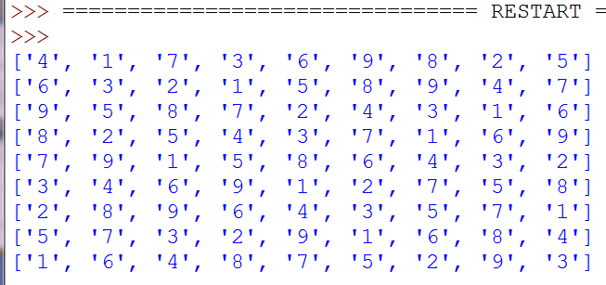
A star (Sudoku game)

Slide 28
Maze Search Program

Slide 29
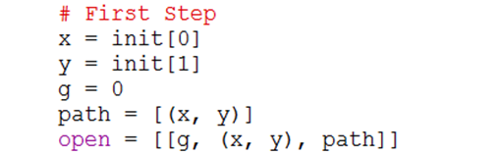
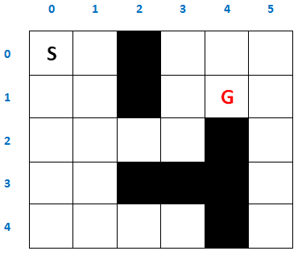


Maze Search Program
Moves order:
Up -> Left -> Down -> Right

Slide 30

Maze Search Program

Slide 31
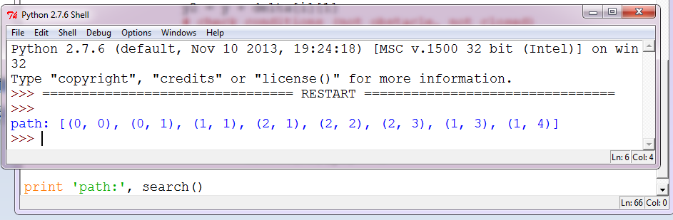
Maze Search Program

Slide 32
Maze Search Program
(Using A star)

Slide 33
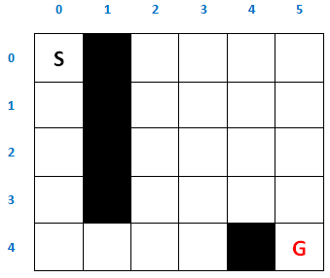
A star (Maze Search)
Heuristic Function
A-star Maze

Slide 34
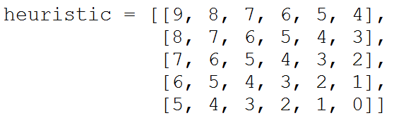
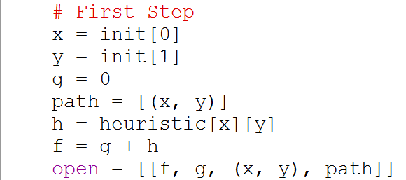
Maze Search (A star)

Slide 35
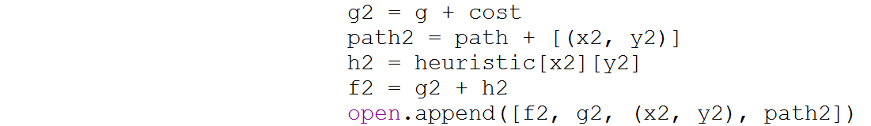
Maze Search (A star)

Slide 36
Maze Search (A star)

Slide 37
Code
The complete code at
https://github.com/ahmed-elhelow/AI-class
E-mail: Ahmed.elhelow@90daraga.com

