Slide 1


Slide 2
How do we write a small game agent?

Slide 3
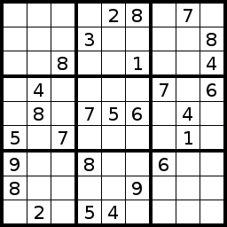
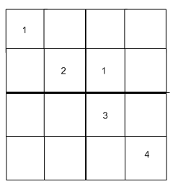
Ex.: Sudoku game
4*4 Sudoku game
9*9 Sudoku game

Slide 4
Constraint Satisfaction Problem
Constraint satisfaction problems (CSPs) are mathematical problems defined as a set of objects whose state must satisfy a number of constraints or limitations.
Examples:
Sudoku
Eight queen puzzle
Solution: Constraint Propagation

Slide 5
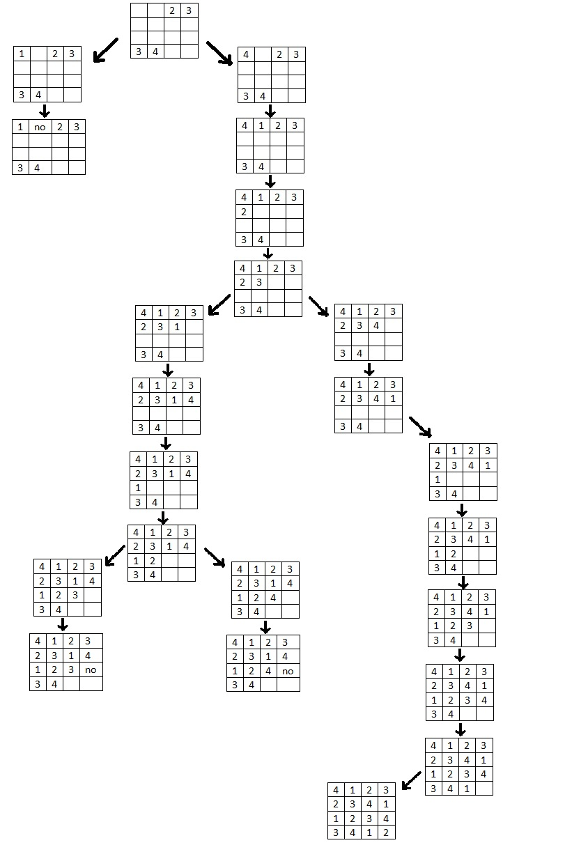
Ex.: Sudoku game
Notes:
Check outside the presentation

Slide 6
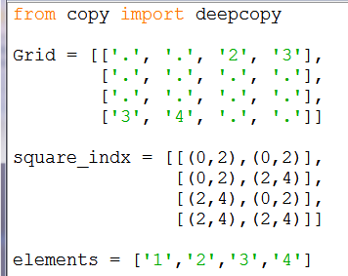
Ex.: Sudoku game
from copy import deepcopy
Grid = [['.', '.', '2', '3'],
['.', '.', '.', '.'],
['.', '.', '.', '.'],
['3', '4', '.', '.']]
square_indx = [[(0,2),(0,2)],
[(0,2),(2,4)],
[(2,4),(0,2)],
[(2,4),(2,4)]]
elements = ['1','2','3','4']

Slide 7
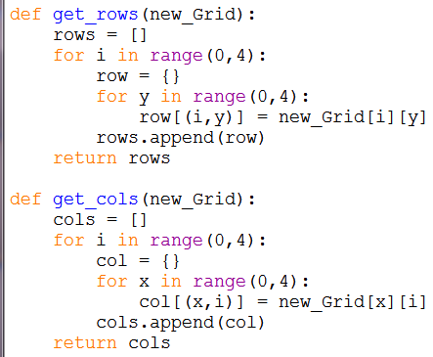
Ex.: Sudoku game
def get_rows(new_Grid):
rows = []
for i in range(0,4):
row = {}
for y in range(0,4):
row[(i,y)] = new_Grid[i][y]
rows.append(row)
return rows
def get_cols(new_Grid):
cols = []
for i in range(0,4):
col = {}
for x in range(0,4):
col[(x,i)] = new_Grid[x][i]
cols.append(col)
return cols

Slide 8
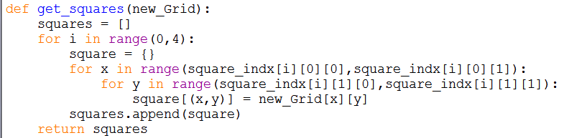
Ex.: Sudoku game
def get_squares(new_Grid):
squares = []
for i in range(0,4):
square = {}
for x in range(square_indx[i][0][0],square_indx[i][0][1]):
for y in range(square_indx[i][1][0],square_indx[i][1][1]):
square[(x,y)] = new_Grid[x][y]
squares.append(square)
return squares

Slide 9
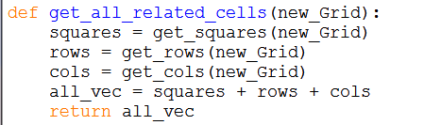
Ex.: Sudoku game
def get_all_related_cells(new_Grid):
squares = get_squares(new_Grid)
rows = get_rows(new_Grid)
cols = get_cols(new_Grid)
all_vec = squares + rows + cols
return all_vec

Slide 10
Ex.: Sudoku game
def get_legal_for_cell(cell_r, cell_c, new_Grid):
if new_Grid[cell_r][cell_c]!='.':
return [None]
map = {}
all_vec = get_all_related_cells(new_Grid)
for a in all_vec:
if (cell_r, cell_c) in a.keys():
map.update(a)
exist = []
for m in map:
if not map[m]=='.':
exist.append(map[m])
rest = list(set(elements) - set(exist))
return rest

Slide 11
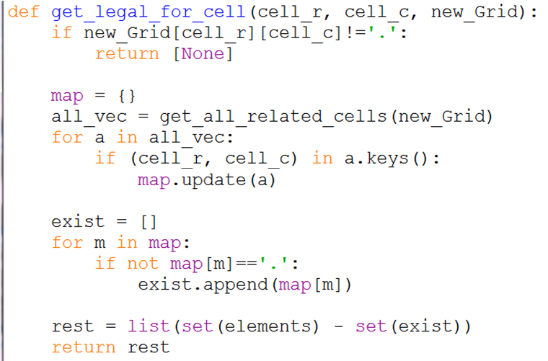
Ex.: Sudoku game

Slide 12
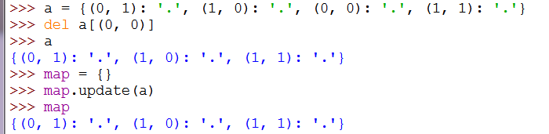
Ex.: Sudoku game
>>> a = {(0, 1): '.', (1, 0): '.', (0, 0): '.', (1, 1): '.'}
>>> del a[(0, 0)]
>>> map = {}
>>> map.update(a)
>>> map
{(0, 1): '.', (1, 0): '.', (1, 1): '.'}
Notes:
The method update() adds dictionary dict2's key-values pairs in to dict.
dict.update(dict2)

Slide 13
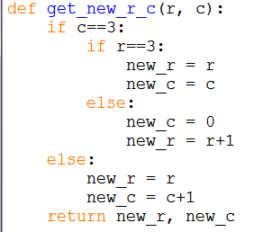
Ex.: Sudoku game
def get_new_r_c(r, c):
if c==3:
if r==3:
new_r = r
new_c = c
else:
new_c = 0
new_r = r+1
else:
new_r = r
new_c = c+1
return new_r, new_c

Slide 14
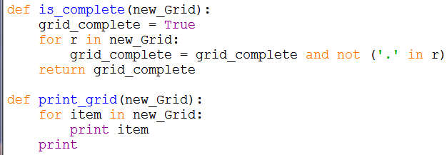
Ex.: Sudoku game
def is_complete(new_Grid):
grid_complete = True
for r in new_Grid:
grid_complete = grid_complete and not ('.' in r)
return grid_complete
def print_grid(new_Grid):
for item in new_Grid:
print item
print

Slide 15
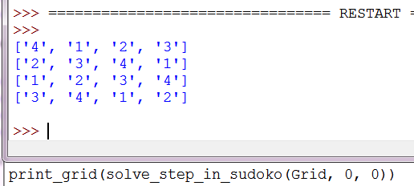
Ex.: Sudoku game

Slide 16
Ex.: Sudoku game
def solve_step_in_sudoko(last_Grid, r, c):
if is_complete(last_Grid):
print 'Complete:'
print_grid(last_Grid)
return 0
## print_grid(last_Grid)
legal_for_cell = get_legal_for_cell(r, c, last_Grid)
for item in legal_for_cell:
new_Grid = deepcopy(last_Grid)
if last_Grid[r][c]=='.':
new_Grid[r][c] = item
new_r, new_c = get_new_r_c(r, c)
solve_step_in_sudoko(new_Grid, new_r, new_c)
solve_step_in_sudoko(Grid, 0, 0)

Slide 17
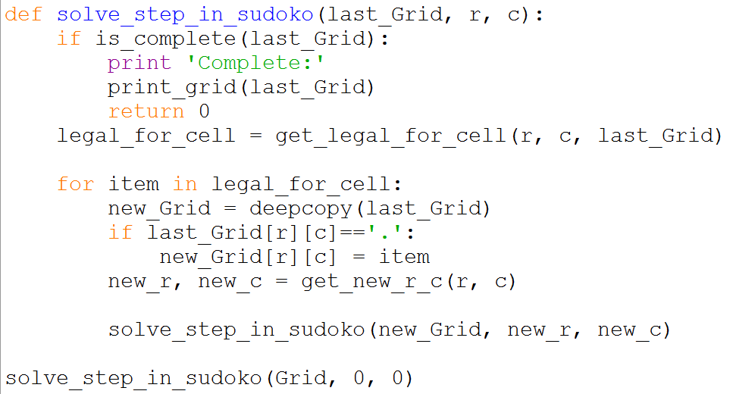
Ex.: Sudoku game

Slide 18
Ex.: Sudoku game
The complete code at
https://github.com/ahmed-elhelow/AI-class
E-mail: Ahmed.elhelow@90daraga.com

