Slide 1
BIG DATA AT THE EDGE • PROJECT PRESENTATION
Adaptive inference for
lung ultrasound at the edge
Group 7 | Charalampos Giannakis & Salomé Poulain
Question: can one model adjust computation to a changing resource budget without giving up useful predictive quality?
VARIABLE BUDGET
→
SHARED-WEIGHT MODES
→
MEASURED TRADE-OFF
Notes:
CHARALAMPOS · ~0:15
We examine adaptive lung-ultrasound inference under changing compute limits. Can one shared-weight model switch inference cost while keeping useful predictive quality? This is an OpenPOCUS technical proxy, not a clinical system.
HANDOFF: Here is the ambulance-inspired constraint.

Slide 2
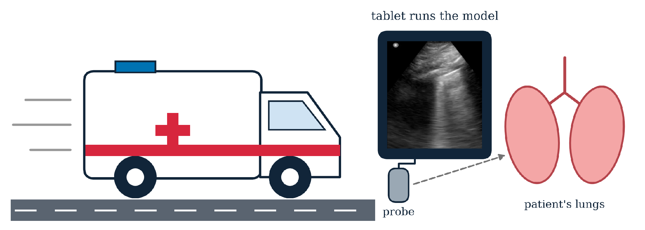
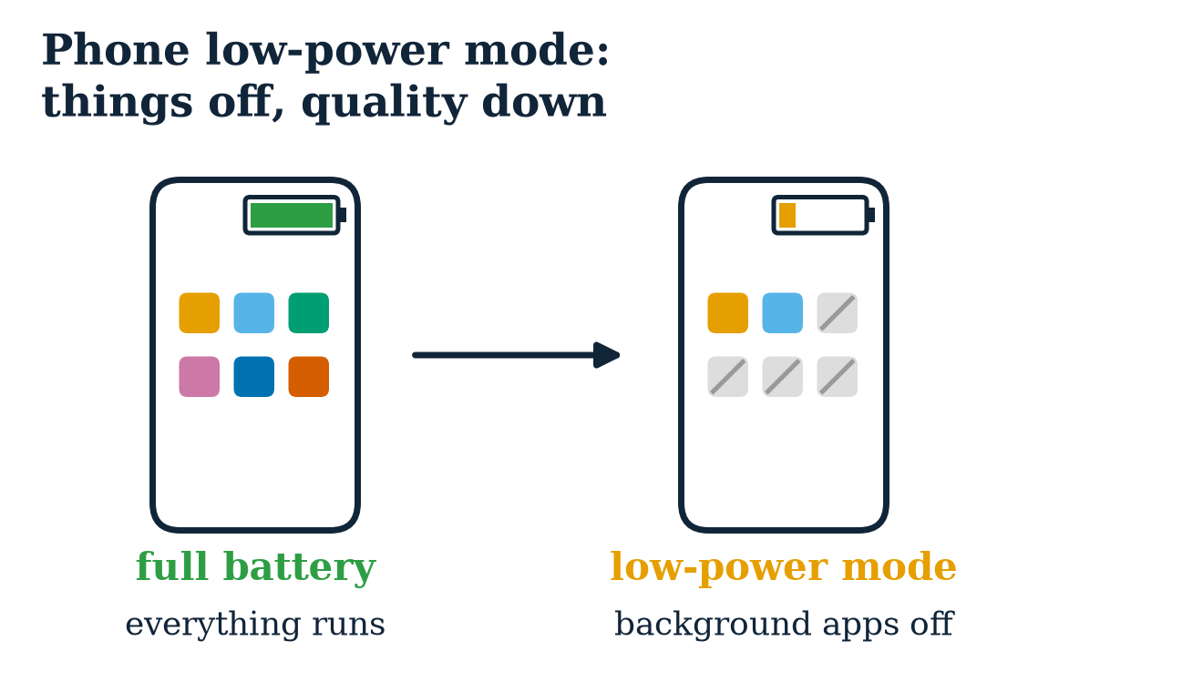
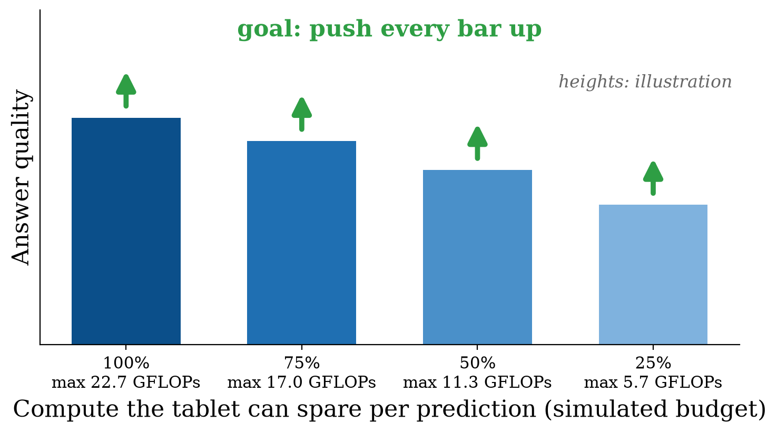
BIG DATA AT THE EDGE / ADAPTIVE POCUS
Problem Scenario
SCENARIO
Tablet flags abnormal lung zones
Spare compute changes with heat, the ultrasound app, battery
Big fixed model: only fits at 100%
Small fixed model: never uses the extra
GOAL
Goal: choose a useful quality–cost mode within each budget.
01 / 11
Notes:
CHARALAMPOS · ~0:35
Imagine a tablet processing a lung ultrasound sequence. The computation available to an AI model may change because other applications need capacity or because of device constraints. A fixed high-cost model may have to defer; a small fixed model cannot use extra compute when it becomes available. Our question is whether one model can switch configurations as the allowed computation changes. We simulate the budget in FLOPs; we did not measure battery or temperature.
HANDOFF: Salo will describe the actual dataset.
Q&A / SCIENTIFIC CAVEATS (not spoken):
The ambulance is a motivating scenario, not tested deployment. Budget b is a simulated model-work limit, not battery percentage. The bar chart is illustrative, not measured results.

Slide 3
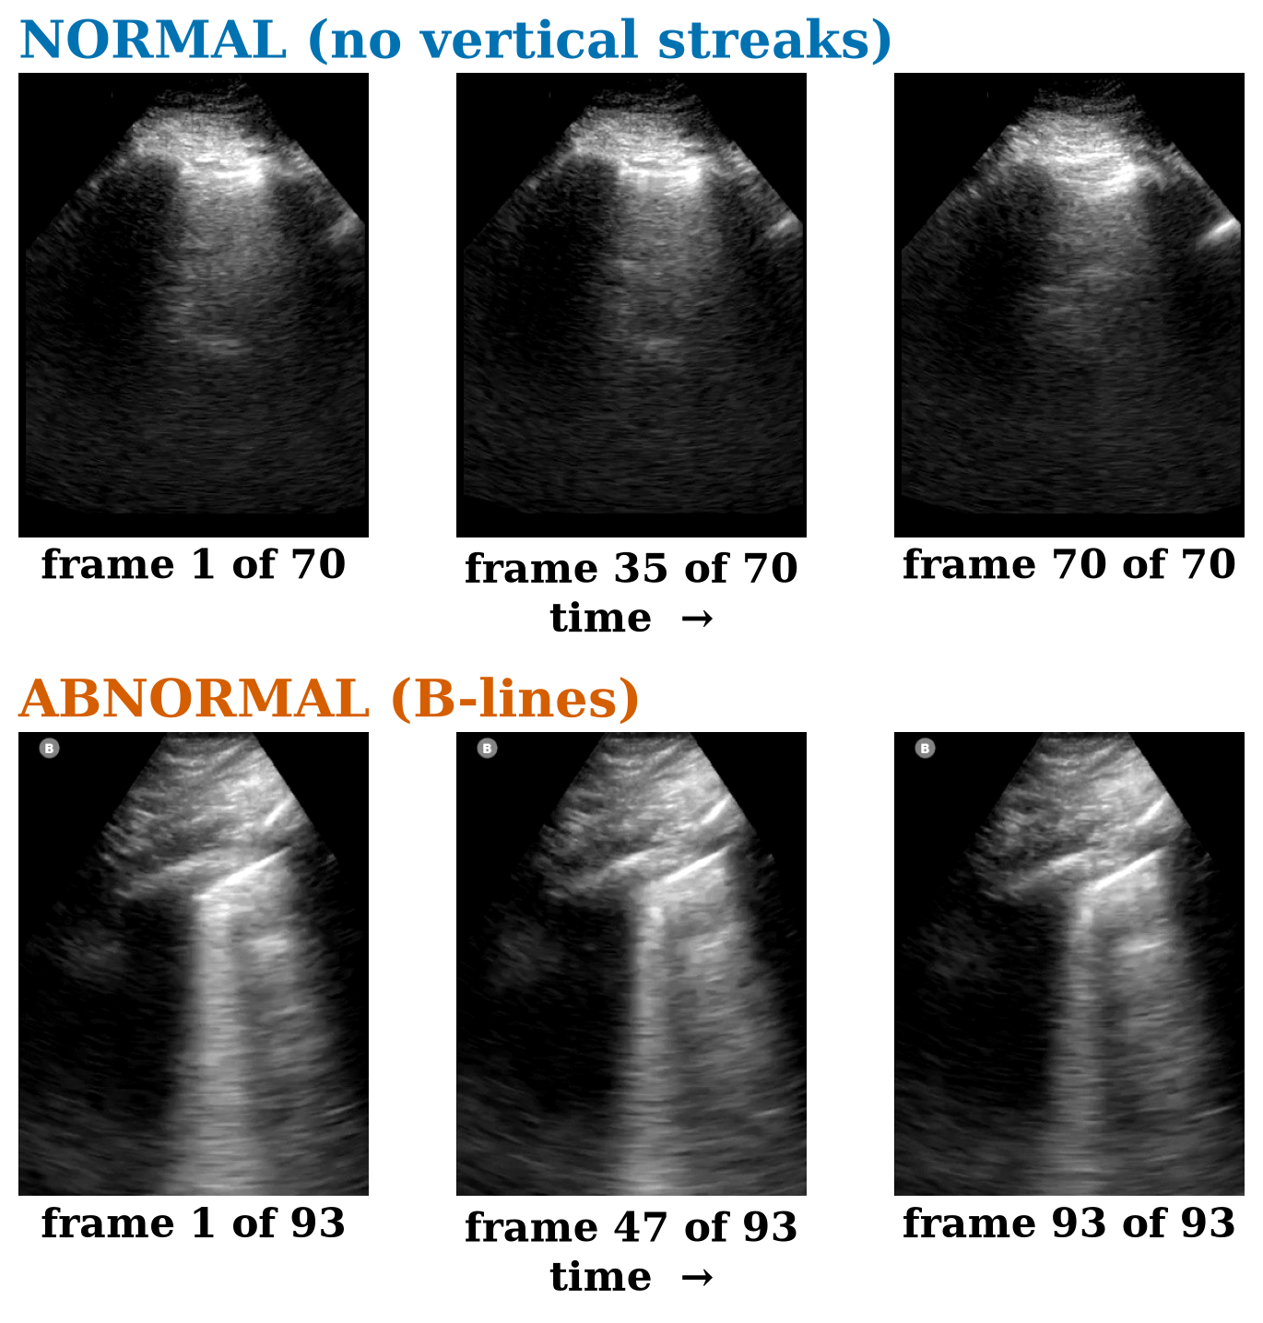
BIG DATA AT THE EDGE / ADAPTIVE POCUS
Dataset and Task
DATA
The data
Public Lung Data was rare.
OpenPOCUS
Researchers at Stanford published it in 2026 for training NN
~50% potential COVID-19, 50% control
226 exams ~ 12 zones
1 video = 1 label: normal, 3x non-normal findings or can't agree
binary: normal or abnormal
1,762 videos
70% normal (macro-F1 needed)
stratified group split: 70/15/15
Max 16 spread out frames
POCUS stands for point-of-care ultrasound: a doctor scans the patient at the bedside with a handheld or portable probe
(Kumar et al., POCUS Journal, 2026)
02 / 11
Notes:
It was very difficult to find public clinical lung data, so we ended up using the OpenPOCUS dataset, which
researchers at Stanford published in 2026 for neural network training.
The dataset contains labelled videos of 226 exams, of which about half were in the COVID-19 group.
The other half did not, so these were people with other lung problems or no lung problems at all.
For each exam, up to 12 different regions of the chest were filmed.
Each video was labelled with 1 of 5 labels.
Either normal, 3 types of non-normal findings, or indeterminate, when the doctors could not agree.
We ended up only keeping the abnormal and normal ones.
We merged the 3 non-normal findings into one class, abnormal, because the separate findings were too rare to
learn on their own.
We finally ended up with 1,762 videos.
Because 70% are normal, a model that always says "normal" already gets 70% accuracy.
So we need to look at macro-F1 too, which scores both classes equally.
We split them into train, validation and test using a stratified group split of 70/15/15.
The split balances class proportions and separates known linked recordings; distinct biological patients cannot be verified from these identifiers.
We only used the test set once, at the very end.
Now let's look at the images.
Here we can see what this looks like.
The abnormal one shows B-lines, a bright vertical streak.
Additionally, you can see that the frames from the video are super similar, spread throughout the video.
That's why we only use 16 frames, spread evenly over the video.
Using every frame costs about nine times more compute, and it scored no better than 16.
On a tablet in an ambulance, that matters, because we can't afford 184 GFLOPs per clip.
So the number of frames is something we can turn up or down.
Fewer frames means less compute.
That's the first knob of our adaptive system.
But not every network handles fewer frames well, so next we had to pick the right one.

Slide 4
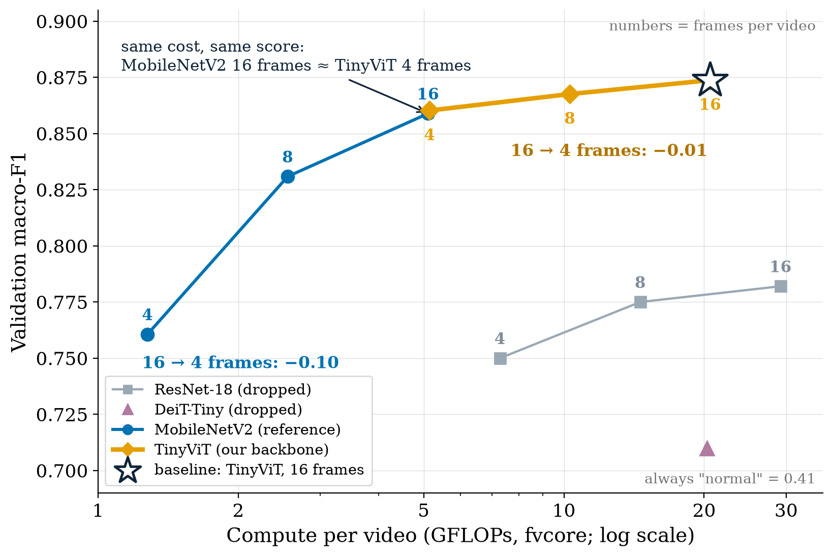
BIG DATA AT THE EDGE / ADAPTIVE POCUS
Baseline and Backbone
SETUP
Four models tested
Beat: always normal 0.41 M-F1
Round 1: 16 frames
Round 2: test 8, 4 frames
TinyViT vs. MobileNetV2:
frame knob: -0.01 loss vs. -0.10
same compute cost, same score
more GFLOP room to scale down
Backbone: TinyViT
Baseline: TinyViT 16 frames
Reference: MobileNetV2
03 / 11
Notes:
So we compared 4 networks on exactly that question, with rules we fixed before training, so we couldn't
pick a favourite afterwards.
Every model had to beat the 'always normal' macro-F1 of 0.41.
DeiT-Tiny was bad and expensive at 16 frames, so we dropped it.
ResNet-18 scored lower and needed more compute, so it went too.
MobileNetV2 loses a lot when it gets fewer frames.
TinyViT barely moves.
Where the lines meet, both use the same compute and get the same score, so choosing TinyViT costs us
nothing.
And at 16 frames TinyViT costs four times more than MobileNetV2, so there's a lot of compute we can
take away, starting from the best score.
So TinyViT is our backbone.
Our static baseline is TinyViT at 16 frames, frozen before we built anything adaptive, and never retrained.
MobileNetV2 stays as a reference, to check that a small model doesn't simply beat us.

Slide 5
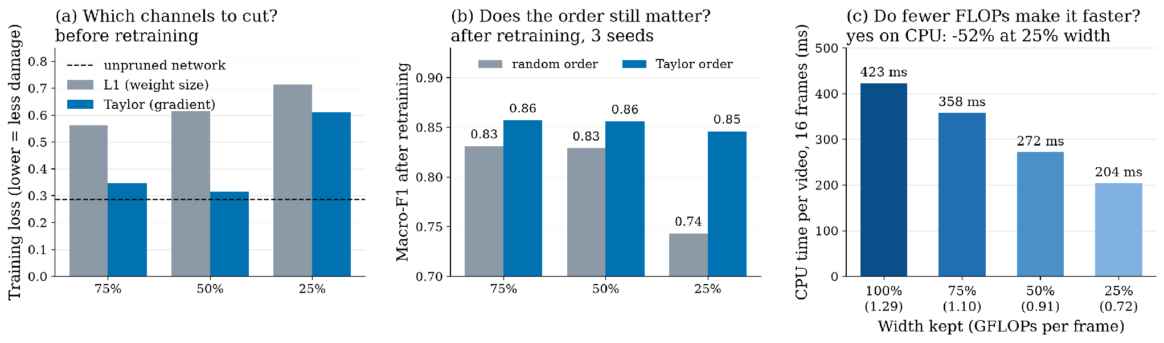
BIG DATA AT THE EDGE / ADAPTIVE POCUS
Structured Pruning
Tried first: 8-bit: 3x smaller file, same FLOPs
Then: cut whole inner channels (59% of compute)
Nested: sorted by Taylor, keep 25–100% in one file
Retrained: knowledge distillation, frozen teacher
Second knob: 25% width close on average, 2× faster at 16 frames
04 / 11
Notes:
We also wanted to make the network itself cheaper.
We first tried 8-bit quantization.
The file got three times smaller, but it doesn't remove any calculations, so the FLOPs stayed the same
and it couldn't move a single point on our plot.
On our CPU it was even slightly slower.
So we switched to structured pruning.
We cut whole channels, because only then does the computation really shrink.
We cut the inner channels, which carry 59 percent of the compute.
To decide which channels go first, we compared two rankings.
L1 looks at how big the weights are.
Taylor estimates how much the error would rise if a channel disappeared.
That matters, because a channel with big weights can still do very little for our task.
On the left, right after cutting, Taylor does less damage at every width, so we used it.
We kept 100, 75, 50 or 25 percent of the channels by Taylor score, so every smaller network sits inside
the bigger one, in one file.
Then we retrained all widths together, with the original network as a frozen teacher, which is knowledge
distillation.
In the middle, after retraining, Taylor still beats a random order.
At 25 percent, random drops to 0.74 while Taylor keeps 0.85.
So the more we cut, the more it matters which channels we keep.
On the right, fewer FLOPs really means faster on CPU, from 423 to 204 milliseconds per video.
We also tried recalibrating batch-norm per width, but that made the narrow widths worse.
And we used the same percentage in every stage, so a separate percentage per stage is something we
didn't test.
So pruning gives us our second knob.

Slide 6
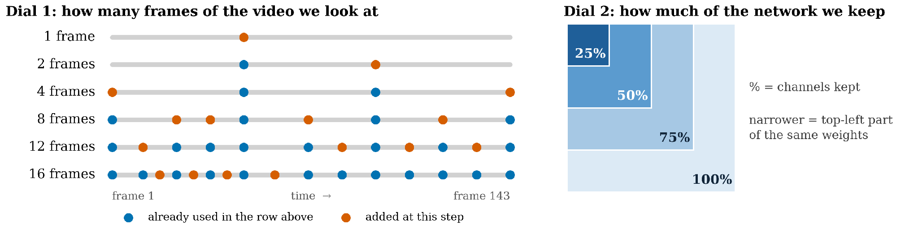
BIG DATA AT THE EDGE / ADAPTIVE POCUS
Adaptive Mechanism
1. Before: train one network for all 24
Every training step: same videos at 3 widths
(full, 25%, and 50 or 75%) sandwich rule
Each width: answers from first 1, 2, 4, 8, 16 frames
Distillation with Baseline 16 teacher per frame setting
Checked in torch: all widths share the weights
2. In use: pick 1 of 24 per video
Dial 1: 1, 2, 4, 8, 12 or 16 frames
Less budget: drop the orange frames
Dial 2: 25, 50, 75 or 100% of channels
Less budget: drop the least important channels
Switching width: under 1 ms
24 configurations in one 20.4 MB file
05 / 11
Notes:
Now we make our model adaptive.
Adaptive means one model that changes its compute at runtime, depending on the budget.
We also tried early exits and lower resolution, but at the same cost both did worse than fewer frames.
So we kept two dials, frames and width.
We trained one network for all 24 combinations.
Every step trains the full and the 25 percent width, because those are the hardest to keep good, plus one
middle width at random.
That's the sandwich rule.
We use the frozen teacher because without it, fine-tuning gave very different results between runs.
We trained it three times, and on average every width scores as well as the original network.
Then, at runtime, the system picks one of the 24 for every video.
Both dials are nested.
Less budget means we drop the orange frames, or the least important channels.
If the budget goes up mid-video, we only compute the new frames.
Going from 4 to 16 frames then costs 15.5 GFLOPs instead of 20.6.
Switching width takes under a millisecond.
So this is one model that adapts at runtime, not four separately trained models.
All 24 fit in one 20 MB file, instead of 62 for four separate models.
We checked in torch that at every width, all 213 weight tensors are just the first part of the shared ones.
The only extra data are 16 small batch-norm buffers.

Slide 7
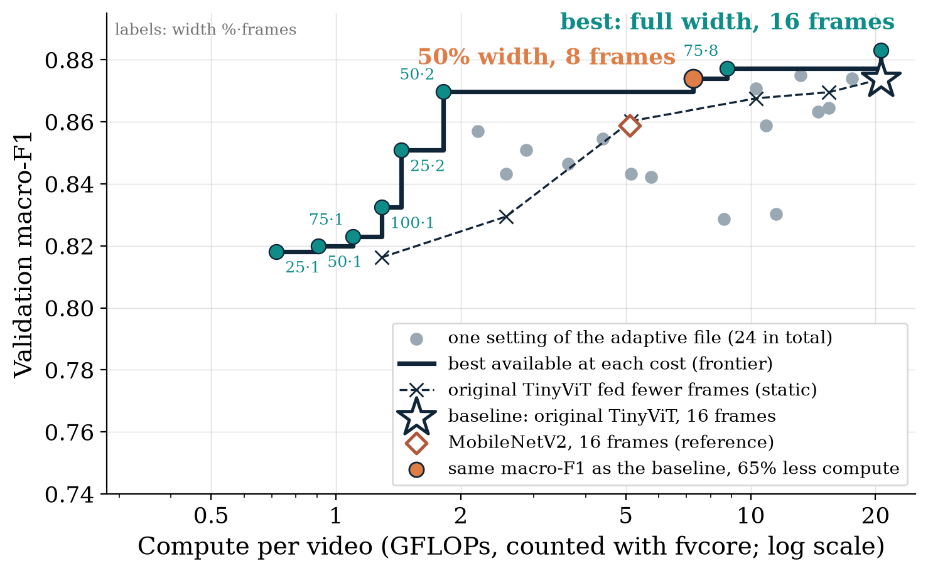
BIG DATA AT THE EDGE / ADAPTIVE POCUS
Pareto Frontier: macro-F1 vs. FLOPs
EVIDENCE
Result
Frontier above Baseline and MobileNetV2
Orange: baseline score, ⅓ of the compute
Full width above star: 2 videos, extra training
whole range, from 0.7 to 20.6 GFLOPs
06 / 11
Notes:
SALO · ~1:15
This is our validation macro-F1 against modeled computation per ultrasound sequence. We have 24 configurations from four widths and six possible frame counts, all sharing one checkpoint. The grey dots show these configurations; the dark staircase traces the best observed validation quality at each computational cost. The original full TinyViT is the star, and MobileNetV2 is the diamond.
One example is width 50% with eight frames: it reaches nearly the original baseline's validation macro-F1 while requiring about 65% less computation. At full width and 16 frames, the nested model is also close to the original. These were validation observations, used to design the controller; selecting a frontier from the same validation split makes this plot optimistic.
The next slides show our frozen choices and the independent held-out evaluation.
Q&A: The slide's comparison is validation-only (254 duplicate-aware units). The plotted frontier is NOT a held-out Pareto result. On held-out F007, nested width-0.5/K8 has macro-F1 0.846, versus original TinyViT K16 0.880. See experiments/F005/README.md and experiments/F007/FINAL_RESULTS.md.

Slide 8
BIG DATA AT THE EDGE / ADAPTIVE POCUS
Controller Policy
External budget b → eligibility screen → deterministic selection or deferral.
Budget b → quality filter → exact FLOP cap → max abnormal recall → lower cost
B = 0.00
B = 0.25
B = 0.50
B = 0.75
B = 1.00
DEFER
w0.5 · K2
w1.0 · K8
w1.0 · K12
w1.0 · K16
0 G
1.82 G
10.30 G
15.45 G
20.60 G
A simulated FLOP budget, not a measured battery, latency, or thermal constraint.
07 / 11
Notes:
CHARALAMPOS · ~0:50
Our controller receives only an external simulated resource budget b. It first keeps configurations meeting validation-screened accuracy, macro-F1 and abnormal-recall requirements. It then removes options exceeding the exact FLOP cap, and chooses the remaining option with highest validation abnormal recall, breaking ties in favor of cheaper computation. At zero capacity it defers. This frozen recall-priority rule selects K2 at 25%, full-width K8 at 50%, K12 at 75% and K16 at 100%. This policy was accepted before opening the held-out test.
HANDOFF: Did those frozen choices retain useful quality?
Q&A / SCIENTIFIC CAVEATS (not spoken):
b in [0,1]; capacity = b × 1.1 × 20.596 G modeled FLOPs. Headroom is simulated, not inferred from CPU availability. No input-dependent difficulty estimator. Rule tuned on validation only and not changed after final test.

Slide 9
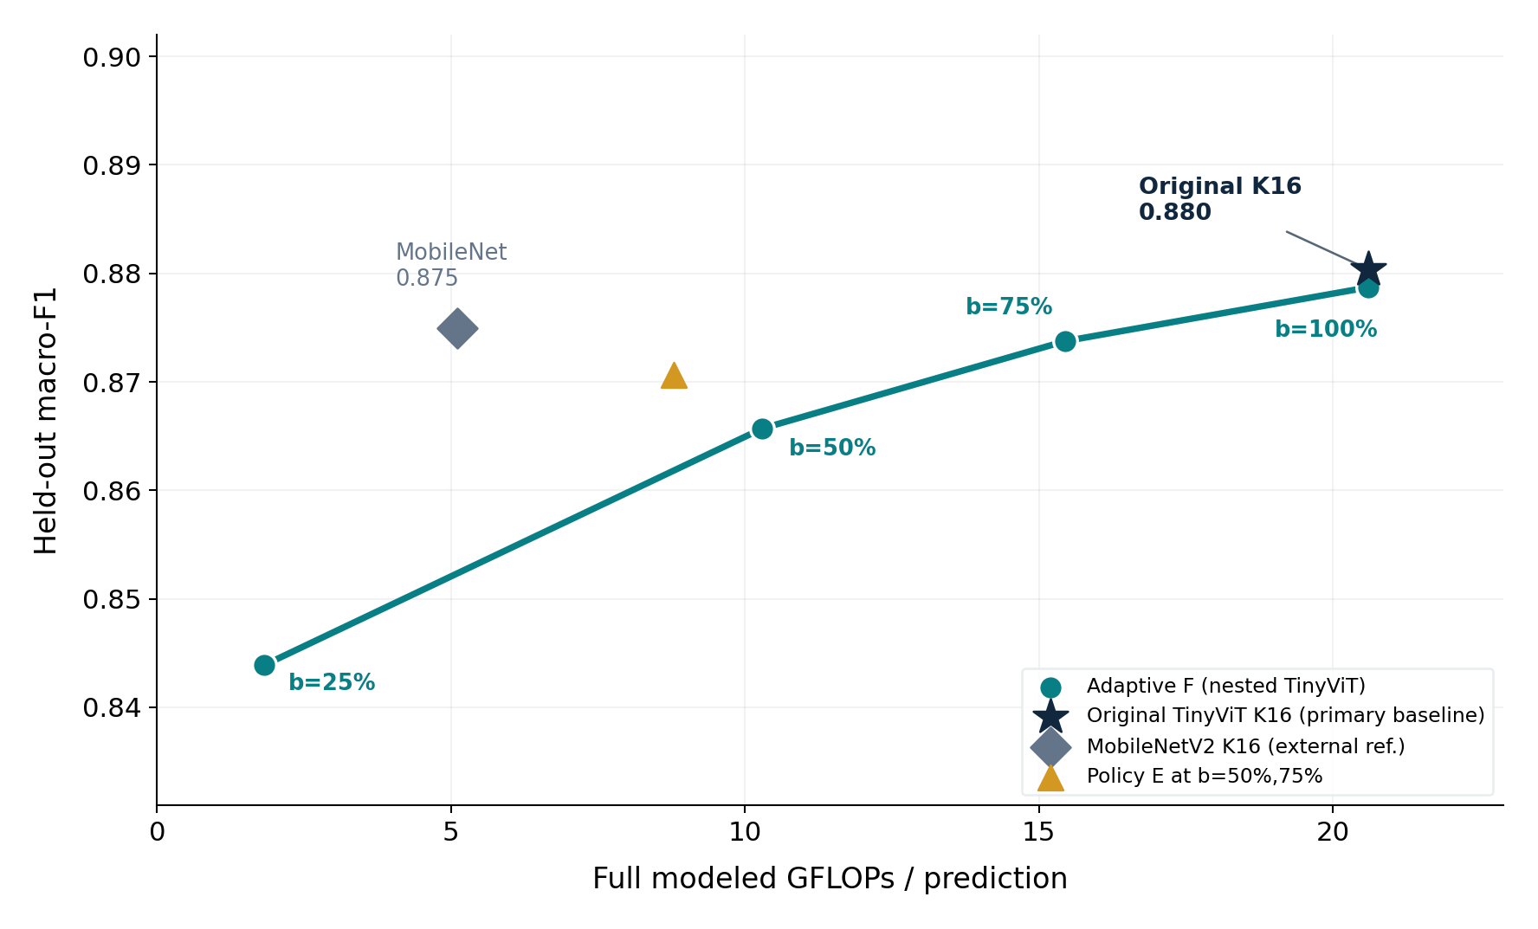
BIG DATA AT THE EDGE / ADAPTIVE POCUS
Test Set Results
265 unseen test units · all shown positive-budget points have 100% coverage
ONE CHECKPOINT
91% less
modeled FLOPs at b=25%
F1 0.844 vs original 0.880
AT FULL COMPUTE
0.879 vs 0.880
Nested vs original TinyViT
Same 20.60 GFLOPs; not
a formal equivalence result.
Original TinyViT K16 is the main architectural baseline; MobileNetV2 is a separate external reference.
08 / 11
Notes:
CHARALAMPOS · ~1:05
These are now the held-out results, not the validation plots. Original TinyViT K16 is our architectural baseline: 20.6 GFLOPs and macro-F1 0.880. The same nested checkpoint can select configurations across budgets: at a quarter budget, just 1.82 GFLOPs with F1 0.844; at full budget, F1 0.879 at the original 20.6 GFLOPs. This demonstrates meaningful model-work flexibility while preserving useful—but not identical—predictive quality. MobileNetV2 is still visible as an external reference and remains competitive, especially at lower computation. We do not claim statistical equivalence or universal superiority.
HANDOFF: Quality is one piece; what happens when the budget changes across requests?
Q&A / SCIENTIFIC CAVEATS (not spoken):
Original B vs nested F at b=1: paired macro-F1 difference F−B −0.0017 [−0.0221,+0.0150] (95% unadjusted bootstrap CI); not an equivalence test. At b=.25, F has ~91.2% fewer full FLOPs than original B's fixed configuration but lower F1. All plotted factorial served points were evaluated on the same 265 units. MobileNet A: 5.108G, F1 0.875. E at b=.5/.75: 8.782G, F1 0.871. The plot connects F's budget progression, NOT an asserted Pareto frontier.

Slide 10
BIG DATA AT THE EDGE / ADAPTIVE POCUS
Mixed Budgets
Each frozen test unit gets one simulated budget state · 53 units per state · 0% always defers
Predictions completed under the same resource schedule
CONTROLLER REALITY CHECK
A · MobileNetV2
80% (212/265)
E and F both cover 80%
20% (53/265)
Under this mixed schedule:
B · original TinyViT
E · 78.6% abnormal recall
C · nested static
60% (159/265)
8.00 GFLOPs / request
D · min-cost
80% (212/265)
F · 76.8% abnormal recall
9.63 GFLOPs / request
E · macro-F1 policy
80% (212/265)
F · recall policy
80% (212/265)
E used less compute with higher observed recall. F was not retuned on test.
Comparison is coverage, not evidence that F has higher accuracy on the same units.
MobileNetV2 (A) also reaches 80% coverage and uses fewer FLOPs than F.
09 / 11
Notes:
CHARALAMPOS · ~1:05
Now each of the 265 held-out units receives one of five simulated budget levels; 53 units per level. The original K16 TinyViT only fits the maximum state, so it covers 20% of requests. Our adaptive F serves every positive state and reaches 80% coverage, with 0% resource always deferred. This is the clearest system-level value of adaptation. But a key control is that MobileNetV2 also covers 80% with less computation than F: adaptation is not universally more efficient. Policies E and F also both cover 80%. On this test split, E had higher abnormal recall at lower average FLOPs. The frozen recall-priority policy F was therefore not automatically the best operating rule.
HANDOFF: We also measured actual CPU latency separately from FLOPs.
Q&A / SCIENTIFIC CAVEATS (not spoken):
Predictive metrics are on *completed* subsets, and B's 20% subset is not directly comparable with F's 80% subset. Correct paired F−B macro-F1 only uses the 53 units both serve: Δ−0.0276 [−0.086,0.000]; coverage diff +60pp. F−E mixed macro-F1 −0.0069 [−0.0258,0.0000], same 212 served. F never exceeds E abnormal recall at the four positive fixed states: identical at .25 and 1; less at .50/.75 with more GFLOPs. At .75, F has slightly higher macro-F1 than E. All intervals 95% unadjusted; 32 known dependency groups, 5000 bootstrap draws. No real live resource monitoring was tested.

Slide 11
BIG DATA AT THE EDGE / ADAPTIVE POCUS
CPU Latency
Validation benchmark · JPEG preprocessing + model inference · one laptop CPU, four threads
Median latency per sequence (ms)
Nested w0.5 K2
38 ms
MobileNetV2 K16
164 ms
Nested w1.0 K8
199 ms
Nested w1.0 K12
309 ms
Nested w1.0 K16
416 ms
Original TinyViT K16
419 ms
200 validation requests · 50 warmups · 5 repeats · AMD Ryzen AI 9 HX 370
No measured energy or battery performance; this is not an ambulance device.
10 / 11
Notes:
CHARALAMPOS · ~0:50
We also benchmarked real CPU latency rather than inferring it from FLOPs. On one AMD laptop CPU with four threads, the median JPEG-preprocessing-plus-inference latency ranged from 38 milliseconds for the smallest selected nested point to 416 milliseconds for full nested K16; original TinyViT took 419 milliseconds. This supports substantial runtime flexibility on this particular machine.
HANDOFF: To conclude, which findings did we establish?
Q&A / SCIENTIFIC CAVEATS (not spoken):
Official validation CPU job 200 requests, 50 warmups, five repeats, four Torch CPU threads; same job for nine preselected points. Results on AMD Ryzen AI 9 HX 370, not medical hardware. The latency bars are *practical JPEG pipeline median* (source benchmark.json practical_jpeg_pipeline[*].chunk4.median_latency_ms), NOT model-only latency. F007 cache diagnostic 50.5625 trillion full independent-request modeled FLOPs vs 29.3747 trillion incremental after within-clip reuse; cached/direct logits max difference 0.0. Official held-out resource results charge fresh-cache independent-request full FLOPs.

Slide 12
BIG DATA AT THE EDGE / ADAPTIVE POCUS
Conclusion and Reflection
The flexible model family works; selecting the best resource policy is a separate problem.
BUILT
OBSERVED
LEARNED
Shared-weight TinyViT
with 24 configurations
on a budget routing
Requests completed:
Original TinyVit → 20%
Adaptive → 80%
Recall-priority F did not
beat macro-F1 policy E
on held-out recall
MobileNetV2 also reaches 80% coverage · OpenPOCUS proxy ≠ clinical validation · FLOPs ≠ energy
11 / 11
Notes:
CHARALAMPOS · ~0:40
We built 24 shared-weight configurations and a deterministic resource-aware controller, then evaluated them on a held-out split. The adaptive family can operate over a wide compute range, and under our frozen mixed schedule it increased coverage from 20 percent for the original full-cost TinyViT to 80 percent. But MobileNetV2 also reached 80 percent with less computation, and our recall-priority policy did not beat a simpler alternative on held-out abnormal recall. So our contribution is demonstrated flexibility and transparent quality–coverage–compute trade-offs—not clinical superiority or ambulance readiness. Thank you.
Q&A / SCIENTIFIC CAVEATS (not spoken):
We cannot claim deployed or clinical performance. One test split, one selected seed/checkpoint, 32 known dependency groups, possible unidentified biological patients, device/label confounding, simulated FLOP capacity and one laptop CPU. No battery, thermal, network or actual medical edge device study. The model family can succeed even when controller rule F is not the best held-out choice.

Slide 13
BIG DATA AT THE EDGE • PROJECT PRESENTATION
Questions
&
Answers
Notes:
Questions & Answers. Backup slides follow; use only if relevant.

Slide 14
BACKUP / Q&A — NOT PART OF THE 10-MINUTE TALK
BACKUP • Why did policy E beat recall-priority F?
The controller optimizes VALIDATION recall; held-out rankings need not match.
At b=.50: F recall .8025 at 10.30 G | E .8148 at 8.78 G
At b=.75: F recall .8025 at 15.45 G | E .8148 at 8.78 G
Mixed: F recall .7679 at 9.63 G | E .7857 at 8.00 G
At b=.25 and b=1.00, F and E make identical predictions.
F has slightly higher macro-F1 at b=.75; no all-metric winner.
Frozen choices; no test-set retuning. 95% paired intervals are unadjusted.
BACKUP ONLY • DO NOT PRESENT UNLESS ASKED
Notes:
BACKUP / Q&A
Q: Didn't the recall-priority controller fail?
A: It executed exactly as designed from validation-derived measurements, but its ranking did not generalize optimally. E never had lower held-out abnormal recall while F spent equal or more FLOPs, although F's macro-F1 at b=.75 was slightly higher. The distinction is architecture adaptivity versus policy quality. This is an honest negative result, not evidence of a broken controller. We did not use held-out results to retune it.
Q: Why choose abnormal recall?
A: Missing abnormal scans was considered more consequential for the proxy setting, but these screening thresholds are research heuristics, NOT clinically validated decision thresholds.

Slide 15
BACKUP / Q&A — NOT PART OF THE 10-MINUTE TALK
BACKUP • What the held-out test establishes
One authorized, frozen evaluation • not new clinical evidence
265 held-out recording units (81 abnormal, 184 normal)
32 known dependency groups • 5,000 paired bootstrap draws
38 evaluation cells • 24 prespecified contrasts
Static TinyViT K16: 20% mixed-budget coverage
Adaptive TinyViT F: 80% coverage
MobileNetV2 A: also 80% coverage, at lower modeled cost
Quality only on served units; paired contrasts use shared served units.
Known-group protection ≠ known distinct patients; OpenPOCUS remains a technical proxy.
BACKUP ONLY • DO NOT PRESENT UNLESS ASKED
Notes:
BACKUP / Q&A
The held-out inference ran once after independent protocol review, D030 acceptance, receipt, and clean identity preflight. We did not choose thresholds or operating points using test predictions. 265 test alias rows correspond to 265 recording evaluation units; 32 known dependency groups support cluster-bootstrap, but not biological-patient independence. For b=0, all systems defer; b=.25/.5/.75/1 each has 53 held-out units in the heterogeneous schedule. F−B macro-F1 is paired on only 53 commonly served units. Descriptive F1 across B's 20% and F's 80% completion sets is not a fair matched ranking.

Slide 16
BACKUP / Q&A — NOT PART OF THE 10-MINUTE TALK
BACKUP • Why 16 spread frames?
16 was set before training • afterwards we tested whether it holds up
what we tried | result | source
All frames (median ~143 per video) vs 16 | no better: macro-F1 0.870 vs 0.874, at ~184 vs 20.6 GFLOPs | F004
Fewer frames: 1, 2, 4, 8, 12, 16 | 8 ≈ 16, 4 slightly lower, 1 and 2 clearly lower | F003
Spread vs consecutive (4 in a row vs 4 spread out) | spread better at 4 (p = 0.04); smaller at 8, none at 16 | F003
Coverage of the spread (first 25, 50, 75 or 100% of clip) | no measurable difference | F003
All on validation (254 units) • TinyViT trained at 16 frames, tested at fewer without retraining
BACKUP ONLY • DO NOT PRESENT UNLESS ASKED
Notes:
IF ASKED: "Why 16 frames?"
We started with 16 frames as a fixed choice before training. Then we tested it. Using every frame didn't score better but cost about nine times the compute, and 8 frames were almost as good as 16. So 16 is enough, and fewer frames give us room to save compute.
IF ASKED: "Why spread out?"
Spread frames cover more of the clip. With only 4 frames that measurably helped (p = 0.04). At 16 it no longer matters, so we kept spread frames everywhere because they're never worse.
Sources: experiments/F003/README.md (frame count, spread vs consecutive, coverage), experiments/F004/README.md (all frames). The repo does not record why 16 was chosen at the start (D024 only fixes K=16).

