Slide 1

CORTEX:A Context & Graph-Aware Multi-Agent Framework for Explainable Industrial IoT Threat Intelligence
Team members:
Lokpradeep B - AM.SC.U4CYS23018
Uday Ganesh B - AM.SC.U4CYS23019
Sri charan N - AM.SC.U4CYS23029
Akshara Kruti P - AM.SC.U4CYS23035
Guide Name:
Dr. Kurunandan Jain, Assistant Professor

Slide 2


CONTENTS
1. Overview
2. Introduction
3. Motivation
4. Problem Statement
5. Literature Review
6. Gap Analysis
7.Threat model
8. Methodology
9. Proposed Architecture
10. Novelty
11. Road Map
12.Progress so Far
13.Contributions
14. Conclusion
15. References
Page: 01

Slide 3
OVERVIEW
Contextual Intelligence Engine
Transforms multi-source telemetry into Dynamic Context Profiles using context extraction, operational modeling, contextual consistency reasoning, and confidence estimation.
Adaptive Graph Intelligence Engine
Builds temporal and provenance knowledge graphs for attack reconstruction and attack path prioritization.
Context & Graph-Aware Multi-Agent Intelligence
Uses CrewAI agents to fuse contextual and graph intelligence, perform explainable threat reasoning, and coordinate autonomous investigations.
Unified Threat Intelligence Dashboard
Visualizes threat intelligence, confidence, attack timelines, attack graphs, root cause analysis, recommendations, and analyst reports.
Page: 02

Slide 4
INTRODUCTION
Mission-Critical Industrial IoT: Manufacturing, energy, water treatment, and critical infrastructure increasingly rely on interconnected Industrial IoT systems.
Evolving Cyber Threats: Ransomware, insider threats, and multi-stage attacks exploit complex Industrial IoT environments.
Challenges in Current Defenses: Existing security solutions often analyze events independently, resulting in fragmented attack visibility, inaccurate attack reconstruction, and high false alerts.
Need for Intelligent Threat: Understanding Security analysts require accurate attack reconstruction, reliable threat confidence, and explainable decision support for timely incident response.
Research Focus: CORTEX proposes a contextual and graph-based framework to enhance Industrial IoT threat analysis using publicly available cybersecurity datasets.
Page: 03

Slide 5
MOTIVATION
Increasing cyber threats in Industrial IIoT demand intelligent and adaptive security solutions.
Existing approaches lack context awareness, attack explainability, and holistic threat understanding.
Security analysts require more than isolated alerts—they need actionable cyber intelligence.
Develop CORTEX, a context- and graph-aware framework for explainable Industrial IIoT threat intelligence.
Page: 04

Slide 6
PROBLEM STATEMENT
+
Ambiguous Attack Progression: Multi-stage Industrial IoT attacks propagate across devices and protocols, making the complete attack progression difficult to reconstruct accurately.
Insufficient Operational Context: Security events often lack sufficient operational and asset context, reducing the reliability of threat interpretation in mission-critical environments.
Uncertain Threat Prioritization: Security analysts struggle to distinguish critical attacks from low-impact events due to the absence of reliable confidence estimation during investigation.
Delayed Incident Investigation: Inaccurate attack reconstruction and fragmented evidence increase manual investigation time, delaying response in Industrial IoT environments.
Page: 05

Slide 7
LITERATURE REVIEW
Page: 06

Slide 8
PAPER 1: A Framework for Anomaly Classification in Industrial Internet of Things Systems
s
Context-Aware Anomaly Classification: Integrates IIoT telemetry with CPS context to improve anomaly detection and classification.
Context Processing Pipeline: Combines contextual features, feature engineering, and anomaly detection for accurate threat analysis.
Improved Threat Detection: Uses operational context to enhance detection of failures, cyber-attacks, and unseen anomalies.
Relation to Our Work: Inspires our Contextual Intelligence Engine, extending context-aware detection with dynamic contextual profiling, confidence estimation, and explainable threat intelligence.
Conference/Journal: Internet of Things (Elsevier, Q1)
Authors: Martha Rodríguez, Diana P. Tobón, Danny Múnera
Year: 2025
Page: 07

Slide 9
PAPER 2: Adaptive context-aware access control for IoT environments leveraging fog computing
s
Fog-Based Access Control: Proposes FB-ACAAC, a framework that dynamically adjusts IoT access policies based on contextual information.
Low-Latency Decisioning: Uses fog nodes alongside cloud to bring policy decisions closer to end nodes, reducing latency.
Context-Aware XACML: Extends XACML into a context-aware scheme, addressing its inability to handle changing environments and behaviors.
Relation to Our Work: Applies context-driven adaptation at the access-control layer; our engine applies the same principle upstream, at the consistency-reasoning layer that would feed such access decisions.
Conference/Journal: International Journal of Information Security (Springer)
Authors: Rudri Kalaria; A. S. M. Kayes; Wenny Rahayu; Eric Pardede; Ahmad Salehi Shahraki
Year: 2024
Page: 08

Slide 10
PAPER 3: BRIDG-ICS: AI-Grounded Knowledge Graphs for Intelligent Threat Analytics in Industry 5.0 CPS
s
AI-Grounded Knowledge Graphs: Integrates CVE, CWE, CAPEC, and MITRE ATT&CK into a unified Industrial Security Knowledge Graph.
Intelligent Threat Analytics: Uses SecureBERT, CySecBERT, and graph learning for threat enrichment and multi-stage attack reasoning.
Attack Path Analysis: Simulates attack propagation, reconstructs attack paths, and evaluates cyber resilience across IT–OT systems.
Relation to Our Work:While BRIDG-ICS provides AI-enriched Knowledge Graphs for Industrial CPS threat reasoning, CORTEX advances this with dynamic behavioral graph intelligence, confidence-aware evidence fusion, adaptive graph evolution, and explainable multi-stage attack reconstruction, enabling real-time, self-adaptive, and more accurate Industrial IIoT threat detection.
Conference/Journal: Cybersecurity (Springer Nature)
Authors: Padmeswari Nandiya, Ahmad Mohsin, Ahmed Ibrahim, Iqbal H. Sarker, Helge Janicke
Year: 2026
Page: 09

Slide 11
PAPER 4: A Multi-Agent System for Cybersecurity Threat Detection and Correlation Using Large Language Models
s
LLM-based Multi-Agent Detection: Uses specialized AI agents for email, log, and IP threat analysis, enabling intelligent and explainable cybersecurity workflows.
Cross-Domain Threat Correlation: Correlates outputs from multiple agents to identify multi-stage, multi-vector cyber attacks with reduced false positives.
Explainable AI Security: Integrates RAG, Chain-of-Thought prompting, and contextual recommendations to generate interpretable security decisions for analysts.
Relation to Our Work: Enhances multi-agent LLM reasoning with persistent behavioral context and graph-based threat memory, enabling continuous Industrial IIoT attack investigation beyond isolated agent decisions.
Conference/Journal: IEEE Access
Authors: Yasser Hmimou, Mohamed Tabaa, Azeddine Khiat, Zineb Hidila
Year: 2025
Page: 10

Slide 12
PAPER 5: Integrating Knowledge Graphs with Retrieval-Augmented Generation to Automate IoT Device Security Compliance
s
Knowledge Graph-driven Compliance: Represents NISTIR 8259A as a semantic knowledge graph for automated IoT security compliance reasoning.
Knowledge Graph + RAG: Integrates Neo4j, Cypher queries, vector retrieval, and LLMs to improve contextual retrieval and compliance validation.
Semantic Security Intelligence: Uses structured graph relationships to enhance query precision, contextual understanding, and explainable IoT security decisions.
Relation to Our Work:While this work automates IoT security compliance using Knowledge Graphs and RAG, CORTEX focuses on real-time cyber threat analysis, enabling behavioral attack investigation and proactive Industrial IIoT defense.
Conference/Journal: IEEE International Conference on Intelligence and Security Informatics (ISI)
Authors: Mohammad M. Islam, Lavanya Elluri, Karuna Pande Joshi
Year: 2025
Page: 11

Slide 13
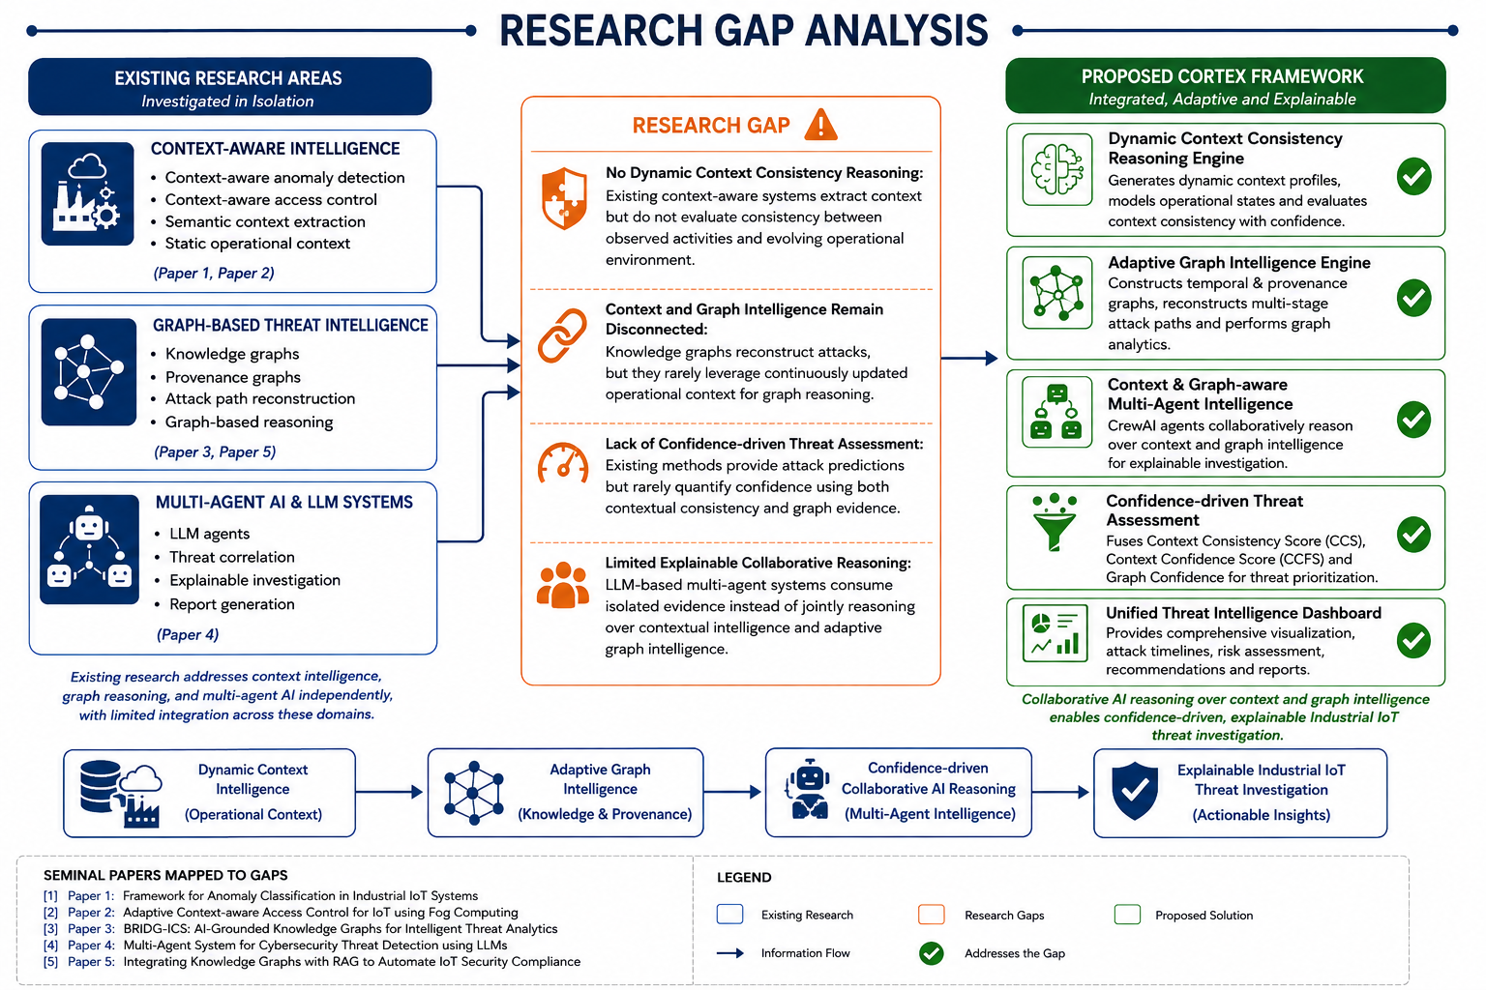
Page: 16
Page: 12

Slide 14
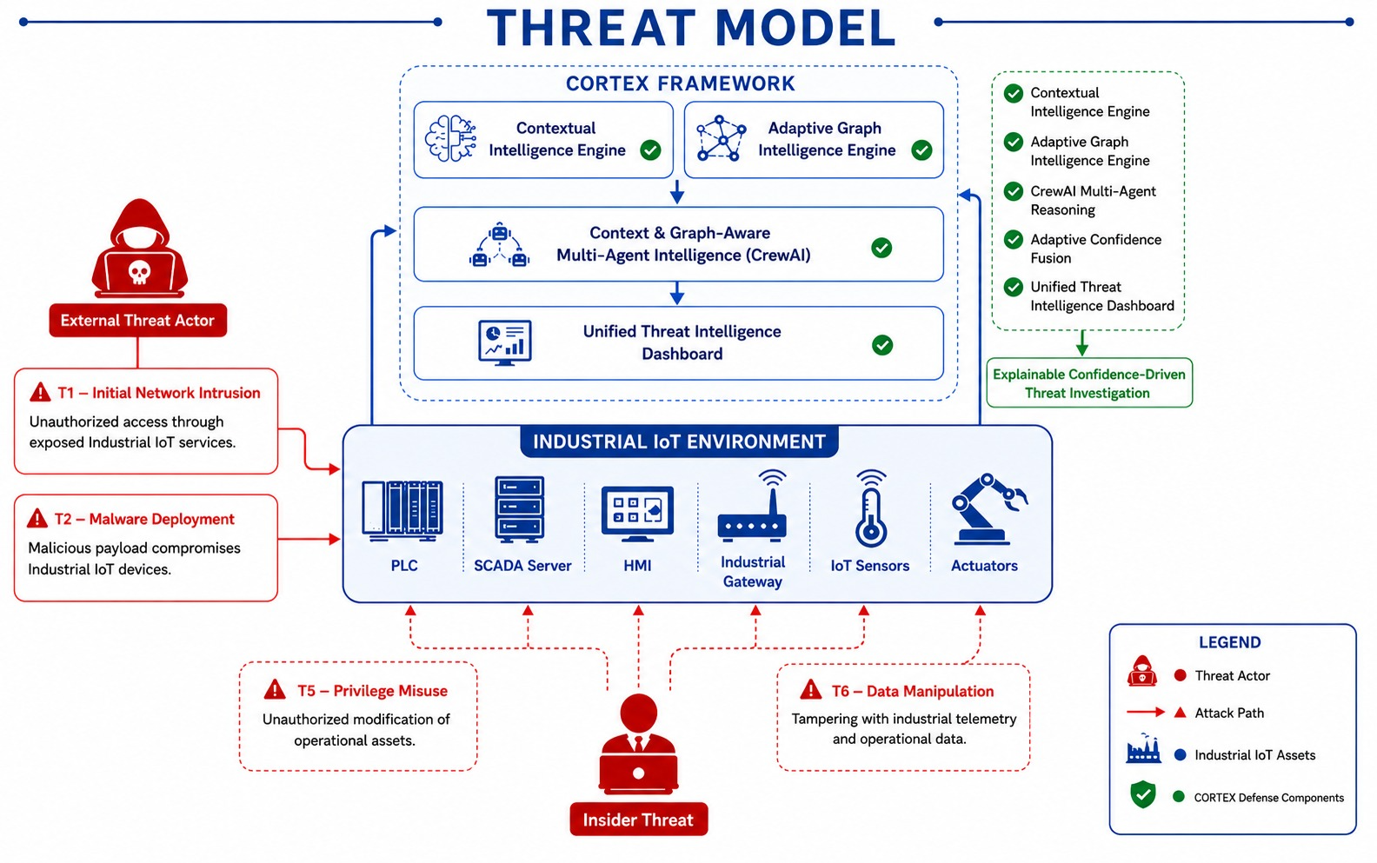
Page: 13

Slide 15
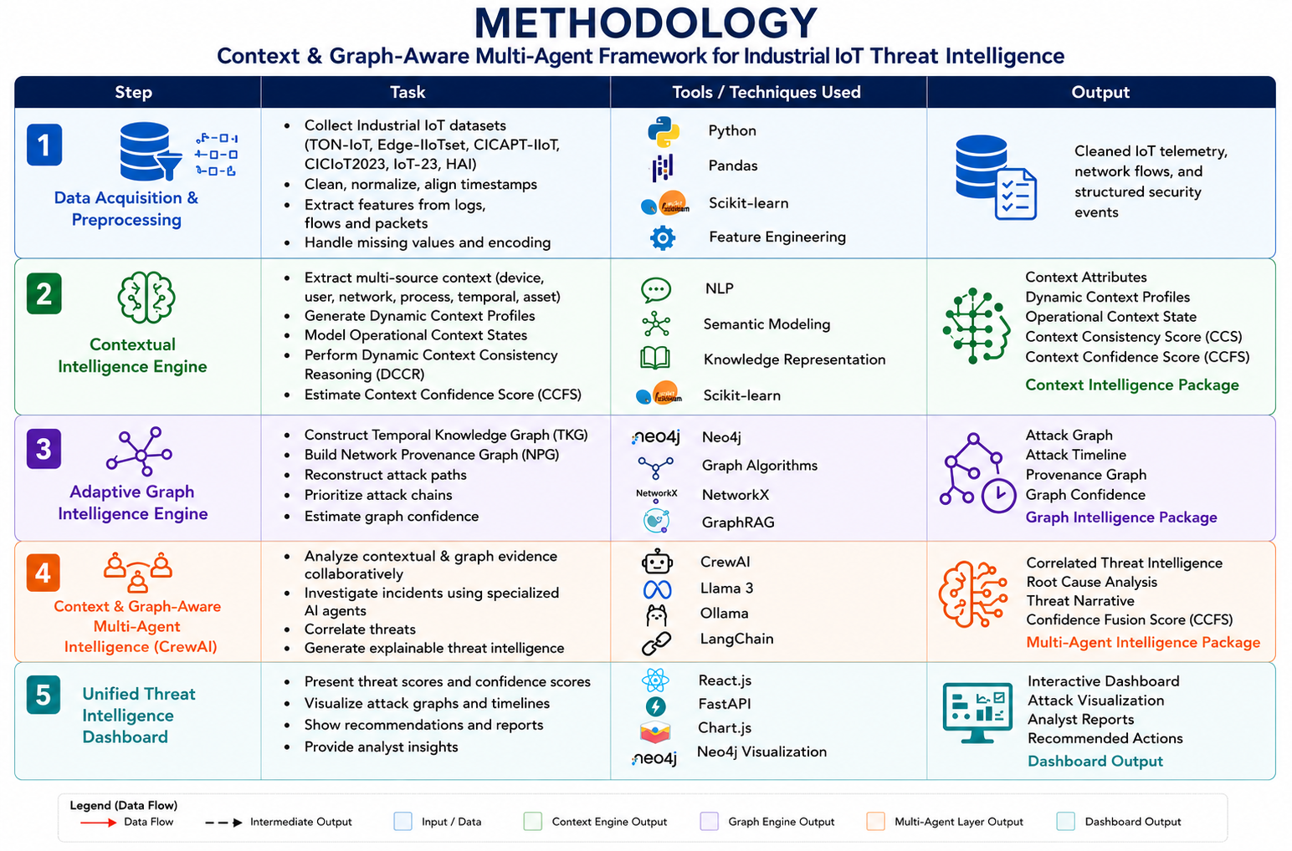
Page: 14

Slide 16
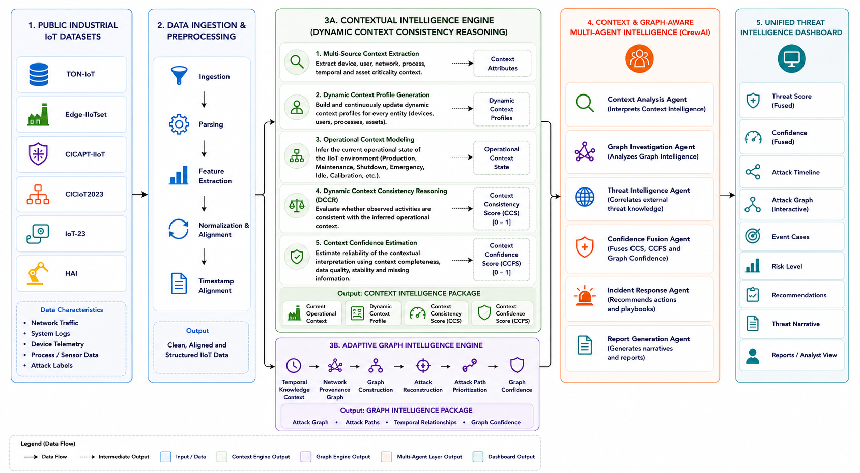
PROPOSED ARCHITECTURE
Page: 15

Slide 17
OVERALL NOVELTY
Dynamic Context Consistency Reasoning (DCCR) – Introduces a novel context reasoning framework that continuously generates Dynamic Context Profiles, models operational states, and evaluates context consistency with confidence-aware contextual intelligence.
Adaptive Graph-Based Attack Reconstruction – Dynamically reconstructs multi-stage attack paths using temporal relationships, provenance graphs, and graph intelligence to reveal attack progression.
Context & Graph-Aware Multi-Agent Intelligence – Employs specialized CrewAI agents to collaboratively fuse contextual and graph intelligence, enabling explainable threat investigation and autonomous cyber decision support.
Adaptive Confidence-Driven Threat Assessment – Produces trustworthy threat prioritization by confidence-aware fusion of contextual reasoning and graph intelligence for explainable Industrial IoT cyber threat assessment.
Page: 16

Slide 18
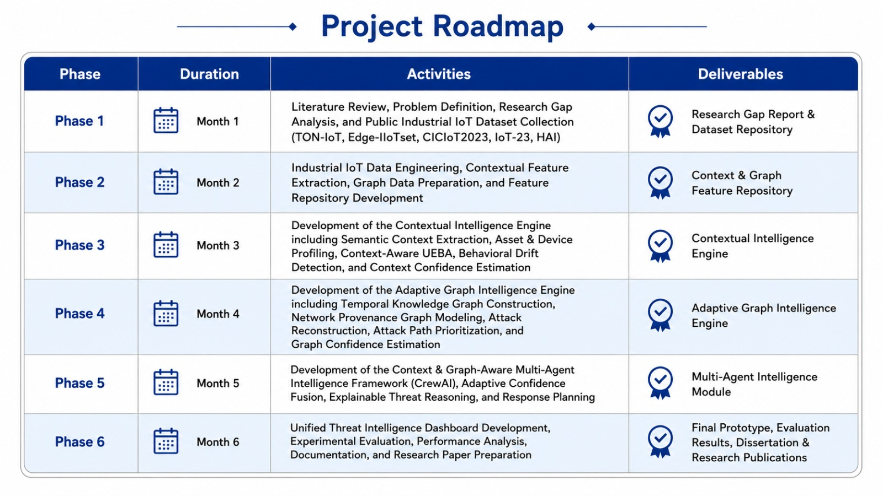
Page: 17

Slide 19
Progress So Far
Studied existing IIoT cybersecurity research .
Reviewed recent research papers and analyzed existing approaches.
Collected, cleaned, normalized, and prepared the TON-IoT dataset.
Identified, classified organized contextual Engine and Graph Engine features.
Designed contextual reasoning , Graph intelligence workflow and generation framework.
Designed Temporal graph and Network graph structure.
Finalized overall CORTEX framework and module interactions.
Implementation of core modules in progress
Page: 18

Slide 20
Overall Contributions
UDAY IIoT Dataset Collection & Preprocessing Contextual IntelligenceEngine Development Multi-Agent AI Integration Dashboard Development | AKSHARA Contextual IntelligenceEngine Development Context Acquisition & Operational Context Modeling Context Confidence Estimation & Validation Dynamic Contextual Reasoning
LOKPRADEEP Adaptive Graph Intelligence Development Temporal Knowledge Graph & Neo4j Attack Reconstruction & Graph Analytics Dashboard Development | CHARAN Network Provenance Graph Multi-Agent AI Development CrewAI & Llama 3 (Ollama) Integration Confidence Fusion & Threat Intelligence
Common Contributions Literature Survey & Methodology System Integration & Testing Performance Evaluation Experimental Analysis
Page: 19

Slide 21
CONCLUSION
Established the complete CORTEX architecture integrating Dynamic Context Consistency Reasoning, Adaptive Graph Intelligence, Context & Graph-Aware Multi-Agent Intelligence, and a Unified Threat Intelligence Dashboard.
Completed the project's research foundation, including literature review, research gap analysis, threat model, methodology, and architecture design aligned with recent Industrial IoT cybersecurity research.
Finalized the Industrial IoT data engineering workflow, contextual intelligence design, graph intelligence framework, and confidence-driven reasoning strategy for explainable threat investigation.
The project is ready to progress into module implementation, integration, experimental evaluation, and validation toward an explainable, confidence-driven Industrial IoT threat intelligence framework.
Page: 20

Slide 22
REFERENCES
[1] Nandiya, Padmeswari, Mohsin, Ahmad, Ibrahim, Ahmed, Sarker, Iqbal H., & Janicke, Helge. (2026). BRIDG-ICS: AI-Grounded Knowledge Graphs for Intelligent Threat Analytics in Industry 5.0 Cyber-Physical Systems. Cybersecurity (Springer). https://arxiv.org/abs/2512.12112
[2] Empl, Philip & Pernul, Günther. (2023). Digital-Twin-Based Security Analytics for the Internet of Things. Information, 14(2), 95. https://doi.org/10.3390/info14020095
[3] Shalaby, Ahmed, et al. (2025). Cybersecurity Threat Detection Based on a UEBA Framework Using Deep Autoencoders. arXiv Preprint. https://arxiv.org/abs/2505.11542
[4] Daniel, G., et al. (2025). Concept Drift Under Harsh Constraints: A Review of Potential Strategies for IoT Systems. IEEE Access. https://ieeexplore.ieee.org/document/11206138
[5] PROV-LLM: Advanced Persistent Threat Detection Based on Process Behavior Subgraphs Using Large Language Models. (2025). Proceedings of IEEE TrustCom 2025. https://doi.org/10.1109/Trustcom66490.2025.00113
Page: 21

Slide 23
REFERENCES
[6] Baha, Lina, Mammasse, Amine, & Saci, Oualid. (2025). A Hybrid GNN–LLM Framework for Correlating Cybersecurity Incidents. Proceedings of the 2025 IEEE International Conference on Theoretical and Applicative Aspects of Computer Science (ICTAACS). https://doi.org/10.1109/ICTAACS69003.2025.11399321
[7] Hmimou, Yasser, Tabaa, Mohamed, Khiat, Azeddine, & Hidila, Zineb. (2025). A Multi-Agent System for Cybersecurity Threat Detection and Correlation Using Large Language Models. IEEE Access, 13. https://doi.org/10.1109/ACCESS.2025.3602681
[8] Islam, Mohammad M., Elluri, Lavanya, & Joshi, Karuna Pande. (2025). Integrating Knowledge Graphs with Retrieval-Augmented Generation to Automate IoT Device Security Compliance. Proceedings of the 2025 IEEE International Conference on IntelligenceandSecurityInformatics(ISI). https://doi.org/10.1109/ISI65680.2025.11201135
Page: 22

Slide 24


