Slide 1

CORTEX: A Cognitive Cyber Intelligence Architecture for Mission-Critical Smart-City IoT Defense
Team members:
Lokpradeep B - AM.SC.U4CYS23018 Uday Ganesh B - AM.SC.U4CYS23019 Sri charan N - AM.SC.U4CYS23029
Akshara Kruti P - AM.SC.U4CYS23035
Guide Name:
Dr. Kurunandan Jain, Assistant Professor

Slide 2

CONTENTS
Overview
Introduction
Motivation
Problem Statement
Project Vision
Literature Review
Gap Analysis
Threat model
Methodology
Challenges
Proposed Architecture
Novelty
Road Map
Conclusion
References
Page: 01

Slide 3
OVERVIEW
Develop a cognitive cyber defense Architecture for Mission-Critical Smart-City IoT.
Integrate Semantic Intelligence, Behavioral Analytics, Graph Intelligence, and Multi-Agent AI.
Introduce a Confidence Fusion Engine for reliable threat assessment. Enable Context-Aware Autonomous Response and Explainable Threat Intelligence.
Improve accuracy, context awareness, explainability, and cyber resilience.
Page: 02

Slide 4

INTRODUCTION
Smart-city IoT relies on interconnected devices generating massive telemetry.
Smart Hospitals Smart Transportation Smart Grid
Industrial IoT Intelligent Surveillance
Emergency Response Networks
The dynamic and distributed nature of these cyber-physical systems expands the attack surface, making them vulnerable to sophisticated and evolving cyber threats. Conventional security solutions often analyze telemetry from individual sources in isolation, limiting their ability to provide comprehensive situational awareness and timely threat response.
Project Goal: Develop an integrated cognitive cyber intelligence architecture capable of transforming raw IoT telemetry into actionable cyber intelligence for autonomous smart-city defence.
Page: 03

Slide 5
MOTIVATION
Current IoT Security Systems Are Fragmented
Existing solutions typically perform only one aspect of cyber defense. Examples:
Intrusion Detection Systems UEBA
Knowledge Graph Analytics
AI-Based Threat Detection Digital Forensics Autonomous Response
Each module independently analyzes telemetry without sharing semantic intelligence. This leads to
Duplicate processing High false positives Poor explainability
Limited attack correlation Delayed incident response
Instead of building another detection system, we propose an integrated cognitive architecture where every intelligence layer enriches the knowledge before passing it to the next layer.
Page: 04

Slide 6
PROBLEM STATEMENT
+
Mission-critical Smart-City IoT environments continuously generate heterogeneous telemetry from thousands of interconnected cyber-physical devices.
Existing cybersecurity systems suffer from several fundamental limitations: Raw telemetry is repeatedly processed by independent security modules. Lack of semantic cyber knowledge generation.
Poor contextual understanding of device behavior.
High false positive rates due to dynamic IoT environments. Limited attack reconstruction and graph reasoning.
AI systems rely primarily on isolated alerts rather than integrated intelligence.
Existing autonomous response mechanisms are largely rule-based and lack contextual reasoning.
Page: 05

Slide 7
PROJECT VISION
+
Towards a Cognitive Cyber Intelligence Architecture
Current Smart-City cybersecurity solutions operate as isolated systems, where intrusion detection, behavioral analytics, graph reasoning, and AI-assisted decision making are performed independently.
Our vision is to develop CORTEX, a unified Cognitive Cyber Intelligence Architecture that progressively transforms raw IoT telemetry into intelligent, explainable, and actionable cyber intelligence.
Instead of repeatedly processing the same telemetry, each research engine enriches the information and passes it to the next layer, creating a continuous intelligence pipeline for mission-critical Smart-City IoT defense.
One Architecture. Four Independent Research Engines. One Unified Cyber Intelligence Pipeline.
Page: 06

Slide 8
LITERATURE REVIEW
Page: 07

Slide 9
PAPER 1: Digital-Twin-Based Security Analytics for the Internet of Things
s
Proposed a Digital Twin-based security analytics framework for IoT.
Enabled cybersecurity knowledge generation and sharing across the IoT lifecycle.
Improved lifecycle-aware security monitoring using Digital Twins.
Relevance to CORTEX:
No semantic intelligence layer; we introduce the Cognitive Security Cortex (CSC).
No Cyber Knowledge Objects, Threat DNA, or Dynamic Trust; we generate AI-ready cyber knowledge.
No behavioral identity or attacker intent modeling; we enrich telemetry before graph reasoning.
Conference/Journal: Information (MDPI) Authors:Philip Empl, Günther Pernul Year: 2023
Citations: 70+ (Google Scholar, 2025)
Page: 08

Slide 10
PAPER 2: Cybersecurity Threat Detection Based on a UEBA Framework Using Deep Autoencoders
s
Proposed a Deep Autoencoder-based UEBA framework for threat detection.
Used behavioral anomaly detection to identify malicious activities.
Generated explainable anomaly predictions for security analysts.
Relevance to CORTEX:
No operational context awareness; we incorporate maintenance, firmware, and device roles.
No context-aware anomaly validation; we introduce
Context-Aware Adaptive Behavioral Intelligence (CABI).
Limited analyst reasoning; we provide X-UEBA with contextual explanations and confidence scores.
Conference/Journal: arXiv Preprint Authors:Ahmed Shalaby et al.
Year: 2025
Page: 09

Slide 11
PAPER 3: Concept Drift Under Harsh Constraints: A Review of Potential Strategies for IoT Systems
s
Reviewed concept drift challenges in IoT systems. Summarized drift adaptation strategies for streaming IoT data.
Highlighted the need for context-aware drift adaptation.
Relevance to CORTEX:
No UEBA-based contextual decision framework; we introduce CABI for context-aware decisions.
No baseline adaptation using operational context; we combine ADWIN with contextual verification.
No drift explanation for analysts; we generate explainable drift decisions with confidence.
Conference/Journal: IEEE Access
Authors: Daniel G. et al.
Year: 2025

Slide 12
PAPER 4: BRIDG-ICS: AI-Grounded Knowledge Graphs for Intelligent Threat Analytics in Industry 5.0 CPS
s
Developed an AI-grounded Knowledge Graph for CPS threat analytics.
Integrated LLMs with Knowledge Graphs for threat reasoning.
Performed attack path analysis for Industry 5.0 CPS.
Relevance to CORTEX:
Lacks IoT-aware temporal and provenance graph modeling .
No confidence-aware graph reasoning; we add Graph Confidence Scoring for reliable attack inference.
No graph-aware collaborative decision making; we
extend it with Graph-Aware Multi-Agent AI for Smart-City IoT.
Conference/Journal: Cybersecurity(Springer)
/ arXiv Preprint
Authors:Padmeswari Nandiya et al.
Year: 2026

Slide 13
PAPER 5: A Multi-Agent System for Cybersecurity Threat Detection and Correlation Using Large Language Models
s
Proposed an LLM-based multi-agent cybersecurity detection framework.
Correlated email, log, and IP threats across multiple domains.
Generated contextual threat recommendations using LLMs.
Relevance to CORTEX:
No graph-based threat reasoning; we introduce Graph-Aware Alert Correlation.
No Temporal Knowledge or Provenance Graphs; we integrate both for attack correlation.
No Smart-City IoT context or confidence scoring; we add IoT-aware reasoning with Graph Confidence Scoring.
Conference/Journal: IEEE Access Authors:Yasser Hmimou et al.
Year: 2025
Citations: 14 (IEEE Xplore)

Slide 14
PAPER 6: PROV-LLM: Advanced Persistent Threat Detection Based on Process Behavior Subgraphs Using Large Language Models
s
Proposed LLM-based APT detection using process provenance subgraphs.
Modeled process behavior provenance for attack analysis.
Generated LLM-assisted explanations for detected threats.
Relevance to CORTEX:
Limited to process provenance; we model Temporal & Network Provenance Graphs for IoT.
No collaborative multi-agent reasoning; we introduce a Graph-Aware Multi-Agent Decision Engine.
No graph confidence or attack prioritization; we provide Graph Confidence Scoring and Adaptive Attack Path Prioritization.
Conference/Journal: IEEE TrustCom Authors:Canhua Chen et al.
Year: 2025

Slide 15
PAPER 7: Integrating Knowledge Graphs with Retrieval-Augmented Generation to Automate IoT Device Security Compliance
s
Developed a Knowledge Graph + RAG framework for IoT security compliance.
Automated NISTIR 8259A compliance using Neo4j and LLMs.
Improved security knowledge retrieval through graph-based querying.
Relevance to CORTEX:
Limited to IoT compliance; we enable real-time threat reasoning.
No incident response or attack detection; we introduce Graph-Aware AI Agents.
No Temporal or Provenance Graphs; we integrate both for attack reconstruction.
Conference/Journal: IEEE ISI Authors:Mohammad M. Islam et al. Year: 2025

Slide 16
PAPER 8: A Hybrid GNN–LLM Framework for Correlating Cybersecurity Incidents
s
Proposed a hybrid GNN–LLM framework for IDS alert correlation.
Used GraphSAGE to identify correlated security incidents.
Generated RAG-based explanations and response recommendations.
Relevance to CORTEX:
Limited to IDS alert correlation; we perform multi-stage attack reconstruction.
No confidence-based decision fusion; we introduce a Confidence Fusion Engine.
No adaptive mitigation or threat narratives; we
generate context-aware responses and explainable attack narratives.
Conference/Journal: IEEE ICTAACS
Authors: Lina Baha et al.
Year: 2025

Slide 17
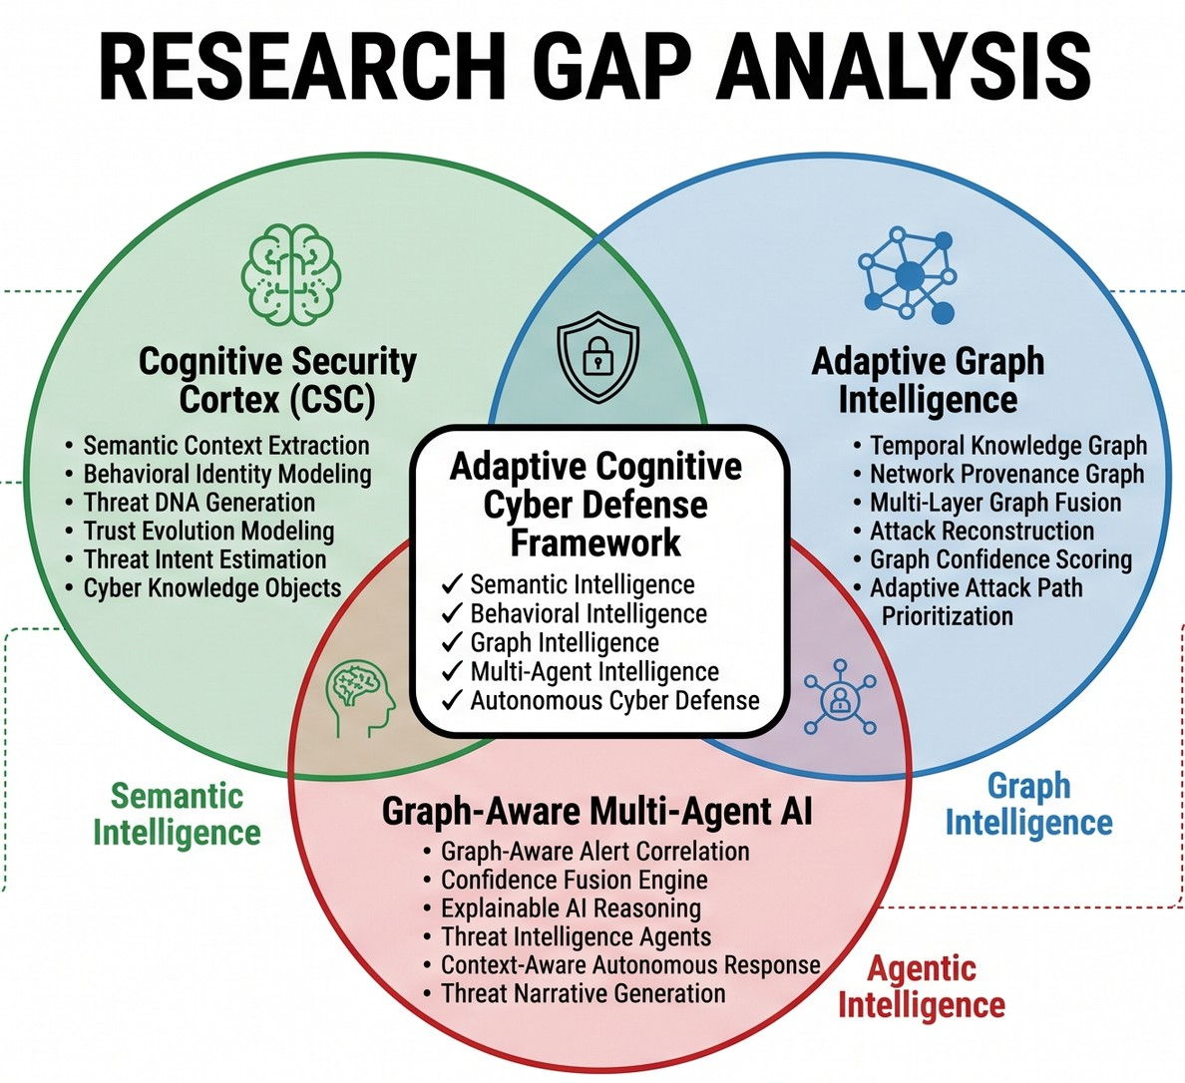

Slide 18

THREAT MODEL
Protected Environment Smart Hospitals Smart Grid
Smart Traffic Management
Water Treatment Plants Industrial IoT
Emergency Response Systems
Smart Surveillance
Attack Objectives Compromise IoT Devices Disrupt Critical Services Steal Sensitive Information
Perform Lateral Movement
Cause Mission-Critical Infrastructure Failure
Threat Actors
Advanced Persistent Threat (APT) Groups
Nation-State Adversaries
Insider Threats Ransomware Operators Cybercriminal Organizations
Assumptions
Large-scale heterogeneous IoT deployment
Continuous telemetry generation
Dynamic network topology Multiple communication protocols Sophisticated multi-stage cyber attacks

Slide 19
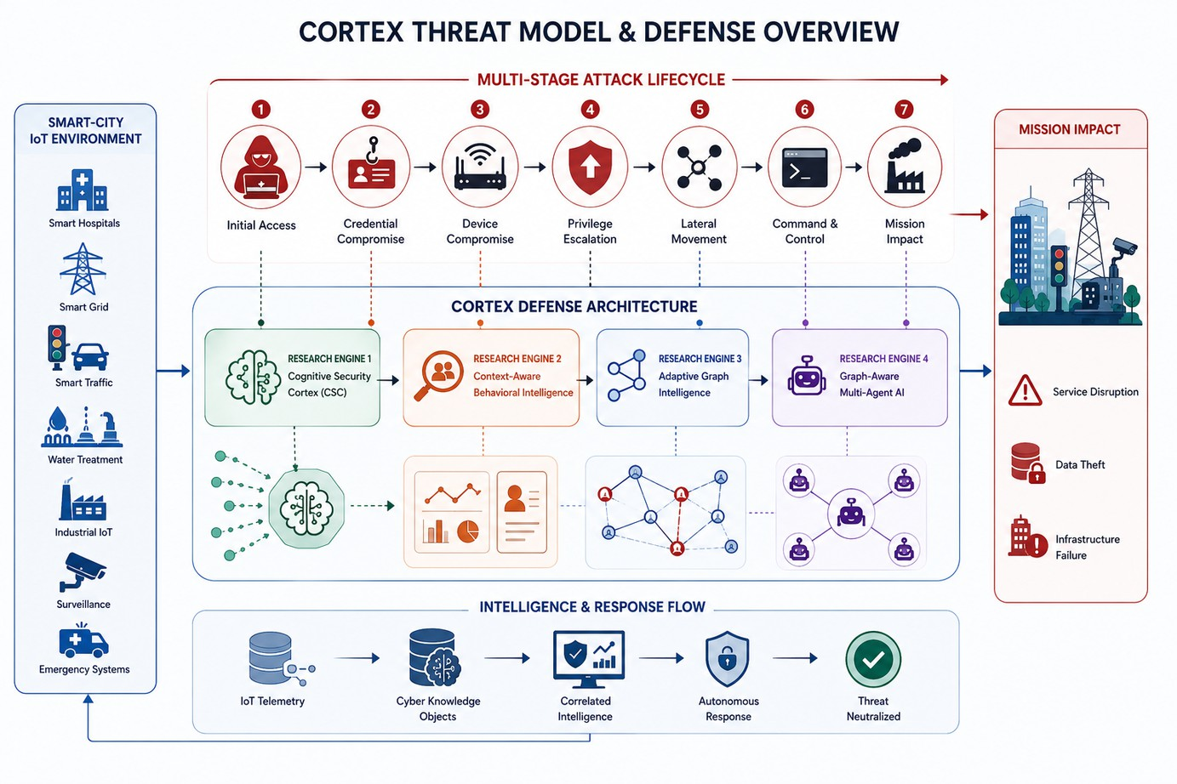
THREAT MODEL

Slide 20

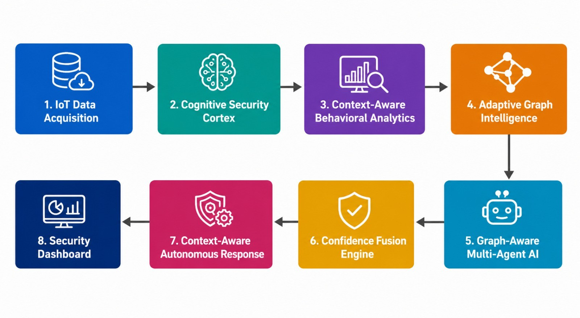
Methodology

Slide 21
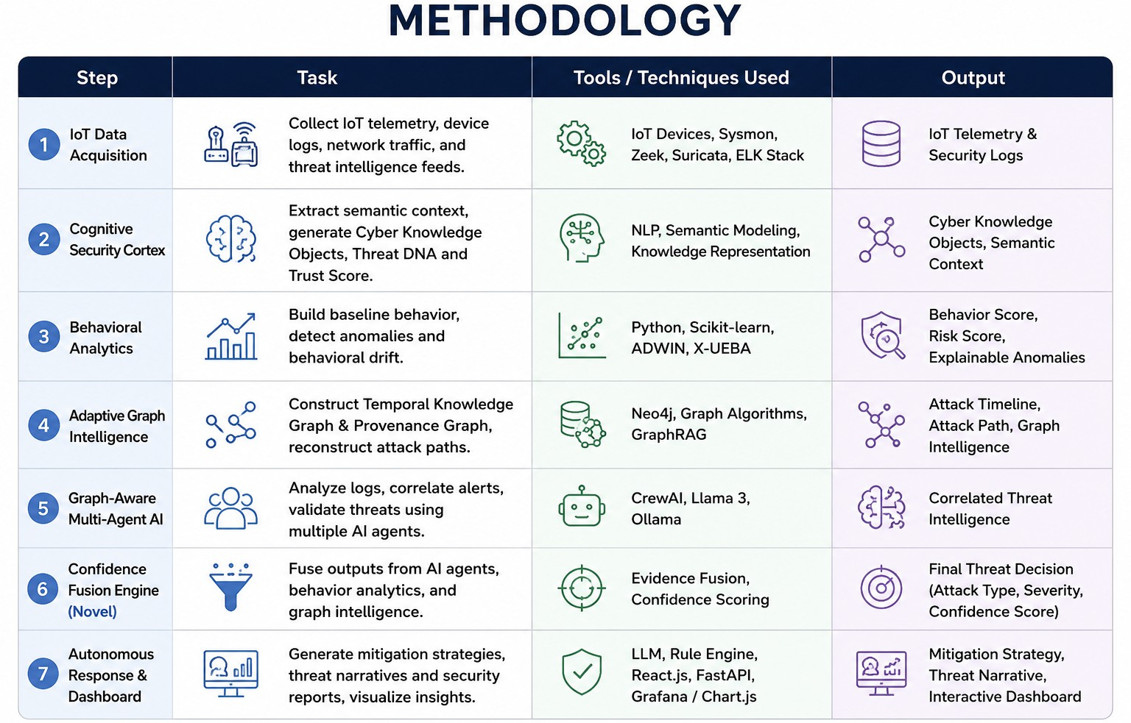

Slide 22
CHALLENGES
IoT Data Acquisition: Real-Time Data Collection, Device Heterogeneity, Multi-Source Data Fusion Cognitive Security Cortex (CSC): Semantic Threat Understanding, Dynamic Threat DNA, Intent Estimation, Adaptive Trust Modeling
CABI & X-UEBA: Behavioral Profiling, Context-Aware Anomaly Detection, Behavioral Drift Adaptation Adaptive Graph Intelligence: Dynamic Attack Knowledge Graphs, Attack Provenance Tracking, Multi-Layer Graph Fusion, Attack Path Reconstruction
Graph-Aware Multi-Agent AI: Collaborative Agent Reasoning, Context Sharing, Confidence-Based Decision Fusion, Explainable AI Reasoning
Autonomous Response: Context-Aware Mitigation, Response Orchestration, Threat Narrative Generation, Explainable Response Planning
Cross-Layer Integration: End-to-End Intelligence Integration, Context Continuity, Unified Confidence Propagation, Real-Time Decision Intelligence, Smart-City Scalability

Slide 23
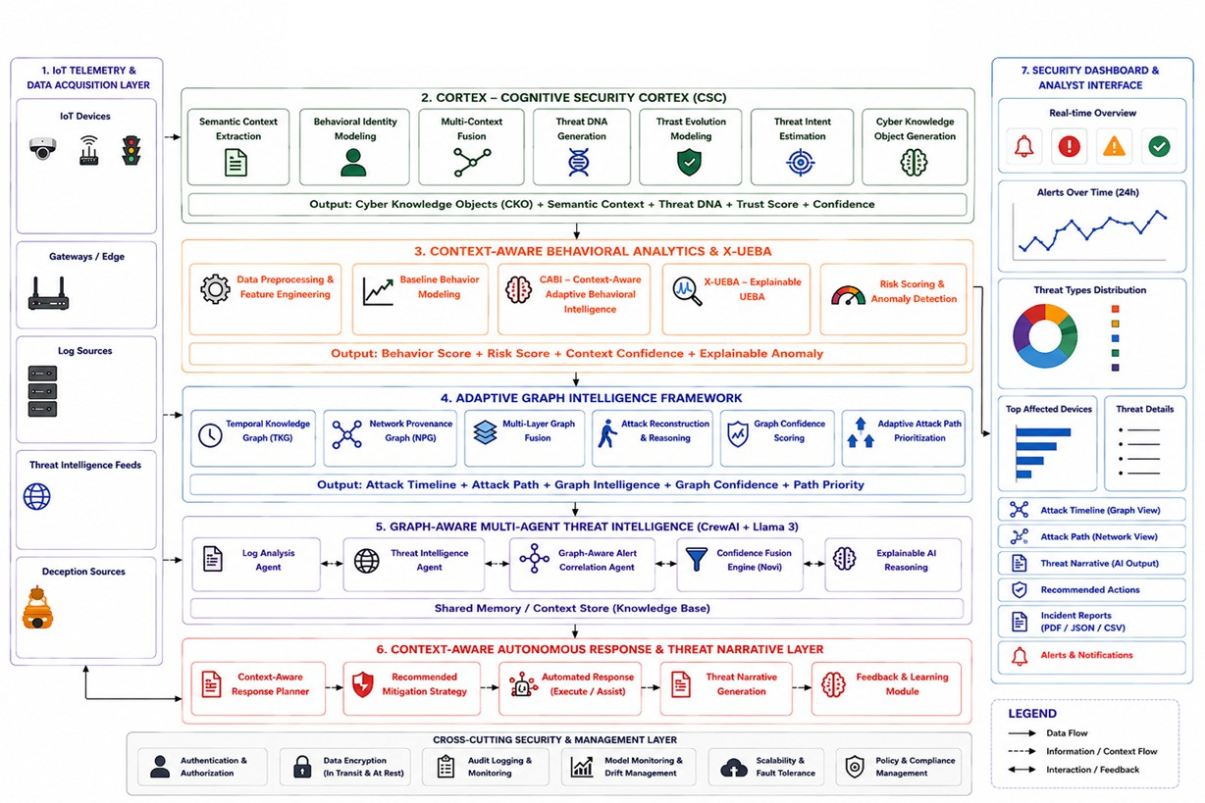
PROPOSED ARCHITECTURE
CORTEX: A Cognitive Cyber Intelligence Architecture for Mission-Critical Smart-City IoT Defense

Slide 24
OVERALL NOVELTY
Our Research Contributions
🔹 Adaptive Cognitive Security Cortex (CSC)
Generates Cyber Knowledge Objects, Threat DNA, and Trust Scores to enrich IoT security context.
🔹 Context-Aware Behavioral Analytics
Detects behavioral drift and generates explainable risk scores using adaptive behavioral intelligence.
🔹 Adaptive Graph Intelligence
Combines Temporal Knowledge Graph and Network Provenance Graph to reconstruct attack paths and detect lateral movement.
🔹 Graph-Aware Multi-Agent AI
AI agents collaborate using graph intelligence and behavioral context, not just raw logs.
🔹 Confidence Fusion Engine
Fuses evidence from multiple intelligent modules to produce a reliable attack type, severity, and confidence score.
🔹 Context-Aware Autonomous Response
Generates adaptive mitigation strategies and explainable threat narratives based on attack context and device criticality.

Slide 25
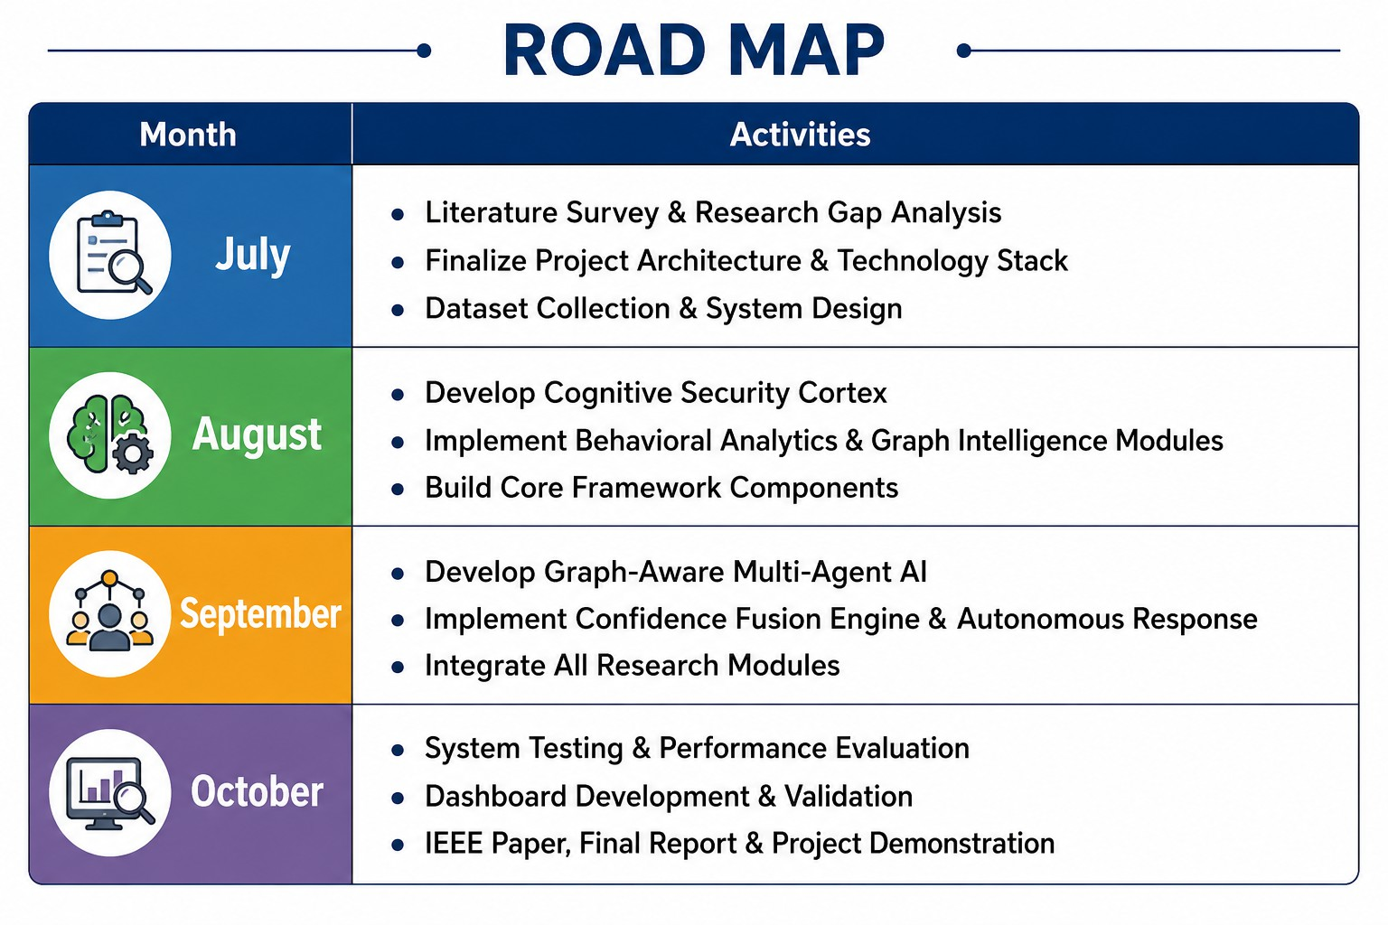

Slide 26
CONCLUSION
We propose CORTEX, an adaptive cognitive cyber defense architecture for Mission-Critical Smart-City IoT environments.
Our framework integrates Semantic Intelligence, Behavioral Analytics, Graph Intelligence, and Multi-Agent AI into a unified cybersecurity platform.
We aim to develop Graph-Aware Threat Intelligence, a Confidence Fusion Engine, and Context-Aware Autonomous Response for intelligent threat detection and incident response.
The proposed research seeks to improve threat detection accuracy, reduce false positives, and provide explainable AI-driven cybersecurity for next-generation smart cities.

Slide 27
REFERENCES
[1] Nandiya, Padmeswari, Mohsin, Ahmad, Ibrahim, Ahmed, Sarker, Iqbal H., & Janicke, Helge. (2026). BRIDG-ICS: AI-Grounded Knowledge Graphs for Intelligent Threat Analytics in Industry
5.0 Cyber-Physical Systems. Cybersecurity (Springer). https://arxiv.org/abs/2512.12112
Empl, Philip & Pernul, Günther. (2023). Digital-Twin-Based Security Analytics for the Internet of Things. Information, 14(2), 95. https://doi.org/10.3390/info14020095
Shalaby, Ahmed, et al. (2025). Cybersecurity Threat Detection Based on a UEBA Framework Using Deep Autoencoders. arXiv Preprint. https://arxiv.org/abs/2505.11542
Daniel, G., et al. (2025). Concept Drift Under Harsh Constraints: A Review of Potential Strategies for IoT Systems. IEEE Access. https://ieeexplore.ieee.org/document/11206138
PROV-LLM: Advanced Persistent Threat Detection Based on Process Behavior Subgraphs Using Large Language Models. (2025). Proceedings of IEEE TrustCom 2025. https://doi.org/10.1109/Trustcom66490.2025.00113

Slide 28
REFERENCES
Baha, Lina, Mammasse, Amine, & Saci, Oualid. (2025). A Hybrid GNN–LLM Framework for Correlating Cybersecurity Incidents. Proceedings of the 2025 IEEE International Conference on Theoretical and Applicative Aspects of Computer Science (ICTAACS). https://doi.org/10.1109/ICTAACS69003.2025.11399321
Hmimou, Yasser, Tabaa, Mohamed, Khiat, Azeddine, & Hidila, Zineb. (2025). A Multi-Agent System for Cybersecurity Threat Detection and Correlation Using Large Language Models. IEEE Access, 13. https://doi.org/10.1109/ACCESS.2025.3602681
Islam, Mohammad M., Elluri, Lavanya, & Joshi, Karuna Pande. (2025). Integrating Knowledge Graphs with Retrieval-Augmented Generation to Automate IoT Device Security Compliance. Proceedings of the 2025 IEEE International Conference on IntelligenceandSecurityInformatics(ISI). https://doi.org/10.1109/ISI65680.2025.11201135

Slide 29



