Slide 1

CORTEX:A Context & Graph-Aware Multi-Agent Framework for Explainable Industrial IoT Threat Intelligence
Team members:
Lokpradeep B - AM.SC.U4CYS23018
Uday Ganesh B - AM.SC.U4CYS23019
Sri charan N - AM.SC.U4CYS23029
Akshara Kruti P - AM.SC.U4CYS23035
Guide Name:
Dr. Kurunandan Jain, Assistant Professor

Slide 2


CONTENTS
1. Overview
2. Introduction
3. Motivation
4. Problem Statement
5. Literature Review
6. Gap Analysis
7.Threat model
8. Methodology
9. Proposed Architecture
10. Novelty
11. Road Map
12. Conclusion
13. References
Page: 01

Slide 3
OVERVIEW
Contextual Intelligence Engine Performs semantic analysis, adaptive UEBA, behavioral drift detection, and contextual risk assessment.
Adaptive Graph Intelligence Engine Constructs temporal and provenance graphs for attack reconstruction and attack path prioritization.
Context & Graph-Aware Multi-Agent Intelligence Uses CrewAI agents to correlate contextual and graph intelligence, perform confidence fusion, and generate explainable threat decisions.
Unified Threat Intelligence Dashboard Visualizes threat scores, attack timelines, attack graphs, root cause analysis, recommendations, and analyst reports.
Page: 02

Slide 4
INTRODUCTION
Mission-Critical Industrial IoT: Manufacturing, energy, water treatment, and critical infrastructure increasingly rely on interconnected Industrial IoT systems.
Evolving Cyber Threats: Advanced Persistent Threats (APTs), ransomware, insider threats, and multi-stage attacks exploit complex Industrial IoT environments.
Challenges in Current Defenses: Existing security solutions often analyze events independently, resulting in fragmented attack visibility, inaccurate attack reconstruction, and high false alerts.
Need for Intelligent Threat: Understanding Security analysts require accurate attack reconstruction, reliable threat confidence, and explainable decision support for timely incident response.
Research Focus: CORTEX proposes a behavioral and graph-based framework to enhance Industrial IoT threat analysis using publicly available cybersecurity datasets.
Page: 03

Slide 5
MOTIVATION
Complex Attack Progression: Multi-stage cyberattacks in Industrial IoT environments are difficult to detect, correlate, and reconstruct accurately.
Fragmented Security Analytics: Existing behavioral, graph-based, and intrusion detection solutions provide isolated insights rather than unified threat understanding.
Unreliable Security Decisions: High false alerts and incomplete attack visibility increase investigation time and reduce analyst confidence.
Need for Unified Threat Intelligence Mission-critical Industrial IoT environments require explainable, confidence-driven threat analysis and decision support.
Page: 04

Slide 6
PROBLEM STATEMENT
+
Ambiguous Attack Progression: Multi-stage Industrial IoT attacks propagate across devices and protocols, making the complete attack progression difficult to reconstruct accurately.
Insufficient Operational Context: Security events often lack sufficient operational and asset context, reducing the reliability of threat interpretation in mission-critical environments.
Uncertain Threat Prioritization: Security analysts struggle to distinguish critical attacks from low-impact events due to the absence of reliable confidence estimation during investigation.
Delayed Incident Investigation: Inaccurate attack reconstruction and fragmented evidence increase manual investigation time, delaying response in Industrial IoT environments.
Page: 05

Slide 7
LITERATURE REVIEW
Page: 06

Slide 8
PAPER 1: Digital-Twin-Based Security Analytics for the Internet of Things
s
Digital Twin Security Analytics: Integrates digital twins with security analytics to generate cybersecurity knowledge from heterogeneous IoT data.
Semantic Context Modeling: Enriches raw telemetry with asset semantics, lifecycle information, historical behavior, and operational context for better threat understanding.
Cybersecurity Knowledge Sharing: Uses digital twins as a knowledge hub to securely share threat intelligence among Industrial IoT lifecycle participants.
Relation to Our Work: Extends Digital Twin–based security analytics by incorporating behavior-driven threat investigation, enabling richer attack context and proactive analysis of Industrial IIoT security events.
Conference/Journal: Information (MDPI, Q2)
Authors: Philip Empl; Günther Pernul
Year: 2023
Impact Factor: 3.1
Google H5 Index: 72
Page: 07

Slide 9
PAPER 2: Concept Drift Under Harsh Constraints: A Review of Potential Strategies for IoT Systems
s
Concept Drift Detection: Detects changes in IoT data patterns caused by evolving system behavior.
Autonomous Adaptation: Enables automatic model updates without continuous human intervention.
Resource-Efficient Learning: Supports lightweight drift handling for resource-constrained IoT devices.
Relation to Our Work: Applies autonomous drift adaptation concepts to Industrial IIoT threat monitoring, enabling security models to continuously adapt to evolving attack behaviors rather than only changing data distributions.
Conference/Journal: IEEE Access
Authors: Ask Espensønn Øren; Nina Kuna Peuker; Akira-Miranda Adeyomi Adeniran-Lowe; Sarah Ruepp; Martin Nordal Petersen
Year: 2025
Impact Factor: 3.9
Google H5 Index: 118
Page: 08

Slide 10
PAPER 3: BRIDG-ICS: AI-Grounded Knowledge Graphs for Intelligent Threat Analytics in Industry 5.0 CPS
s
AI-Grounded Knowledge Graphs: Integrates CVE, CWE, CAPEC, and MITRE ATT&CK into a unified Industrial Security Knowledge Graph.
Intelligent Threat Analytics: Uses SecureBERT, CySecBERT, and graph learning for threat enrichment and multi-stage attack reasoning.
Attack Path Analysis: Simulates attack propagation, reconstructs attack paths, and evaluates cyber resilience across IT–OT systems.
Relation to Our Work:While BRIDG-ICS provides AI-enriched Knowledge Graphs for Industrial CPS threat reasoning, CORTEX advances this with dynamic behavioral graph intelligence, confidence-aware evidence fusion, adaptive graph evolution, and explainable multi-stage attack reconstruction, enabling real-time, self-adaptive, and more accurate Industrial IIoT threat detection.
Conference/Journal: Cybersecurity (Springer Nature)
Authors: Padmeswari Nandiya, Ahmad Mohsin, Ahmed Ibrahim, Iqbal H. Sarker, Helge Janicke
Year: 2026
Page: 09

Slide 11
PAPER 4: A Multi-Agent System for Cybersecurity Threat Detection and Correlation Using Large Language Models
s
LLM-based Multi-Agent Detection: Uses specialized AI agents for email, log, and IP threat analysis, enabling intelligent and explainable cybersecurity workflows.
Cross-Domain Threat Correlation: Correlates outputs from multiple agents to identify multi-stage, multi-vector cyber attacks with reduced false positives.
Explainable AI Security: Integrates RAG, Chain-of-Thought prompting, and contextual recommendations to generate interpretable security decisions for analysts.
Relation to Our Work: Enhances multi-agent LLM reasoning with persistent behavioral context and graph-based threat memory, enabling continuous Industrial IIoT attack investigation beyond isolated agent decisions.
Conference/Journal: IEEE Access
Authors: Yasser Hmimou, Mohamed Tabaa, Azeddine Khiat, Zineb Hidila
Year: 2025
Impact Factor: 3.9
Google H5 Index: 118
Page: 10

Slide 12
PAPER 5: Integrating Knowledge Graphs with Retrieval-Augmented Generation to Automate IoT Device Security Compliance
s
Knowledge Graph-driven Compliance: Represents NISTIR 8259A as a semantic knowledge graph for automated IoT security compliance reasoning.
Knowledge Graph + RAG: Integrates Neo4j, Cypher queries, vector retrieval, and LLMs to improve contextual retrieval and compliance validation.
Semantic Security Intelligence: Uses structured graph relationships to enhance query precision, contextual understanding, and explainable IoT security decisions.
Relation to Our Work:While this work automates IoT security compliance using Knowledge Graphs and RAG, CORTEX focuses on real-time cyber threat analysis, enabling behavioral attack investigation and proactive Industrial IIoT defense.
Conference/Journal: IEEE International Conference on Intelligence and Security Informatics (ISI)
Authors: Mohammad M. Islam, Lavanya Elluri, Karuna Pande Joshi
Year: 2025
Page: 11

Slide 13
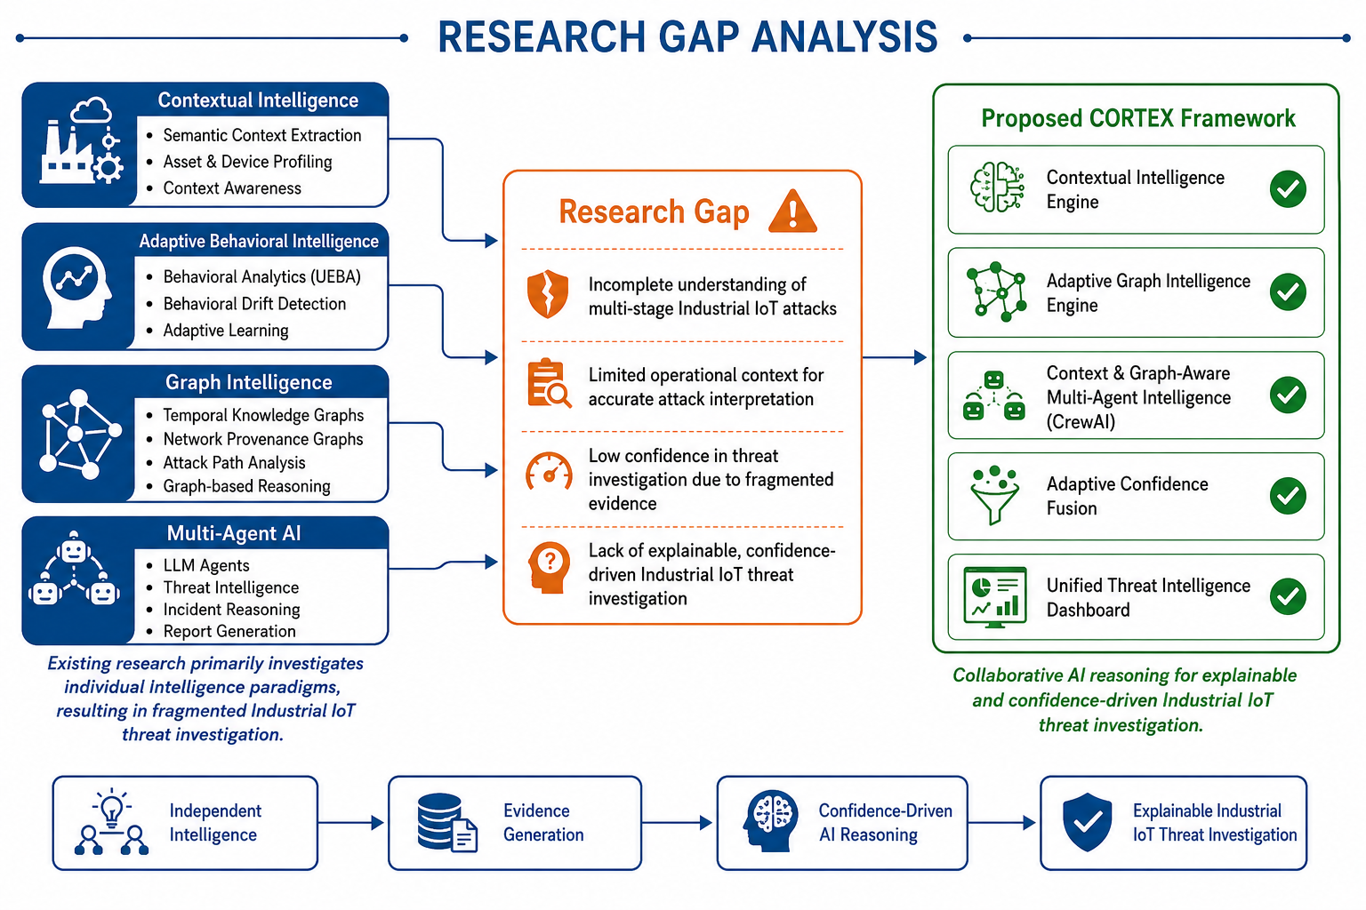
Page: 16
Page: 12

Slide 14
THREAT MODEL
Protected Environment
Manufacturing Plants
Smart Factories
Power & Energy Systems
Water Treatment Plants
Oil & Gas Facilities
Industrial Control Systems (ICS)
Industrial IoT Networks
Threat Actors
Advanced Persistent Threat (APT) Groups
Nation-State Adversaries
Insider Threats
Ransomware Operators
Supply Chain Attackers
Cybercriminal Organizations
Attack Objectives
Compromise Industrial IoT Devices
Disrupt Industrial Operations
Steal Operational & Production Data
Perform Lateral Movement
Cause Safety & Production Downtime
Assumptions
Industrial IoT Environment
Continuous Telemetry Generation
Multiple Industrial Communication Protocols
Sophisticated Multi-Stage Cyberattacks
Mission-Critical Infrastructure
Page: 13

Slide 15
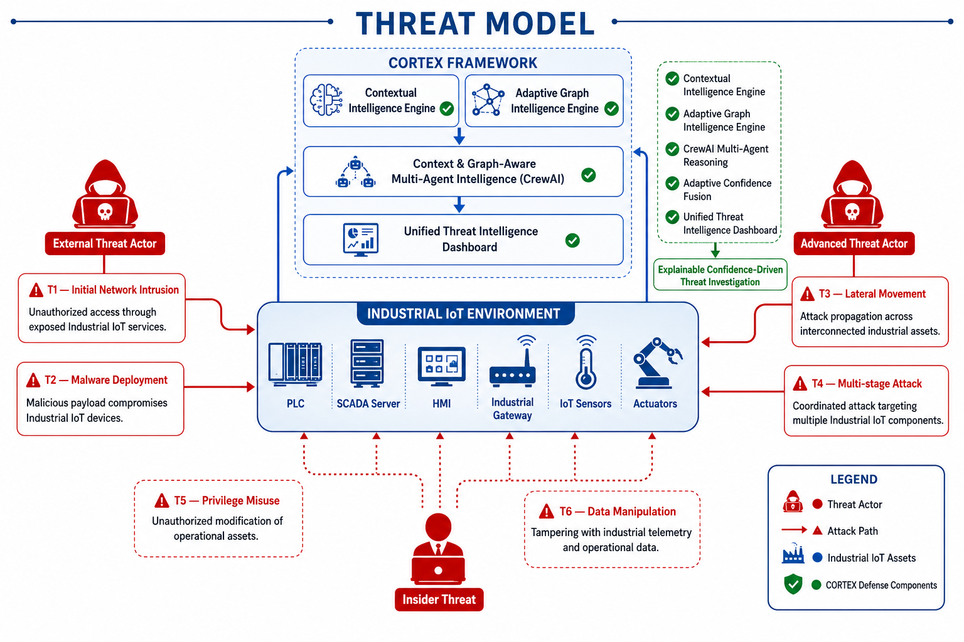
Page: 14

Slide 16
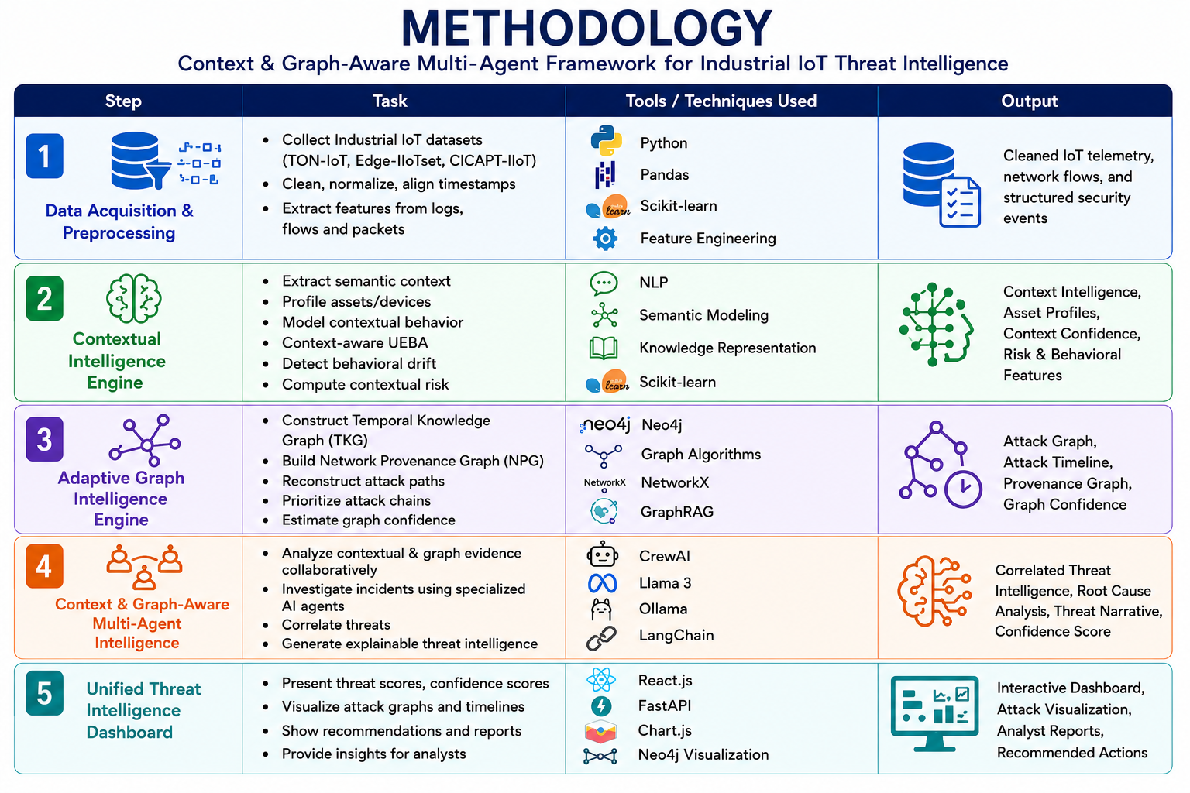
Page: 15

Slide 17
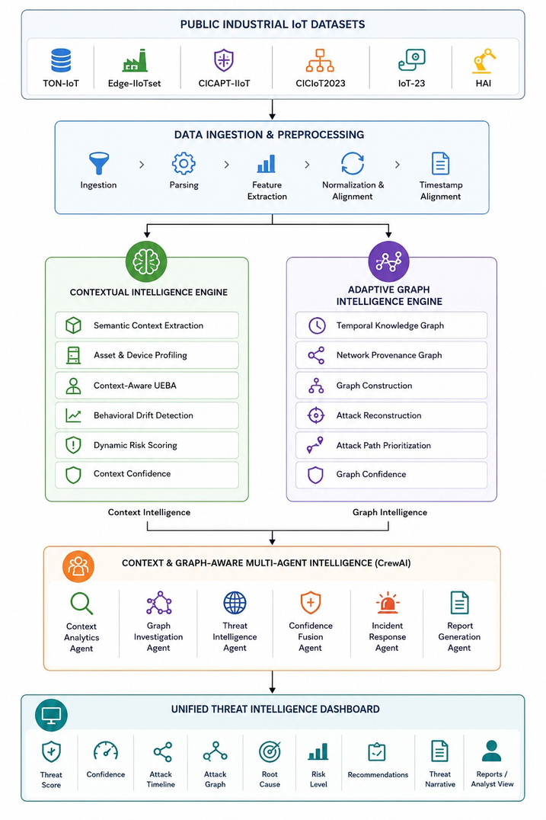
PROPOSED ARCHITECTURE
Page: 16

Slide 18
OVERALL NOVELTY
Context-Aware Threat Understanding – Enhances Industrial IoT threat interpretation by incorporating semantic context, behavioral analytics, and operational asset awareness.
Adaptive Graph-Based Attack Reconstruction – Dynamically reconstructs multi-stage attack paths using temporal and provenance graph intelligence.
Context & Graph-Aware Multi-Agent Intelligence – Employs specialized CrewAI agents to collaboratively investigate threats and generate explainable cyber intelligence.
Adaptive Confidence-Driven Threat Assessment – Produces reliable threat prioritization through confidence-aware fusion of contextual and graph-based investigation evidence.
Page: 17

Slide 19
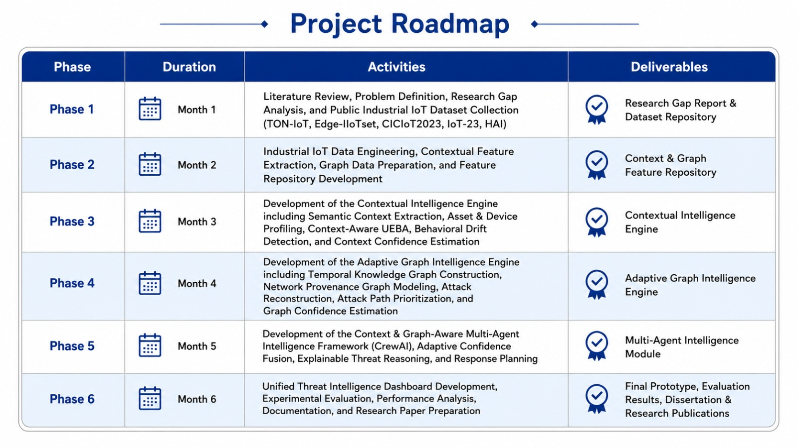
Page: 18

Slide 20
CONCLUSION
Industrial IoT Focus: Addresses the challenge of investigating complex multi-stage cyberattacks in mission-critical Industrial IoT environments.
Proposed Framework: Combines contextual intelligence, adaptive graph intelligence, and context-aware multi-agent reasoning for comprehensive threat investigation.
Expected Outcomes: Delivers explainable attack reconstruction, confidence-driven threat assessment, and actionable security recommendations through a unified dashboard.
Future Scope: Provides a foundation for scalable, AI-driven Industrial IoT security analytics and future autonomous cyber defense systems.
Page: 19

Slide 21
REFERENCES
[1] Nandiya, Padmeswari, Mohsin, Ahmad, Ibrahim, Ahmed, Sarker, Iqbal H., & Janicke, Helge. (2026). BRIDG-ICS: AI-Grounded Knowledge Graphs for Intelligent Threat Analytics in Industry 5.0 Cyber-Physical Systems. Cybersecurity (Springer). https://arxiv.org/abs/2512.12112
[2] Empl, Philip & Pernul, Günther. (2023). Digital-Twin-Based Security Analytics for the Internet of Things. Information, 14(2), 95. https://doi.org/10.3390/info14020095
[3] Shalaby, Ahmed, et al. (2025). Cybersecurity Threat Detection Based on a UEBA Framework Using Deep Autoencoders. arXiv Preprint. https://arxiv.org/abs/2505.11542
[4] Daniel, G., et al. (2025). Concept Drift Under Harsh Constraints: A Review of Potential Strategies for IoT Systems. IEEE Access. https://ieeexplore.ieee.org/document/11206138
[5] PROV-LLM: Advanced Persistent Threat Detection Based on Process Behavior Subgraphs Using Large Language Models. (2025). Proceedings of IEEE TrustCom 2025. https://doi.org/10.1109/Trustcom66490.2025.00113
Page: 20

Slide 22
REFERENCES
[6] Baha, Lina, Mammasse, Amine, & Saci, Oualid. (2025). A Hybrid GNN–LLM Framework for Correlating Cybersecurity Incidents. Proceedings of the 2025 IEEE International Conference on Theoretical and Applicative Aspects of Computer Science (ICTAACS). https://doi.org/10.1109/ICTAACS69003.2025.11399321
[7] Hmimou, Yasser, Tabaa, Mohamed, Khiat, Azeddine, & Hidila, Zineb. (2025). A Multi-Agent System for Cybersecurity Threat Detection and Correlation Using Large Language Models. IEEE Access, 13. https://doi.org/10.1109/ACCESS.2025.3602681
[8] Islam, Mohammad M., Elluri, Lavanya, & Joshi, Karuna Pande. (2025). Integrating Knowledge Graphs with Retrieval-Augmented Generation to Automate IoT Device Security Compliance. Proceedings of the 2025 IEEE International Conference on IntelligenceandSecurityInformatics(ISI). https://doi.org/10.1109/ISI65680.2025.11201135
Page: 21

Slide 23

Page: 22

