Slide 1

CORTEX:A Context & Graph-Aware Multi-Agent Framework for Explainable Industrial IoT Threat Intelligence
Team members:
Lokpradeep B - AM.SC.U4CYS23018
Uday Ganesh B - AM.SC.U4CYS23019
Sri charan N - AM.SC.U4CYS23029
Akshara Kruti P - AM.SC.U4CYS23035
Guide Name:
Dr. Kurunandan Jain, Assistant Professor

Slide 2


CONTENTS
Problem Statement
This Weeks Progress
Upcoming Weeks Targets
Proposed System Architecture
Overall Novelty
Expected Contributions
Conclusion
References
Page: 01

Slide 3
PROBLEM STATEMENT
+
Ambiguous Attack Progression: Multi-stage Industrial IoT attacks propagate across devices and protocols, making the complete attack progression difficult to reconstruct accurately.
Insufficient Operational Context: Security events often lack sufficient operational and asset context, reducing the reliability of threat interpretation in mission-critical environments.
Uncertain Threat Prioritization: Security analysts struggle to distinguish critical attacks from low-impact events due to the absence of reliable confidence estimation during investigation.
Delayed Incident Investigation: Inaccurate attack reconstruction and fragmented evidence increase manual investigation time, delaying response in Industrial IoT environments.
Page: 02

Slide 4
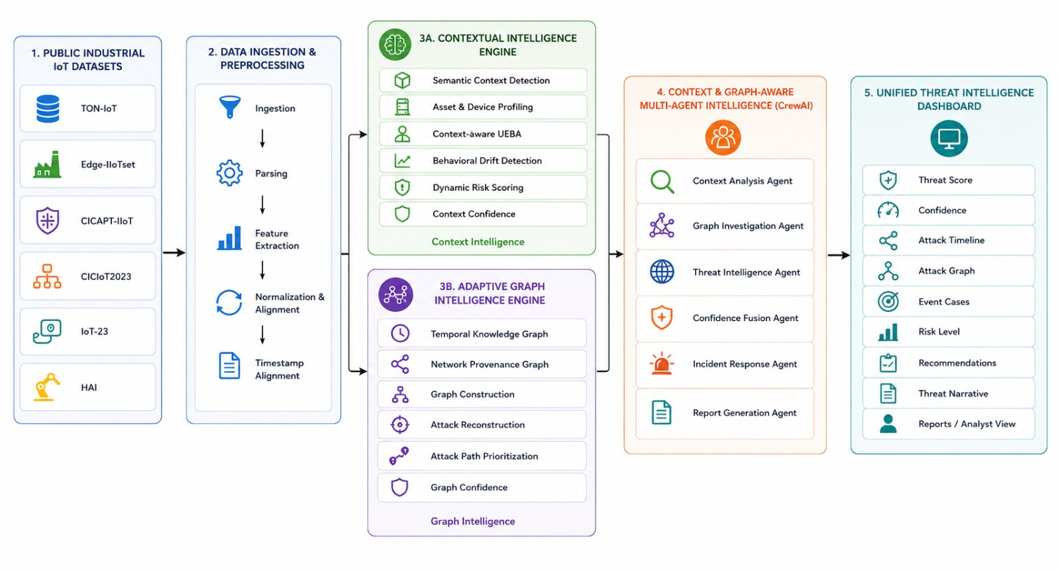
PROPOSED ARCHITECTURE
Page: 03

Slide 5
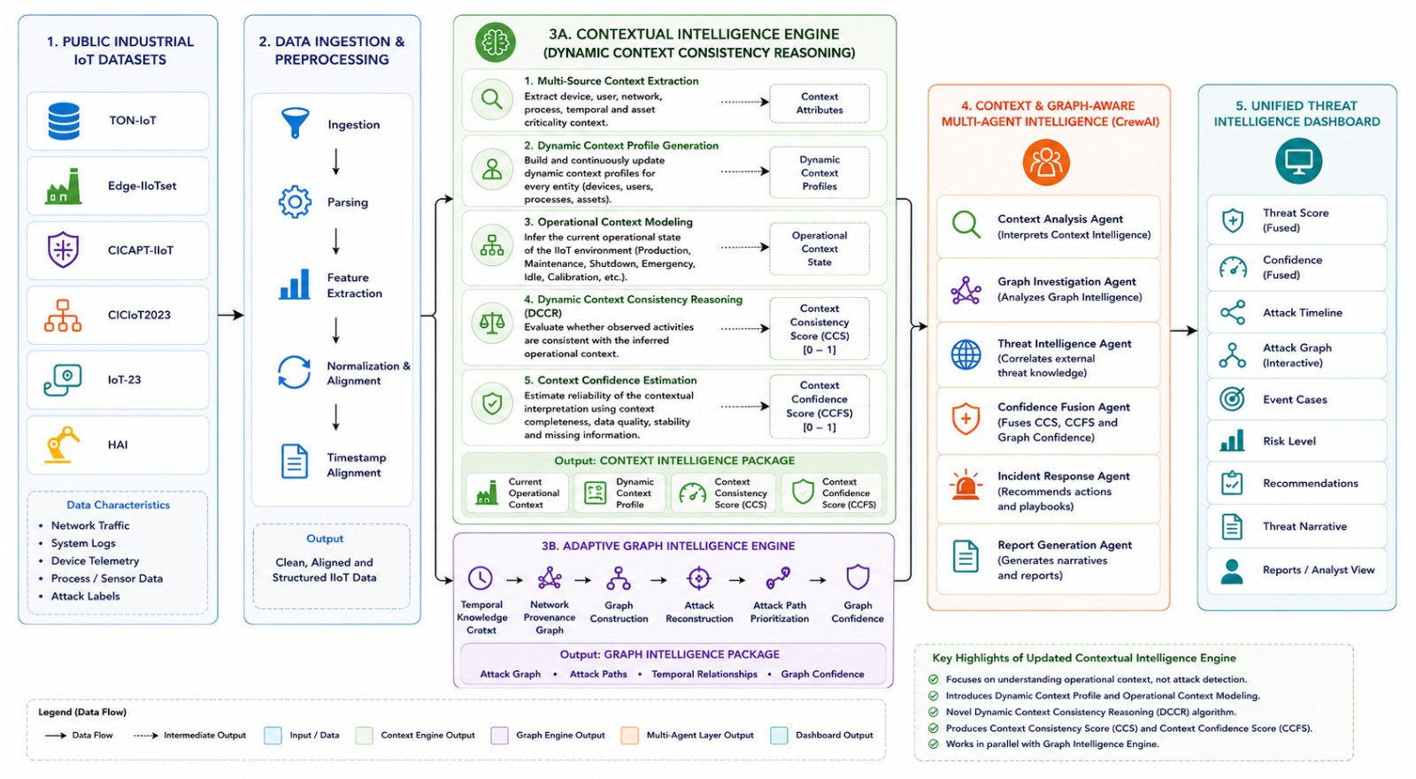
Revised Architecture
Page: 04

Slide 6
OVERALL NOVELTY
Dynamic Context Consistency Reasoning (DCCR) – Introduces a novel context reasoning framework that continuously generates Dynamic Context Profiles, models operational states, and evaluates context consistency with confidence-aware contextual intelligence.
Adaptive Graph-Based Attack Reconstruction – Dynamically reconstructs multi-stage attack paths using temporal relationships, provenance graphs, and graph intelligence to reveal attack progression.
Context & Graph-Aware Multi-Agent Intelligence – Employs specialized CrewAI agents to collaboratively fuse contextual and graph intelligence, enabling explainable threat investigation and autonomous cyber decision support.
Adaptive Confidence-Driven Threat Assessment – Produces trustworthy threat prioritization by confidence-aware fusion of contextual reasoning and graph intelligence for explainable Industrial IoT cyber threat assessment.
Page: 05

Slide 7
Expected Contributions
UDAY IIoT Dataset Collection & Preprocessing Feature Engineering & Data Validation Contextual Intelligence Development Network Provenance Graph Development Multi-Agent AI Integration | AKSHARA IIoT Dataset Collection & Preprocessing Contextual Intelligence & UEBA Development Semantic Context Extraction Behavioral Analytics & Risk Scoring Adaptive Graph Intelligence Integration
LOKPRADEEP Adaptive Graph Intelligence Development Temporal Knowledge Graph & Neo4j Attack Reconstruction & Graph Analytics Multi-Agent AI Integration Dashboard Development | CHARAN Multi-Agent AI Development CrewAI & Llama 3 (Ollama) Integration Confidence Fusion & Threat Intelligence Dashboard Development
Common Contributions Literature Survey & Methodology System Integration & Testing Performance Evaluation Experimental Analysis
Page: 06

Slide 8
This Week's Progress
Established the development environment and configured the core technology stack for the CORTEX framework.
Curated and organized the selected Industrial IoT datasets for experimentation.
Performed initial dataset exploration to analyze data structure, feature distribution, and preprocessing requirements.
Initiated the implementation of the data ingestion and preprocessing pipeline, including parsing and feature extraction
Commenced the implementation of the Contextual Intelligence Engine (Layer 3A) by adapting suitable approaches from the selected literature to the chosen datasets.
Initiated the Adaptive Graph Intelligence Engine (Layer 3B) by exploring graph construction and temporal event correlation techniques.
Current Status: Project setup, dataset preparation, preprocessing initialization, and foundational development of Layers 3A and 3B are in progress.
Page: 07

Slide 9
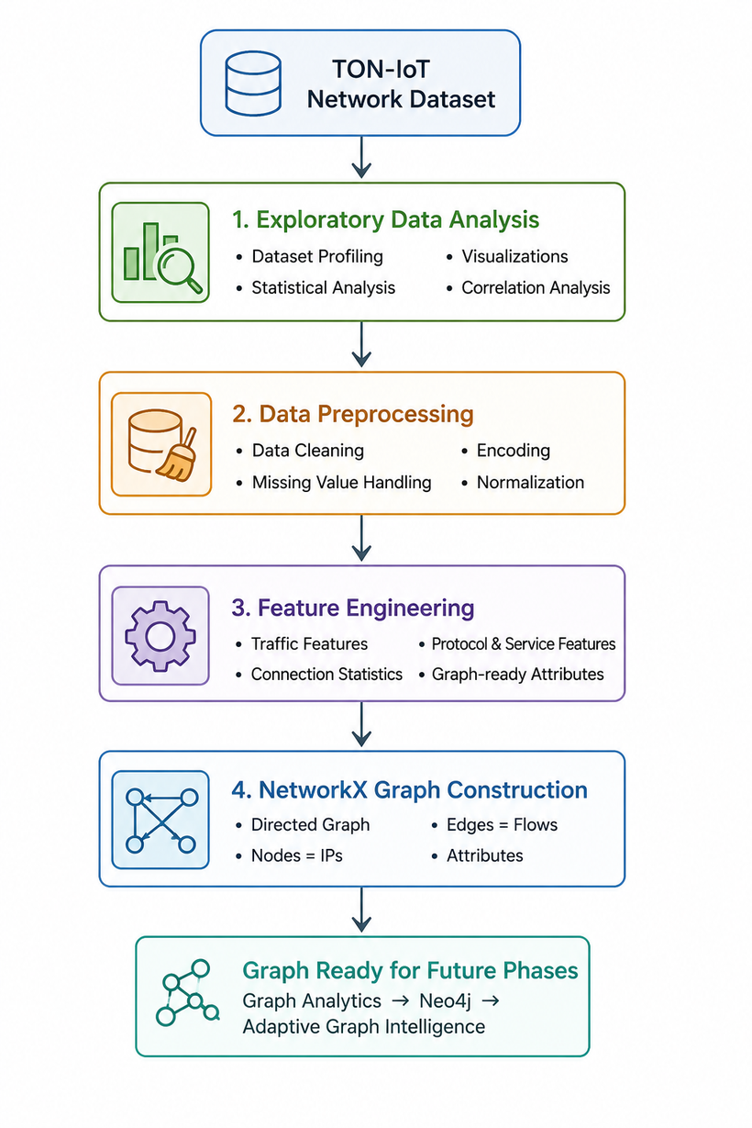
Results
Page: 08

Slide 10
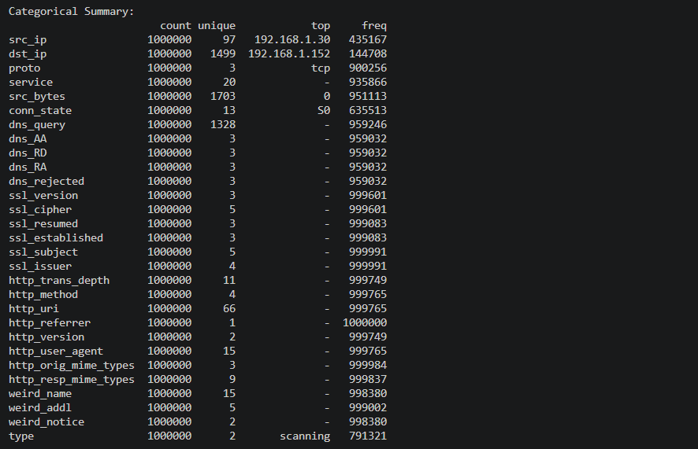
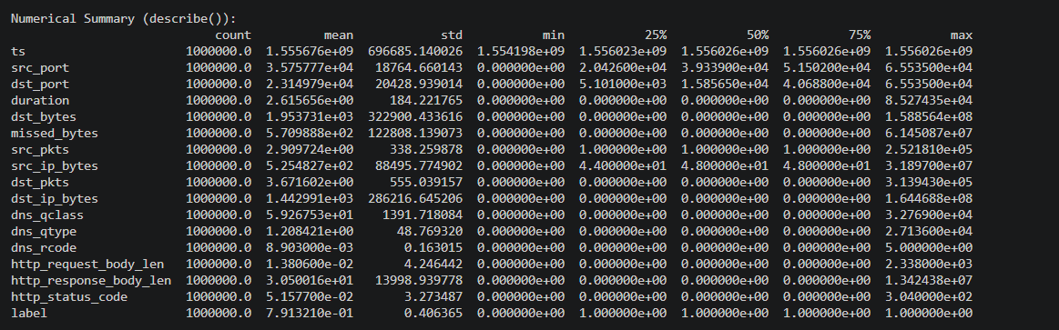
Results
Page: 09

Slide 11
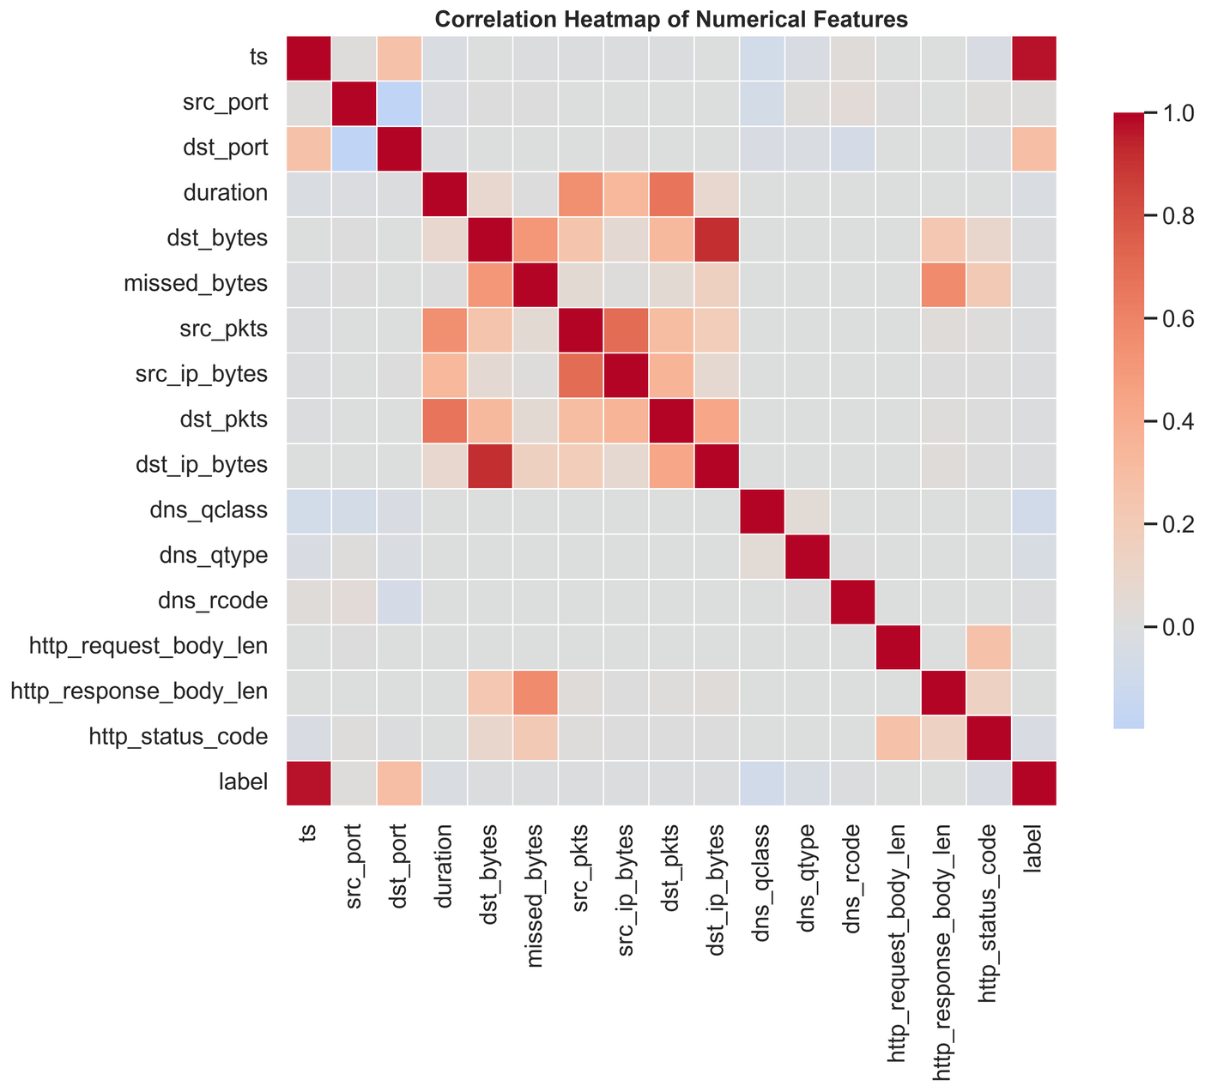
Results
Page: 10

Slide 12
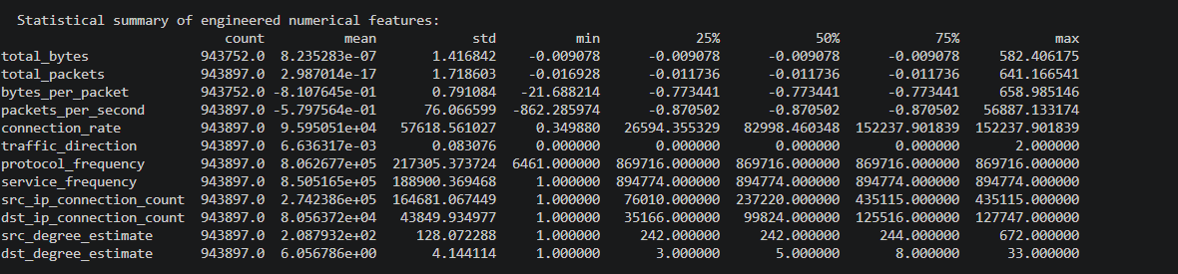
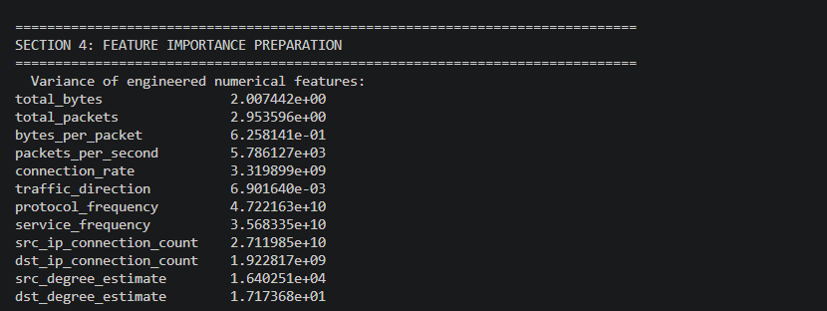
Results
Page: 11

Slide 13
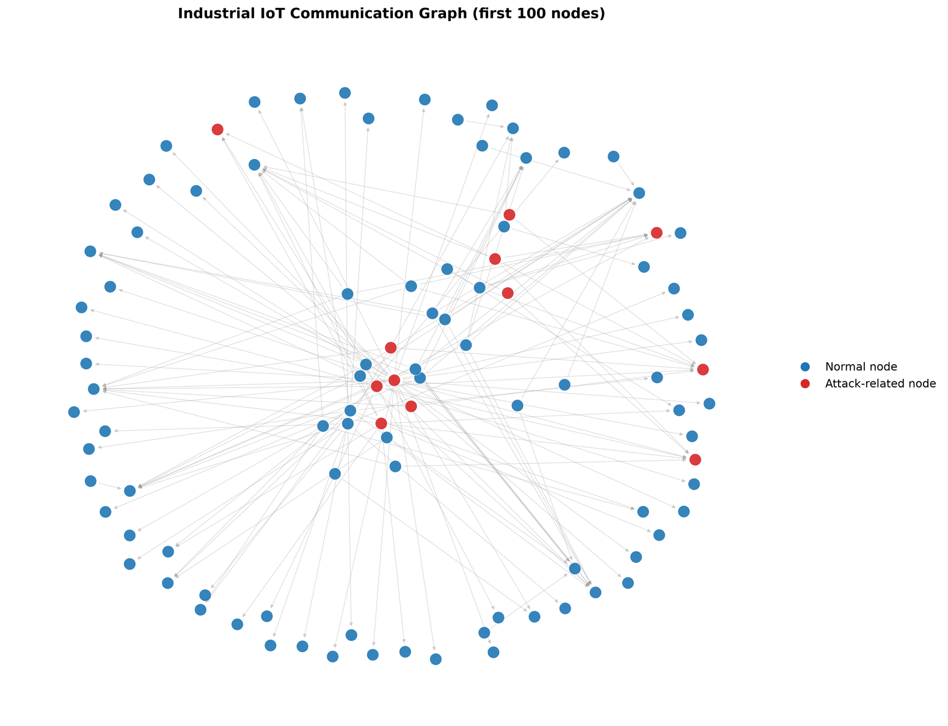
Results
Page: 12

Slide 14
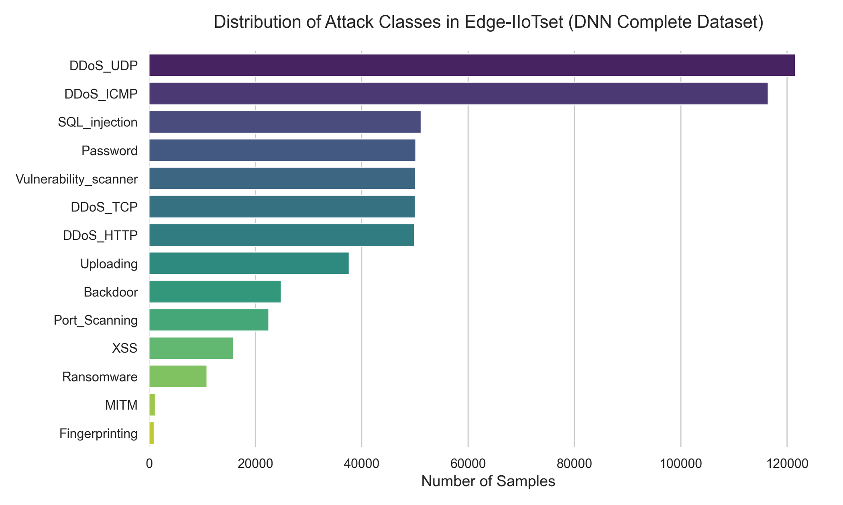
Results
Page: 13

Slide 15
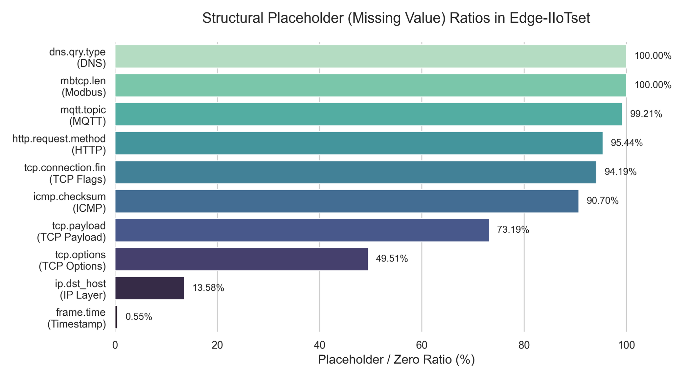
Results
Page: 14

Slide 16
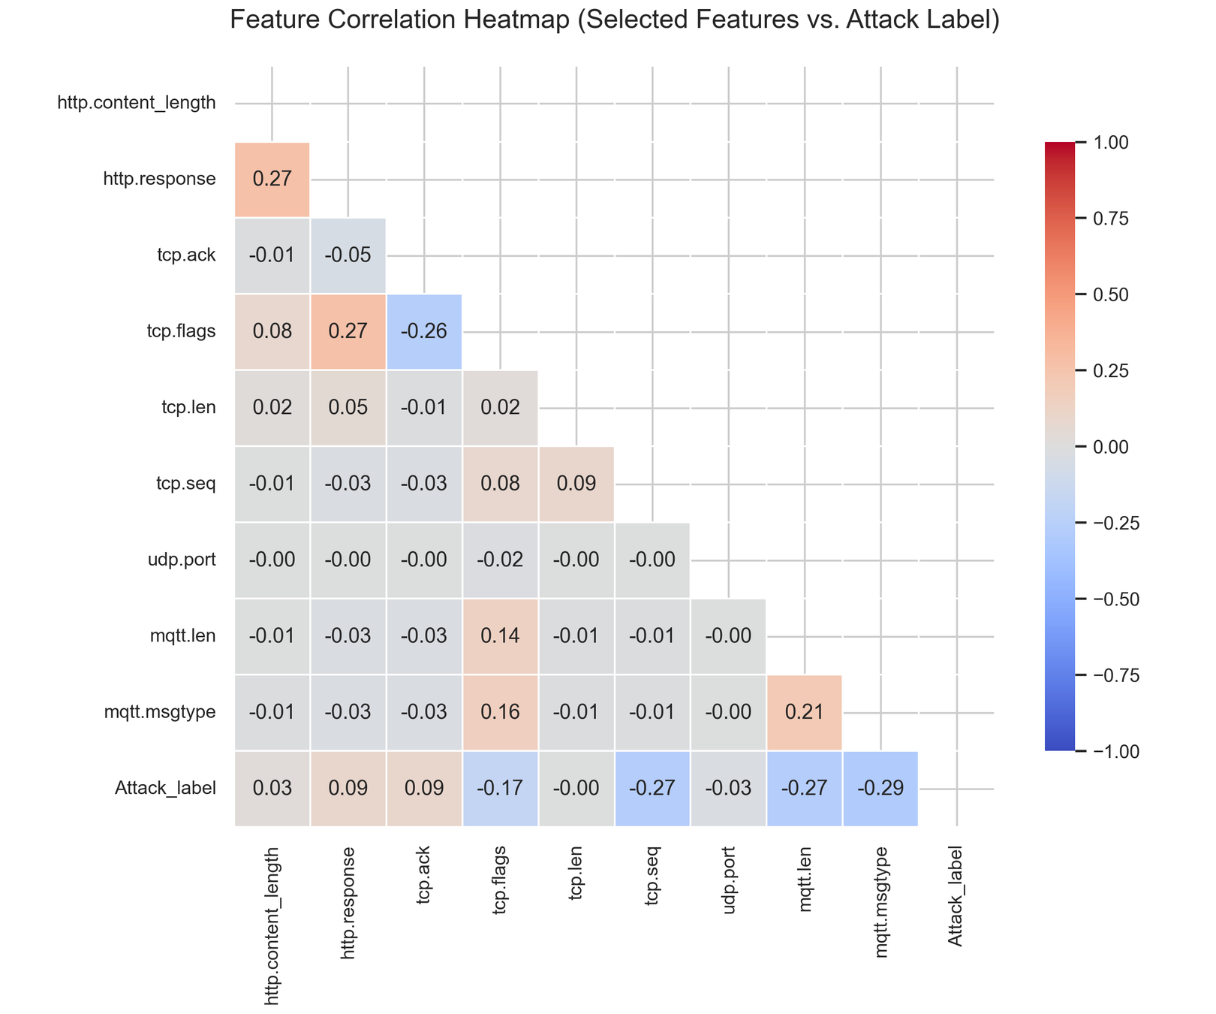
Results
Page: 15

Slide 17
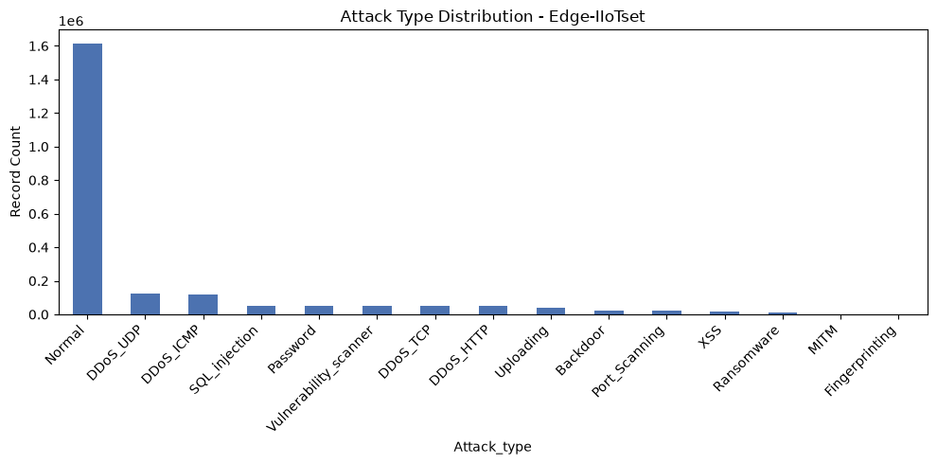
Results
Page: 16

Slide 18
Upcoming Week Targets
Extend the data ingestion and preprocessing pipeline with feature extraction, normalization, and timestamp synchronization.
Complete the core implementation of the Contextual Intelligence Engine (Layer 3A), including contextual analysis, behavioral profiling, and risk assessment.
Advance the Adaptive Graph Intelligence Engine (Layer 3B) through Temporal Knowledge Graph and Network Provenance Graph construction.
Implement graph-based attack reconstruction and temporal event correlation for multi-stage threat analysis.
Evaluate and refine the outputs of Layers 3A and 3B using the selected Industrial IoT datasets.
Initiate the integration of Layers 3A and 3B to establish the foundation for the Graph-Aware Multi-Agent Intelligence framework.
Page: 17

Slide 19
Conclusion
Successfully established the implementation foundation for the proposed CORTEX framework.
Initiated the initial setup, dataset preparation, and preprocessing workflow.
Initiated the development of the Contextual Intelligence (Layer 3A) and Adaptive Graph Intelligence (Layer 3B) modules.
The project is well-positioned to advance toward core module implementation and integration in the upcoming development phase.
Page: 18

Slide 20
References
[1] A. Alsaedi, N. Moustafa, Z. Tari, A. Mahmood, and A. Anwar, "TON_IoT Telemetry Dataset: A New Generation Dataset of IoT and IIoT for Data-Driven Intrusion Detection Systems," IEEE Access, vol. 8, pp. 165130–165150, 2020.
[2] M. A. Ferrag, O. Friha, D. Hamouda, L. Maglaras, and H. Janicke, "Edge-IIoTset: A New Comprehensive Realistic Cyber Security Dataset of IoT and IIoT Applications for Centralized and Federated Learning," IEEE Access, vol. 10, pp. 40281–40306, 2022.
[3] P. Empl and G. Pernul, "Digital-Twin-Based Security Analytics for the Internet of Things," Information, vol. 14, no. 2, Art. no. 95, 2023.
[4] G. Daniel et al., "Concept Drift Under Harsh Constraints: A Review of Potential Strategies for IoT Systems," IEEE Access, 2025.
[5] Canadian Institute for Cybersecurity (CIC), University of New Brunswick, "CICAPT-IIoT: A Provenance-Based APT Attack Dataset for IIoT Environment," 2024.
[6] Canadian Institute for Cybersecurity (CIC), University of New Brunswick, "CICIoT2023 Dataset," 2023.
Page: 19

Slide 21


