Slide 1

CORTEX:A Context & Graph-Aware Multi-Agent Framework for Explainable Industrial IoT Threat Intelligence
Team members:
Lokpradeep B - AM.SC.U4CYS23018
Uday Ganesh B - AM.SC.U4CYS23019
Sri charan N - AM.SC.U4CYS23029
Akshara Kruti P - AM.SC.U4CYS23035
Guide Name:
Dr. Kurunandan Jain, Assistant Professor

Slide 2


CONTENTS
Problem Statement
Proposed Architecture
Overall Novelty
Expected Contributions
This Week's Progress
Results
Individual Week’s Contribution
Conclusion
References
Page: 01

Slide 3
PROBLEM STATEMENT
+
Ambiguous Attack Progression: Multi-stage Industrial IoT attacks propagate across devices and protocols, making the complete attack progression difficult to reconstruct accurately.
Insufficient Operational Context: Security events often lack sufficient operational and asset context, reducing the reliability of threat interpretation in mission-critical environments.
Uncertain Threat Prioritization: Security analysts struggle to distinguish critical attacks from low-impact events due to the absence of reliable confidence estimation during investigation.
Delayed Incident Investigation: Inaccurate attack reconstruction and fragmented evidence increase manual investigation time, delaying response in Industrial IoT environments.
Page: 02

Slide 4
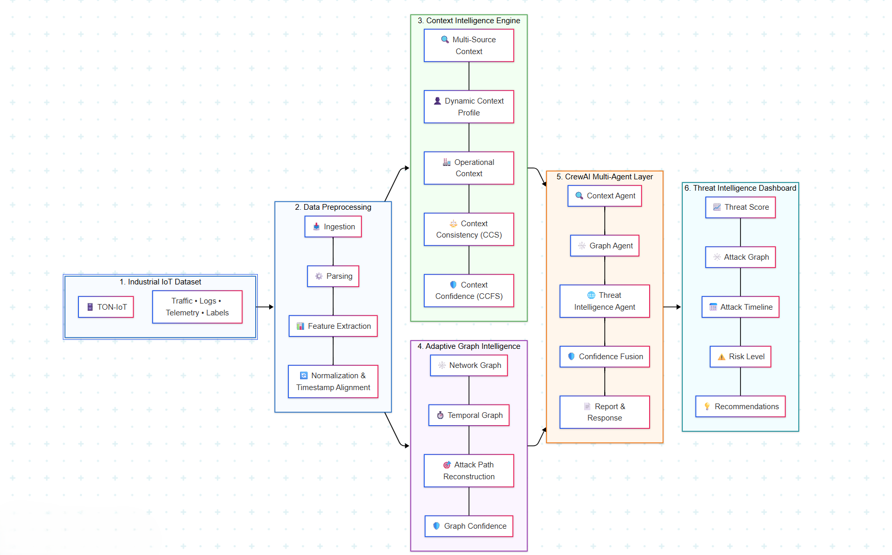
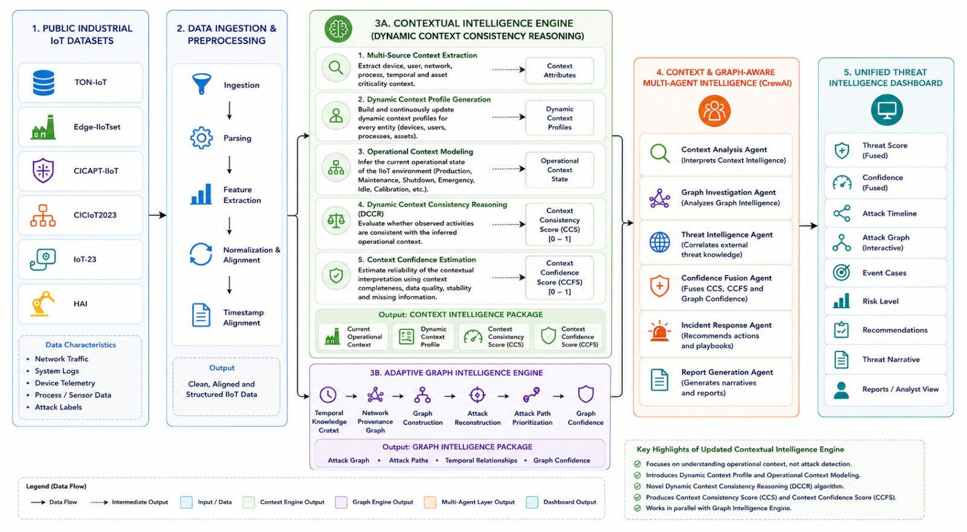
PROPOSED ARCHITECTURE
Page: 03

Slide 5
OVERALL NOVELTY
Dynamic Context Consistency Reasoning (DCCR) – Introduces a novel context reasoning framework that continuously generates Dynamic Context Profiles, models operational states, and evaluates context consistency with confidence-aware contextual intelligence.
Adaptive Graph-Based Attack Reconstruction – Dynamically reconstructs multi-stage attack paths using temporal relationships, provenance graphs, and graph intelligence to reveal attack progression.
Context & Graph-Aware Multi-Agent Intelligence – Employs specialized CrewAI agents to collaboratively fuse contextual and graph intelligence, enabling explainable threat investigation and autonomous cyber decision support.
Adaptive Confidence-Driven Threat Assessment – Produces trustworthy threat prioritization by confidence-aware fusion of contextual reasoning and graph intelligence for explainable Industrial IoT cyber threat assessment.
Page: 04

Slide 6
Overall Contributions
UDAY IIoT Dataset Collection & Preprocessing Contextual IntelligenceEngine Development Multi-Agent AI Integration Dashboard Development | AKSHARA Contextual IntelligenceEngine Development Context Acquisition & Operational Context Modeling Context Confidence Estimation & Validation Dynamic Contextual Reasoning
LOKPRADEEP Adaptive Graph Intelligence Development Temporal Knowledge Graph & Neo4j Attack Reconstruction & Graph Analytics Dashboard Development | CHARAN Network Provenance Graph Multi-Agent AI Development CrewAI & Llama 3 (Ollama) Integration Confidence Fusion & Threat Intelligence
Common Contributions Literature Survey & Methodology System Integration & Testing Performance Evaluation Experimental Analysis
Page: 05

Slide 7
This Week's Progress
Finalized the ToN-IoT dataset by analyzing its structure and identifying the required features .
Completed the data preprocessing pipeline, including data cleaning, categorical encoding, feature normalization, and dataset preparation.
Conducted feature analysis to identify significant features and prepare the feature mapping for contextual and graph-based analysis.
Started implementing the Contextual Intelligence Engine (Layer 3A) by defining contextual parameters and establishing the workflow for contextual analysis.
Initiated the Adaptive Graph Intelligence Engine (Layer 3B) by defining graph entities, relationships, and the foundation of the Temporal Knowledge Graph and Network Provenance Graph.
Page: 06

Slide 8
Individual Week’s Contribution
Page: 07

Slide 9
Lokpradeep
Performed graph-oriented data preprocessing for graph construction.
Conducted graph feature engineering by extracting entities, temporal attributes, and relationship information.
Designed the graph schema by defining graph nodes, relationships, and graph properties.
Page: 08

Slide 10
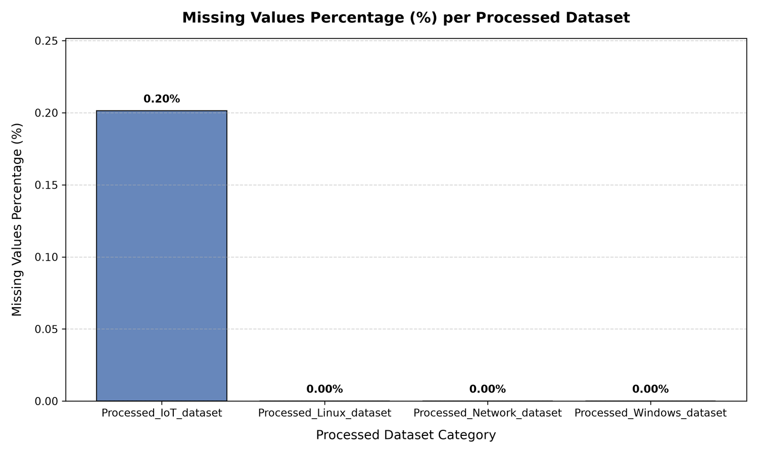
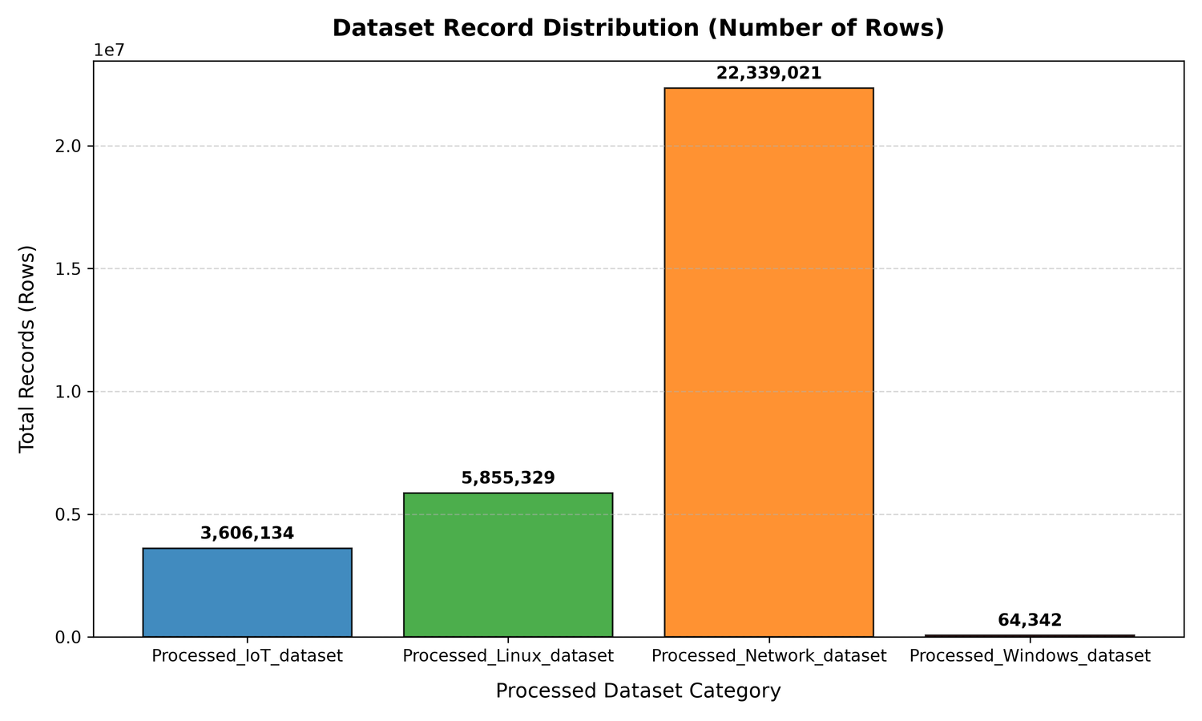
Graph-Oriented Dataset Preparation
Page: 09

Slide 11
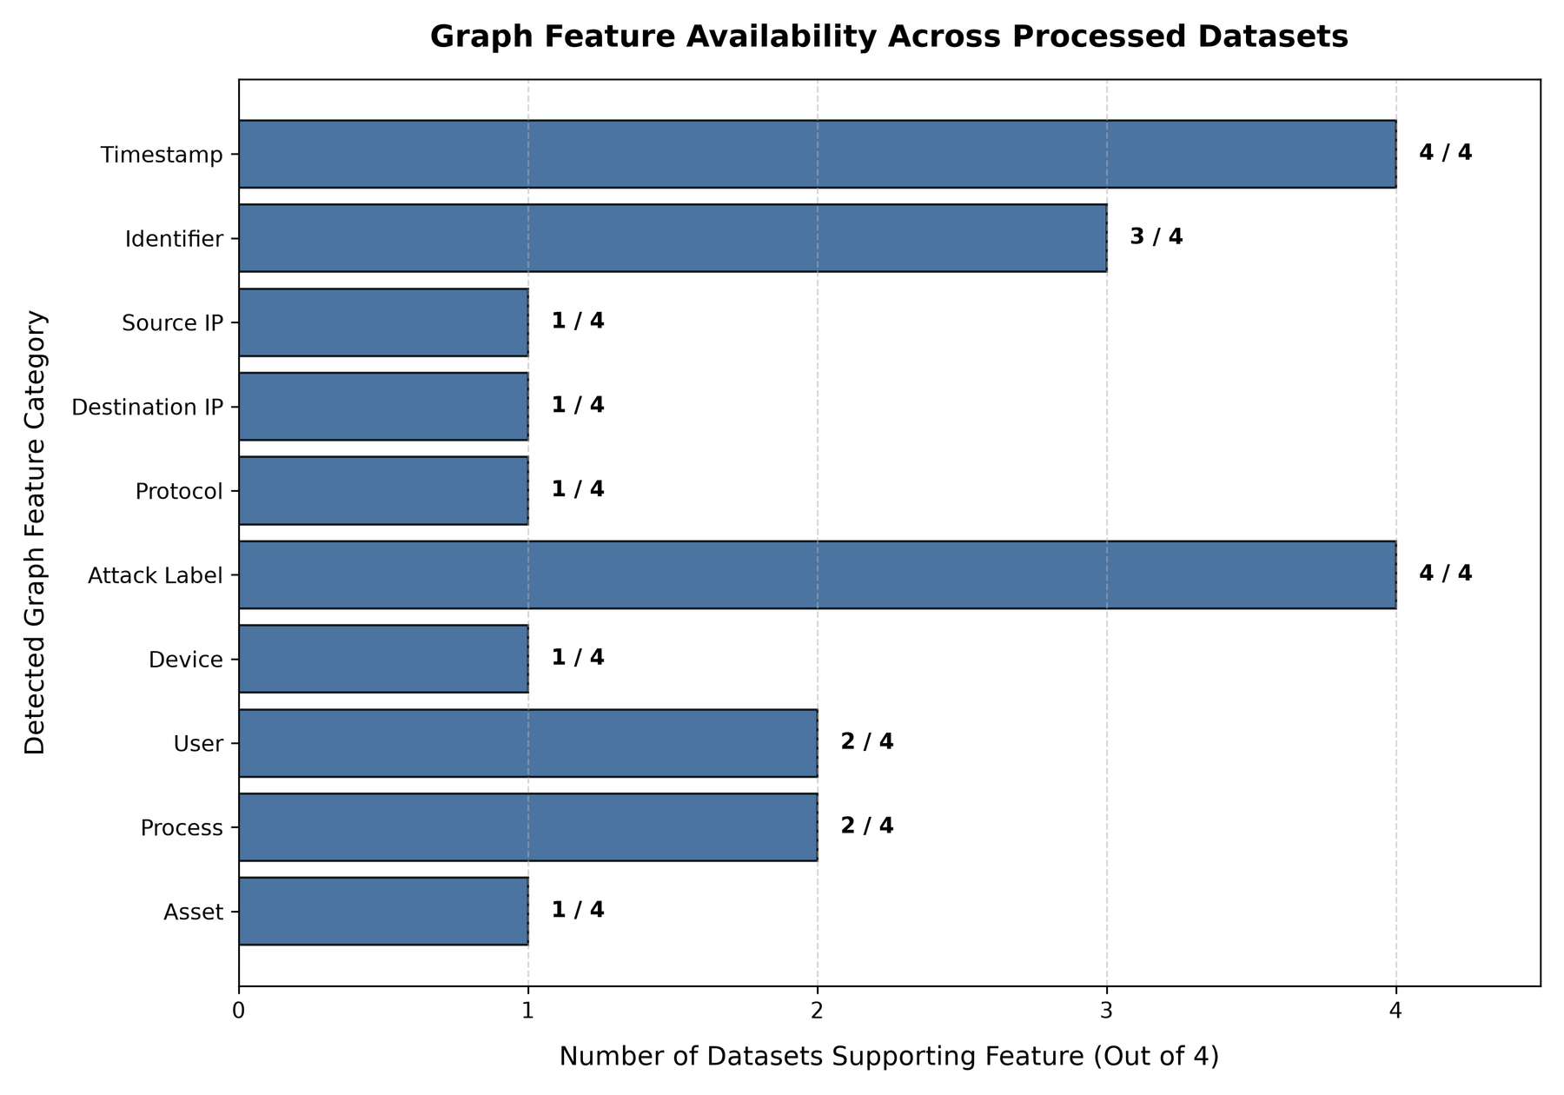
Graph-Oriented Dataset Preparation
Page: 10

Slide 12
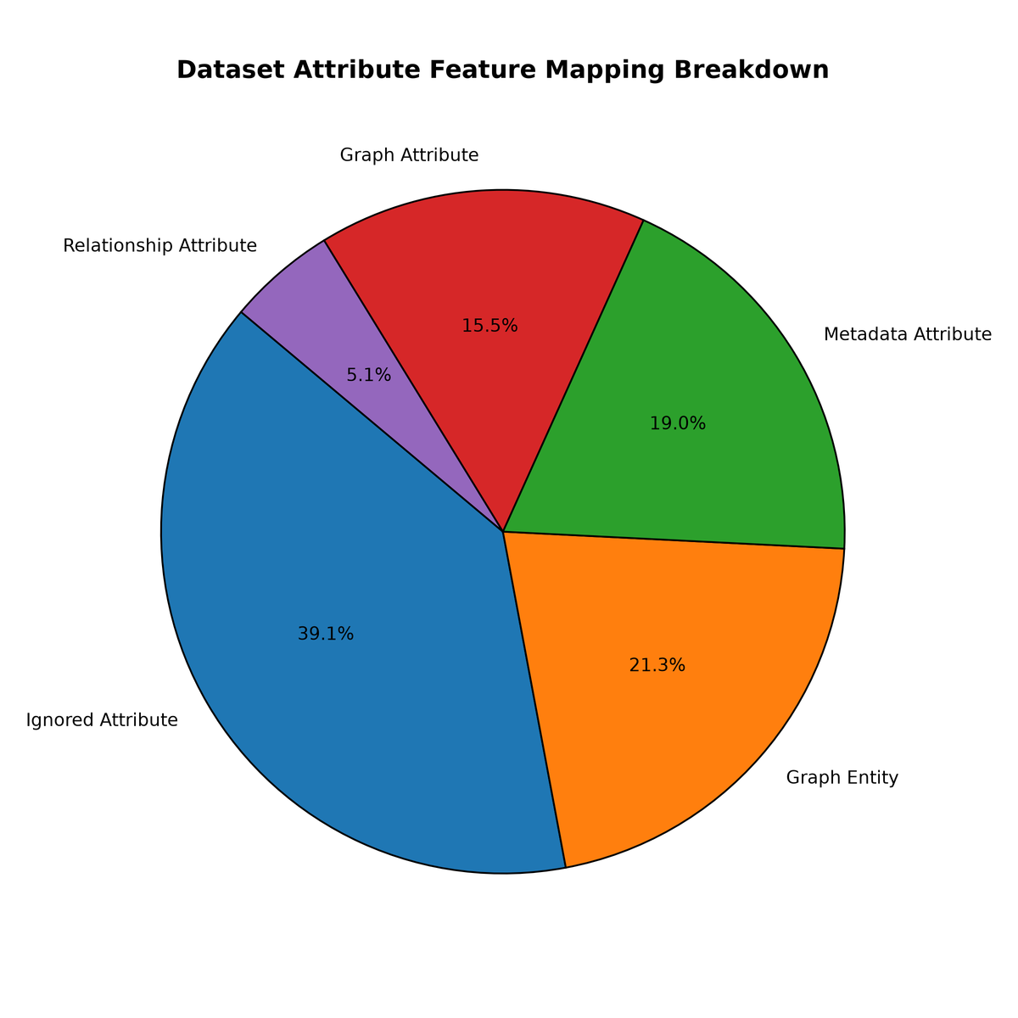
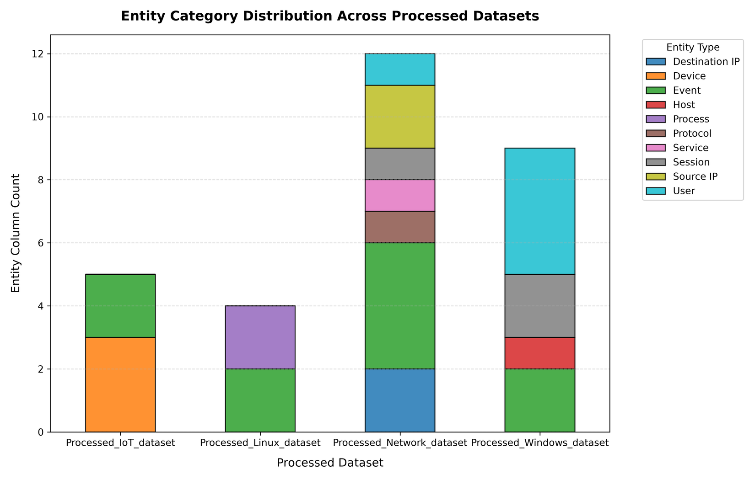
Graph Feature & Relationship Engineering
Page: 11

Slide 13
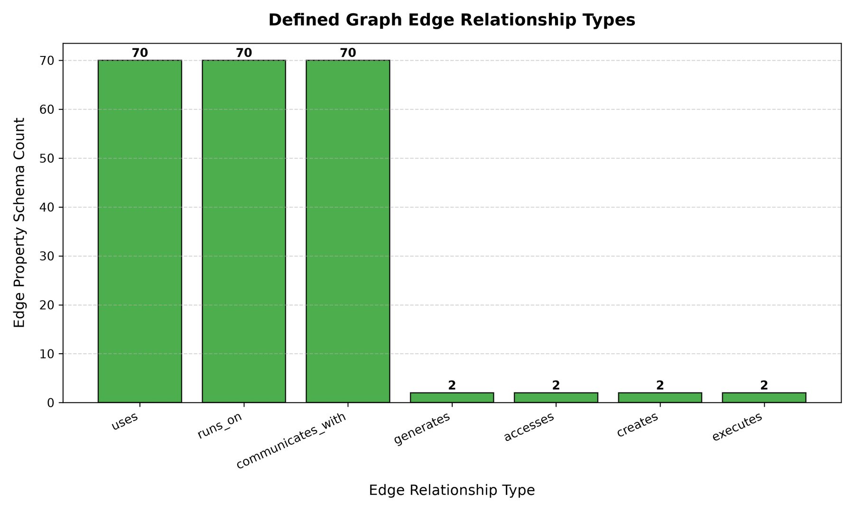
Graph Feature & Relationship Engineering
Page: 12

Slide 14
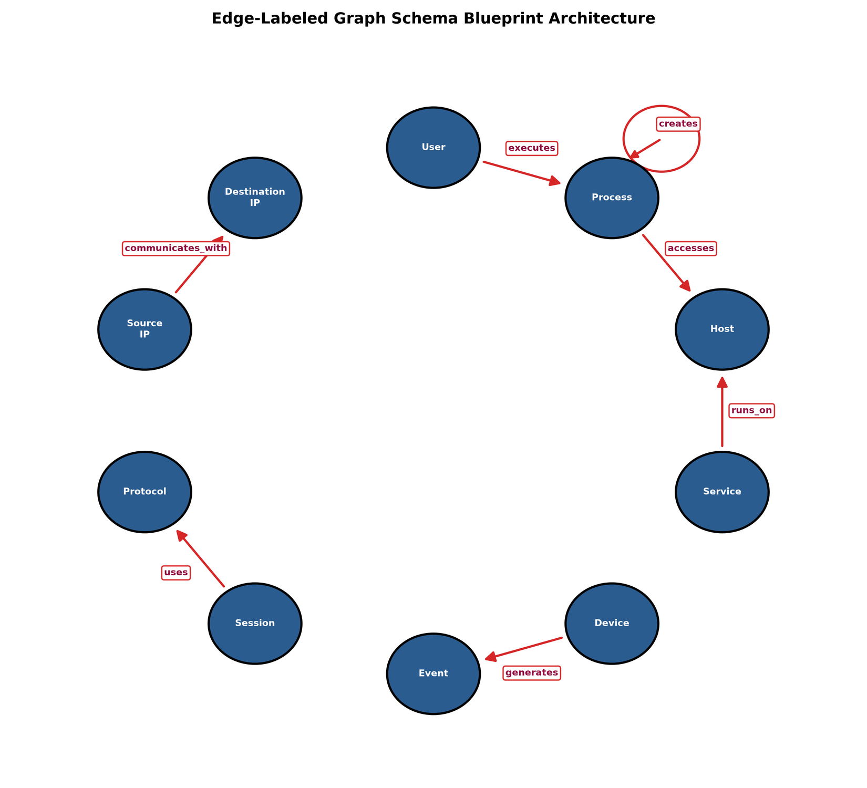
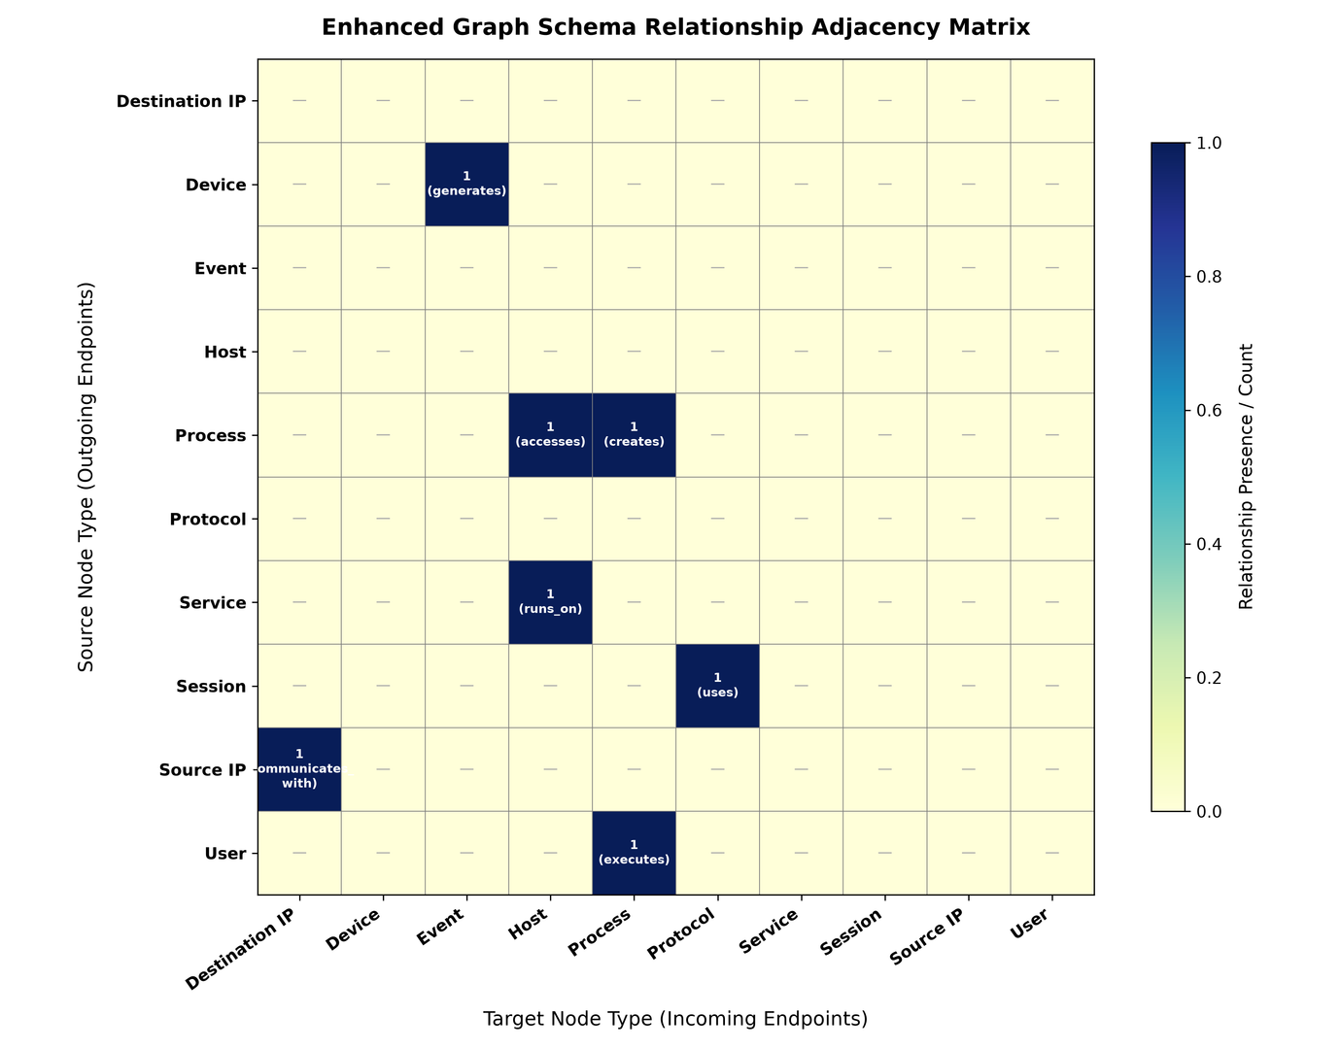
Graph Schema Design
Page: 13

Slide 15
Graph Schema Design
Page: 13

Slide 16
Uday
Finalized the TON-IoT dataset and completed context-oriented feature analysis.
Developed the Feature Dictionary and Context Attribute Repository for six contextual dimensions.
Designed the Dynamic Context Profile for Industrial IoT entities.
Implemented Stage 1: Multi-Source Context Extraction for Network, IoT, Linux, and Windows telemetry.
Prepared the Contextual Intelligence Engine for Stage 2 development.
Page: 14

Slide 17
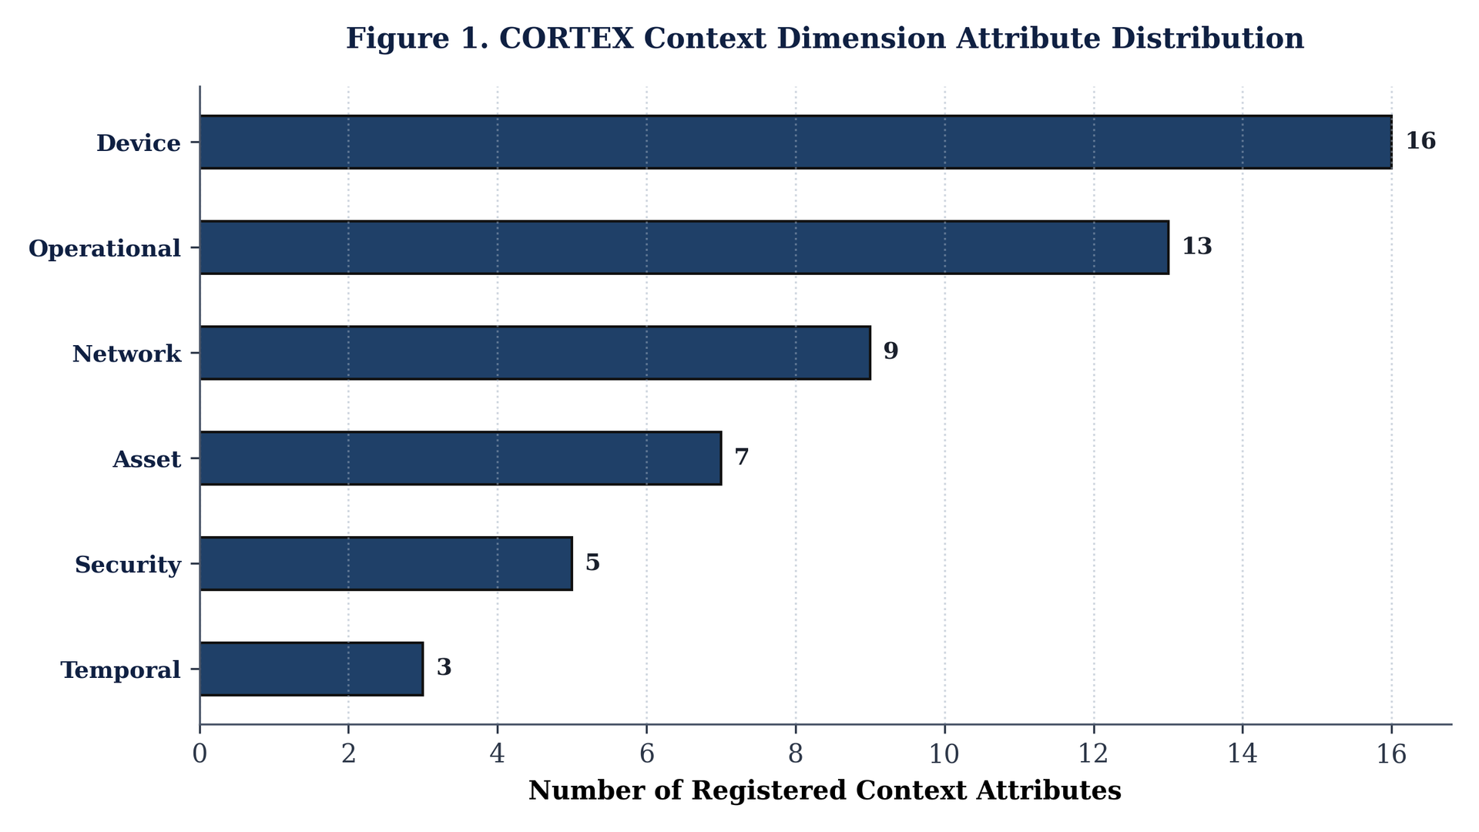
Context Dimension Attribute Distribution
Page: 15

Slide 18
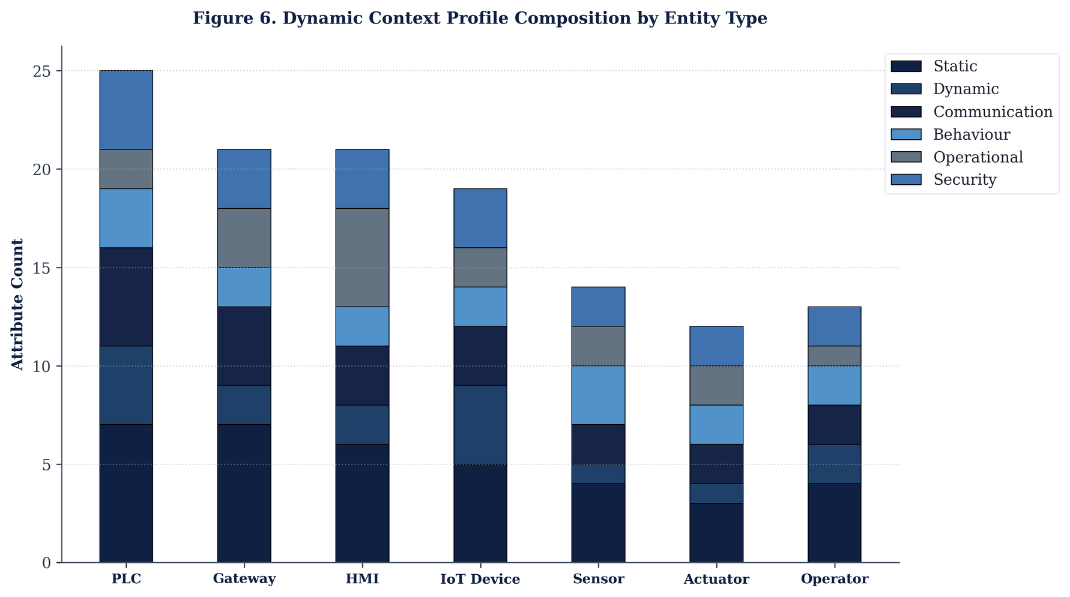
Dynamic Context Profile Composition by Entity Type
Page: 16

Slide 19
Charan
Developed the Network Provenance Graph schema(NPG) using the processed ToN-IoT network datasets.
Implemented graph analytics for attack path reconstruction and event correlation.
Validated the graph structure and optimized nodes, relationships, and graph connectivity.
.
Page: 17

Slide 20
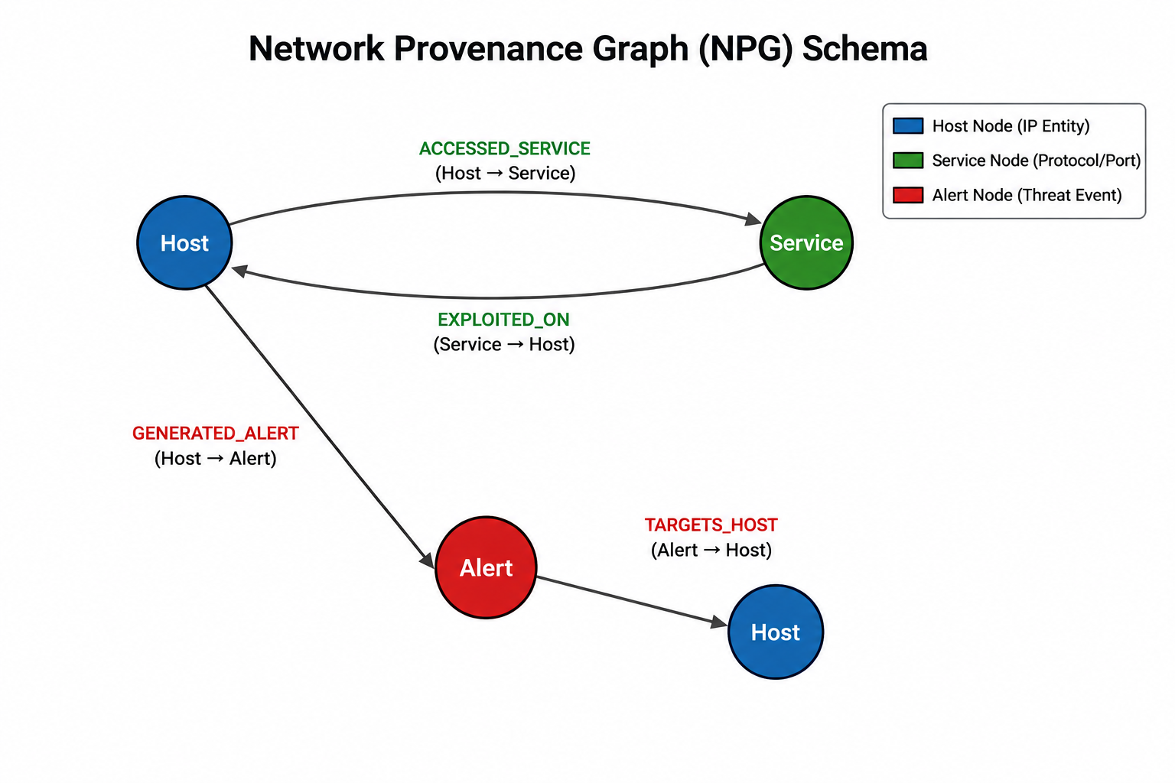
Network Provenance Graph (NPG) Schema
Page: 18

Slide 21
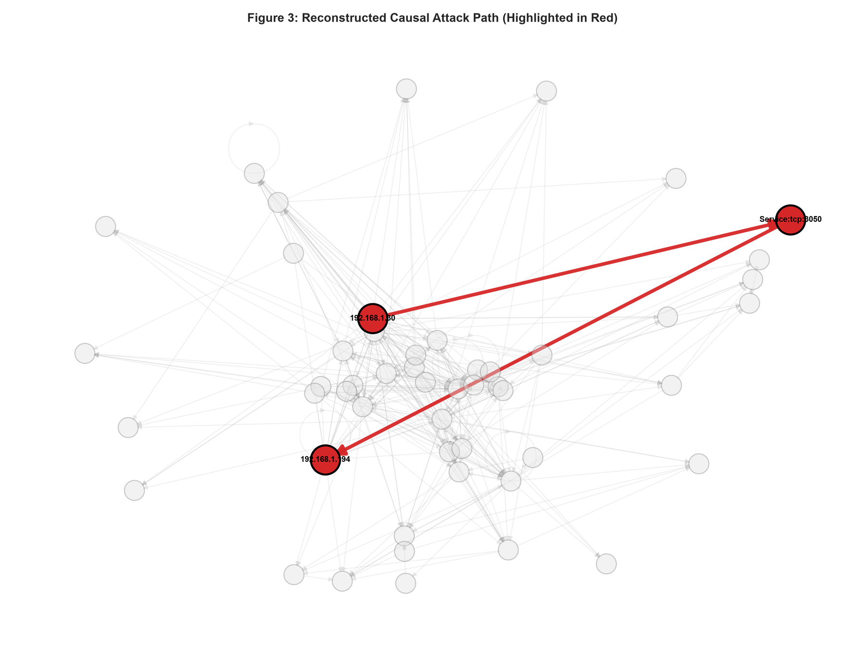
ATTACK PATH RECONSTRUCTION USING NETWORK PROVENANCE GRAPH
Page: 19

Slide 22
Akshara
Computed contextual score distributions for six operational context dimensions
Evaluated the overlap between benign and malicious context scores to assess the effectiveness of each context dimension for cyber threat intelligence
Classified the features in the dataset into contextual categories
Defined dynamic contextual parameters with importance scores and cyber threat intelligence contribution
Page: 20

Slide 23
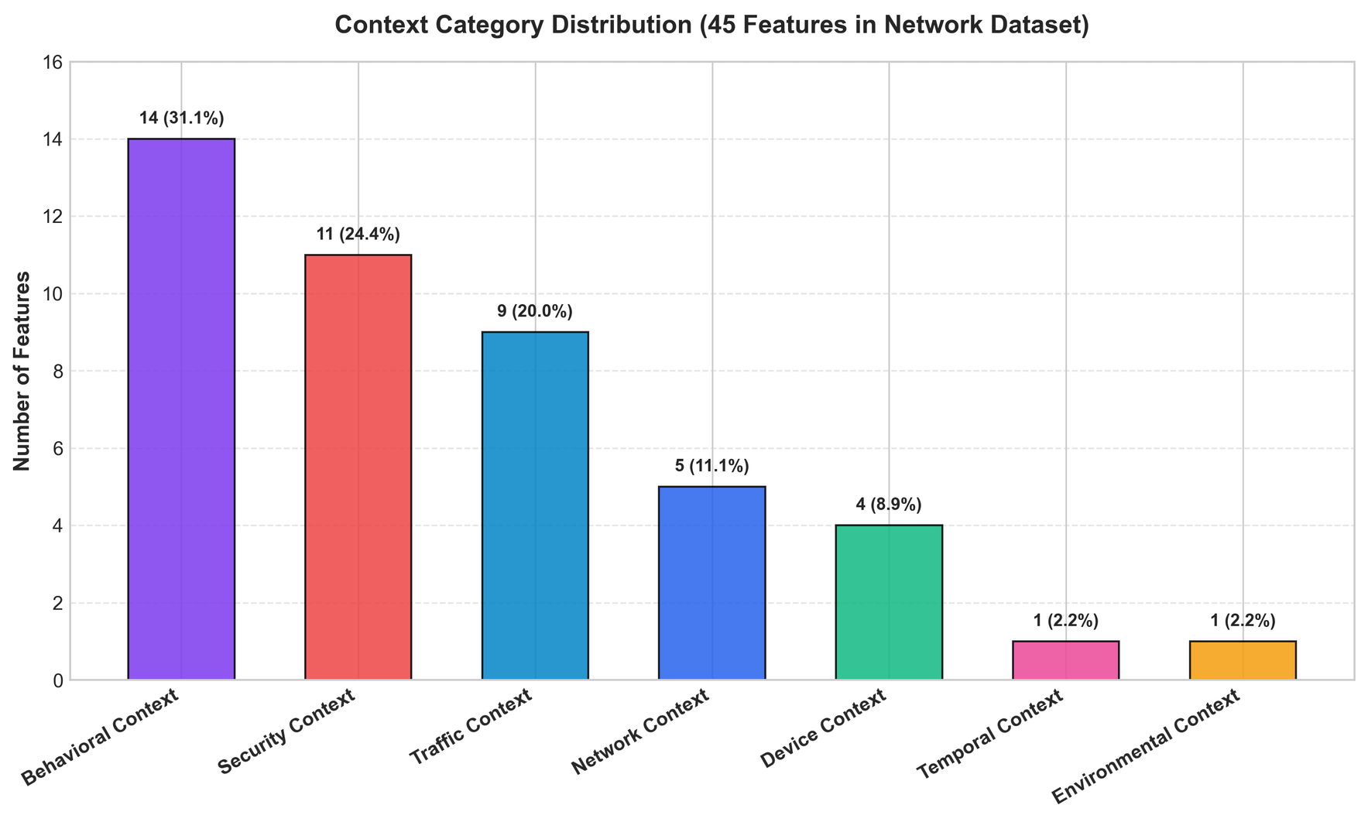
Classification of feature into contextual categories
Page: 22

Slide 24
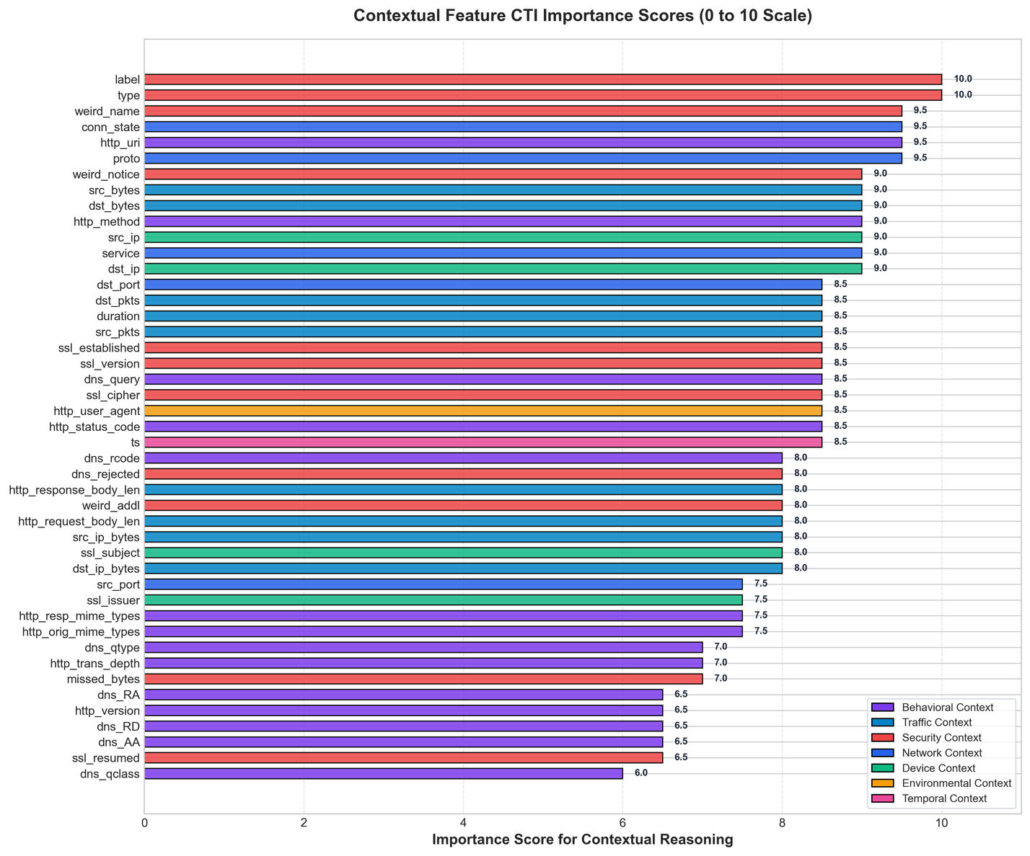
Importance scores and cyber threat intelligence contribution
Page: 23

Slide 25
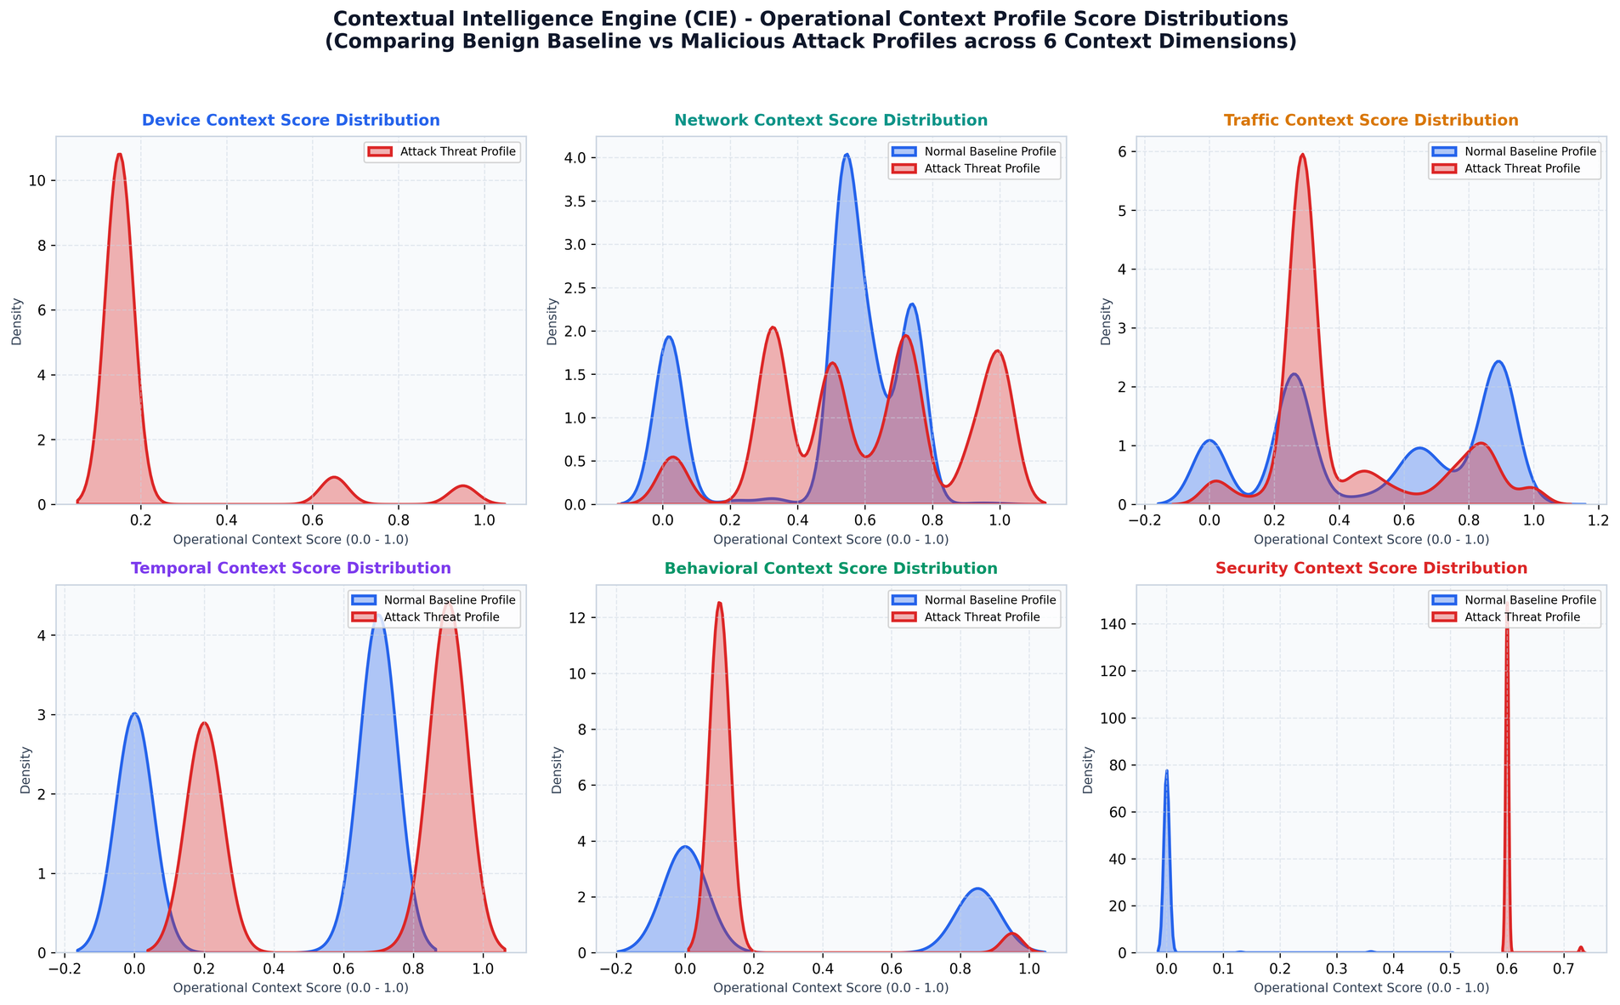
Context Profile Score Distribution
Page: 21

Slide 26
Conclusion
Successfully completed the ToN-IoT dataset preparation, context-oriented preprocessing, and graph-oriented feature engineering.
Established the initial development workflows for the Contextual Intelligence (Layer 3A) and Adaptive Graph Intelligence (Layer 3B) modules.
Completed the design of the contextual reasoning and graph intelligence foundations, including the Temporal Knowledge Graph and Network Provenance Graph planning.
The project is well-positioned to advance toward the implementation, integration, and validation of the core intelligence modules in the next development phase.
Page: 24

Slide 27


