Slide 1

CORTEX:A Context & Graph-Aware Multi-Agent Framework for Explainable Industrial IoT Threat Intelligence
Team members:
Lokpradeep B - AM.SC.U4CYS23018
Uday Ganesh B - AM.SC.U4CYS23019
Sri charan N - AM.SC.U4CYS23029
Akshara Kruti P - AM.SC.U4CYS23035
Guide Name:
Dr. Kurunandan Jain, Assistant Professor

Slide 2


CONTENTS
Problem Statement
Proposed Architecture
Overall Novelty
Expected Contributions
This Week's Progress
Results
Individual Week’s Contribution
Conclusion
References
Page: 01

Slide 3
PROBLEM STATEMENT
+
Ambiguous Attack Progression: Multi-stage Industrial IoT attacks propagate across devices and protocols, making the complete attack progression difficult to reconstruct accurately.
Insufficient Operational Context: Security events often lack sufficient operational and asset context, reducing the reliability of threat interpretation in mission-critical environments.
Uncertain Threat Prioritization: Security analysts struggle to distinguish critical attacks from low-impact events due to the absence of reliable confidence estimation during investigation.
Delayed Incident Investigation: Inaccurate attack reconstruction and fragmented evidence increase manual investigation time, delaying response in Industrial IoT environments.
Page: 02

Slide 4
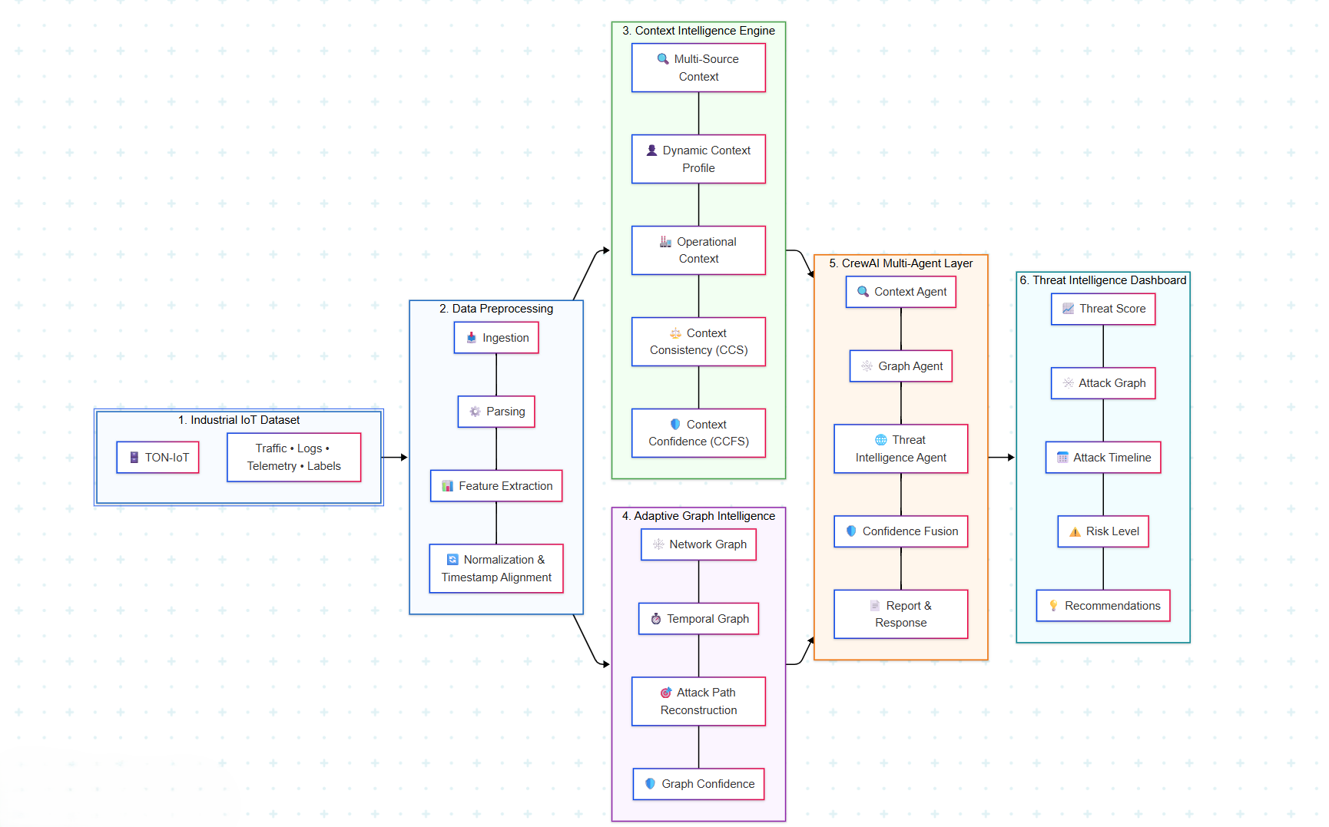
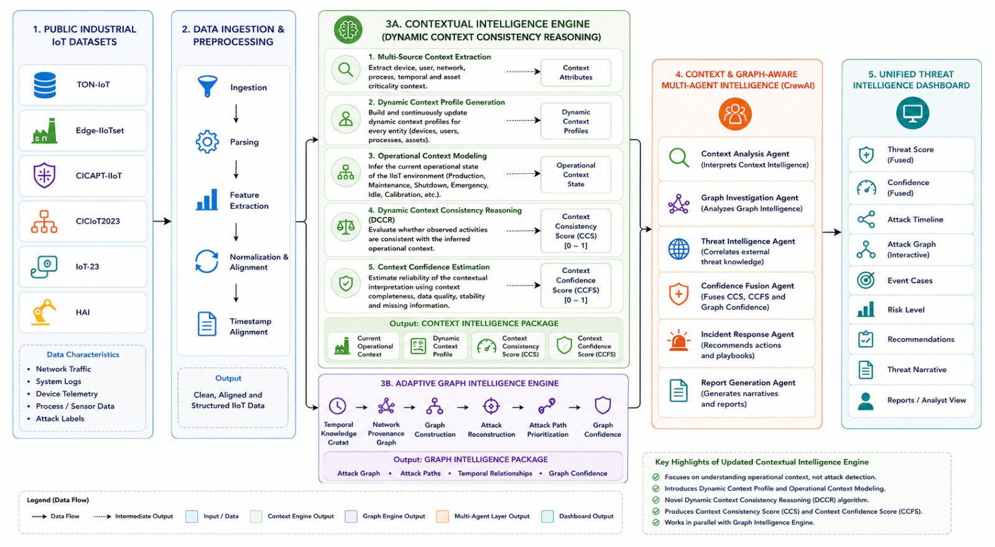
PROPOSED ARCHITECTURE
Page: 03

Slide 5
OVERALL NOVELTY
Dynamic Context Consistency Reasoning (DCCR) – Introduces a novel context reasoning framework that continuously generates Dynamic Context Profiles, models operational states, and evaluates context consistency with confidence-aware contextual intelligence.
Adaptive Graph-Based Attack Reconstruction – Dynamically reconstructs multi-stage attack paths using temporal relationships, provenance graphs, and graph intelligence to reveal attack progression.
Context & Graph-Aware Multi-Agent Intelligence – Employs specialized CrewAI agents to collaboratively fuse contextual and graph intelligence, enabling explainable threat investigation and autonomous cyber decision support.
Adaptive Confidence-Driven Threat Assessment – Produces trustworthy threat prioritization by confidence-aware fusion of contextual reasoning and graph intelligence for explainable Industrial IoT cyber threat assessment.
Page: 05

Slide 6
Overall Contributions
UDAY IIoT Dataset Collection & Preprocessing Contextual IntelligenceEngine Development Multi-Agent AI Integration Dashboard Development | AKSHARA Contextual IntelligenceEngine Development Context Acquisition & Operational Context Modeling Context Confidence Estimation & Validation Dynamic Contextual Reasoning
LOKPRADEEP Adaptive Graph Intelligence Development Temporal Knowledge Graph & Neo4j Attack Reconstruction & Graph Analytics Dashboard Development | CHARAN Network Provenance Graph Multi-Agent AI Development CrewAI & Llama 3 (Ollama) Integration Confidence Fusion & Threat Intelligence
Common Contributions Literature Survey & Methodology System Integration & Testing Performance Evaluation Experimental Analysis
Page: 06

Slide 7
This Week's Progress
Advanced the implementation of the Contextual Intelligence Engine (Layer 3A) by refining contextual reasoning, operational profiling, and adaptive context representation.
Extended the Adaptive Graph Intelligence Engine (Layer 3B) through the implementation of Temporal Knowledge Graph (TKG) construction, Network Provenance Graph (NPG) modeling, and graph structure refinement.
Standardized contextual, temporal, and provenance representations across heterogeneous Industrial IoT telemetry to establish a unified cyber intelligence framework.
Refined graph traversal, provenance correlation, and temporal event modeling to strengthen explainable threat investigation and graph intelligence.
Established the implementation foundation for graph analytics, adaptive attack reconstruction, confidence-driven threat assessment, and subsequent multi-agent intelligence integration.
Page: 07

Slide 8
Individual Week’s Contribution
Page: 08

Slide 9
Uday
Implemented Dynamic Context Profile Generation for Industrial IIoT entities.
Integrated Welford’s algorithm for online statistical baseline generation.
Integrated multi-source telemetry into entity-specific dynamic profiles.
Page: 09

Slide 10
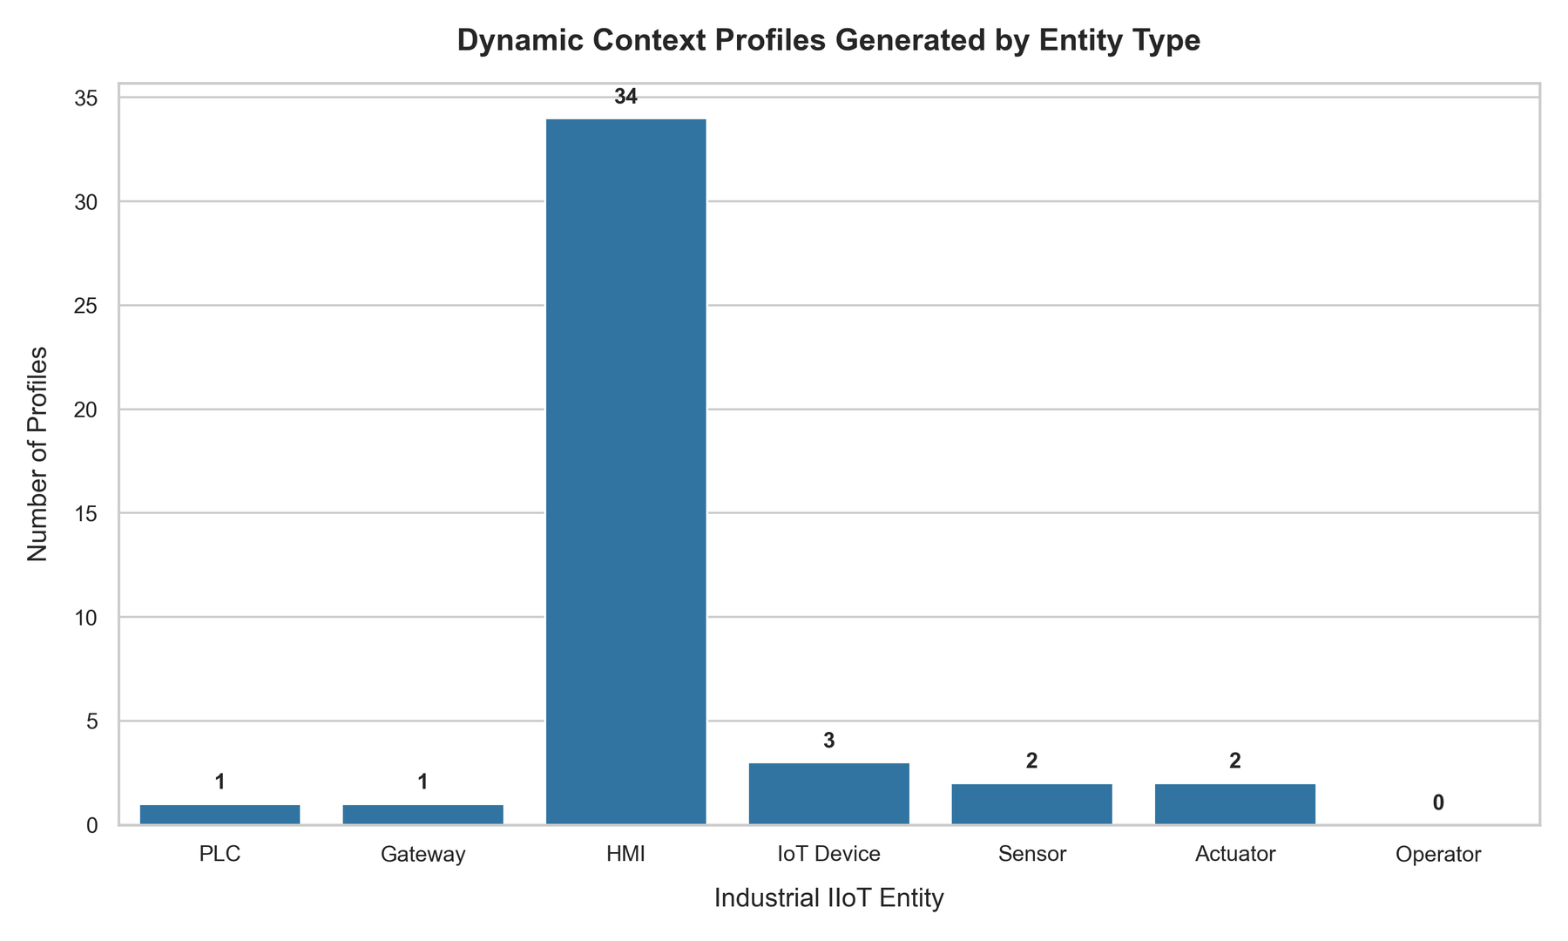
Page: 10

Slide 11
Charan
Refined the Network Provenance Graph by improving provenance relationship modeling and graph connectivity.
Enhanced provenance graph generation through structural optimization and node–edge consistency validation.
Standardized provenance representations for reliable graph traversal and future attack path analysis.
Page: 11

Slide 12
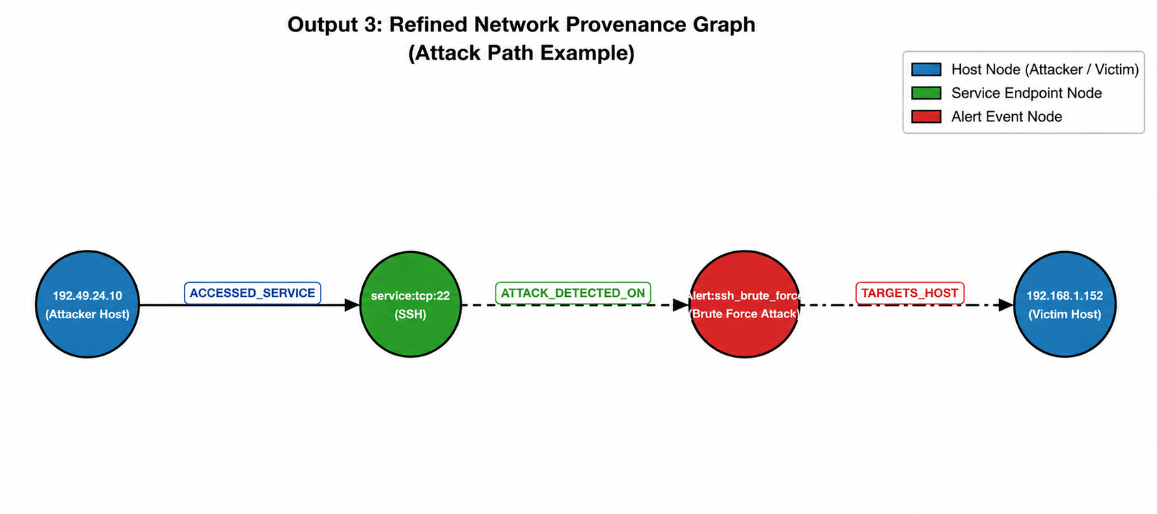
Charan
Page: 12

Slide 13
Akshara
Enhanced contextual confidence estimation by refining contextual scoring and feature importance evaluation.
Improved adaptive contextual parameter modeling using operational and behavioral intelligence.
Standardized contextual confidence metrics to support consistent confidence-aware reasoning.
Established the implementation foundation for confidence fusion and explainable contextual intelligence.
Page: 13

Slide 14
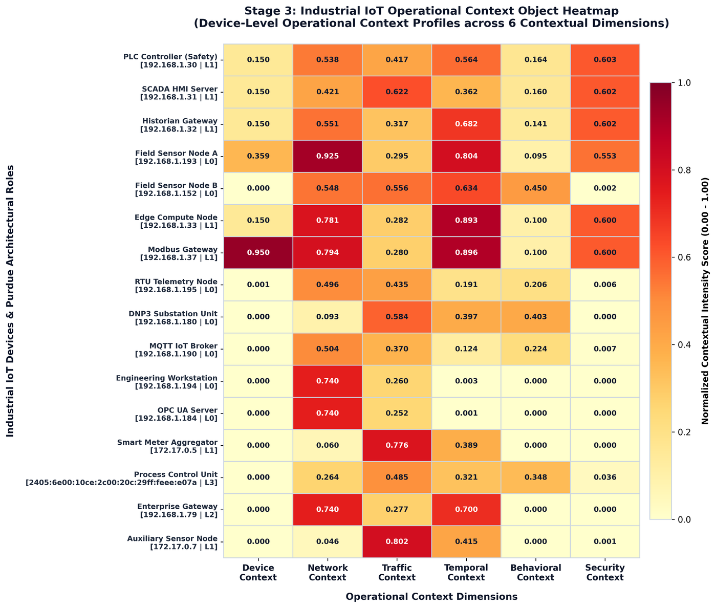
Operational Context Objects
Page: 14

Slide 15
Conclusion
Successfully advanced the implementation of the Contextual Intelligence Engine (Layer 3A) through contextual reasoning refinement, operational profiling, and adaptive context representation.
Extended the Adaptive Graph Intelligence Engine (Layer 3B) by implementing the foundations of the Temporal Knowledge Graph (TKG) and Network Provenance Graph (NPG) for graph-based cyber intelligence.
Refined graph-oriented data modeling by enhancing temporal relationships, provenance representation, and graph schema to support explainable threat analysis.
Established implementation foundation for subsequent graph analytics, attack reconstruction, confidence-aware reasoning, and multi-agent intelligence integration in the next development phase.
Page: 15

Slide 16


