Slide 1


SIMATS ENGINEERING Saveetha Institute of Medical and Technical Sciences Chennai-602105.
Online Quiz with leaderboard
Presentation By: K. Krishna Charan 192311316
Supervisor: L. Reetha

Slide 2
Aim
To develop a secure and interactive online platform for conducting quizzes in a digital environment.
To enable user registration and authentication with proper security measures.
To allow users to participate in quizzes categorized by difficulty or topic.
To automatically evaluate responses and display results in real time.
To provide a dynamic leaderboard that showcases top performers based on scores and time.
To offer administrative control for managing quiz content, users, and results.
To ensure data accuracy, prevent cheating, and maintain quiz integrity.
To enhance user engagement through a responsive, user-friendly, and visually appealing interface.

Slide 3
Abstract
User-Friendly Interface: The system provides an intuitive and engaging interface, allowing users to easily navigate through the quiz process from login to result viewing.
Secure Login System: User authentication ensures that only registered participants can access and attempt quizzes, maintaining data integrity and user privacy.
Quiz Management: The platform offers categorized quizzes (easy, medium, hard), each with a fixed number of questions and automatic scoring upon completion.
Real-Time Leaderboard: A dynamic leaderboard displays top scorers based on accuracy and completion time, promoting healthy competition and motivation.
Result Analysis: Upon quiz submission, users receive instant feedback on their performance, including score, correct answers, and time taken.

Slide 4
Introduction
The Online Quiz with Leaderboard system is a web-based application designed for conducting quizzes in an organized and interactive manner.
It allows users to securely log in using their credentials to access available quizzes.
Once logged in, users can choose quiz categories based on difficulty levels such as easy, medium, or hard.
The system presents a series of timed questions and automatically evaluates the responses.
After completing the quiz, users can view their scores and see how they rank on a dynamic leaderboard.
All quiz attempts and results are stored and can be reviewed for performance tracking and improvement.

Slide 5
Algorithm
Start the system and display the login interface.
Input user details (name, email, password) and quiz category selection.
Validate input fields and store user data in local storage.
Load quiz questions based on the selected category and start the timer.
Allow user to select answers and submit the quiz manually or on timeout.
Evaluate the quiz, calculate score, and display explanations for wrong answers.
Update and display the leaderboard by saving and sorting scores.
Provide options to logout or reset the leaderboard, then end the session.

Slide 6
Flow Diagram
Start
Online Quiz System With Leaderboard
Login
Show Quiz
Attempt Quiz
View Results
Leaderboard
Logout
End

Slide 7
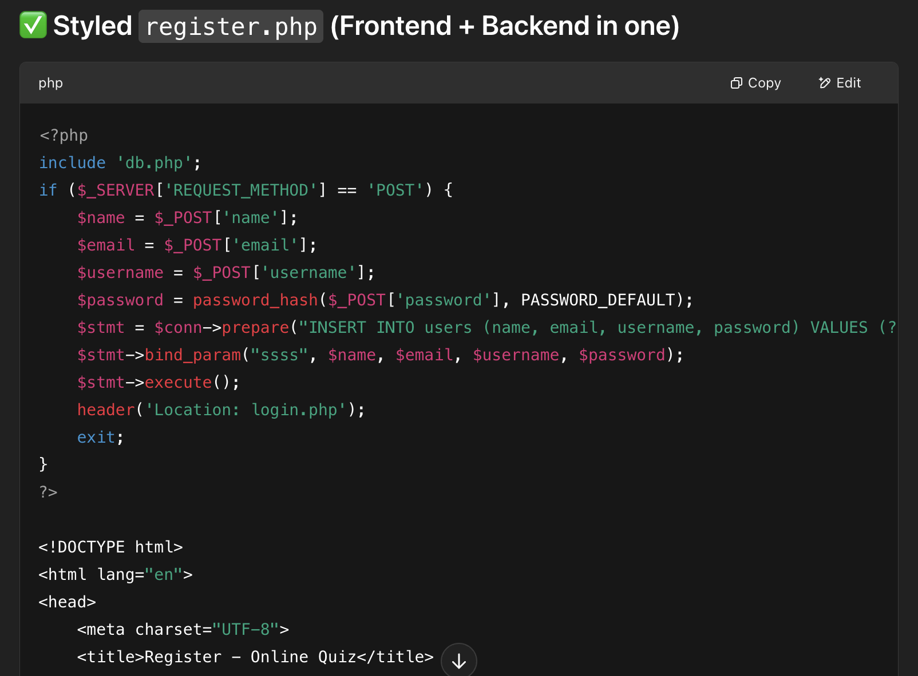
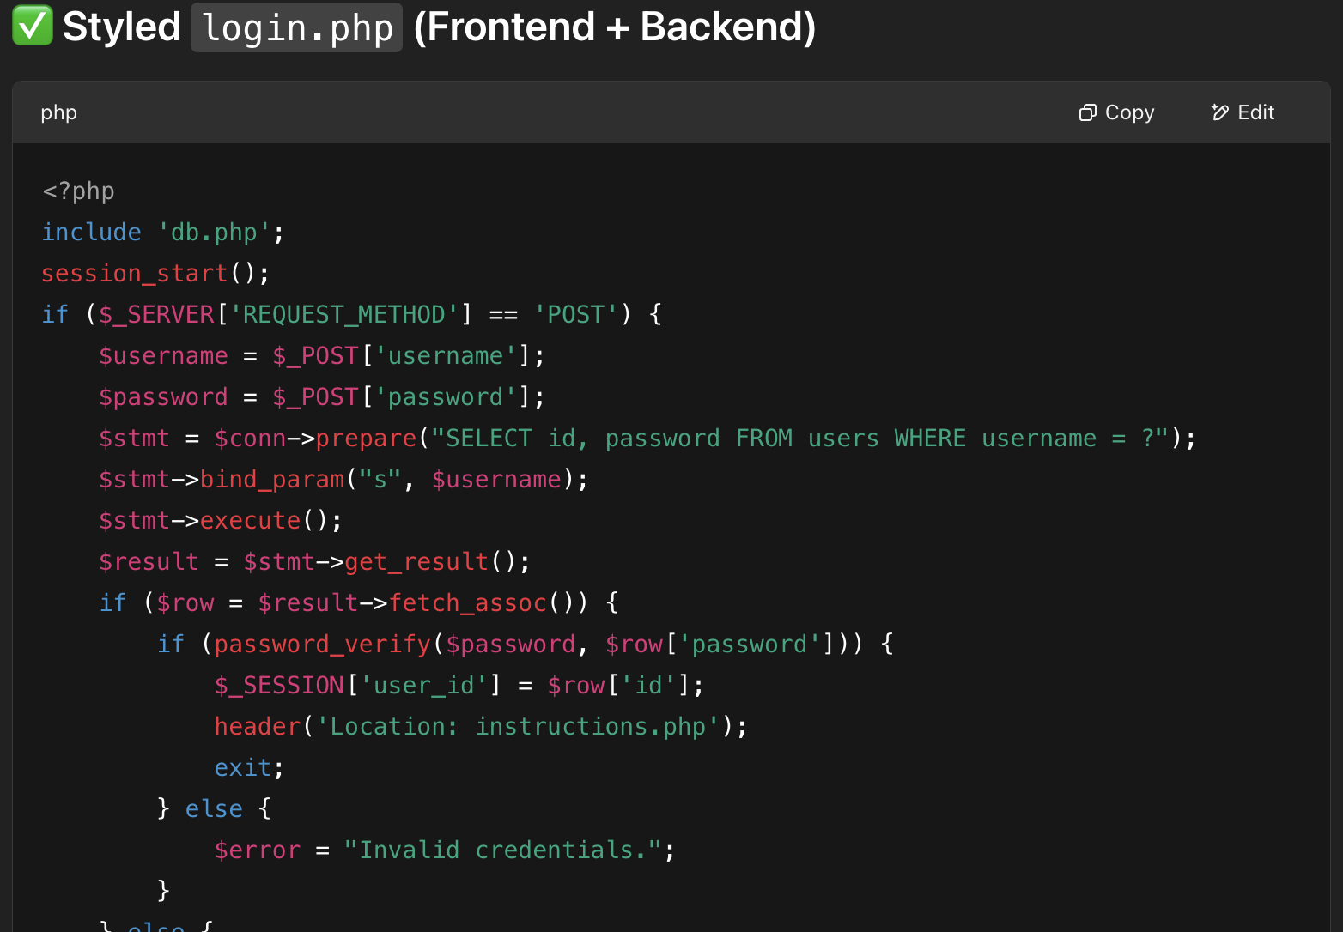
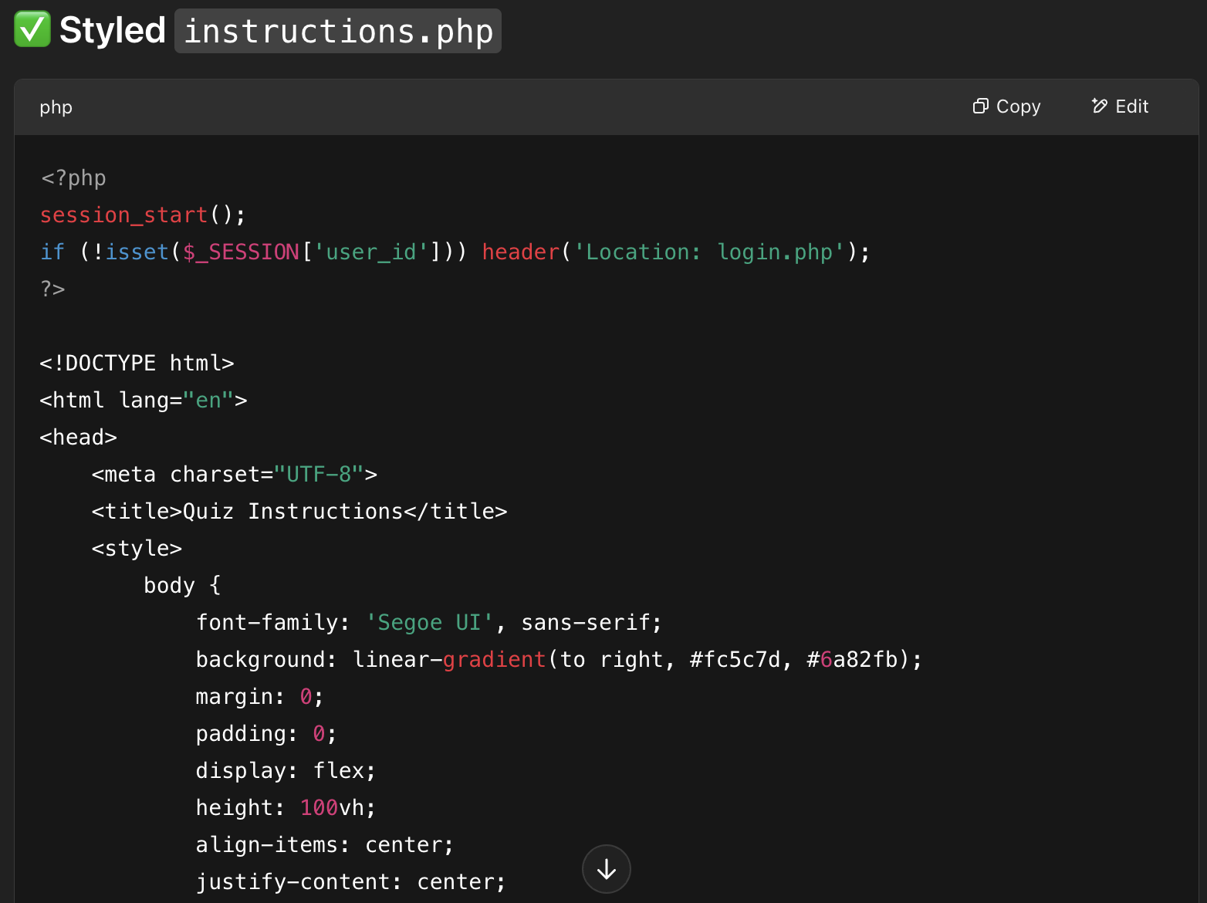
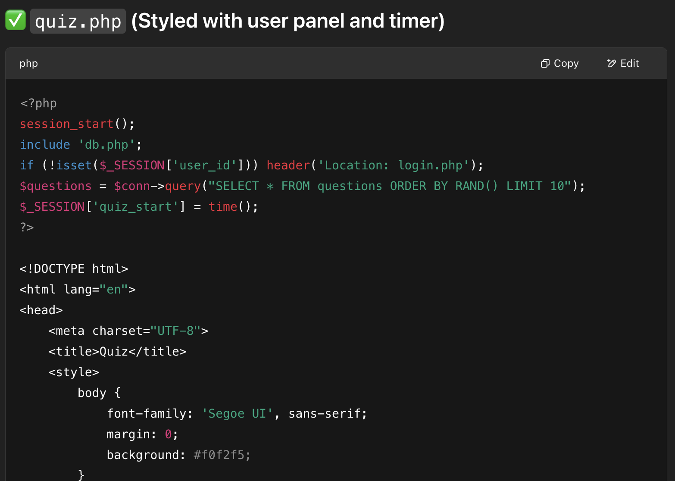
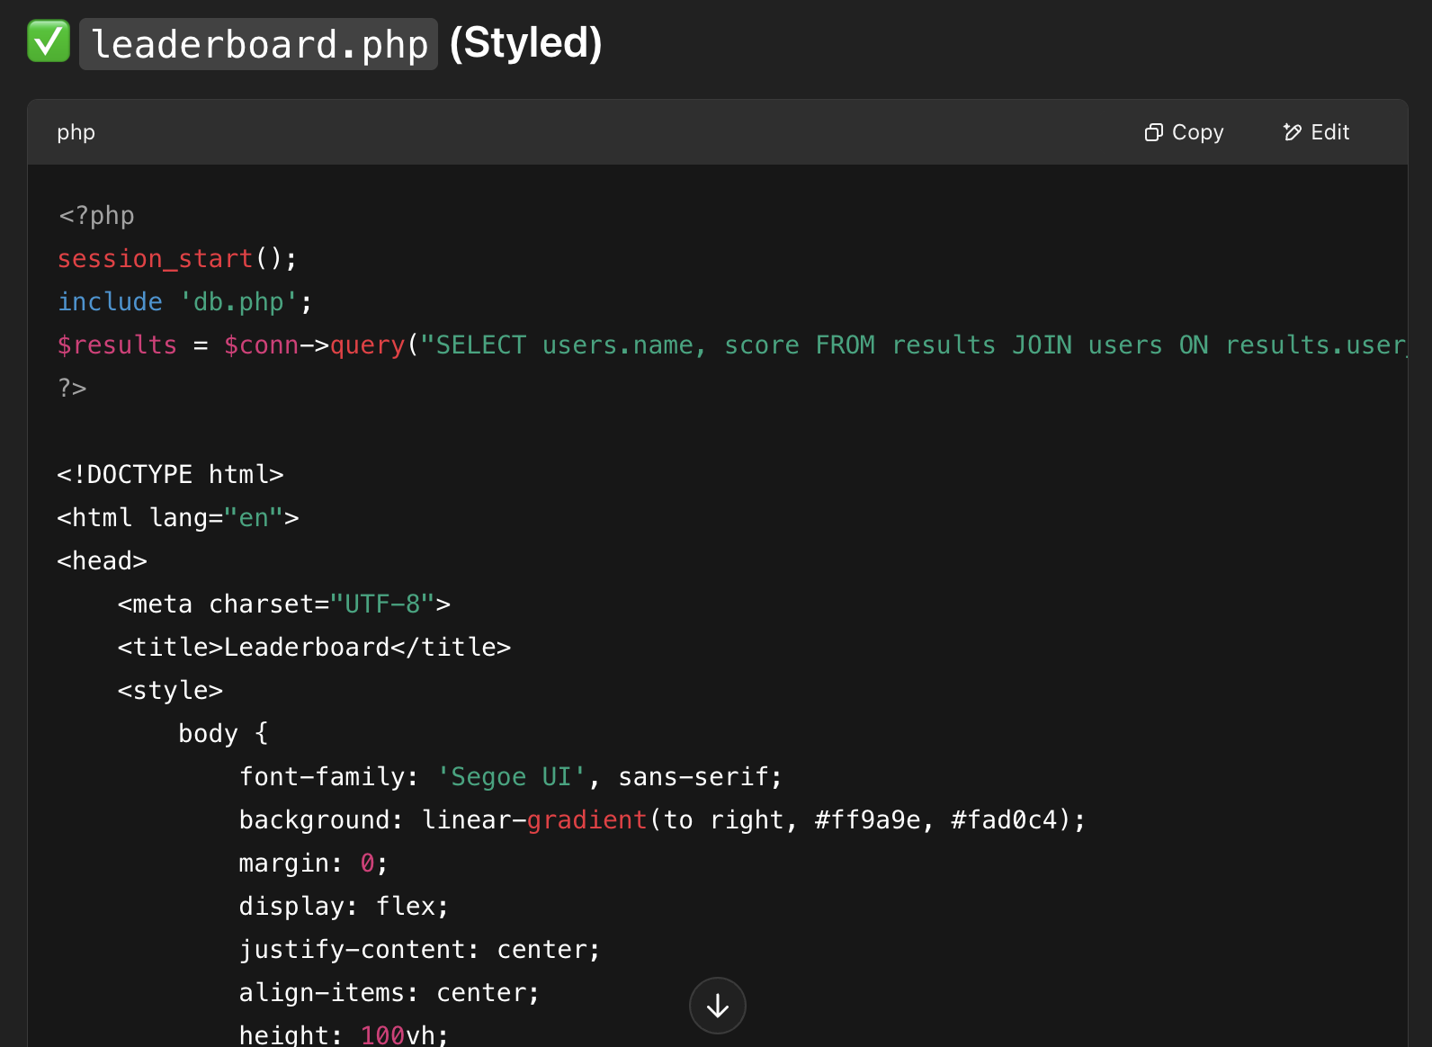
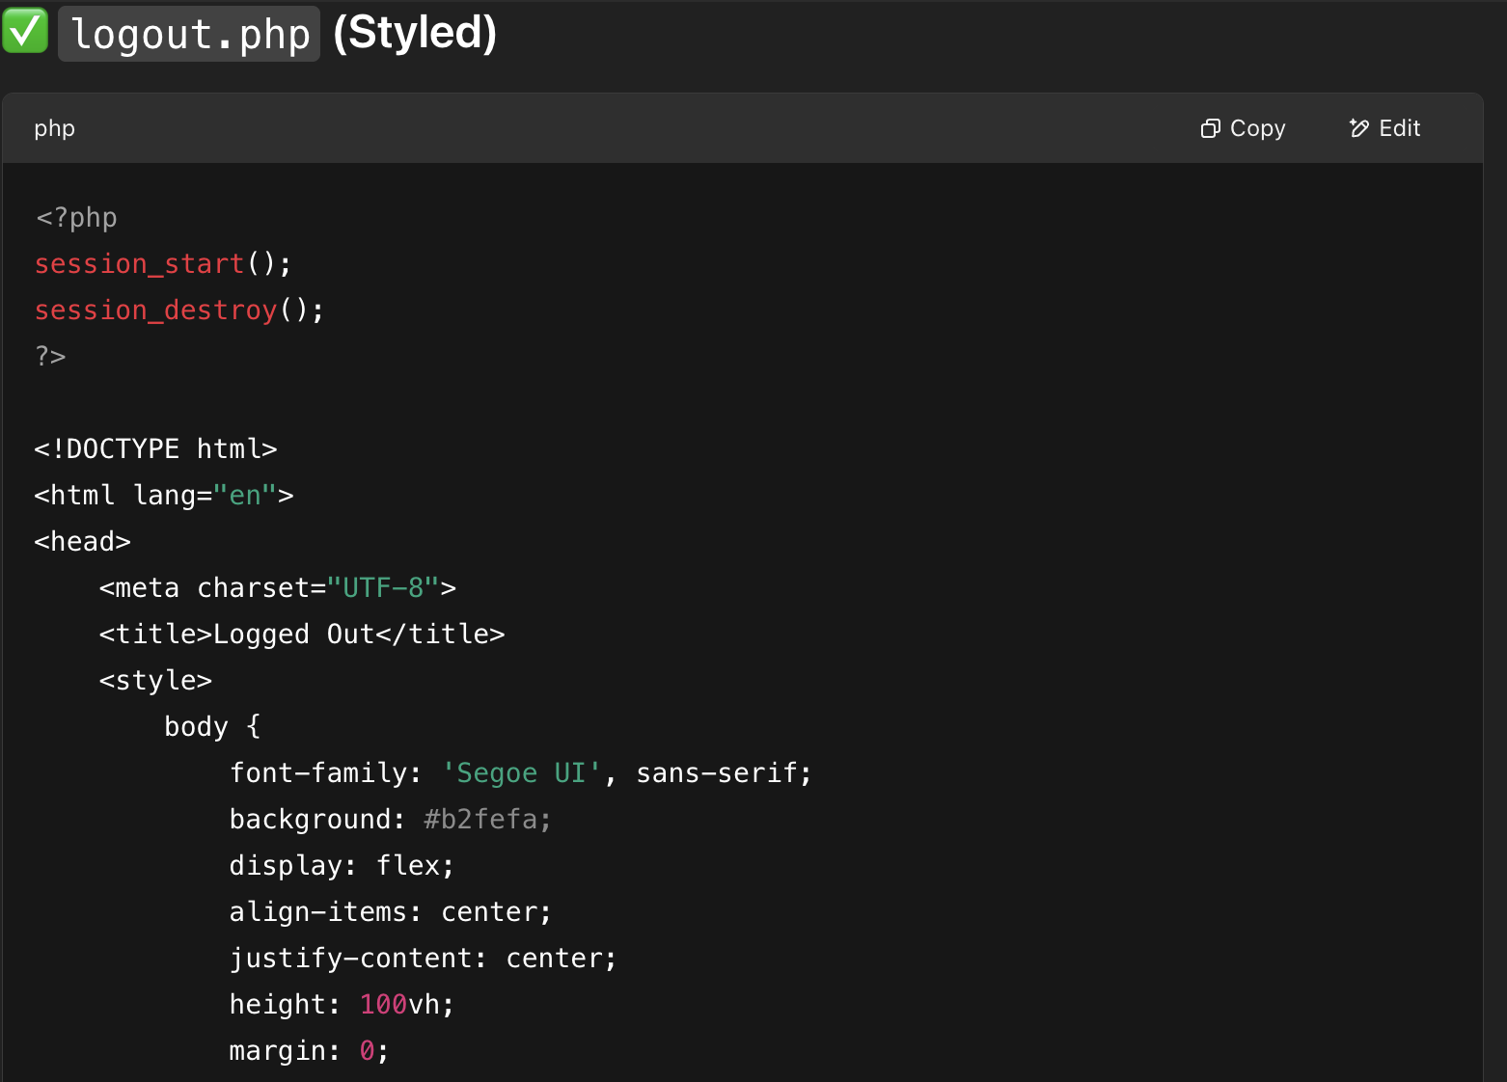
Input/Output
Code Snippets:

Slide 8
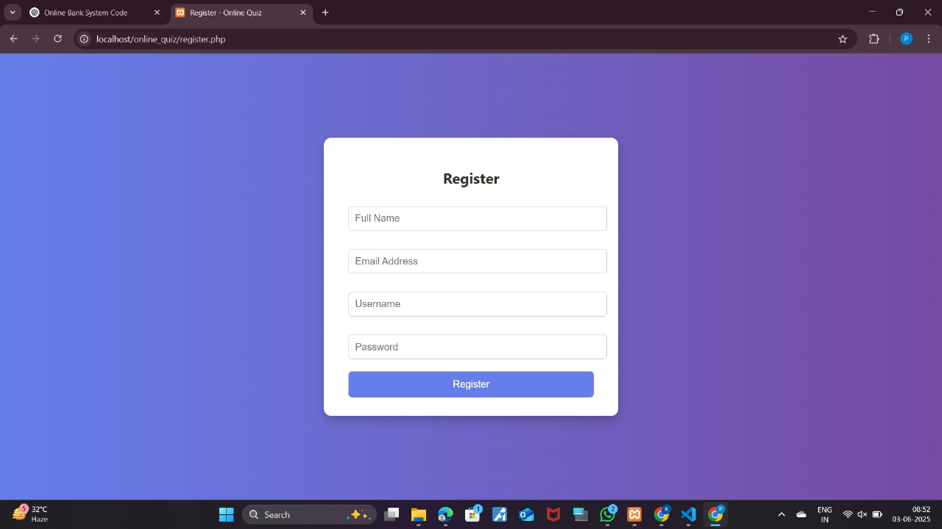
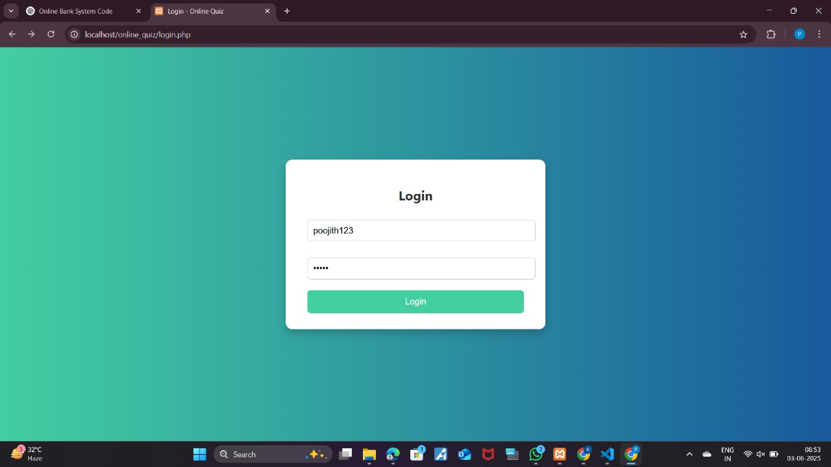
Input/Output
Register
2. Login

Slide 9
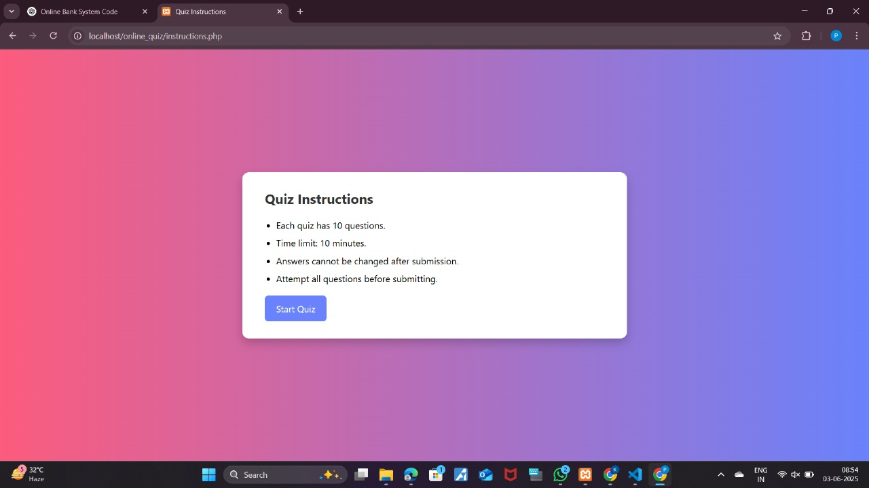
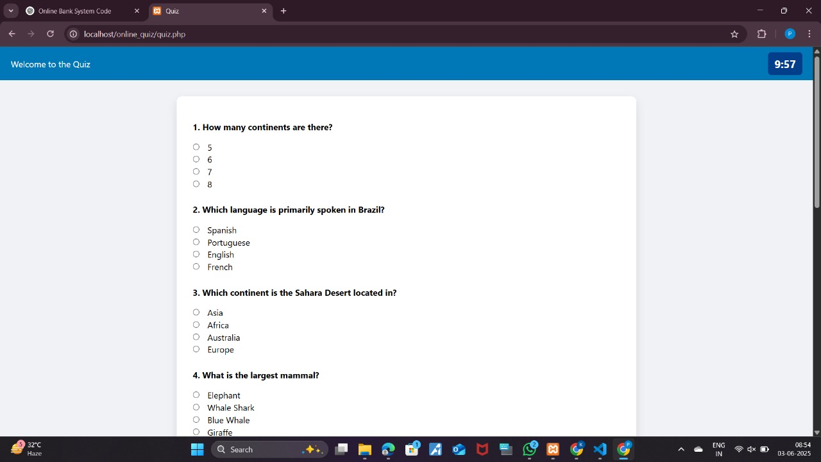
Input/Output
3. Instructions
4. Quiz

Slide 10
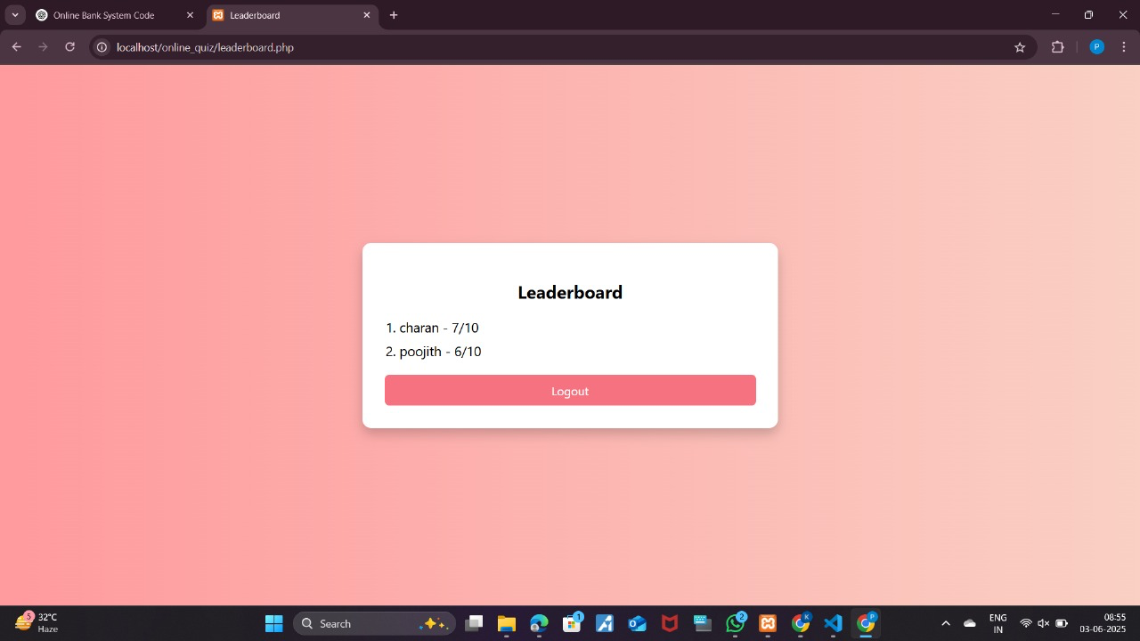
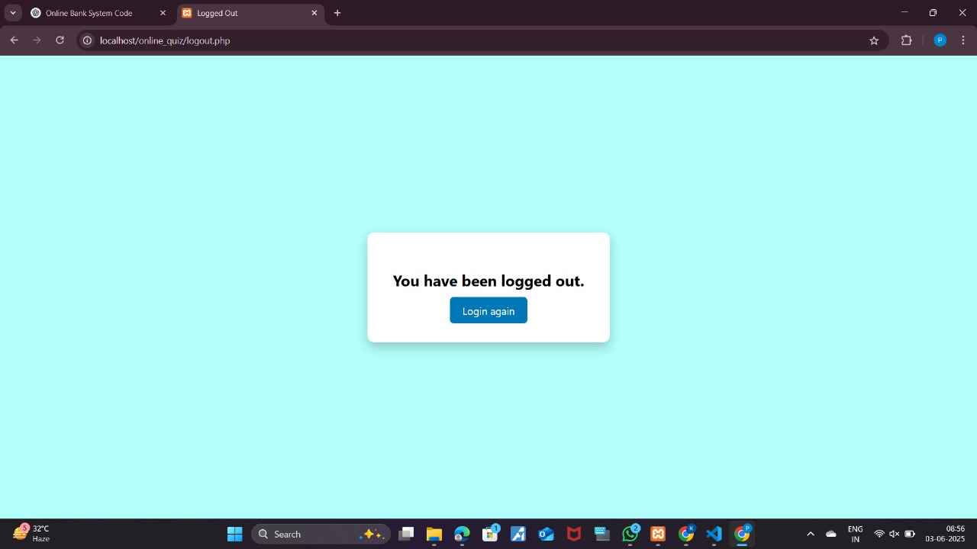
Input/Output
5. Leaderboard
6. Logout

Slide 11
Dataset Used
User Details: Name, Email, Password, and Selected Quiz Category.
Quiz Questions:
Divided into Easy, Medium, and Hard levels.
Each question has options, correct answer, and explanation.
Quiz Results: User name and score are stored for the leaderboard.
All data is stored in the browser's local storage for testing purposes. In real applications, databases like MySQL or JSON/CSV files can be used.

Slide 12
Result Analysis
User Participation – Users can successfully log in and attempt quizzes based on selected difficulty.
Score Calculation – The system accurately evaluates answers and calculates scores.
Leaderboard Accuracy – Leaderboard displays top scores in descending order without error.
Answer Feedback – Explanations for incorrect answers are shown to enhance learning.
Data Persistence – User scores and details are correctly saved using local storage.
Category-wise Functionality – All quiz levels (Easy, Medium, Hard) load and function as expected.
Timer Accuracy – Countdown timer runs properly and submits the quiz when time is up.

Slide 13
References
Laudon, K. C., & Laudon, J. P. (2020). Management Information Systems: Managing the Digital Firm (16th ed.). Pearson.
Kurose, J. F., & Ross, K. W. (2021). Computer Networking: A Top-Down Approach (8th ed.). Pearson.
Stallings, W. (2016). Cryptography and Network Security: Principles and Practice (7th ed.). Pearson.
Elmasri, R., & Navathe, S. B. (2016). Fundamentals of Database Systems (7th ed.). Pearson.
Sharma, G., & Arora, A. (2019). Online Quiz System Using JavaScript and Local Storage. International Journal of Computer Applications, 175(2), 12-17.
Patel, R., & Singh, A. (2020). Design and Implementation of an Online Quiz Application Using HTML5 and JavaScript. International Journal of Advanced Research in Computer Science, 11(4), 32-38.

Slide 14
Thank You

