Slide 1


SRKR ENGINEERING COLLEGE
COMMUNITY SERVICE INTERNSHIP PRESENTATION
GreeNova
Community-driven solutions for a sustainable lifestyle
Community: Vempadu
Duration: 28-05-2025 to 29-07-2025
Mentor: Mr. B.N.V.Narasimha Raju, Assistant Prof., Department of CSE in SRKR Engineering College

Slide 2
Introduction:
The main purpose of our Community Service Internship was to understand the waste management problems in our locality and find practical solutions.
Our project focused on identifying why people throw waste outside and how this habit leads to issues like mosquito breeding, drainage blockage, and unhygienic surroundings.
Through this project, we aimed to create awareness about proper waste disposal, encourage the use of dustbins, and promote cleanliness among residents.
This activity helped us develop teamwork, communication, and social responsibility while contributing to a cleaner and healthier community.

Slide 3

Problems Identified in the Community:
Many residents throw household waste outside due to the lack of dustbins and proper awareness.
This careless disposal leads to garbage accumulation, mosquito breeding, and frequent drainage blockages. Most people are unaware of the importance of waste segregation and hygiene practices. There is no proper system for waste collection or monitoring cleanliness in the area.
Irregular cleaning schedules and limited coordination between residents and municipal workers make the situation worse.
Problem Statement

Slide 4

Abstract:
To identify and understand the major waste management problems in our locality, such as garbage accumulation, mosquito breeding, and drainage blockages.
To study the reasons behind improper waste disposal and lack of awareness among residents.
To spread awareness about cleanliness, waste segregation, and the importance of using dustbins.
To encourage community participation in maintaining a clean and healthy environment.
To promote a sense of social responsibility and teamwork among citizens and students through this community service activity.

Slide 5
Purpose of the Survey:
To identify the main waste management problems like garbage accumulation and drainage blockages in our locality.
To understand why residents throw waste outside and their awareness level about cleanliness. To promote proper waste disposal habits and create awareness on using dustbins and maintaining hygiene.
How the Survey was Conducted:
Conducted through door-to-door interactions.
Location: Vempadu
Key Questions:
Are you aware of the concept of
waste decomposition Do you separate wet waste and dry waste? Do you face any issues with waste collection in your areas?
Survey Findings:
Many residents do not have dustbins at home, which leads to throwing waste outside and poor sanitation.
65% of residents were unaware of proper waste segregation practices.

Slide 6
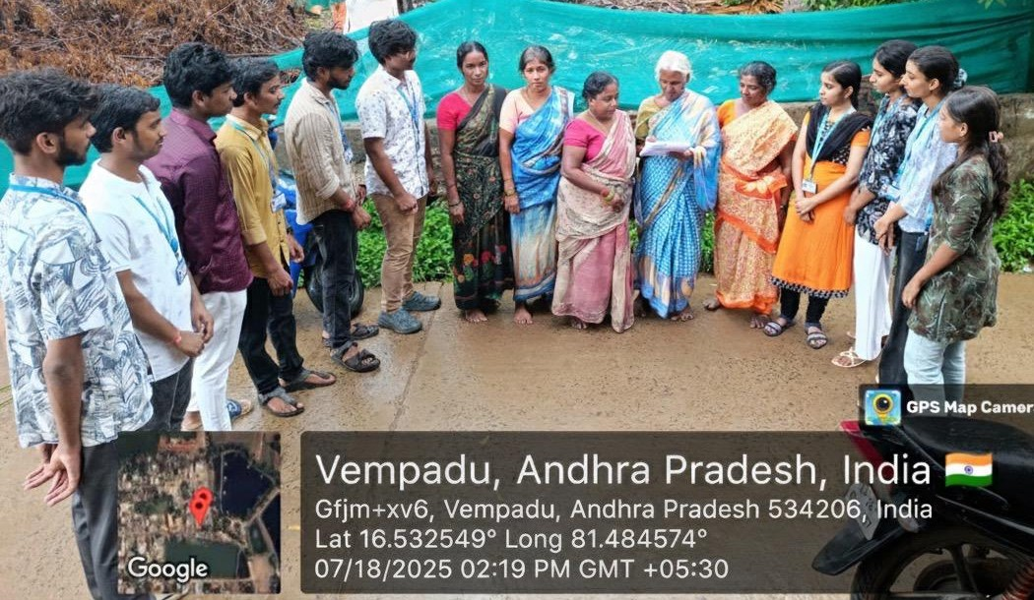
Survey Activity Snapshot

Slide 7
Weekly Work Schedule
Week
Week 1
Week 2
Week 3
Week 4
Week 5
Week 6
Week 7
Dates
20/06/2025-28-06-2025
29/06/2025-5/07-2025
6/07/2025-08/07/2025
09/07/2025-10/07/2025
11/07/2025-15/07/2025
16/07/2025-18/07/2025
19/07/2025-30/07/2025
Activity
Visited Vempadu Community, interacted with residents, and conducted surveys on sanitation and drainage issues
Continued survey in uncovered areas, analysed and collected data to identify major issues.
Identified areas where household waste is being thrown openly instead of using dustbins.
Met village residents, shared survey findings, discussed possible solutions, and planned community cleanliness activities.
Took part in cleanliness drives with workers, monitored cleaned areas, and ensures proper waste disposal.
Conducted awareness campagins and school visits to promote hygiene and waste segregation.
Implementing a web application on waste management “GREENOVA”

Slide 8
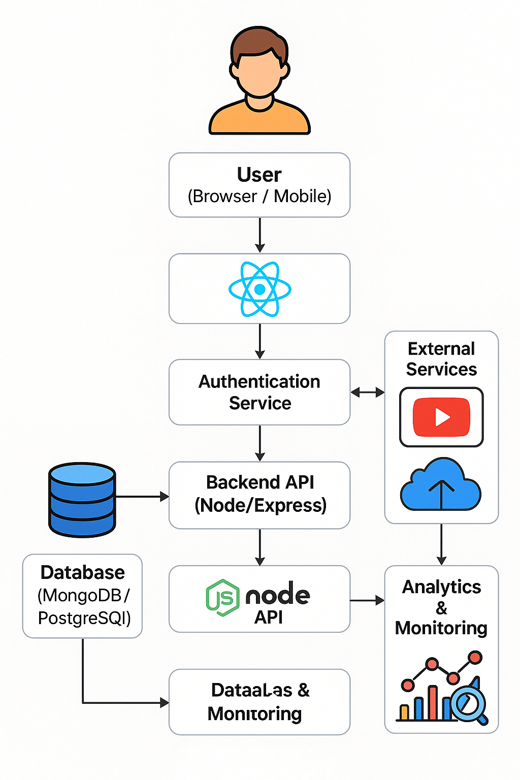
TECHNOLOGICAL SOLUTION
GreeNova provides an interactive platform that educates users on effective waste management and sustainable practices through a user-friendly interface.
The website includes a categorized video library featuring informative content on recycling, composting, upcycling, and e-waste disposal.
Users can explore and filter videos to learn practical waste segregation methods and eco-friendly habits.
The system allows team members to dynamically add new awareness videos, keeping the platform updated and engaging.
GreeNova promotes community participation by collecting feedback and spreading awareness digitally, connecting technology with environmental responsibility.

Slide 9
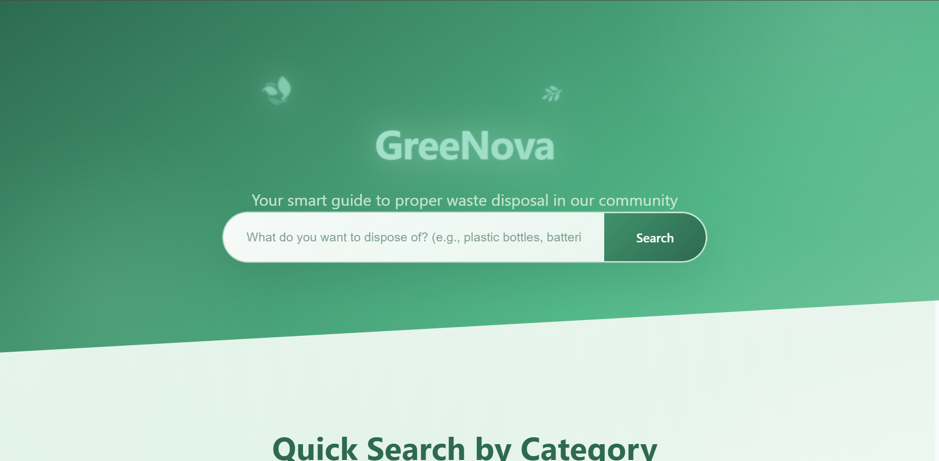

Slide 10
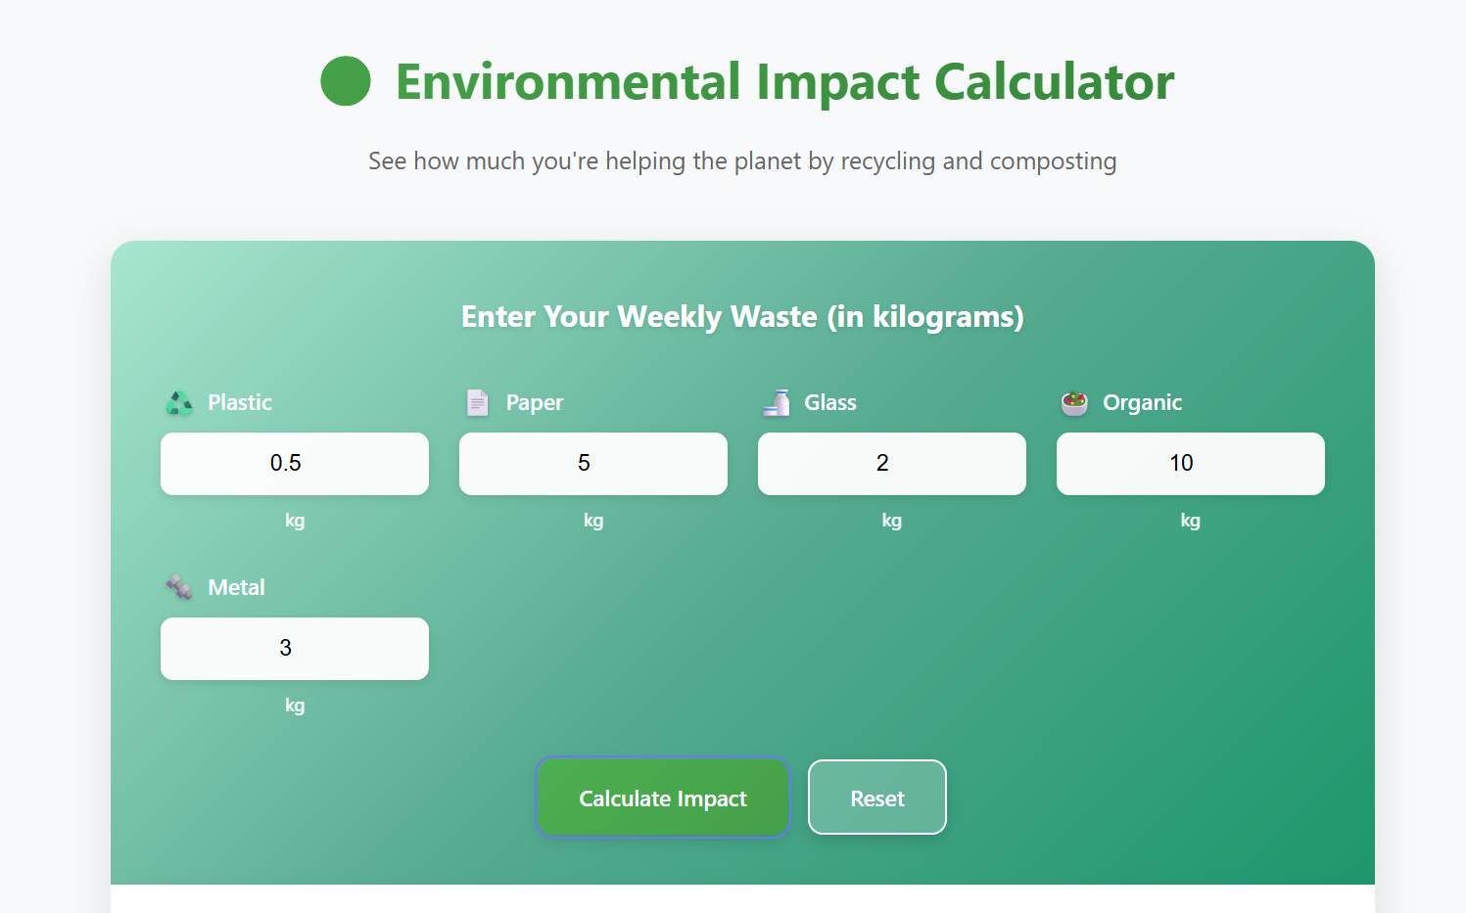
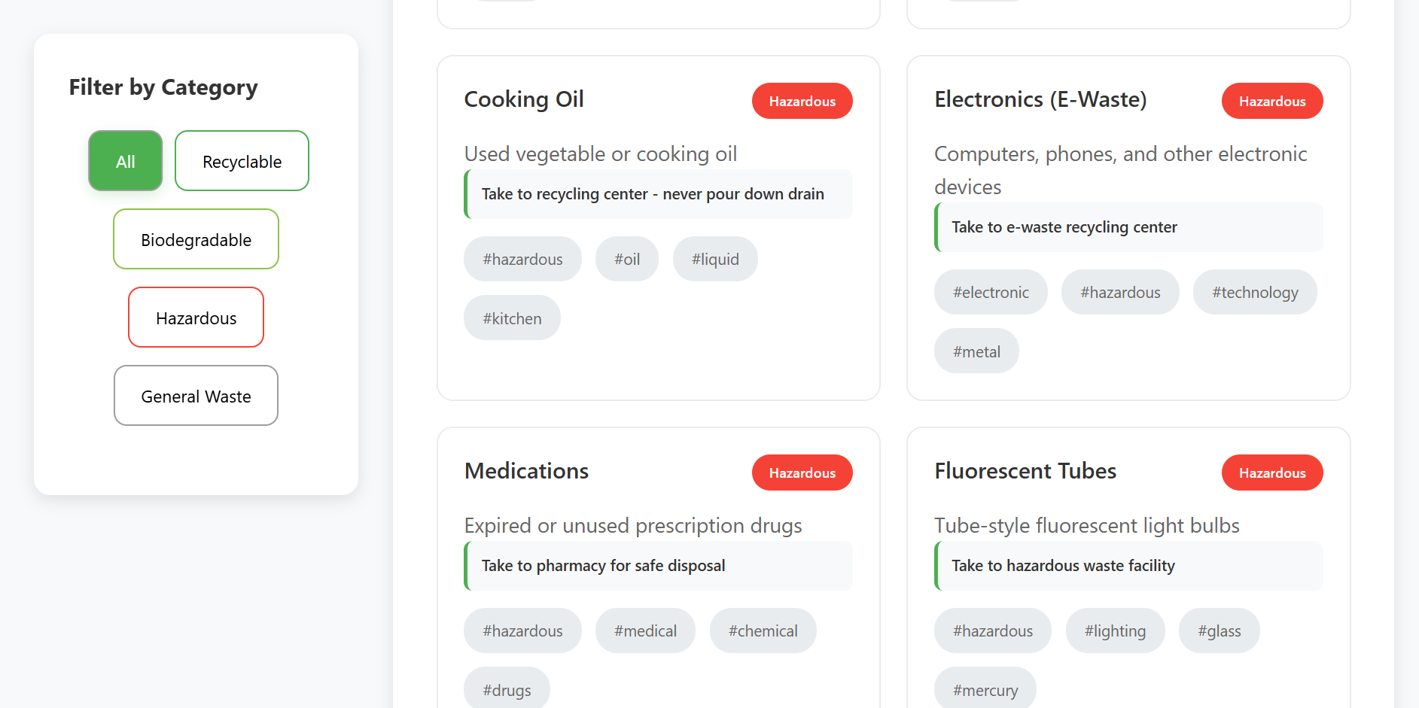
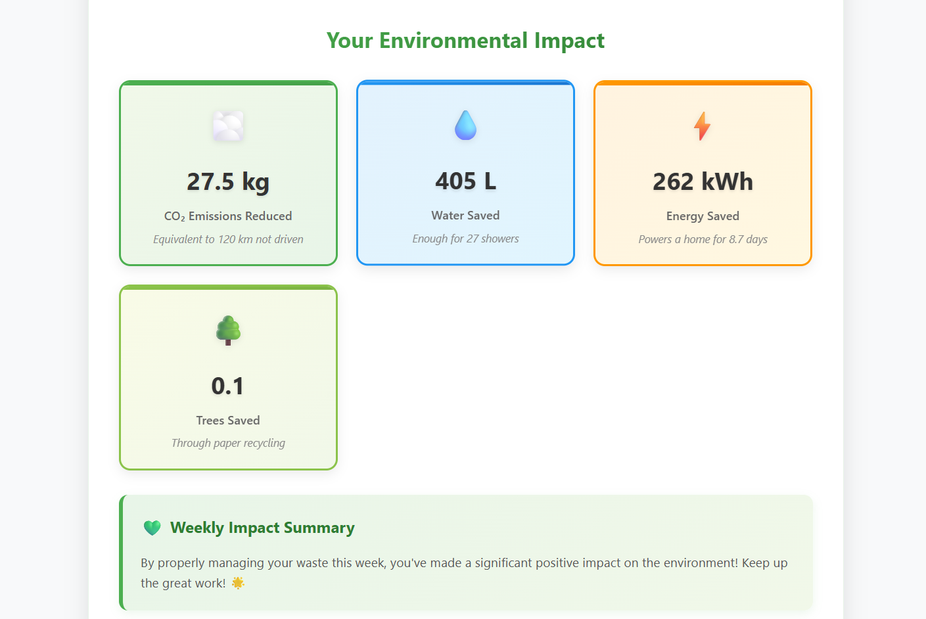
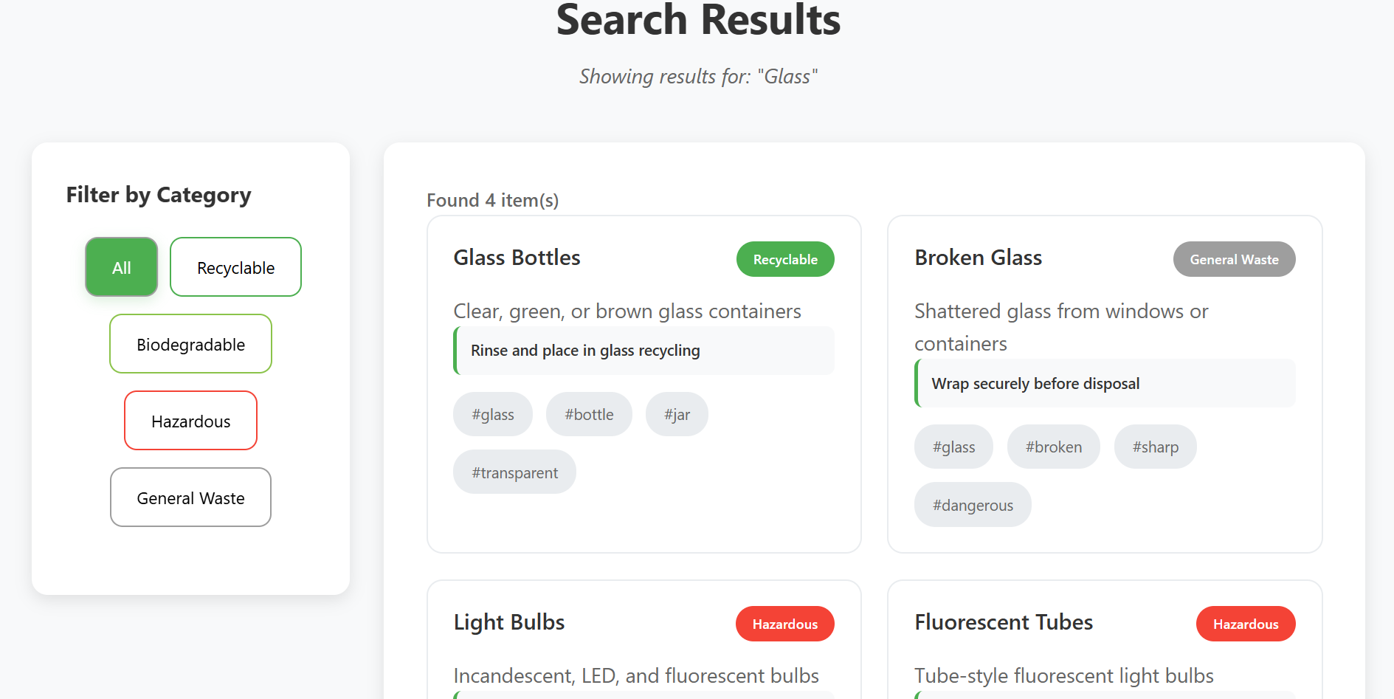
Body

Slide 11
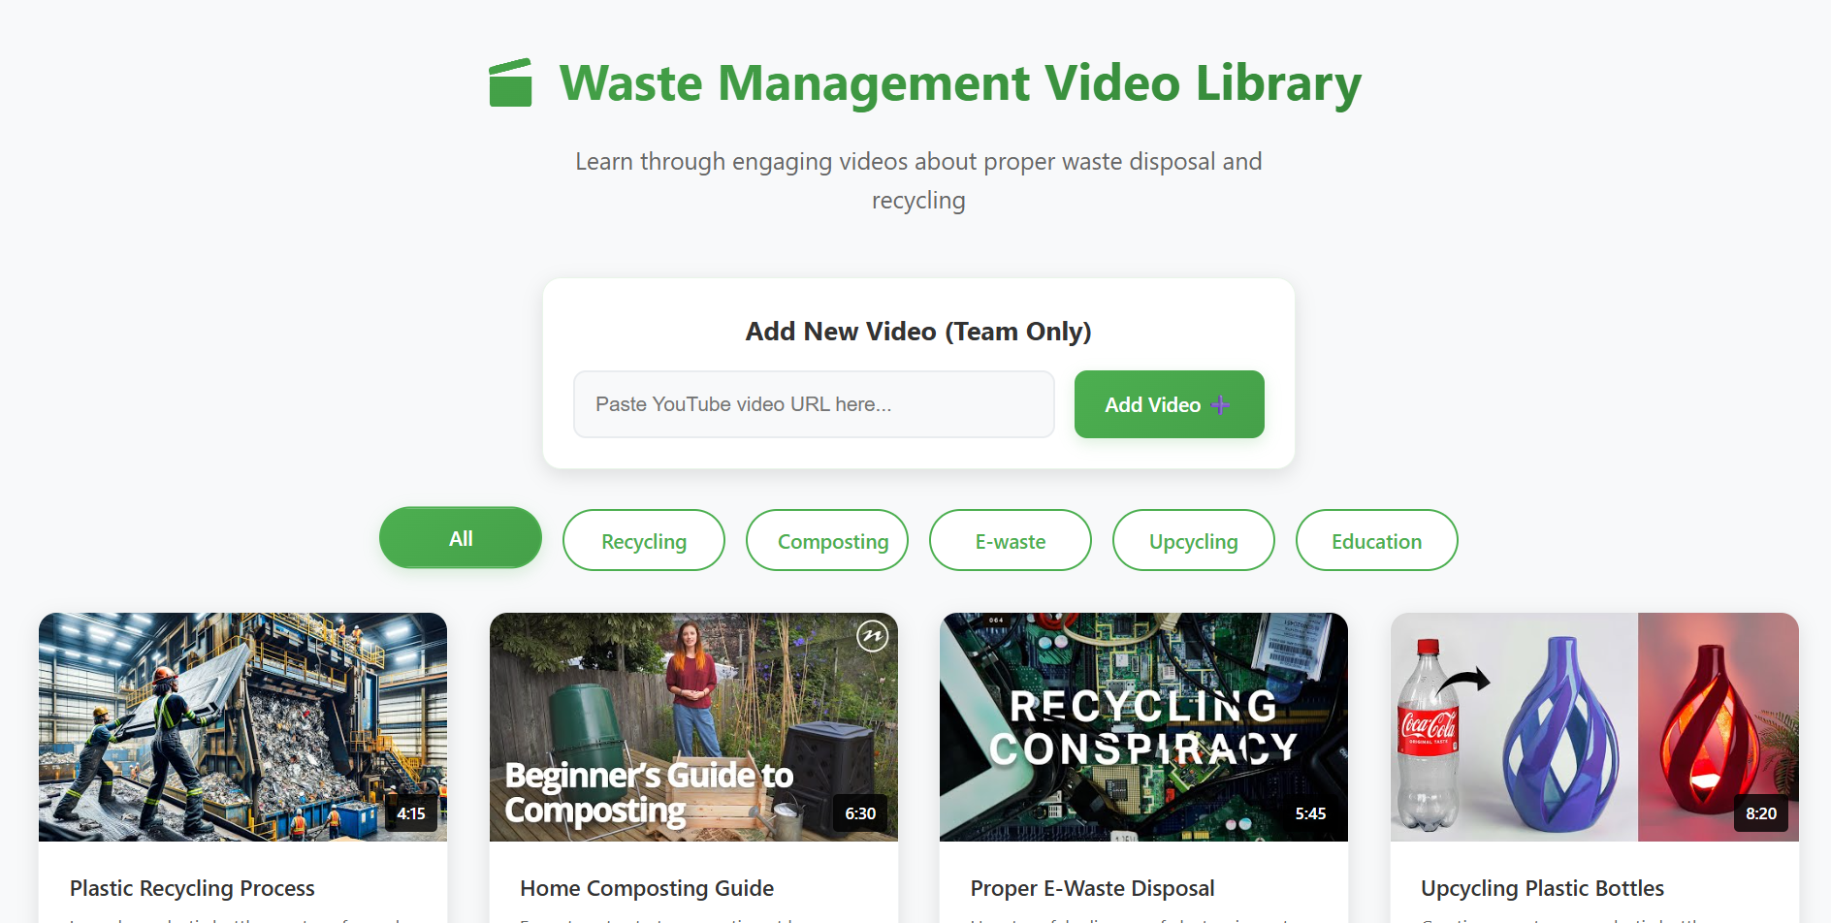
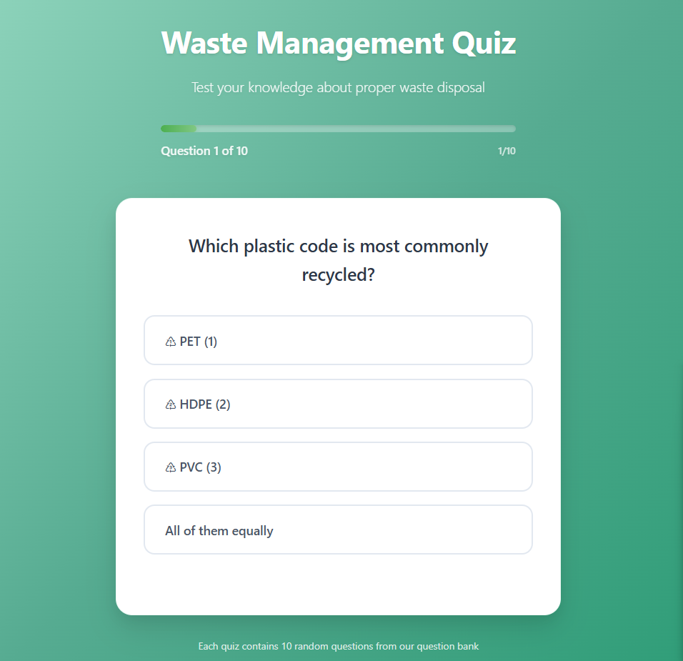
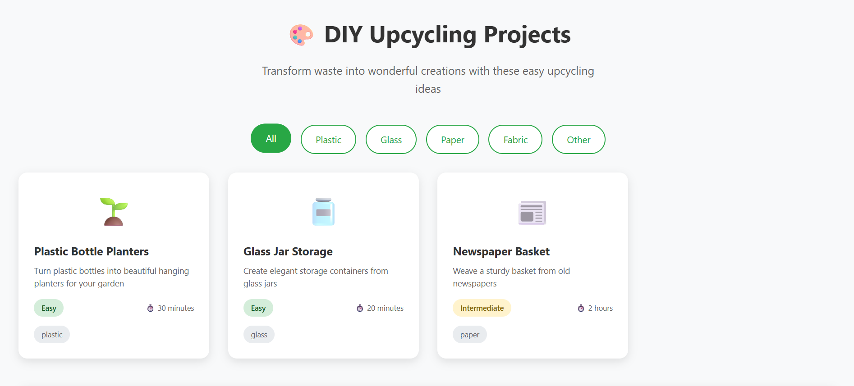

Slide 12
Awareness & Campaign Activities
Activities Conducted
Poster & Banner Campaigns: Displayed awareness posters with messages like “Clean Streets, Healthy Homes.”
Door-to-Door Awareness: Interacted with residents and explained proper waste disposal and hygiene habits.
School Awareness Sessions: Conducted small talks with students to promote civic responsibility and cleanliness.
Waste Spot Identification: Identified areas where household waste was being thrown and suggested proper disposal methods.
Impact / Outcomes
Increased public awareness about waste segregation and hygiene practices.
Improved cooperation between the community and sanitation staff.
Youth and students actively participated in maintaining cleanliness.
The local environment improved,
with cleaner streets and unblocked drains.

Slide 13
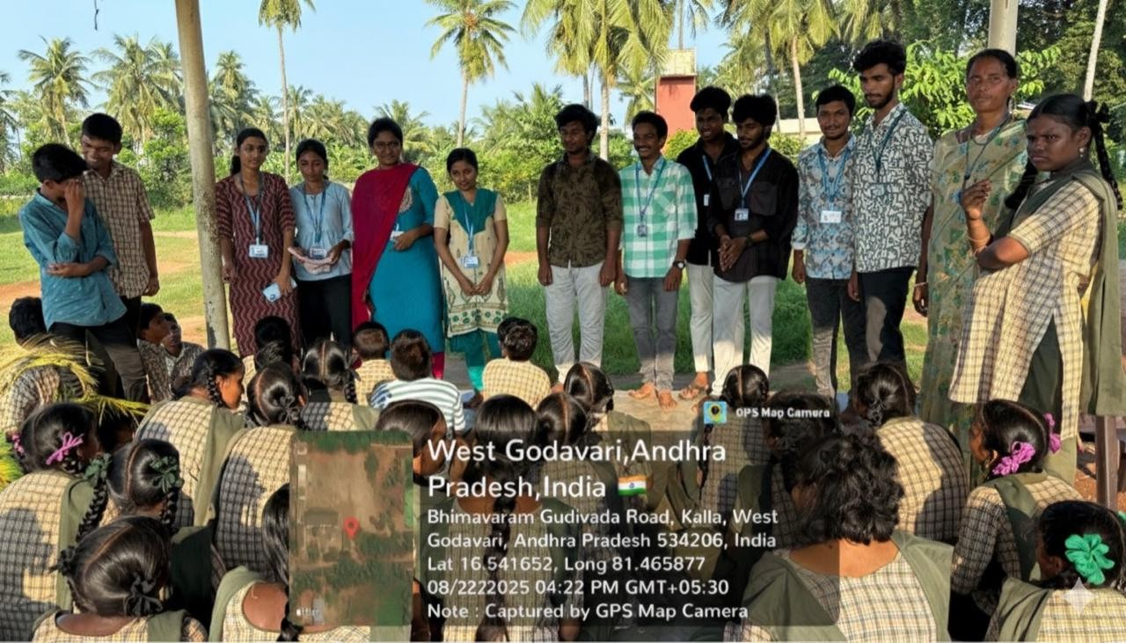
Awareness Campaign Activity

Slide 14
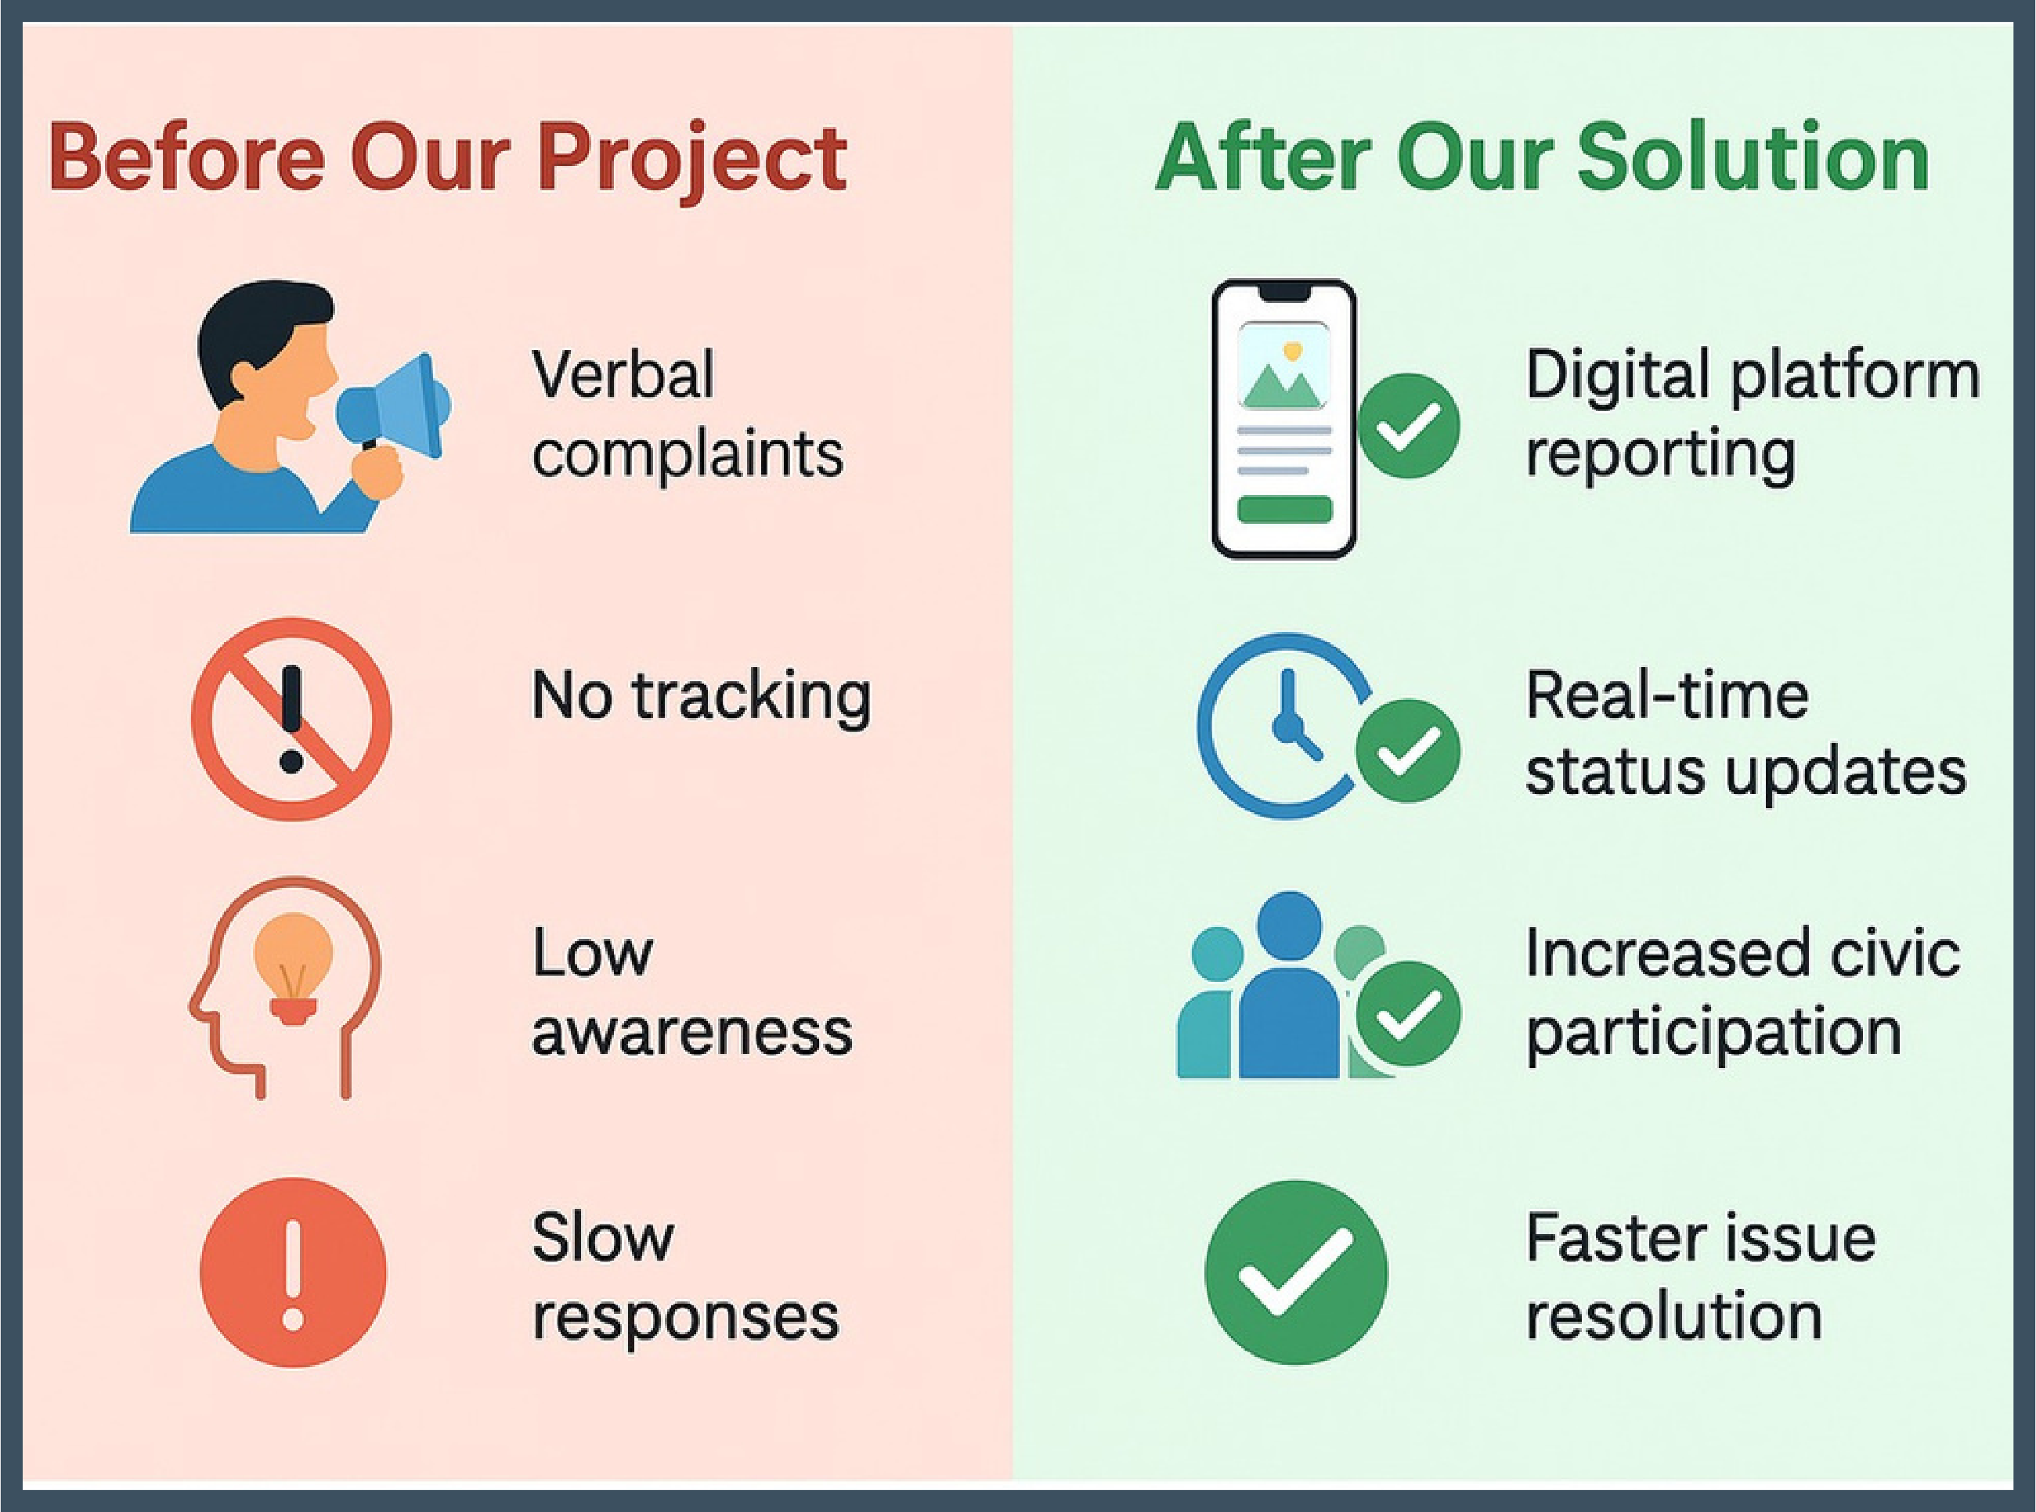
Community Insights (Before vs After)
Key Insights
Our project created awareness among residents about proper waste disposal and cleanliness practices.
Through surveys, door-to-door interactions, and poster campaigns, citizens became more responsible for maintaining hygiene in their surroundings.
The initiative improved communication between residents and local workers, encouraging teamwork and civic responsibility.
Regular awareness drives inspired youth and students to participate actively in community cleanliness efforts.
Overall, the project promoted a cleaner, healthier, and more united community in Gandhi Nagar.

Slide 15

Sustainable Development Goals Achieved:
SDG 3 – Good Health and Well-Being: Promoted public health by reducing mosquito breeding and spreading awareness about hygiene and waste management.
SDG 6 – Clean Water and Sanitatio: Improved sanitation by identifying drainage blockages and encouraging proper waste disposal habits among residents.
SDG 13 – Climate Action : Reduced pollution and supported environmental cleanliness by preventing open waste dumping and water stagnation.
SDG 17 – Partnerships for the Goals : Built collaboration among students, youth, and residents to achieve long-term community improvement and awareness.

Slide 16
Recommendations for Long-Term Improvement
Systematize Maintenance: Establish a fixed and regular schedule for drainage cleaning, garbage collection, and street maintenance, instead of waiting for problems to arise.
Promote Responsible Waste Habits: Conduct continuous awareness programs to educate residents about waste segregation (dry/wet) and proper disposal methods.
Strengthen Local Coordination: Appoint or assign a community volunteer to monitor cleanliness and act as a bridge between residents and local authorities.
Sustain Community Drives: Organize regular cleanliness and awareness drives to ensure long-term behavioral change and community responsibility.
Involve Youth and Schools: Encourage students and youth groups to actively take part in maintaining cleanliness and spreading awareness in their surroundings.

Slide 17
Conclusion
Identified Root Causes: The internship provided valuable exposure, revealing that recurring civic issues like garbage accumulation, mosquito breeding, and drainage blockages significantly affect the quality of life.
Created Awareness: Conducted surveys, poster campaigns, and door-to- door interactions to spread awareness about cleanliness, waste segregation, and hygiene.
Community Involvement: Encouraged active participation from residents, youth, and students in maintaining clean surroundings.
Enhanced Skills: Improved important social skills like teamwork, leadership, empathy, and communication while working closely with the community.
Overall Outcome: The project successfully promoted cleanliness, civic responsibility, and community awareness in leading to meaningful learning and positive environmental change.

Slide 18
THANK YOU

