Slide 1
PROJECT-BASED LEARNING • REVIEW–4
AIMS-Campus
AI-Powered Intelligent Maintenance & Smart Complaint Management System
A smart system where students report campus problems and AI sends each one to the right maintenance team.
TEAM
MENTOR
ACADEMIC DETAILS
Indrakaranreddy (2510030148)
Gaurav Sri Harsha (2510030268)
Yagneshwar Reddy (2510030394)
Hemanth Goud (2510030326)
Arabati Charan
Dr. Rafeeq
Department of Computer Science Engineering
K L University, Hyderabad
Academic Year 2026–27
DATABASE & BACKEND ENGINEERING
Notes:
Introduce the project, team and mentor. One-line pitch: students report a campus problem, the AI understands it, and the right technician is assigned and tracked until it is fixed.

Slide 2




Project Objectives
01 REPORT
02 SORT WITH AI
03 TRACK
04 ANALYZE
One place for students to report any campus problem, with a photo.
AI reads the complaint and picks its type, urgency and department.
Every complaint is followed from Pending to Verified, with deadlines.
Dashboards show trends, staff workload and delays to managers.
THE PROBLEM
OUR SOLUTION
Complaints sent on paper or by phone get lost. Nobody knows who is fixing what, and urgent issues wait in the same line as small ones.
AIMS-Campus is one system to report, sort, assign, fix and verify every complaint, with AI deciding what is urgent.
Notes:
Explain the problem first: manual complaint handling is slow and untraceable. Then walk the four goals left to right: report, sort with AI, track, analyze.

Slide 3




Project Development Approach
HOW WE BUILT IT
1
2
3
4
5
6
Understand the Problem
→
Design the Database
→
Build the Backend
→
Build the Frontend
→
Add the AI
→
Test & Demo
List what users need
Plan how data is stored
Rules and APIs
Screens for each role
Connect Groq to sort complaints
Check every feature
HOW ONE COMPLAINT TRAVELS
→
→
→
→
Student reports
AI analyzes
Manager assigns
Staff fixes it
Student verifies
Describes the issue and adds a photo
Picks type, urgency and department
Chooses the right technician
Updates status and logs the work
Confirms the fix and rates it
Notes:
Top row: the six stages we followed while building. Bottom row: what happens to a single complaint in the live system, from the student's report to the final verification.

Slide 4





Project Implementation
FRONTEND
BACKEND
DATABASE
React + Vite + Tailwind CSS
Node.js + Express
MongoDB Atlas
The screens users see: forms, lists and charts.
The brain: checks requests and applies the rules.
Safe cloud storage for users, complaints and history.
AI SERVICE
IMAGE STORAGE
SECURITY
Groq (Llama 3)
Cloudinary
JWT login + bcrypt
Reads each complaint and suggests type and urgency.
Keeps complaint photos and serves them quickly.
Secure sign-in, protected passwords, role-based access.
DEVELOPMENT SETUP Node.js 18+ and npm, running on a local computer (backend on port 5000, frontend on port 5173). Communication uses our own REST API plus the Groq and Cloudinary APIs.
Notes:
Keep this slide in plain language: React is what users see, Express is the logic, MongoDB stores the data, Groq is the AI, Cloudinary stores photos, JWT keeps logins secure.

Slide 5
System Architecture
USER
FRONTEND
BACKEND
DATABASE
Student, Staff, Manager or Admin
React app with screens and forms
Express API: login, rules, assignment
MongoDB stores all the data
IN SIMPLE WORDS
1. The user clicks Submit.
2. The frontend sends it to the backend.
3. The backend asks the AI and saves it.
4. The answer comes back to the screen.
GROQ AI
CLOUDINARY
Reads and sorts complaints
Stores complaint photos
RESPONSE: the result travels back from the database to the user's screen
Notes:
Follow the yellow arrows: User, Frontend, Backend, Database. The backend also talks to two outside services: Groq for AI analysis and Cloudinary for photos. The green arrow shows the response returning to the user.

Slide 6
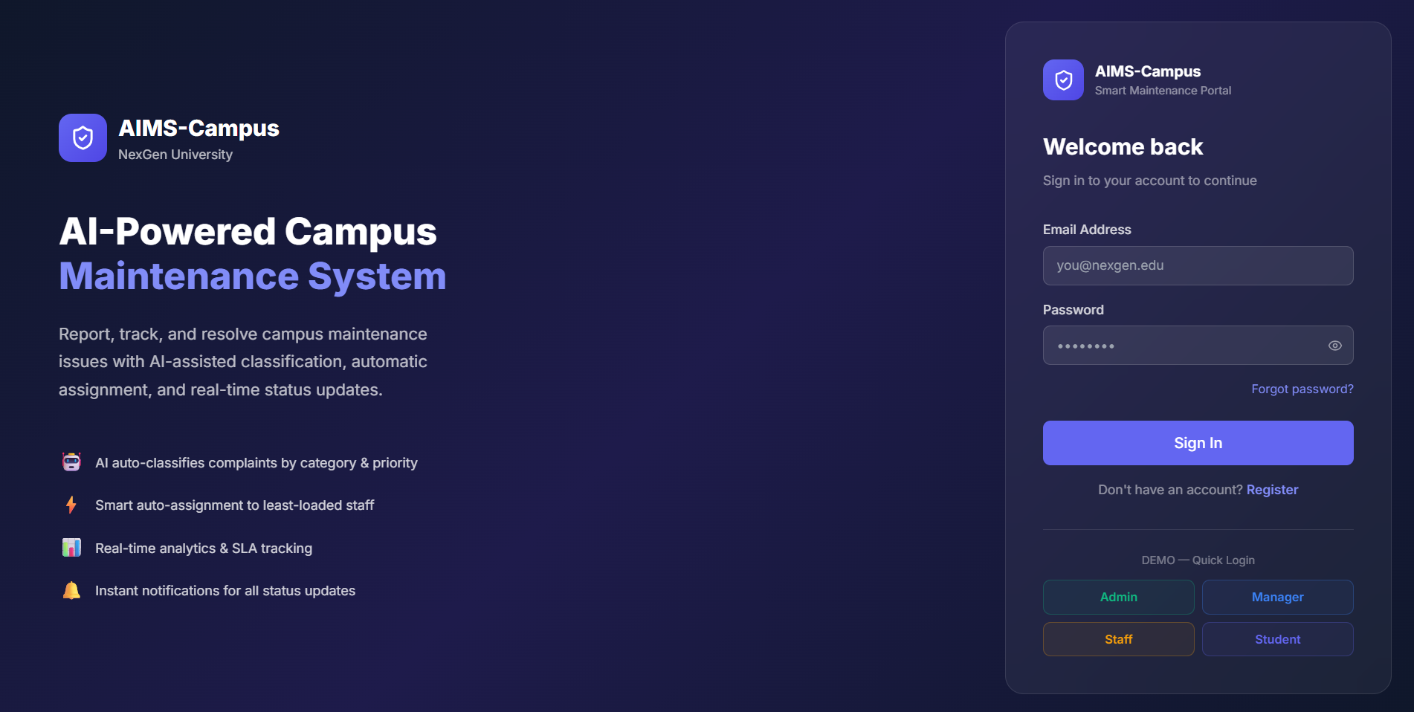
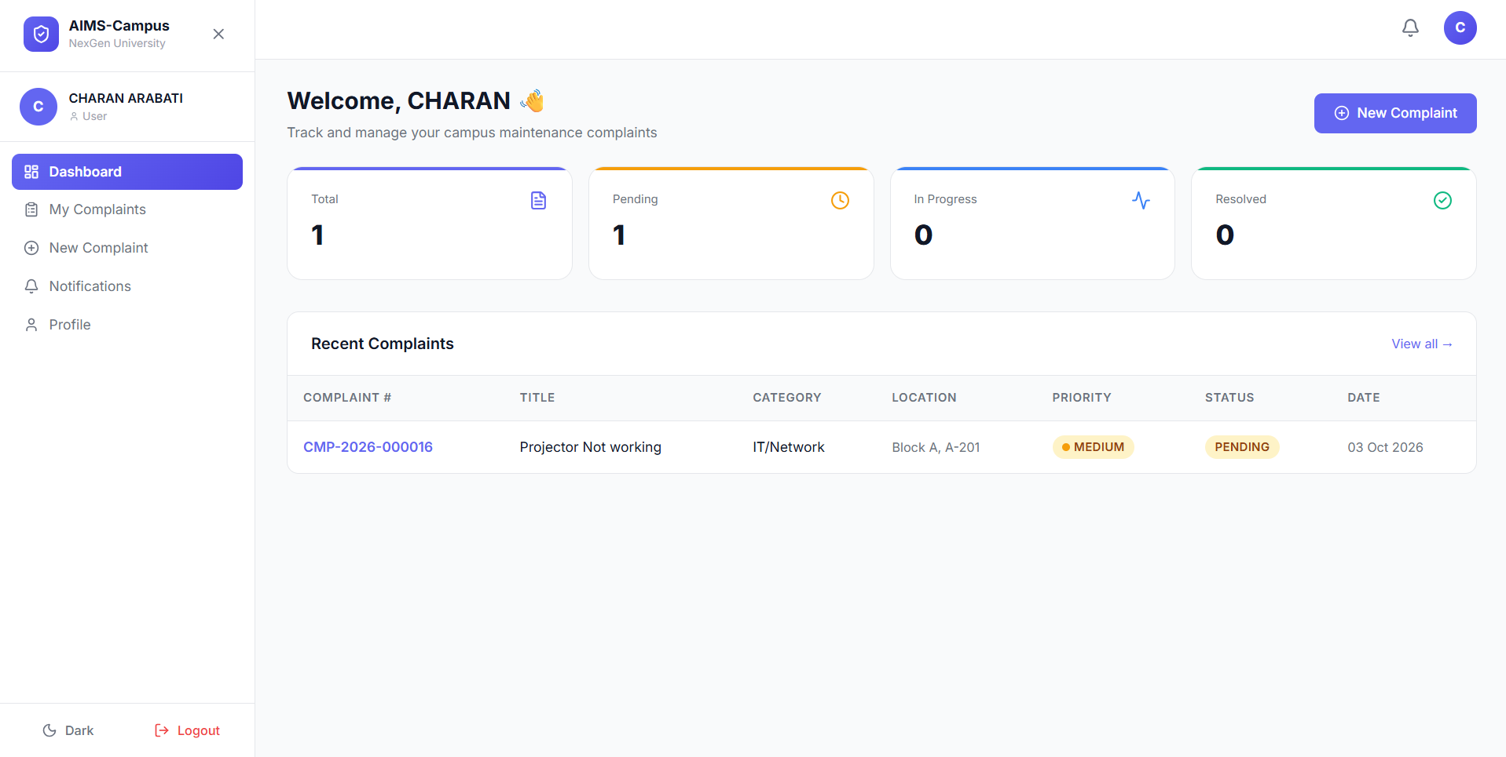
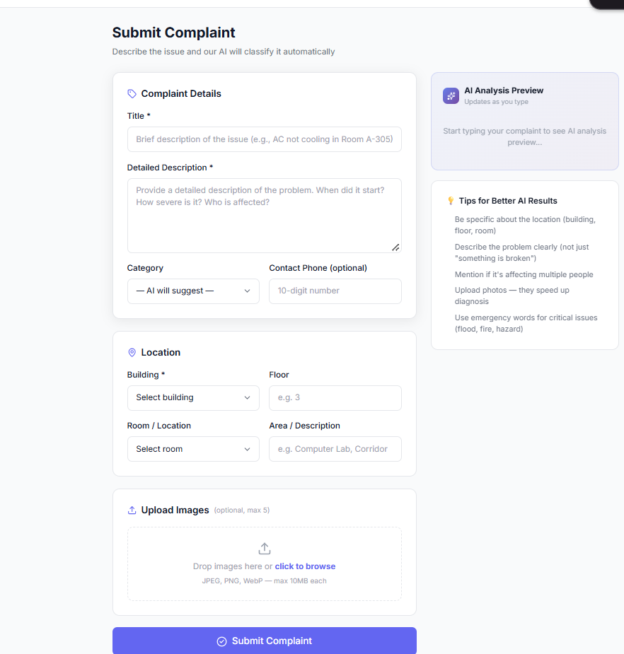

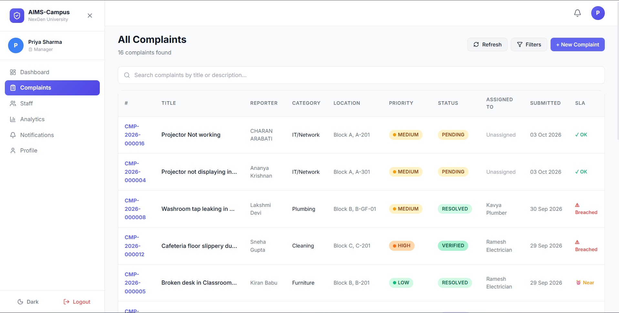
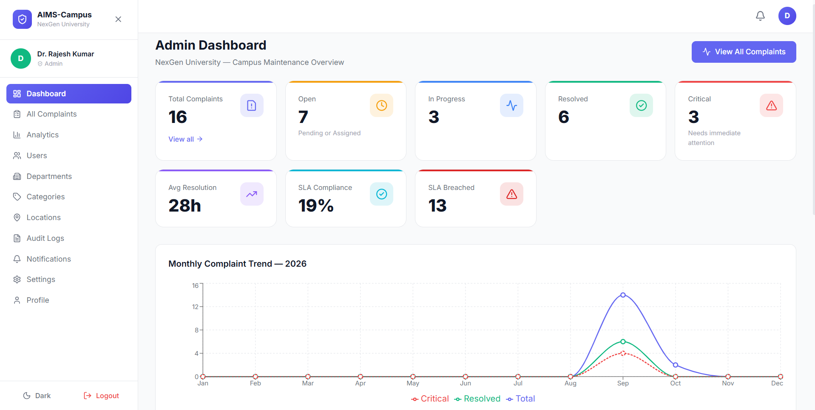
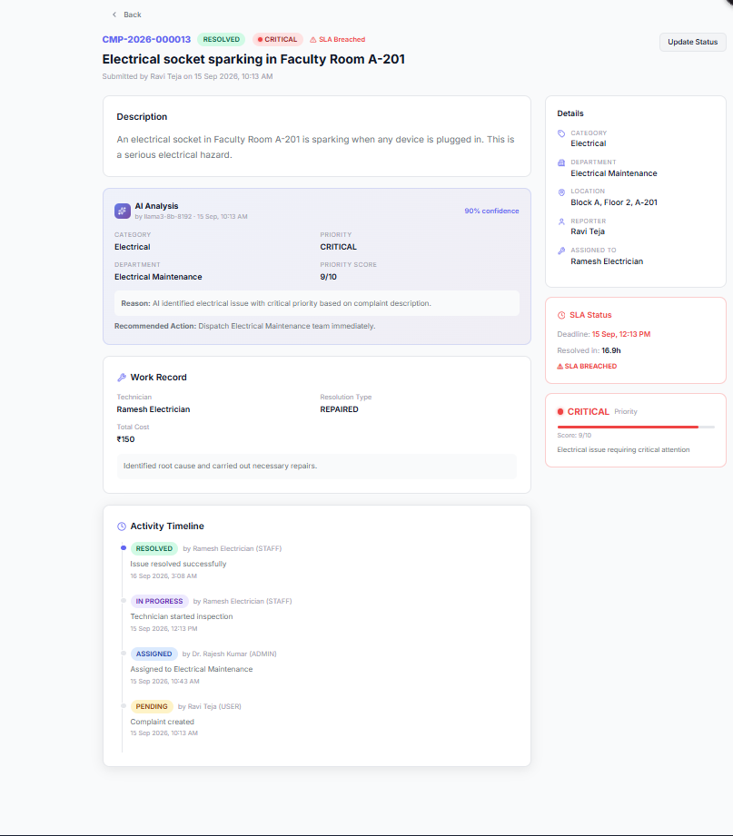
Screens / Working Demonstration
Paste screenshot here
Paste screenshot here
Paste screenshot here
1. Login Page
2. Home Page
3. Complaint Form
Sign in with a role-based account
Student's complaints at a glance
Describe the issue and add a photo
Paste screenshot here
Paste screenshot here
Paste screenshot here
4. Main Application
5. Dashboard
6. Result Page
Manager reviews AI result and assigns staff
KPIs, trends and staff workload
Resolved, verified and rated
Notes:
Replace each dashed box with a real screenshot from the running app (login, student home, complaint form, manager assignment view, admin dashboard, resolved complaint with rating). Demo order: README 'Demo Flow'.

Slide 7

Functional Results
WHAT EACH PERSON CAN DO IN THE SYSTEM
Student
Staff
Manager
Admin
Report with a photo
Track live status
Verify the fix and rate it
See assigned tasks
Update work progress
Log parts and time used
Review the AI result and override it
Assign work to staff
View department stats
Manage users and departments
See campus-wide analytics
View audit logs
SMART FEATURES FOR EVERYONE
AI auto-sorting
Deadline alerts
Photo proof
Search & alerts
With backup rules if AI is down
Late tasks are flagged
Before and after images
Find complaints, get notified
Notes:
Show that every role has its own view and permissions. Mention the AI backup rules: if the AI service is offline, simple keyword rules still classify the complaint.

Slide 8
Testing Results
Test Case | Expected Result | Actual Result | Status
Login (all 4 roles) | Correct dashboard opens for each role | As Expected | Pass
Submit complaint + photo | Saved; AI sets type and priority | As Expected | Pass
Wrong-role access | Student cannot open admin pages | As Expected | Pass
Assign complaint | Staff gets the task; status ASSIGNED | As Expected | Pass
Update progress | Status moves to IN_PROGRESS, RESOLVED | As Expected | Pass
Verify and feedback | Status VERIFIED; rating saved | As Expected | Pass
Analytics dashboard | Charts update with new data | As Expected | Pass
AI backup rules | Keywords classify if AI is down | As Expected | Pass
Notes:
These 8 scenarios cover the whole demo flow. Before presenting, run each one (README Demo Flow), then replace the amber cells with the real outcome (for example 'Dashboard opened' / Pass).

Slide 9
Performance Analysis
RESPONSE TIME
TEST CASES
SUCCESSFUL TESTS
45 ms
8
8 / 8
Page load time, seen in the browser Network tab (F12)
Total scenarios tested (previous slide)
Number of tests marked Pass
ERROR RATE
DATABASE RESPONSE
API RESPONSE
0 %
12 ms
28 ms
Failed tests ÷ total tests × 100
Time for a typical save or search in MongoDB
Time for an API call, measured with Postman
Notes:
Fill the amber blanks with your measured values before presenting. Quick way: use Postman for API time, the browser Network tab for page load, count Pass results from the testing slide, and error rate = failed / total x 100.

Slide 10
Results & Analysis
4
11
15
7
6
13
User roles
Data models
Key API endpoints
Analytics queries
Complaint stages
Issue categories
BEFORE
AFTER AIMS-CAMPUS
Paper forms and phone calls, easy to lose
No way to see the status
Every issue treated the same
No data to learn from
One digital system for everyone
Live tracking, Pending to Verified
AI sets urgency and picks the team
Dashboards show trends and delays
ANALYSIS AI sorting, clear roles and deadline tracking make maintenance organized and accountable, and the backup rules keep it working even when the AI is offline.
Notes:
The six numbers come from the project documentation (README): roles, data models, API endpoints, analytics queries, lifecycle stages and categories. Then contrast the old manual process with the new system.

Slide 11

Conclusion & Future Scope
CONCLUSION
FUTURE SCOPE
Objectives achieved: one system to report, sort, assign, fix and verify complaints
AI sorts complaints automatically, with a safe backup
Four roles, each with its own secure dashboard
Managers get live analytics to make decisions
Mobile app for faster reporting
SMS and email alerts
Predict repeat problems from past data
Support for multiple campuses
Train our own AI model on campus data
Notes:
Close by restating the outcome: complaints are now reported, sorted by AI, assigned, fixed and verified in one place. Then invite questions.

