Slide 1
OFFICE NETWORKING PROJECT
(using Cisco Packet Tracer)
Project By : CHARAN NANDARAPU
Email : nandarapucharan065@gmail.com
Linked In : www.linkedin.com/in/charan-nandarapu

Slide 2
Problem Statement:
There are three companies, which communicate each other frequently are in different locations.
Our aim is to configure the network for three different companies in such a way that all the PCs in each company must be able to communicate with each other as well as with all the PCs of any other company.
The companies are named as CMP X, CMP Y and CMP Z.
CMP X has 5 Rooms with 1 PC in each room.
CMP Y has 3 Rooms with 3 PCs in each room.
CMP Z has 2 Rooms with 4 PCs in each room.

Slide 3

COMPANY-A
COMPANY-B
COMPANY-C

Slide 4
IP ADRESS REGULAGTIONS:
Here, we assigned the following IP network addresses to each of the company:
CMP A: 144.186.96.0/22
CMP B: 50.152.0.0/17
CMP C: 210.98.169.64/27

Slide 5
CONSTRAINTS:
Logical Constraints:
All the PCs in a single room must be on the same sub network .
All the rooms of a single company must be on a different sub-network.
These will be assigned after sub-netting the assigned network address only for the relevant company (no outside network or the network of other company will be accepted)
Physical Constraints:
You have to assign IPs to the PCs using Static IP allocation.
Use Straight Through wires, Cross Over cables or Serial DCE wires where necessary and applicable.
Use Generic Router and Generic PCs for your design.

Slide 6
Main Aim:
Our main execution is to minimize the number of routers and maximize the number of Switches.
Approach:
The above network can be achieved by using RIPv2 Protocol for Classless Subnet Addressing.
We use CLI of the router to configure the RIPv2 Protocol for classless Subnet Addressing.
We Use Cisco Packet Tracer Software to simulate the above network.

Slide 7
COMPANY-A
COMPANY-B
COMPANY-C
144.186.96.0/22
50.152.0.0/17
210.98.169.64/27
No of Switches used – 17
No of Routers used – 5
No of PCs - 22
Protocol – RIPv2
Topology – Bus Topology

Slide 8
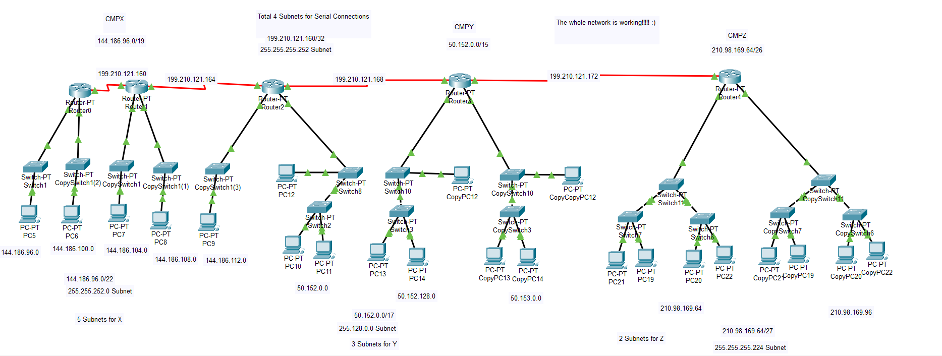
Network Simulation Using Cisco Packet Tracer

Slide 9
THANK YOU

