Slide 1
c
FAULT DIAGONISE & WIND TRUBINE MONETRING SYSTEM

Slide 2
Problem Statement
c
Wind turbines are critical for renewable energy production, but their efficiency and reliability are often compromised by unexpected faults, mechanical wear, and harsh environmental conditions. Traditional maintenance approaches rely on scheduled inspections or reactive repairs, leading to high operational costs, downtime, and potential energy losses.

Slide 3
Existing System
c
The existing wind turbine monitoring and maintenance system primarily relies on scheduled inspections and reactive maintenance, where faults are addressed only after they occur. Traditional methods include manual inspections, SCADA (Supervisory Control and Data Acquisition) systems, and vibration analysis, which provide limited real-time insights and often fail to predict faults in advance.

Slide 4
Objectives
c
The objective of the Fault Diagnosis and Wind Turbine Monitoring System is to enable real-time monitoring, early fault detection, and predictive maintenance of wind turbines using IoT sensors. The system aims to optimize turbine performance, reduce downtime, and minimize maintenance costs by proactively identifying mechanical, electrical, and structural issues. It ensures remote access and control through a cloud-based dashboard or mobile application, enhancing safety and operational efficiency. By maintaining historical data for analysis, the system supports continuous improvement, extends turbine lifespan, and contributes to the reliability and sustainability of renewable energy production.

Slide 5
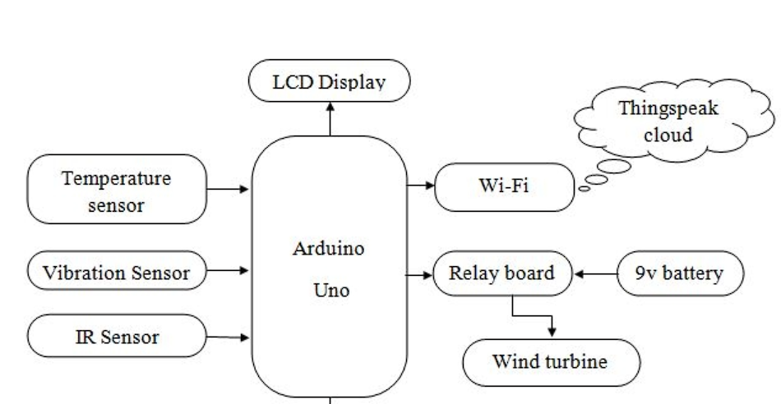
Block Diagram
c
ESP 8266

Slide 6
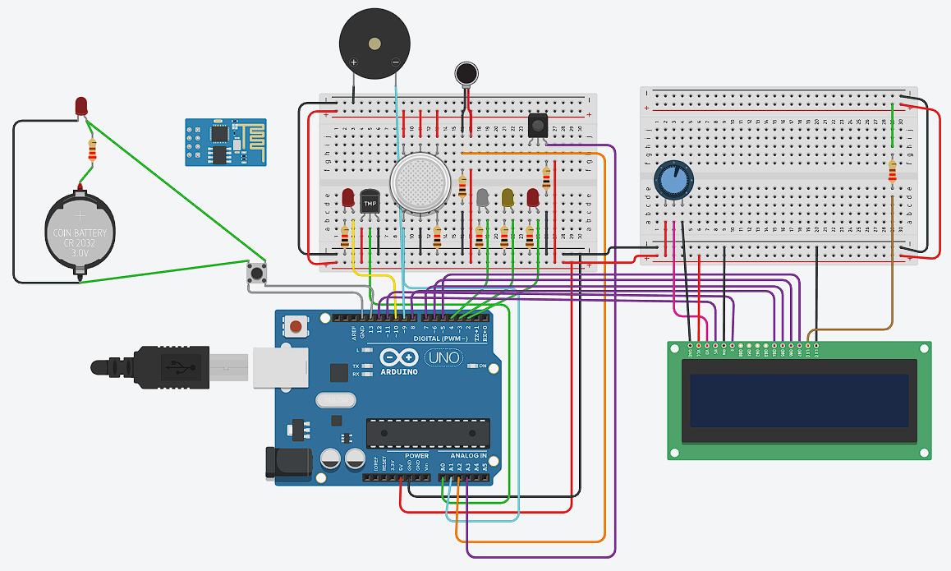
Simulation
c

Slide 7
Componentns
c
Components | Cost (Rs.)
Temperature Sensor | 120
Vibration Sensor | 100
IR Sensor | 30
Display Module | 500
LCD Display | 200
ESP8266 | 400
Wind Mill(Motor,Proppler,Battery) | 500

Slide 8
References
c
Zhang, Z., Verma, A., & Kusiak, A. (2012). Fault Analysis and Condition Monitoring of Wind Turbines. Renewable Energy, 45, 175-183.
Kusiak, A. (2013). Smart Wind Turbines: Data Analytics and Reliability-Centered Maintenance.
Tavner, P. (2012). Condition Monitoring of Rotating Electrical Machines. IET Renewable Energy Series.

