Slide 1


Global Artificial Intelligence Platform Capabilites {GAIP}
Global Artificial Intelligence Platform Capabilites {GAIP}
Experts in delivering transformative Solutions that generate long term values and Propel Innovation-Led Growth

Slide 2

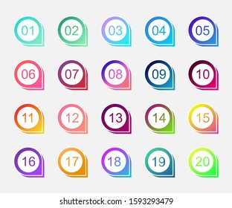
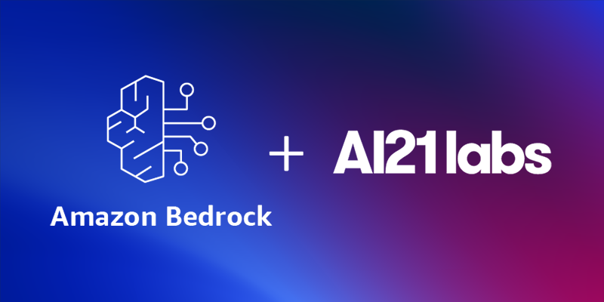
AWS Services & LLM PLATFORM for call recording analysis
Amazon Transcribe Call Analytics is a generative AI-powered API for generating highly accurate call transcripts and extracting conversation insights to improve customer experience and enhance agent and supervisor productivity.
State Space Model (SSM)
A121Labs Services
Jamba 1.5 mini models
Mamba
Available in Amazon Bedrock

Slide 3

000
Global Artificial Intelligence Platform Capabilites {GAIP}
Accelerator & Use cases
Experts in delivering transformative Solutions that generate long term values and Propel Innovation-Led Growth
2022
Notes:
https://capgemini.sharepoint.com/:p:/s/SectorHubStrategyandGTM2021/EcDl6iA1AL5Du_9Z75qkPhoBLj4_CKtshwnX_8Z_AdXUZQ?e=cct0E0&clickparams=eyJBcHBOYW1lIjoiVGVhbXMtRGVza3RvcCIsIkFwcFZlcnNpb24iOiIyNy8yMjA2MDYxNDgwNSIsIkhhc0ZlZGVyYXRlZFVzZXIiOmZhbHNlfQ%3D%3D

Slide 4
Global Artificiel Intelligence
Platform CapabilitES {GAIP}
Capgemini’s Global Artificial Intelligence Platform embodies a unique combination of competence - domain expertise and technology. We support BUs, MUs and Global Sectors to create new avenues through transformation and innovation.
INDUSTRY & MARKET DEVELOPMENT
Support Industry leaders to drive the definition of Industry strategy and its execution
Market Research
Account Research Radar
Thought Leadership
Domain Advisory Services
ACCOUNT ENABLEMENT
Support Account development/management industrialization and coordination across SBUs, GBLs, MUs & Geographies
Go To Market & Client Engagement
Pro Active Pitches
RFP & RFI Support
Plug & Play Assets
Accelerators/ POCs / MVP’s
KNOWLEDGE ACCELERATION
Increase delivery teams’ client impact with strong industry expertise, accelerators, Automotive Industry Training & Certification
Co-development with technology partners
Training & Certification
KPI & Benchmarking
Framework Creation

Slide 5
Global Artificiel Intelligence
Platform CapabilitES {GAIP}
Capgemini’s Gloaba AI Platform embodies a unique combination of competence - domain expertise and technology. We support BUs, MUs and Global Sectors to create new avenues through transformation and innovation.
Our Expertise :
Artificiall Intelligence, Machine Learning, Cloud Technologies
Technology :
AWS, AZURE, PYTHON, TENSORFLOW, GENAI Tech
Client Engagement
RFP/ RFI Support
Industry Account Research Radar
Go To Market & Client Engagement
Pro Active Pitches
GAIP Assets
Plug & Play Assets
Accelerators/ POCs / MVP’s
Co-development with technology partners
Digital Transformation
SAP | SAP/4 HANA Migration
Industry 4.0, IoT, Blockchain
Augmented, Virtual Reality Implementation and AI / ML
Innovation & Strategy
Thought Leadership
Domain Advisory Services | Terraform
Product Innovation Roadmap
Business Process Re-engineering

Slide 6
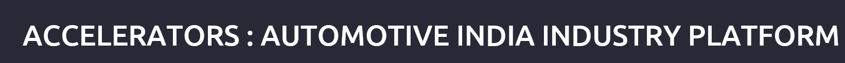
1 | New Age Demand Sensing Social Platform for real-time demand sensing based on customer insight
2 | EV Battery Management/Intelligence Battery Management, Health Diagnostics and Predictive Insights and Performance Monitoring
3 | Sustainability in Automotive Sustainability Framework Framework for Continuous Monitoring of Sustainability in Electric Vehicle Vale chain
4 | Metaverse Digital Twin of the Factory, Remote assistance, Virtual layout Planning, Robot teaching and training ,Collaborative and interactive training - Up Coming Asset
5 | Cognitive & Predictive Quality In-line quality inspection solution featuring a smart glass and a visual inspection engine on the edge device.
6 | Data Driven Intelligent Manufacturing Analytics platform to monitor and optimize operational performance across the organization
7 | SAP – IBP Platform Integrated business accelerators for process efficiency , accuracy and transparency
 | Connectivity & Service Experience
8 | Vehicle Sales Management Central cockpit for vehicle sales management connecting dealers, importers and OEMs
9 | Immersive AutoNXT Digital transformation of maintenance, repair & operations
10 | Virtual Product Display Digital solution leveraging AR and VR for demonstrating product features and functionality virtually with immersive experience and 3D technology
11 | Business Process Assessment framework(KPI) A framework for assessing business processes using industry standard benchmarking and KPIs
12 | Automotive Reference template - SAP Pre-configured building blocks in SAP, documentation and business process library for Automotive OEMs and Suppliers
13 | Equipment as a Service (EaaS) Platform to enable Equipment-as-a-Service by integrating sales, operations & services
14 | Fleet Management Fleet Telematics & Analytics, Manage fleet remotely, Real-time data usage, Value-added services - Up Coming Asset
Notes:
Metaverse
Demand Sensing
EV
Connect Service
VSM
SAP IBP
Virtual Product Disp

Slide 7

HIS STORY
“Every problem having an solution, you just need to right direction.”
Manikantan Poonkundran
Portfolio Manager
Capgemini America

