Slide 1
PROJECT TITLE: Enhancing farmer productivity through innovative technology solutions
Project
Review-4
Batch Number: CSE_124
Under the Supervision of,
Ms. Radhika Sreedharan
Asst. Professor
School of Computer Science and Engineering
Presidency University
Roll Number | Student Name
20221CSE0301 | CHARAN J
20221CSE0304 | NAGENDRA BABU R
20221CSE0752 | VISHWAS Y S
Name of the Program: B.Tech(CSE)
Name of the HoD: Dr. Blessed Prince
Name of the Program Project Coordinator: Muthuraju V
Name of the School Project Coordinators: Dr. Sampath A K , Dr. Geetha A

Slide 2
Problem Statement Number:
Organization: Ministry of Agriculture & Farmers Welfare(MoA&FW)
Category : Software
Problem Description: The system aims to improve farmer productivity by providing technology-based decision support for agriculture. It uses data such as soil health, weather conditions, and crop information to generate smart recommendations. The solution helps farmers increase yield, reduce costs, and adopt sustainable farming practices.
i. Suggests suitable crops based on soil, season, and climate.
ii. Provides irrigation and fertilizer guidance to save water and improve yield.
iii. Gives pest, disease, and weather alerts for timely action.
iv. Estimates crop yield and overall farm productivity.
v. Shows market prices and modern farming methods to increase farmer income.

Slide 3
Content
Problem Statement
Objectives
Background and Related work for title Selection
Analysis of Problem Statement
Innovation or Novel Contributions
Git-hub Link
Timeline of the Project
References

Slide 4
Content (continuation)..
Problem Statement:
Farmers face challenges in making timely and accurate decisions related to crop selection, irrigation, and pest management due to lack of reliable information.
Traditional farming practices rely on experience and guesswork, leading to low productivity, higher input costs, and crop losses.
A data-driven, AI-enabled system can provide smart recommendations, improve farm efficiency, and increase farmer income sustainably.

Slide 5
Content (continuation)..
Objectives:
To help farmers choose the right crop for their land and season.
To guide farmers on proper irrigation and fertilizer usage.
To provide weather, pest, and disease alerts on time.
To increase crop yield, reduce costs, and improve farmer income.

Slide 6
Content (continuation)..
Background and Related work for title Selection :
Farming depends heavily on weather, soil, and water availability.
Most farmers still use traditional methods based on experience.
New technologies like mobile apps and sensors are being used in agriculture.
There is a need for simple and integrated technology solutions for farmers.

Slide 7
Content (continuation)..
Analysis of Problem Statement:
Challenges:
Farmers have limited access to modern technology.
Weather changes and pests affect crops.
Lack of proper information for farming decisions.
Impact:
Better crop yield and farm productivity.
Reduced cost of farming inputs.
Increased farmer income and sustainable farming.

Slide 8
Github Link
URL:
https://github.com/Charan-gcr/Enhancing-farmer-productivity-through-innovative-technology-solutions

Slide 9
Analysis of Problem Statement
Technology Stack Components:
Frontend: Web or mobile interface for farmers (HTML, CSS, JavaScript / Android app).
Backend: Python /Java/Node.js
Database & Analytics: MySQL/Firebase.
Software Requirements:
Operating System: Windows/Linux/Android
Web Browser: Google Chrome
Development Tools: VS Code/Android Studio

Slide 10
Content (continuation)..
Innovation or Novel Contributions:
Combines soil, weather, and crop data in a single platform.
Provides simple and easy-to-understand recommendations for farmers.
Offers real-time alerts for weather, pests, and diseases.
Supports farmers in increasing yield and income using technology.

Slide 11
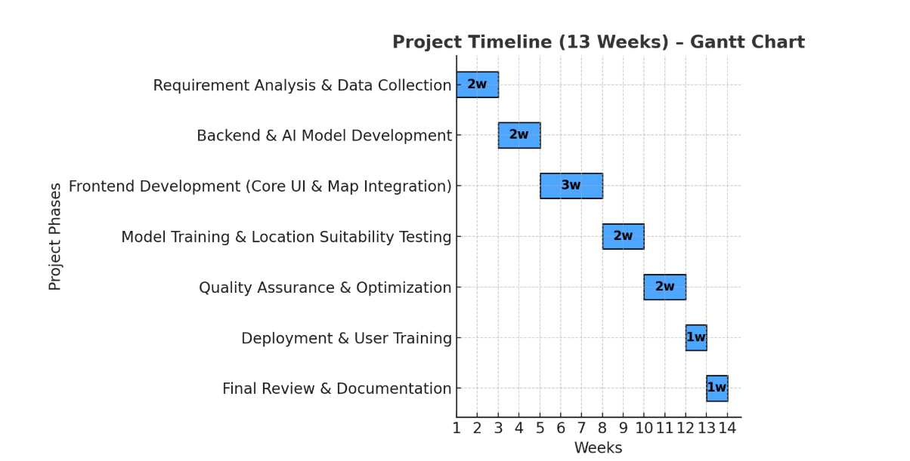
Content (continuation)..

Slide 12
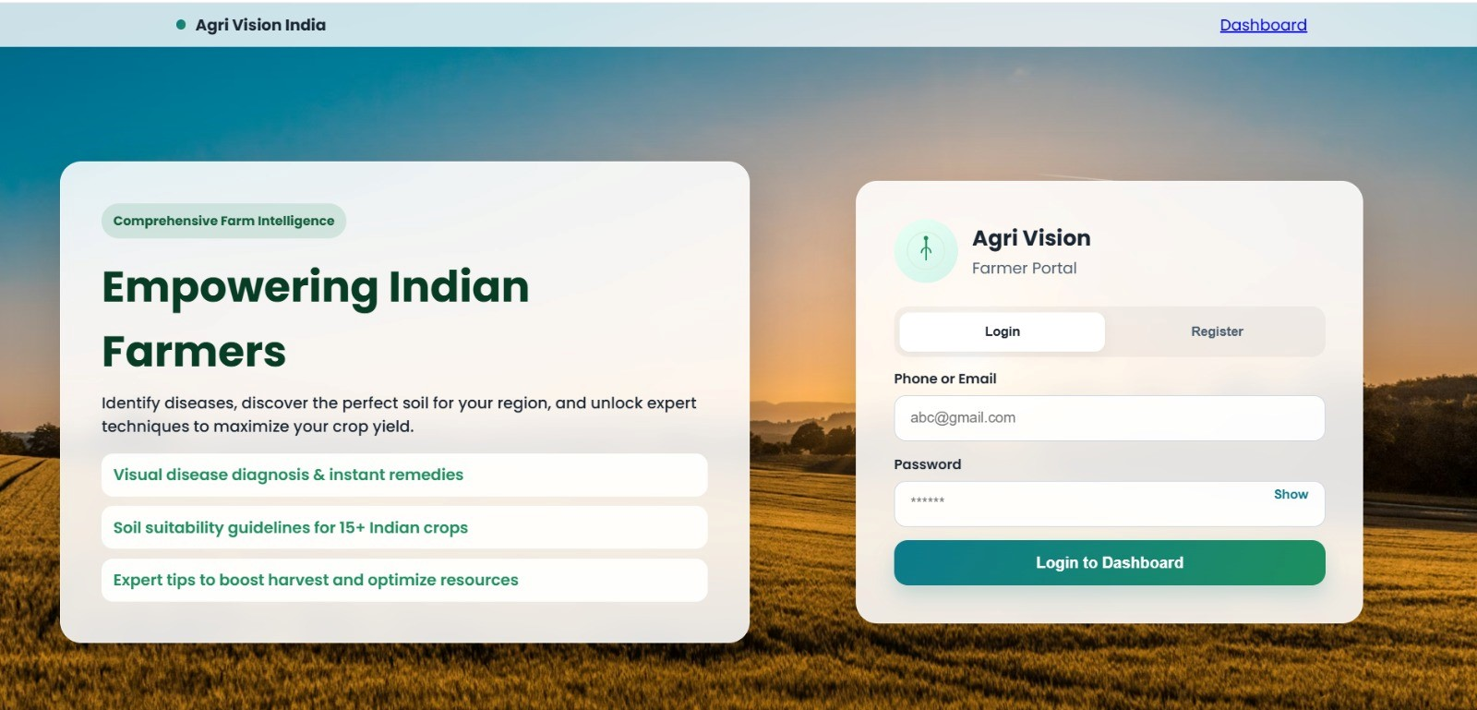
Login/ register dashboard
Entry point of the Agri Vision system
Provides user authentication (Login/Register)
Simple and user-friendly interface for farmers
Highlights key features:
Disease detection
Crop & soil recommendations
Farming guidance
Secure login using backend validation & database Enables personalized dashboard access
Designed for easy navigation and accessibility

Slide 13
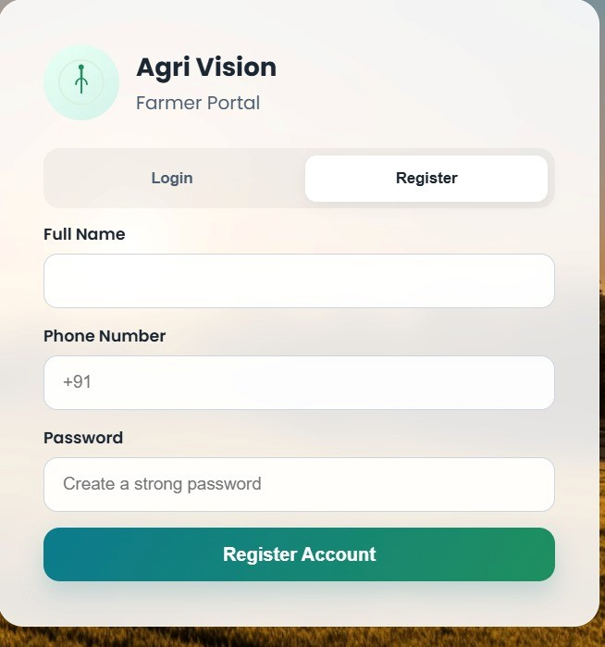
Register
New farmer account creation interface
Collects basic user details:
Full Name
Phone Number
Password
Secure data storage in database
Input validation for correct data entry
Enables first-time users to access system features
Redirects to login/dashboard after registration

Slide 14
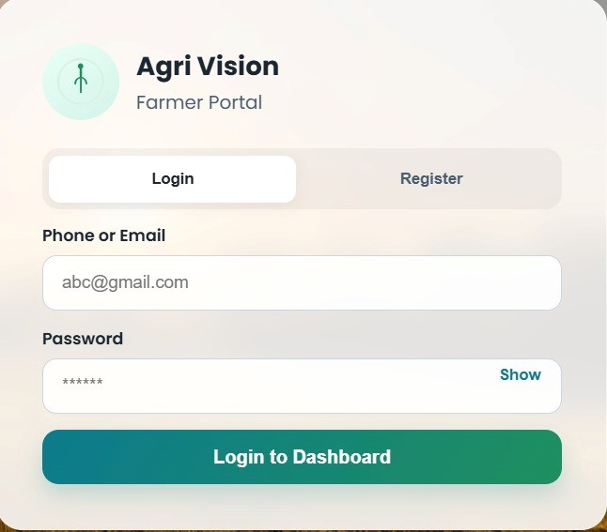
Login
Farmer authentication interface
Supports Login & New User Registration
Input fields:
Phone/Email
Password
Secure credential verification via backend
“Show Password” feature for usability
Redirects user to dashboard after login
Ensures personalized access to services

Slide 15
References
[1] Ministry of Agriculture & Farmers Welfare, Government of India, “Digital Agriculture Mission 2021–2025,” New Delhi, India, 2021.
[2] Food and Agriculture Organization of the United Nations, “The State of Food and Agriculture,” FAO, Rome, Italy, 2022.
[3] A. Kamilaris, A. Kartakoullis, and F. X. Prenafeta-Boldú, “A review on the practice of big data analysis in agriculture,” Computers and Electronics in Agriculture, vol. 143, pp. 23–37, 2017.
[4] S. Wolfert, L. Ge, C. Verdouw, and M. J. Bogaardt, “Big data in smart farming – A review,” Agricultural Systems, vol. 153, pp. 69–80, 2017.
[5] P. K. Sharma and S. Singh, “Applications of IoT in smart agriculture,” International Journal of Advanced Research in Computer Engineering & Technology, vol. 9, no. 6, pp. 82–86, 2020.

Slide 16


