Slide 1
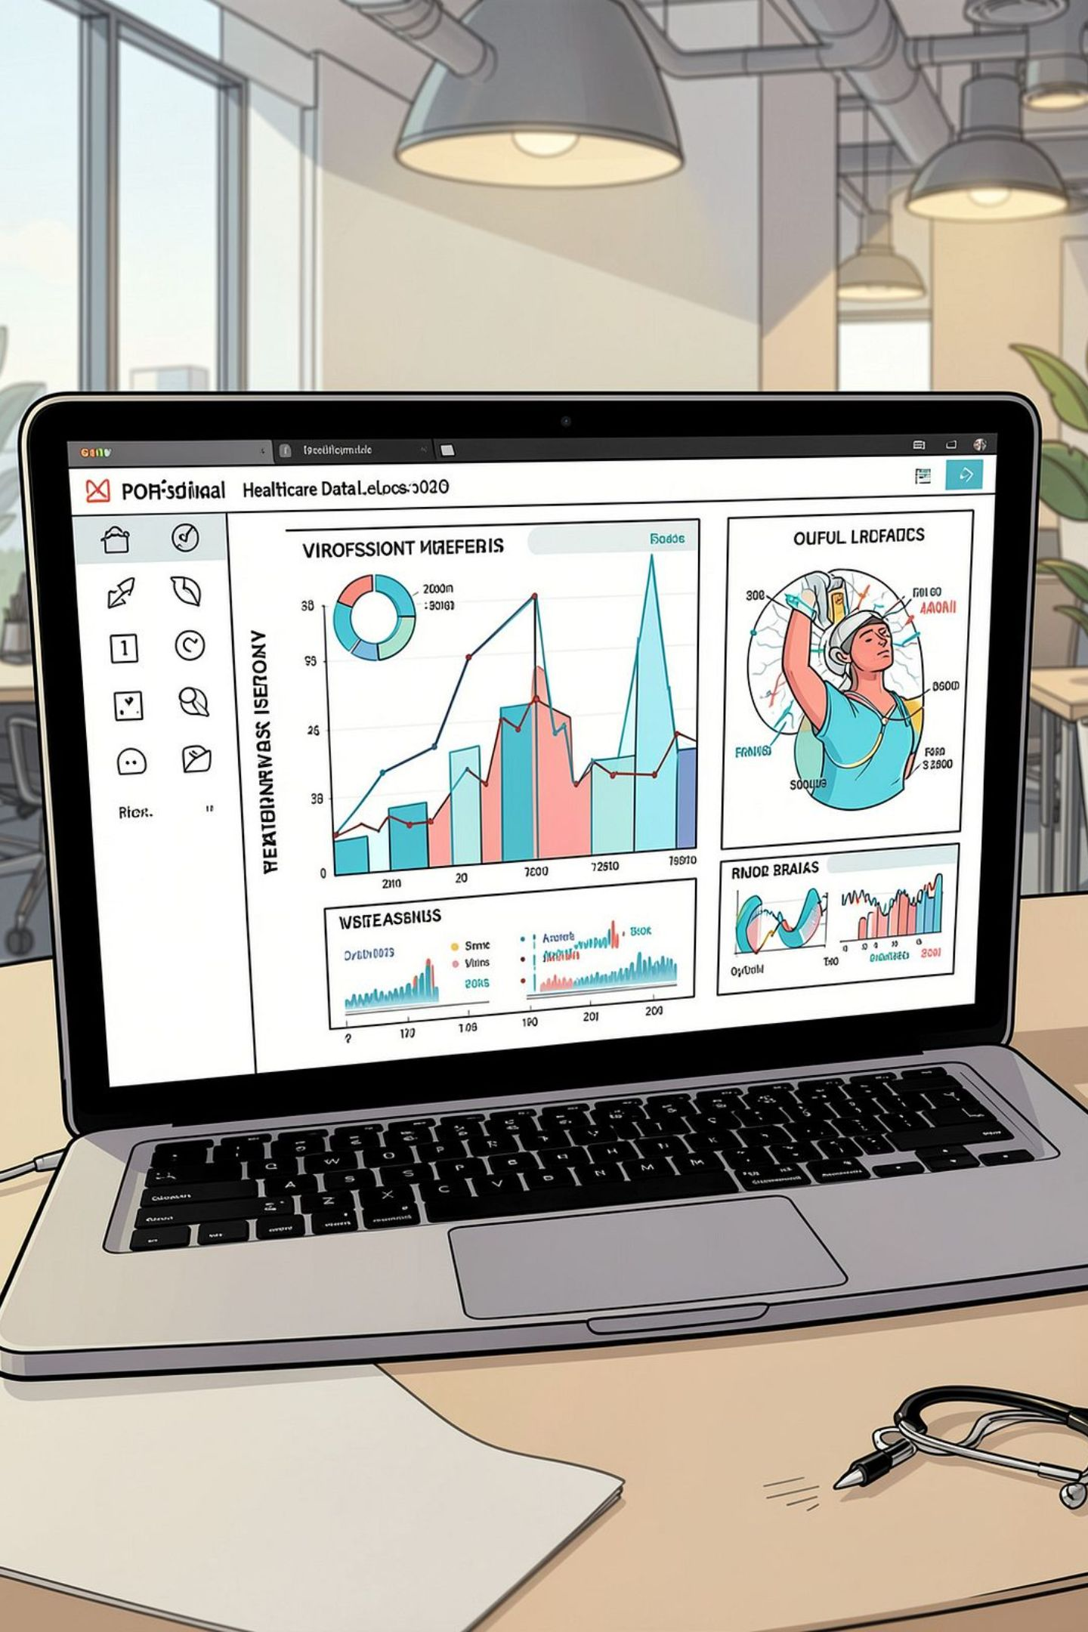
Medical Insurance Cost Predictor
Predicting individual medical insurance charges using regression models built from demographic, behavioral, and health features. A practical walkthrough for data science students and practitioners interested in applied regression for healthcare insurance.

Slide 2

Why this matters
Healthcare costs vary widely—predictive models help individuals and insurers estimate expected charges.
Clarifies which factors (age, BMI, smoking, children, region, gender) drive cost differences.
Supports budgeting, underwriting decisions, and targeted wellness interventions.

Slide 3
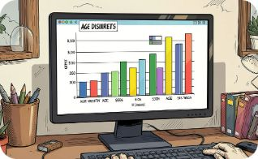
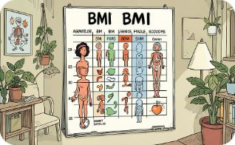

Data Overview
Dataset fields: age, sex, BMI, number of children, smoker status, region, and recorded insurance charges. Typical size: several hundred to a few thousand rows — enough to train baseline regression models while illustrating preprocessing steps.
Age
BMI
Smoking
Numeric — strong positive correlation with charges in many cohorts.
Continuous — higher BMI often linked to increased costs due to comorbidities.
Categorical (yes/no) — one of the strongest single predictors of higher charges.

Slide 4

Data Preparation & Feature Engineering
Cleaning: handle missing values, correct inconsistent entries, remove duplicates.
Encoding: convert categorical variables (sex, smoker, region) using one-hot or target encoding.
Scaling: standardize numeric features (age, BMI) for algorithms sensitive to scale.
Feature creation: interactions (age×smoker), BMI categories, comorbidity flags, or polynomial terms if nonlinear effects present.

Slide 5
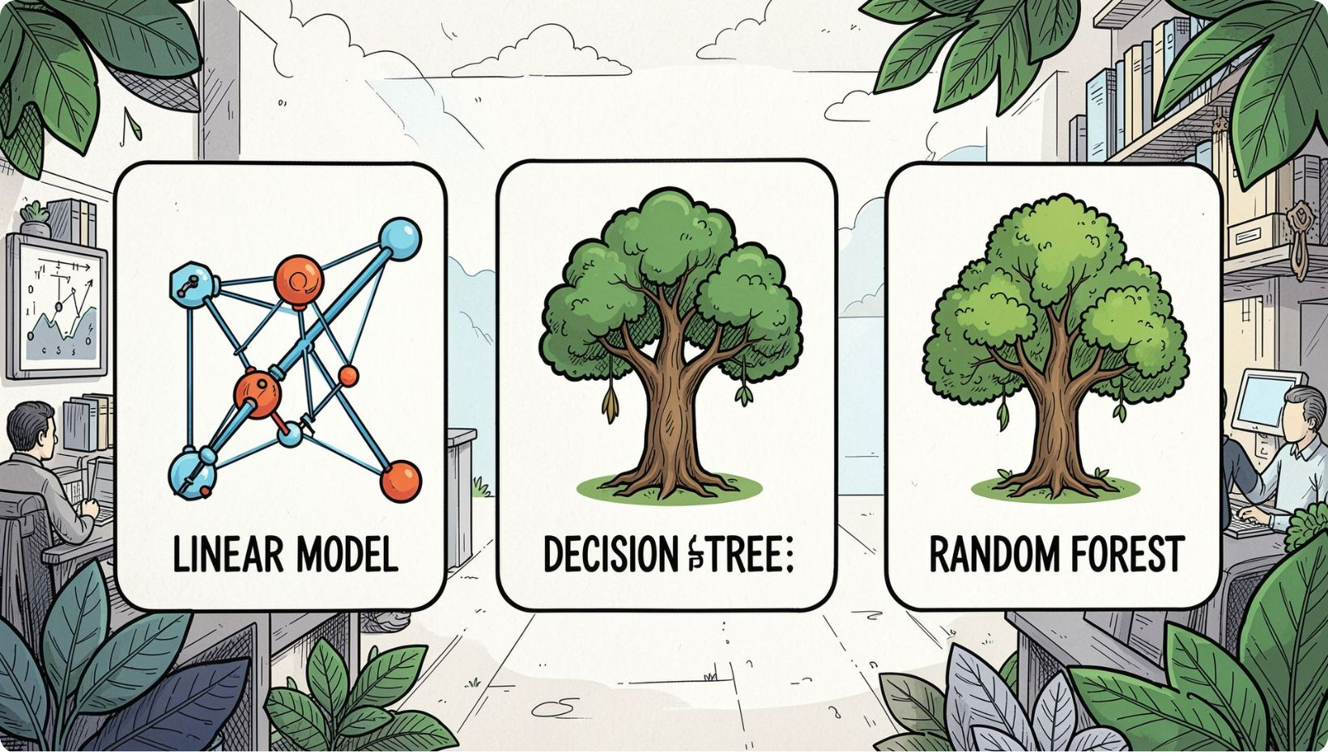
Modeling Approach
Compare several regression techniques to find the best balance of accuracy, interpretability, and robustness:
Linear Regression: Baseline, interpretable coefficients, good when relationships are mostly linear.
Decision Tree Regression: Captures nonlinearities and interactions, but prone to overfitting.
Random Forest Regression: Ensemble reduces variance, typically improves predictive performance.

Slide 6
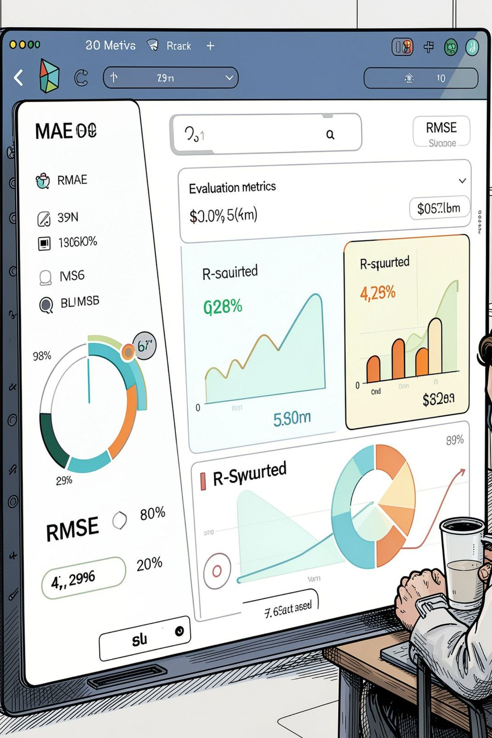
Evaluation Strategy
Use robust evaluation to compare models and estimate real-world performance:
Train/Test split (e.g., 80/20) and cross-validation for stable estimates.
Metrics: MAE (median-friendly), RMSE (penalizes large errors), R² (variance explained).
Assess residuals for heteroscedasticity, nonlinearity, and subgroup bias (smokers vs non-smokers, regions).

Slide 7
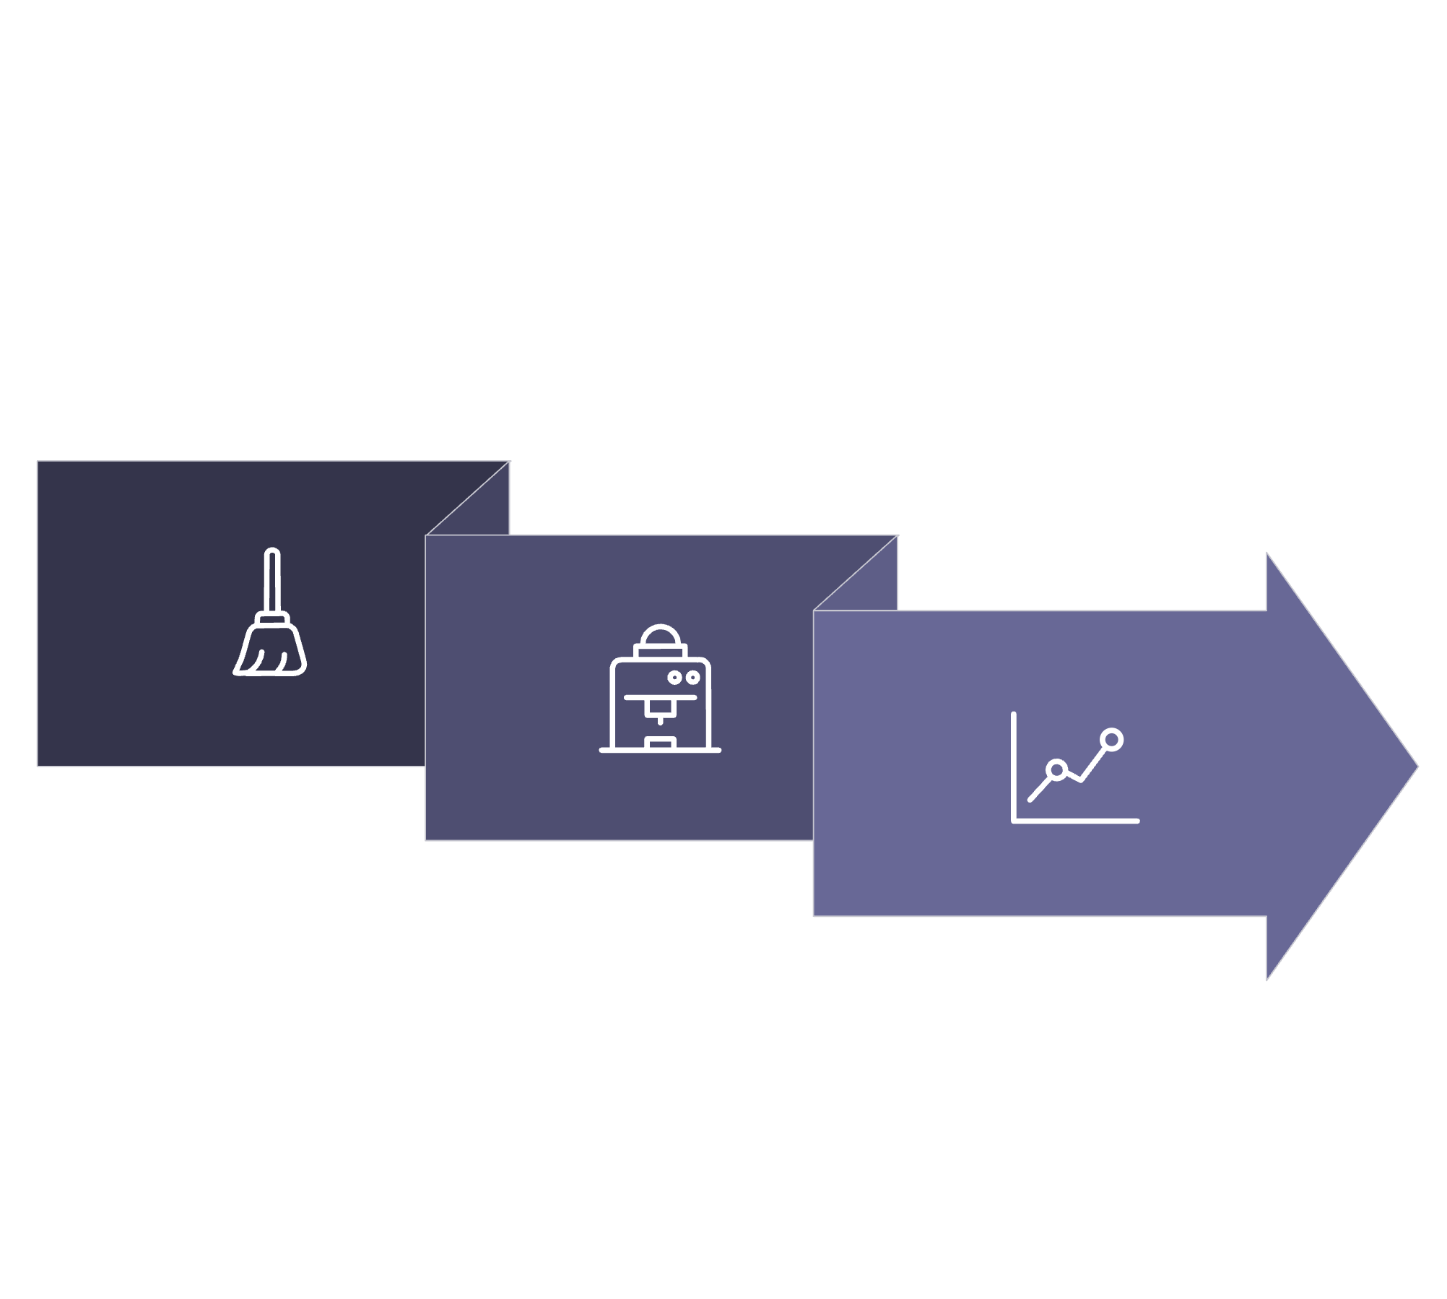
Preprocess
Evaluate
Train Models
Pipeline: clean → train & tune → evaluate & interpret.

Slide 8
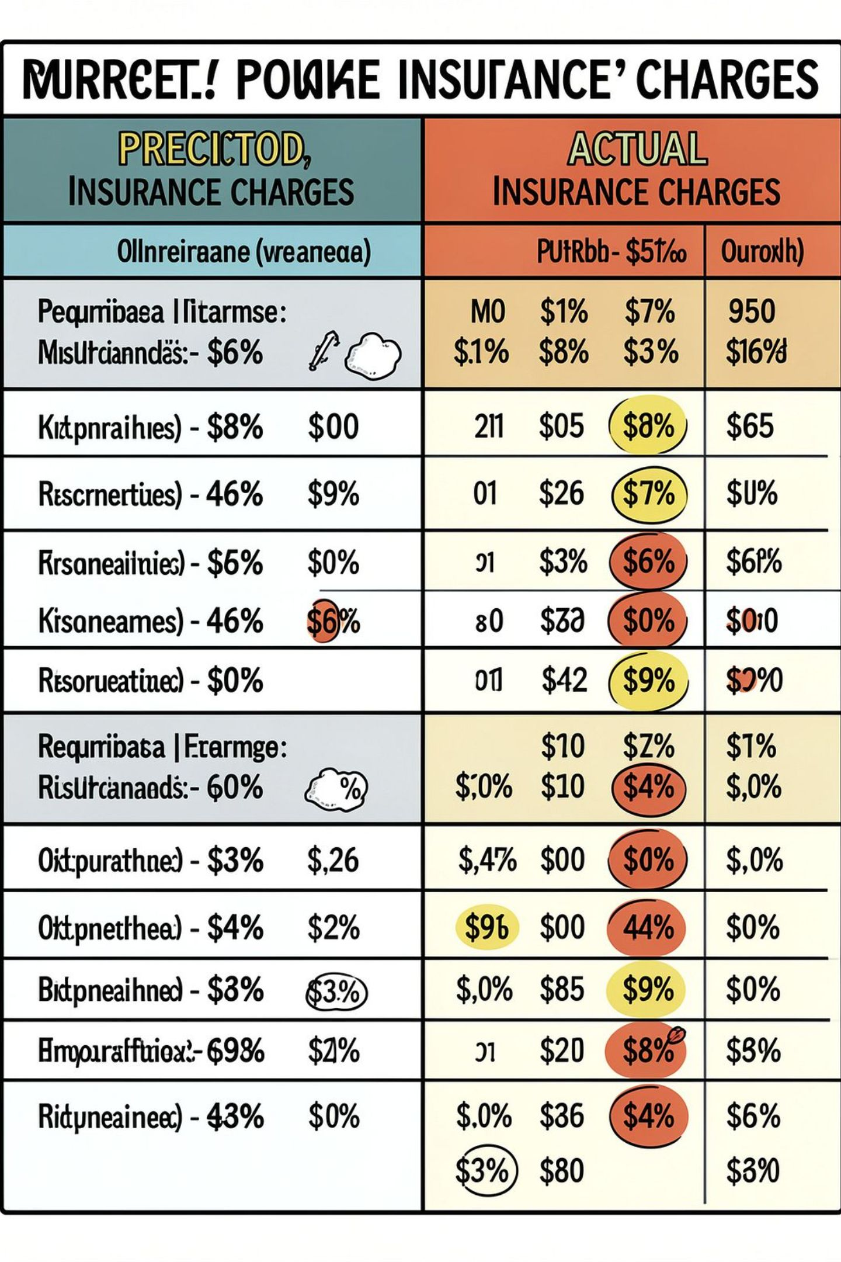
Interpreting Results & Key Insights
Typical findings: smoker status and higher BMI often produce the largest positive effect on charges.
Age shows a steady upward trend; interactions (age × BMI, smoker × age) can improve fit.
Regional differences reflect utilization and pricing variation — include region-specific adjustments when necessary.
Examine and explain outliers — rare high-cost cases may be driven by chronic conditions not captured in features.

Slide 9
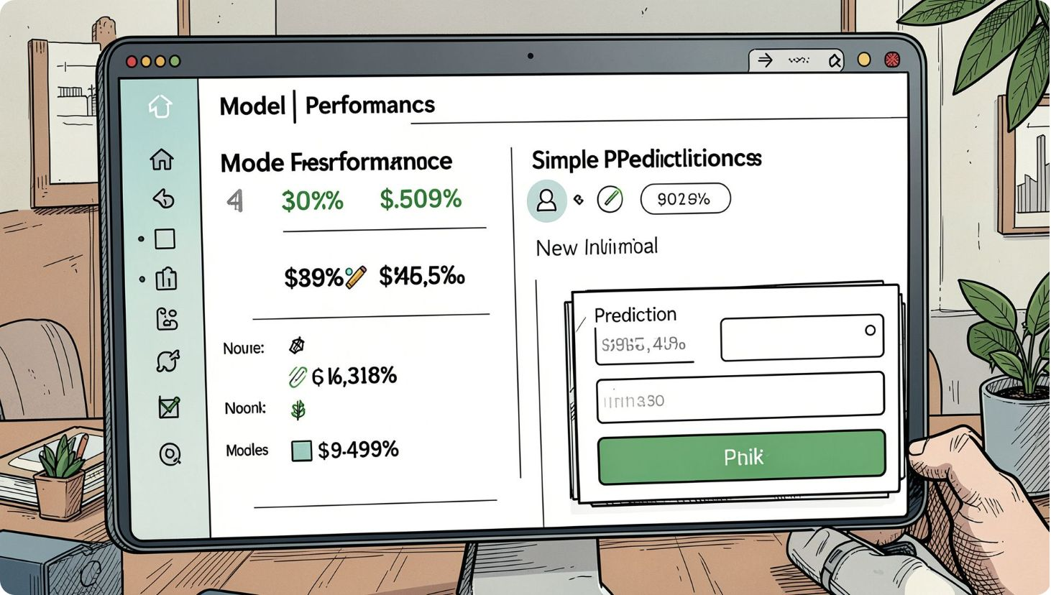

Deployment & Use Cases
Turn the model into a usable tool:
Web form or API: input age, BMI, smoking, children, region → return estimated charge and confidence interval.
Decision support for insurers: risk segmentation and pricing guidance.
Personal finance: help individuals forecast expected healthcare expenses and inform lifestyle interventions.
Ensure fairness checks and privacy safeguards before production deployment.

Slide 10

Next Steps & Practical Tips
Run feature importance and SHAP analyses to explain individual predictions and build trust.
Try additional models (Gradient Boosting, XGBoost) and calibrate prediction intervals.
Validate on external or holdout datasets to check generalization across different populations.
Document data provenance, preprocessing, and fairness audits to meet healthcare compliance and ethical standards.
Ready to build the predictor? Start with data cleaning, baseline linear regression, then iterate with tree ensembles and explainability tools.

