Slide 1
Intelligent Carbon Credit
Management System
Database + Blockchain + Predictive Analytics
DBMS PROJECT
First Review Presentation

Slide 2
Introduction
2
Centralized platform
Multiple stakeholders
Technology layers
Manages carbon projects, verification, credit generation, marketplace activity and transactions.
Connects companies/project owners, verifiers, buyers and administrators through role-based workflows.
Uses MySQL for structured application data, blockchain for token ownership, and AI/ML for price prediction and analytics.
The system is designed to manage the carbon-credit lifecycle from project creation to marketplace activity and analytics.
Carbon Credit Management System

Slide 3
Problem Statement
3
• Carbon-project information needs centralized management.
• Verification must be controlled according to stakeholder roles.
• Carbon credits need traceable generation and ownership.
• Buyers need a marketplace to discover and purchase credits.
• Transactions require reliable database records.
• Future market-price information can support better decision making.
Challenge
Project, verification, ownership and transaction information span multiple stages.
Need
A connected workflow using database, blockchain and analytics.
Goal
Provide a centralized platform with traceability and predictive insights.
Carbon Credit Management System

Slide 4
Objective
4
MAIN OBJECTIVE
To develop a role-based database-driven system that manages carbon projects, verification, carbon-credit tokenization and marketplace transactions, while using MySQL for reliable data management and AI-based analytics for future price prediction.
Carbon Credit Management System

Slide 5
Functionalities Used / Planned
5
Company / Seller
Verifier / Admin
Buyer
Register/login • Create project • Submit project • Generate/list credits
Review project • Verify CO₂ reduction • Approve/reject • Monitor activity
Browse marketplace • Check price • Purchase credits • View transactions
Blockchain
AI / Analytics
System
Mint tokens • Transfer ownership through smart contract • Record transaction hash
Prepare market data • Predict future prices • Display trends and analytics
JWT authentication • RBAC • MySQL persistence • API integration • Dashboard
Carbon Credit Management System

Slide 6
Project Steps — Completed vs Pending
6
COMPLETED — CORE WEB/DBMS IMPLEMENTATION
PENDING — ADVANCED INTEGRATION
• Requirements & system design
• ER/database design
• MySQL schema & constraints
• Views, procedures & triggers
• Sample data & DB testing
• Backend REST APIs
• JWT authentication & RBAC
• Seller/project module
• Verifier module
• Buyer & marketplace module
• Transaction management
• Frontend integration
• Carbon-credit generation integration
• Blockchain / smart contract
• Token ownership transfer
• Credit retirement
• AI dataset preparation
• Price prediction model
• Dynamic pricing / recommendations
• Analytics dashboard integration
• Online deployment
• Multi-user online testing
• Final end-to-end integration
Blockchain and AI are planned project components and are not presented as completed implementation.
Carbon Credit Management System

Slide 7
UML — Use Case Diagram
7
Carbon Credit Management System
Login
Admin
Company / Seller
Manage Users / Data
Create / Submit Project
Verifier
Verify Project
Mint / Manage Credits
View Analytics
Buyer
Purchase Credits
Browse Marketplace
Carbon Credit Management System

Slide 8
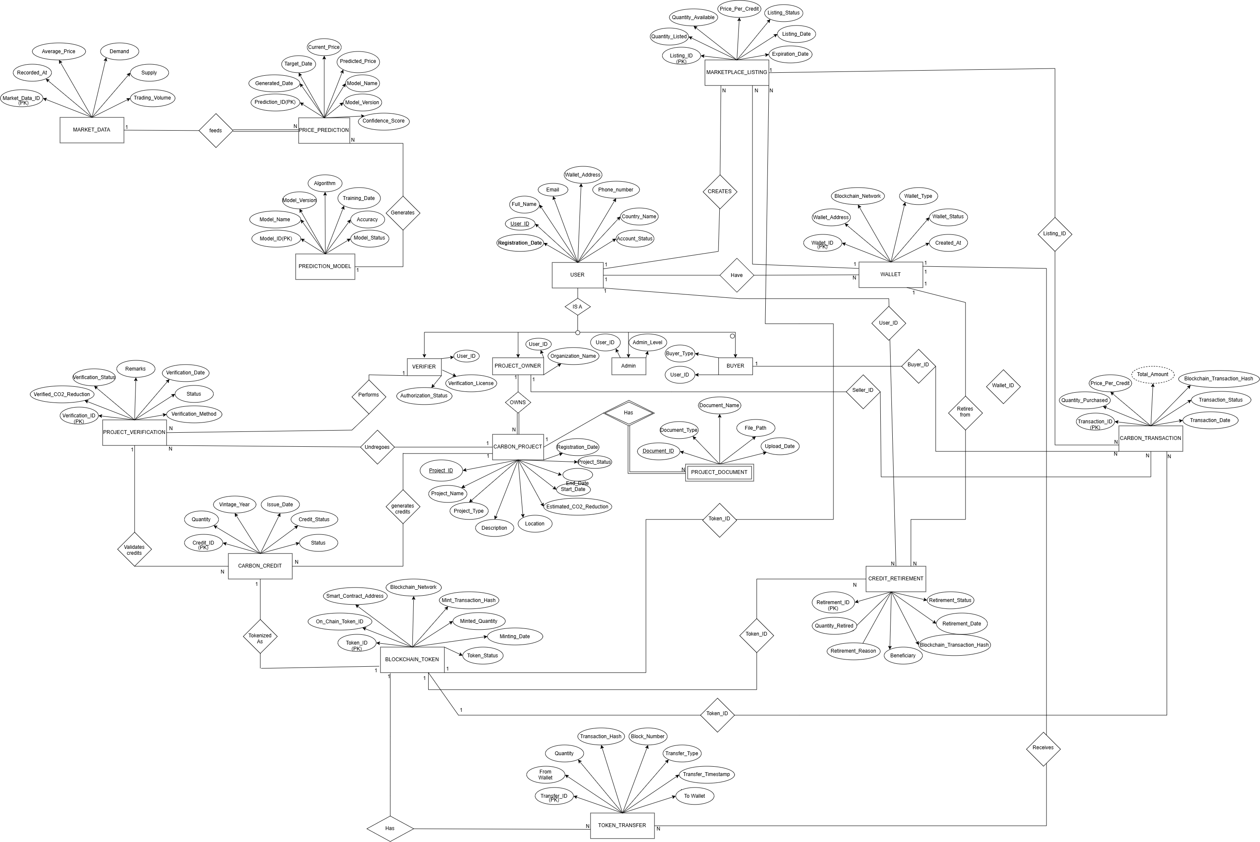
Database Design — ER Diagram (MySQL)
8
MySQL stores structured application records. Blockchain references such as token IDs and transaction hashes can be stored with off-chain records once blockchain integration is implemented.
Carbon Credit Management System

Slide 9
Full Project Flow
9
Company Registers
Creates Carbon Project
Project Verification
Carbon Credits Generated
Blockchain Tokens Minted
Smart Contract Transfers Ownership
Buyer Purchases Credits
Credits Listed on Marketplace
MySQL Database Updates
AI Predicts Future Prices
Dashboard Displays Analytics
Pending stages: blockchain tokenization, smart-contract ownership transfer, AI prediction and final analytics integration.
Carbon Credit Management System

Slide 10
System Architecture
10
Users / Companies / Buyers
Frontend
Node.js / Express Backend
MySQL Database
Blockchain
AI / ML Service
Analytics
MySQL is the primary relational database for users, projects, verification, listings and transactions.
Carbon Credit Management System

Slide 11
Database / DBMS Concepts Used
11
Relational schema
Constraints
Indexes
Views
Structured tables connected through PK/FK relationships.
Keys, uniqueness and validation rules.
Improve lookup performance.
Reusable query-based representations.
Procedures
Triggers
Transactions
Normalization
Encapsulate database operations.
React automatically to database events.
Maintain consistency in purchase operations.
Reduce redundancy and improve integrity.
Carbon Credit Management System

Slide 12
Current Status & Remaining Work
12
COMPLETED — CORE FOUNDATION
PENDING — ADVANCED FEATURES
MySQL database and schema
Constraints, indexes, views, procedures and triggers
Backend REST APIs
JWT authentication and role-based access
Seller / project workflow
Verifier workflow
Buyer / marketplace workflow
Transaction history
Frontend integration
GitHub repository
Carbon-credit generation integration
Blockchain token minting
Smart contract
Ownership transfer
Credit retirement
AI/ML dataset preparation
Future price prediction
Dynamic pricing / recommendation
Analytics dashboard integration
Public deployment + multi-user testing
Final end-to-end testing
Current milestone: the MySQL-backed core web application is functional locally; advanced blockchain and AI components remain to be implemented.
Carbon Credit Management System

Slide 13
Development Roadmap
13
1–12
Core DBMS + Web Application
COMPLETED
13–17
Blockchain + Tokenization + Retirement
PENDING
18–23
AI Dataset + Prediction + Dynamic Pricing
PENDING
24–25
Frontend Analytics + Dashboards
PARTIALLY PENDING
26–29
Integration + Testing + Deployment + Documentation
PENDING
30
Final Presentation
PENDING
Carbon Credit Management System

Slide 14
Thank You
Questions & Discussion
Key takeaway
The MySQL-backed carbon-credit management foundation is implemented; blockchain, AI prediction and final deployment are the next development stages.

