Slide 1


Database Integrated Carbon Credit Tokenization Using Blockchain
22AIE303-Database Management Systems
Team –C_09
Amrutha Tammurothu-24255
Bala Prasanna kumar-24256
Charan Tej Reddy Yammanuru-24259
Poojitha Devineni-24263

Slide 2
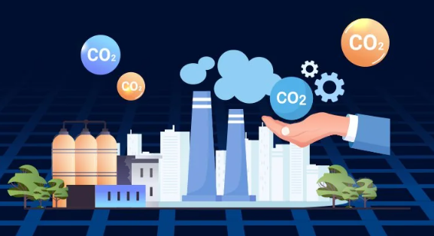
Introduction
The Carbon Credit Management System is a web-based platform that manages carbon reduction projects and carbon credits. It connects companies, verifiers, and the marketplace in one system. Companies can create projects, verifiers can approve and verify them, and companies can buy or sell carbon credits. The system also maintains credit usage, transactions, project status, and verification records securely in the database.The increasing impact of climate change has created a need for secure and transparent carbon credit management systems. Traditional systems face challenges such as inaccurate reporting, limited transparency, and inefficient verification. This project proposes a Carbon Credit Management System that integrates blockchain technology and database management to securely track, verify, and trade carbon credits.

Slide 3

Why Blockchain?
Transparency – Makes carbon-credit transactions traceable.
Security – Provides tamper-resistant transaction records.
Prevents double spending – Helps ensure the same credit is not sold twice.
Trust – Provides reliable proof of credit ownership and transfers.

Slide 4
Motivation
Growing concerns about climate change and increasing carbon emissions motivated the development of an efficient carbon management system.
Increasing global carbon emissions and climate change issues inspired the need for better carbon management.
Lack of transparency and trust in existing carbon credit systems motivated the use of blockchain technology.
The project aims to provide a secure and efficient platform for carbon credit tracking and trading.

Slide 5
Problem statement
Existing carbon credit systems lack transparency and secure tracking.
Manual verification can lead to inaccurate reporting.
Organizations face difficulty managing carbon credits and transactions.
Lack of proper monitoring of carbon usage and carbon credit

Slide 6
Proposed Solution
Develop a centralized carbon credit management platform.
Provide secure storage and tracking of carbon credit data.
Implement verifier-based project approval.
Enable organizations to trade carbon credits.
Automatically monitor carbon balance and project eligibility.

Slide 7
Objectives
To develop a secure platform for managing carbon reduction projects and carbon credits.
To provide transparent tracking of carbon credit generation, usage, and transactions.
To implement a verifier-based approval system for accurate project validation.
To enable organizations to buy, sell, and manage carbon credits efficiently.
To monitor carbon balance by comparing registered credits with reported carbon usage.
To improve trust, accountability, and transparency in carbon credit management using blockchain technology.

Slide 8
Limitations Of Existing Systems
Lack of transparency in existing carbon credit management systems.
Difficulty in accurately tracking carbon credit generation, usage, and ownership.
Manual verification processes can lead to delays and inaccurate reporting.
Limited security and risk of data manipulation in centralized systems.
Lack of efficient mechanisms for carbon credit trading between organizations.
Difficulty in monitoring an organization's carbon balance and project eligibility.

Slide 9
Proposed System Features
Organization-based carbon management.
Project registration and approval.
Carbon credit generation tracking.
Credit usage monitoring.
Carbon credit buying and selling.
Verification workflow.
Transaction history management.

Slide 10
System Architecture
User registration & login
Create carbon project
Verifier review & approval
Project completion
List credits for sale
MySQL storage layer
Credit trading complete
Calculate credit balance
Purchase credits needed
Dashboard & reports
Visual summary of all activities

Slide 11
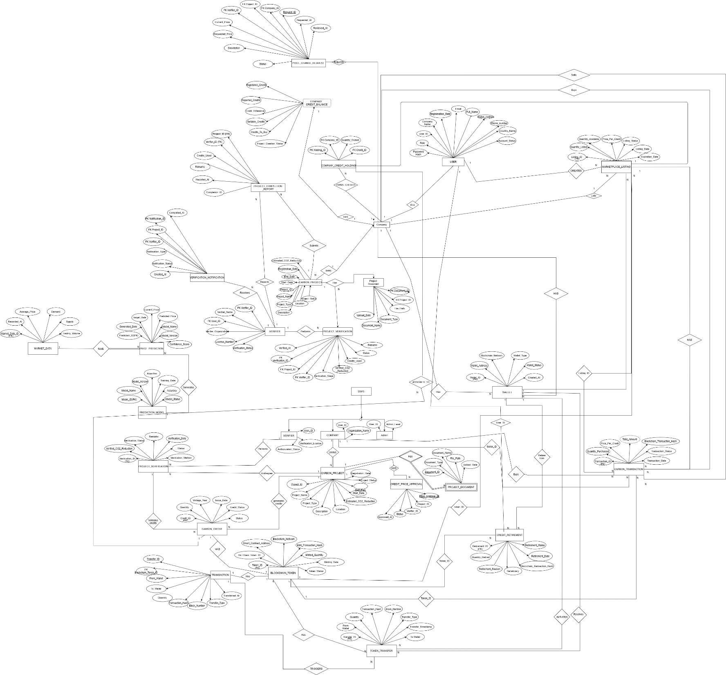
ER Diagram

Slide 12
Database Schema – Tables & Relationships
Core Tables: Users, Companies, Projects, Project Verifications
Carbon Credit Tables: Carbon Credits, Marketplace, Transactions
Verification Tables: Project Verifications, Verification Notifications
Primary Keys (PK): Uniquely identify each record.
Foreign Keys (FK): Establish relationships between related tables.
Major relationships include:
  Users(Companies) → Projects
  Projects → Project Verifications
  Projects → Carbon Credits
  Users(Companies) → Marketplace
  Users(Companies) → Transactions
  Marketplace → Transactions

Slide 13
DBMS Concepts and Its Uses
Primary Key
Identifies users, companies, projects, credits & transactions
Foreign Key
Establishes relationships between tables
Constraints
Maintains valid and consistent data
Indexes
Speeds up frequent searches
Views
Provides credit balance & dashboard reports

Slide 14
DBMS Concepts and Its Uses
Procedures
Handles project and credit operations
Triggers
Automates database updates
Transactions
Ensures safe credit buying and selling
Joins
Combines related project and company data
Aggregate Functions
Calculates total credits and transactions

Slide 15
SQL OPERATIONS & QUERIES
Select
SELECT * FROM users;
SELECT * FROM projects;
Insert
INSERT INTO users VALUES(...);
INSERT INTO projects VALUES (...);
Update
UPDATE projects
SET status='APPROVED'
WHERE project_id=1;
Delete
DELETE FROM projects
WHERE project_id=1;
Join
SELECT company_name, project_name
FROM companies
JOIN projects;
Order by
SELECT * FROM projects
ORDER BY created_at DESC;
Where
SELECT * FROM projects
WHERE status='APPROVED';
Aggregate
SUM()
COUNT()
AVG()
Credit Difference
Available Credits =
Registered Credits - Reported Credits

Slide 16
Algorithm: Carbon Credit Management System
Step 1: Start
Step 2: User Registration & Login
User registers with required details.
System verifies user credentials.
User accesses the system dashboard.
Step 3: Company Registration
Store company details in the database.
Link users with their respective organizations.
Step 4: Project Creation
Company submits a new carbon reduction project.
Store project details in the Projects table.
Step 5: Project Verification
Send project approval request to verifier.
Verifier checks project information.
If approved, project status is updated.

Slide 17
Algorithm: Carbon Credit Management System
Step 6: Carbon Credit Generation
Calculate registered carbon credits based on approved projects.
Store generated credits in the Carbon Credits table.
Step 7: Project Completion Verification
After project completion, verifier enters actual credits used.
Update reported carbon credits.
Step 8: Calculate Credit Difference
Credit Difference = Registered Credits - Reported Credits
Step 9: Credit Decision
If Credit Difference < 0:
  Company cannot create new projects.
  Company must purchase credits from marketplace.
If Credit Difference > 0:
  Company can sell excess credits.
  Verifier sets credit selling price.
  Company can request price modification.

Slide 18
Algorithm: Carbon Credit Management System
Step 10: Carbon Credit Trading
Buyers purchase available credits.
Transaction details are stored.
Credit balance is updated automatically.
Step 11: Generate Reports
Display:
  Project status
  Registered credits
  Used credits
  Available credits
  Transaction history
Step 12: End

Slide 19
Completed Work
Developed a Carbon Credit Management System for organizations.
Implemented user authentication and role-based access.
Designed a MySQL database with related tables and relationships.
Applied DBMS concepts like keys, constraints, views, procedures, and triggers.
Created project registration and verifier approval workflow.
Implemented carbon credit calculation and balance monitoring.
Developed credit buying and selling marketplace.
Managed secure carbon credit transactions.
Created dashboards for projects, credits, and transaction tracking.
Tested and validated database operations and system functionality.

Slide 20
Future Work
Integrate blockchain technology for secure and transparent carbon credit transactions.
Implement AI-based carbon emission prediction for better credit estimation.
Develop a mobile application for easier access and management.
Introduce advanced analytics and visualization dashboards for better decision-making.
Improve system scalability to support large organizations and multiple users.
Automate carbon footprint calculation using real-time activity data.

Slide 21
Conclusion
The Carbon Credit Management System provides a secure and transparent solution for managing carbon reduction projects, carbon credits, and trading activities. The system uses DBMS concepts such as relational tables, constraints, views, stored procedures, and triggers to ensure accurate data storage and efficient operations. It enables organizations to track credit generation, monitor carbon usage, and make informed decisions based on their credit balance. The verifier-based approval process improves reliability, while the marketplace allows secure buying and selling of carbon credits. Overall, the system helps improve transparency, reduce manual errors, and supports effective carbon credit management for sustainable environmental practices.

Slide 22


