Slide 1
FUTURE SALES PREDICTION – -ADS_PHASE 5 TEAM NUMBER : 01 - B.CHARAN SAI REDDY (team member) Problem Statement : Project Documentation & Submission Document the future sales prediction project and prepare it for submission. Future sales prediction involves adapting the model to handle larger datasets or increased complexity. Steps: Data Collection: Ensure you have a comprehensive and up-to-date dataset. As your sales data grows, regularly update and expand your dataset to capture new patterns and trends. Feature Engineering: Continuously refine and expand your feature set. Add new features that might influence sales, such as seasonality, marketing campaigns, or economic indicators. Model Selection: Choose a model that can handle the increased data volume and complexity. For future prediction, time series models like ARIMA or Prophet might be suitable, or consider more advanced machine learning models like XGBoost or LSTM if the data is highly nonlinear.

Slide 2
Feature Scaling and Normalization: Ensure that your features are appropriately scaled and normalized to prevent any issues with model convergence and performance. EvaluationMetrics: Revisit your evaluation metrics to account for the evolving nature of your problem. You may need to focus on different metrics as your business objectives change. Data Preprocessing: Implement more advanced data preprocessing techniques, such as handling missing data, outliers, and ensuring data quality as your dataset grows. Ensemble Methods: Combine multiple models or techniques to enhance prediction accuracy. This can help capture complex relationships in your data Scalable Infrastructure : Ensure your infrastructure can handle increased computational demands as your model scales. Consider cloud-based solutions or parallel processing. Compliance and Ethics: As the dataset grows, pay attention to data privacy, ethical considerations, and compliance with regulations.

Slide 3
Data Preprocessing: Implement more advanced data preprocessing techniques, such as handling missing data, outliers, and ensuring data quality as your dataset grows.
[15]:
#importing necessary libraries
import pandas as pd
from sklearn.preprocessing import StandardScaler, LabelEncoder
from sklearn.impute import SimpleImputer
from sklearn.model_selection import train_test_split
import warnings
warnings.simplefilter(action='ignore', category=FutureWarning)
# Import the Netflix dataset
file_path = r"C:\Users\gayat\OneDrive\Desktop\sales_data.csv" # Remove the 'r'␣
↪from the parentheses
encoding = "ISO-8859-1"
df = pd.read_csv(file_path, encoding=encoding) df.head()
[15]:
TV Radio Newspaper Sales
0 230.1 37.8
1 44.5 39.3
2 17.2 45.9
3 151.5 41.3
4 180.8 10.8
69.2 22.1
45.1 10.4
69.3 12.0
58.5 16.5
58.4 17.9
[16]: df.info()
<class 'pandas.core.frame.DataFrame'> RangeIndex: 200 entries, 0 to 199 Data columns (total 4 columns):
3

Slide 4
# |  | Column | Non-Null Count |  | Dtype
0 |  | TV | 200 non-null |  | float64
1 |  | Radio | 200 non-null |  | float64
2 |  | Newspaper | 200 non-null |  | float64
3 |  | Sales | 200 non-null |  | float64
dtypes: float64(4) memory usage: 6.4 KB
[17]:
[17]:
df.head()
TV Radio Newspaper Sales
0 230.1 | 37.8 | 69.2 | 22.1
1 44.5 | 39.3 | 45.1 | 10.4
2 17.2 | 45.9 | 69.3 | 12.0
3 151.5 | 41.3 | 58.5 | 16.5
4 180.8 | 10.8 | 58.4 | 17.9
[18]:
df.isnull()
[18]: |  | TV | Radio | Newspaper | Sales
 | 0 | False | False | False | False
 | 1 | False | False | False | False
 | 2 | False | False | False | False
 | 3 | False | False | False | False
 | 4 | False | False | False | False
 | .. | … | … | … …
 | 195 | False | False | False | False
 | 196 | False | False | False | False
 | 197 | False | False | False | False
 | 198 | False | False | False | False
 | 199 | False | False | False | False
[200 rows x 4 columns]
[19]:
df.fillna(df.mean(), inplace=True)
df.dropna(inplace=True)
[22]:
value_sales = df['TV'].value_counts()
print("\nsales:") print(value_sales)
sales:
199.8 2
109.8 2
17.2 2
177.0 2
4

Slide 5
222.4 | 2 ..
139.3 | 1
216.8 | 1
199.1 | 1
26.8 | 1
232.1 | 1
Name: TV, Length: 190, dtype: int64
[25]:
label_encoder = LabelEncoder()
df['Sales'] = label_encoder.fit_transform(df['Sales']) df
[25]: | TV | Radio | Newspaper | Sales
 | 0 230.1 | 37.8 | 69.2 | 106
 | 1 44.5 | 39.3 | 45.1 | 28
 | 2 17.2 | 45.9 | 69.3 | 40
 | 3 151.5 | 41.3 | 58.5 | 66
 | 4 180.8 | 10.8 | 58.4 | 80
 | .. … | … | … …
 | 195 38.2 | 3.7 | 13.8 | 14
 | 196 94.2 | 4.9 | 8.1 | 52
 | 197 177.0 | 9.3 | 6.4 | 56
 | 198 283.6 | 42.0 | 66.2 | 118
 | 199 232.1 | 8.6 | 8.7 | 84
[200 rows x 4 columns]
[27]:
from sklearn.linear_model import LinearRegression
model=LinearRegression()
[32]:
X = df.drop('Newspaper', axis=1)
y = df['Newspaper']
X_train, X_test, y_train, y_test = train_test_split(X, y, test_size=0.2,␣
↪random_state=42)
[33]:
print("\n X_test info")
print(X_test.info())
X_test info
<class 'pandas.core.frame.DataFrame'> Int64Index: 40 entries, 95 to 76
Data columns (total 3 columns):
# Column Non-Null Count Dtype
0 TV 40 non-null float64
5

Slide 6
1 Radio
40 non-null
float64 int64
2 Sales 40 non-null dtypes: float64(2), int64(1) memory usage: 1.2 KB
None
[40]:
model.fit(X_train,y_train)
[40]: LinearRegression()
[ ]:
6

Slide 7
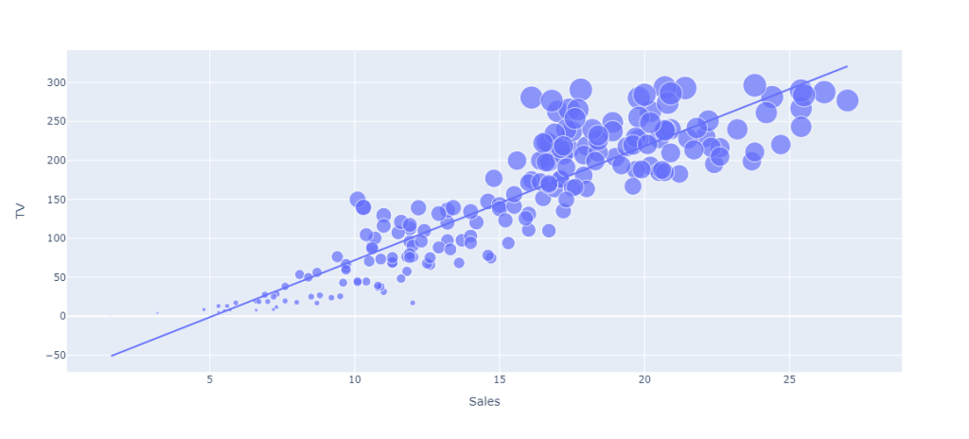
import plotly.express as px import plotly.graph_objects as go figure = px.scatter(data_frame = data, x="Sales", y="TV", size="TV", trendline="ols") figure.show()

Slide 8
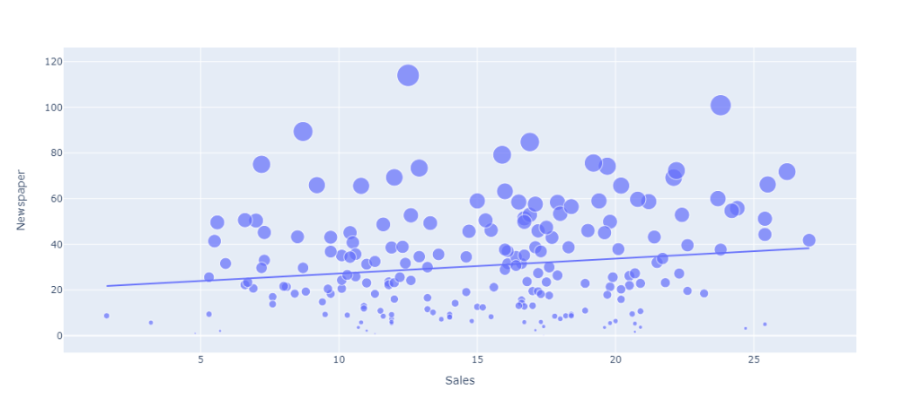
figure = px.scatter(data_frame = data, x="Sales", y="Newspaper", size="Newspaper", trendline="ols") figure.show()

Slide 9
Conclusion: By projecting future sales income, businesses can create through financial plans, including profit and loss estimates, cash flow management, and investment decisions. Organisations can efficiently plan their financial resources and acquire funding when necessary by using accurate sales forecasting

