Slide 1

MSC TECHNOLOGIES Job Oriented Training with Real Time JOB IN 90 DAY Mobile : 9148102585, : 8121203075 : msctechnologies111@gmail.com

Slide 2
DEMO ROADMAP
WHAT IS PYTHON
ADVANTAGES OF PYTHON
WHERE PYTHON IS USED
PYTHON TOPICS
ROBOT FRAMEWORK & PYTEST & PYTEST BDD
SELENIUM TOPICS & PLAYWRIGHT
REST API TOPICS
OUR SUCCESS METHODS TO GET A JOB & SUSTAIN
KEY BENEFITS FOR STUDENTS

Slide 3
What is Python
High-level Programing language
Developed by Guido Van Rossum in 1989 and first released in 1991
Borrowed features from
Functional Programing from C
OOP from C++
Scripting from Perl and Shell script
Modular from Modula 3
Syntax from C and ABC Language

Slide 4
Why Python/ Advantages
Python is easy to learn and use
Simple easy-to-use syntax
Require lesser coding
Modular
Dynamic
Object-oriented and Packages
Interpreted
Portable
High level
Automatic Memory Management.
Well Defined Libraries and open-source Frameworks built with python
Compatible with Major Platforms
Open Source

Slide 5
Where Python
Test frameworks
Automation
AI & Generative AI
Machine Learning
Web Application
Graphical user interfaces
Multimedia
System administration
Scientific and Numeric Applications
Web scraping
Desktop applications
Database Access
Embedded scripting language
Network Programming
Text processing
Image processing

Slide 6
Python Basic and Advance Topics
Data Types
Slicing
Conditional Operations
Loops
Functions
File Handling
Regular Expressions
Modules
OOP
Exceptions
Threading
paramiko
Requests
sys,os and re
Selenium
PYTEST

Slide 7
Robot Framework Topics
About Robot Framework
Robot File Structure
Variable operations
Conditional Statements
Loops
Create Keywords
Create and usage of Resource Files
Use Python functions in Robot File
Resource and Library
About Collections and Operating System and String Libraries
Setup and Tear down section and Suite Setups
Tags
Execution options

Slide 8
Selenium & Playwright
About Selenium
Element locators
Handle Popups
Double click operations
Scroll down
Switch to another tab
Page load timeout and page refresh.
Get window screenshot
Get window title and text from element
Set Windows size
Waits(Implicit and Explicit)
Select drop down values
Switch to windows
Zoom operations
Select Check box and radio button
Navigators

Slide 9
REST API
ABOUT WEB SERVICES
HTTP Methods(GET, POST, PUT AND DELETE)
IMPLEMENT REST API WITH FLASK FRAMEWORK
API MANUAL TESTING WITH POSTMAN TOOL
API AUTOMATION WITH PYTHON REQUESTS MODULE
API AUTOMATION WITH ROBOT FRAMEWORK REQUESTS LIBRARY
HTTP RESPONSE CODES
VALIDATE API RESPONSE WITH ASSERT KEYWORD

Slide 10
OUR SUCCESS METHODS TO GET A JOB & SUSTAIN
WE PROVIDE THE RIGHT DIRECTION FOR LEARNING WITHOUT CONFUSION.
PRACTICAL SESSIONS BY STUDENTS ON EVERY TOPIC
PRACTICAL ASSIGNMENTS ON REAL-TIME TOPICS AND USE CASES
DETAILED AND CLEAR EXPLANATION OF A PROJECTS AND ROLES AND RESPONSIBILITIES
CREATE A RESUME WITH RELEVANT SKILLS AND NAUKRI PROFILE AS INDUSTRY REQUIREMENTS TO GET RECRUITERS ATTENTION
TRAINING ON REAL TIME CONCEPTS GIT, JIRA, LINUX, JENKINS AND MYSQL
DAILY MOCK INTERVIEW ON TECHNICAL, MANAGER AND HR QUESTIONS
PERSONALIZED FEEDBACK AND MENTORING FOR IMPROVEMENT EACH STUDENT
WE TEACH STUDY TECHNIQUES TO BOOST MEMORY & SPEED UP LEARNING
Our Ultimate goal is to train students to crack interviews and sustain their jobs independently.

Slide 11
KEY BENEFITS FOR STUDENTS
100% JOB PLACEMENT
AFTER GETTING JOB ALSO WE PROVIDE JOB SUPPORT AND ASSISTANCE
FROM LAST 15 YEARS WE ARE FULLY DEDICATED ON PYTHON AUTOMATION TRAINING AND JOB PLACEMENTS
WE FOLLOW EFFECTIVE TEACHING METHODS TO MAKE CONCEPTS SIMPLE AND CLEAR
WE PROVIDE TRANING BY EXPERTS WITH REALTIME CONCEPTS
OUR COURSES ARE DESIGNED AND SUMMARIZED BY EXPERTS TO MAKE LEARNING FAST AND EASY
TRAINING ON AI TOOLS TO DEVELOP CODE AND DEBUG MORE EFFICIENTLY AND FASTER.
24/7 WE PROVIDE ISOLATED PYTHON AUTOMATION ENVIRONMENT FOR PRACTICE AND LEARNING
RIGHT PLACE TO MOVE MANUAL TESTING TO AUTOMATION and NON-IT to IT
WE PROVIDE ALL REQUIRED DOCS FOR STUDENTS

Slide 12
Student ?
DOES PYTHON IS DIFFICULT TO LEARN ?
IS ANY PRIOR CODING KNOWLEDGE IS REQUIRED TO LEARN PYTHON ?
WILL YOU COVER REALTIME CONCEPTS AND RESUME PREPARATION ?
CAN YOU PROVIDE EXPERIENCE REQUIRED DOCUMENTS ?
CAN YOU PROVIDE SUPPORT AFTER GETTING JOB ?
HOW WILL BE THE INTERVIEW CALLS AFTER COMPLETING COURSE ?
CAN NON-IT PROFESSIONALS JOIN AND TRANSITION TO AUTOMATION CAREERS ?
HOW LONG WILL IT TAKE TO BECOME JOB-READY AFTER THE COURSE ?

Slide 13
Contact US
MSC TECHNOLOGIES
GROUD FLOOR, BESIDE RAMDEV MEDICAL, DENTAL COLLEGE MAIN ROAD
MUNNEKOLALU, BANGALORE- 560037
Mobile : 9148102585, 8121203075
EMAIL : msctechnologies111@gmail.com
WEBSITE : https://www.youtube.com/@MSCTECHNOLOGIES-d4c
LOCATION : https://maps.app.goo.gl/xsE8z79PEpdTwfZ68

Slide 14
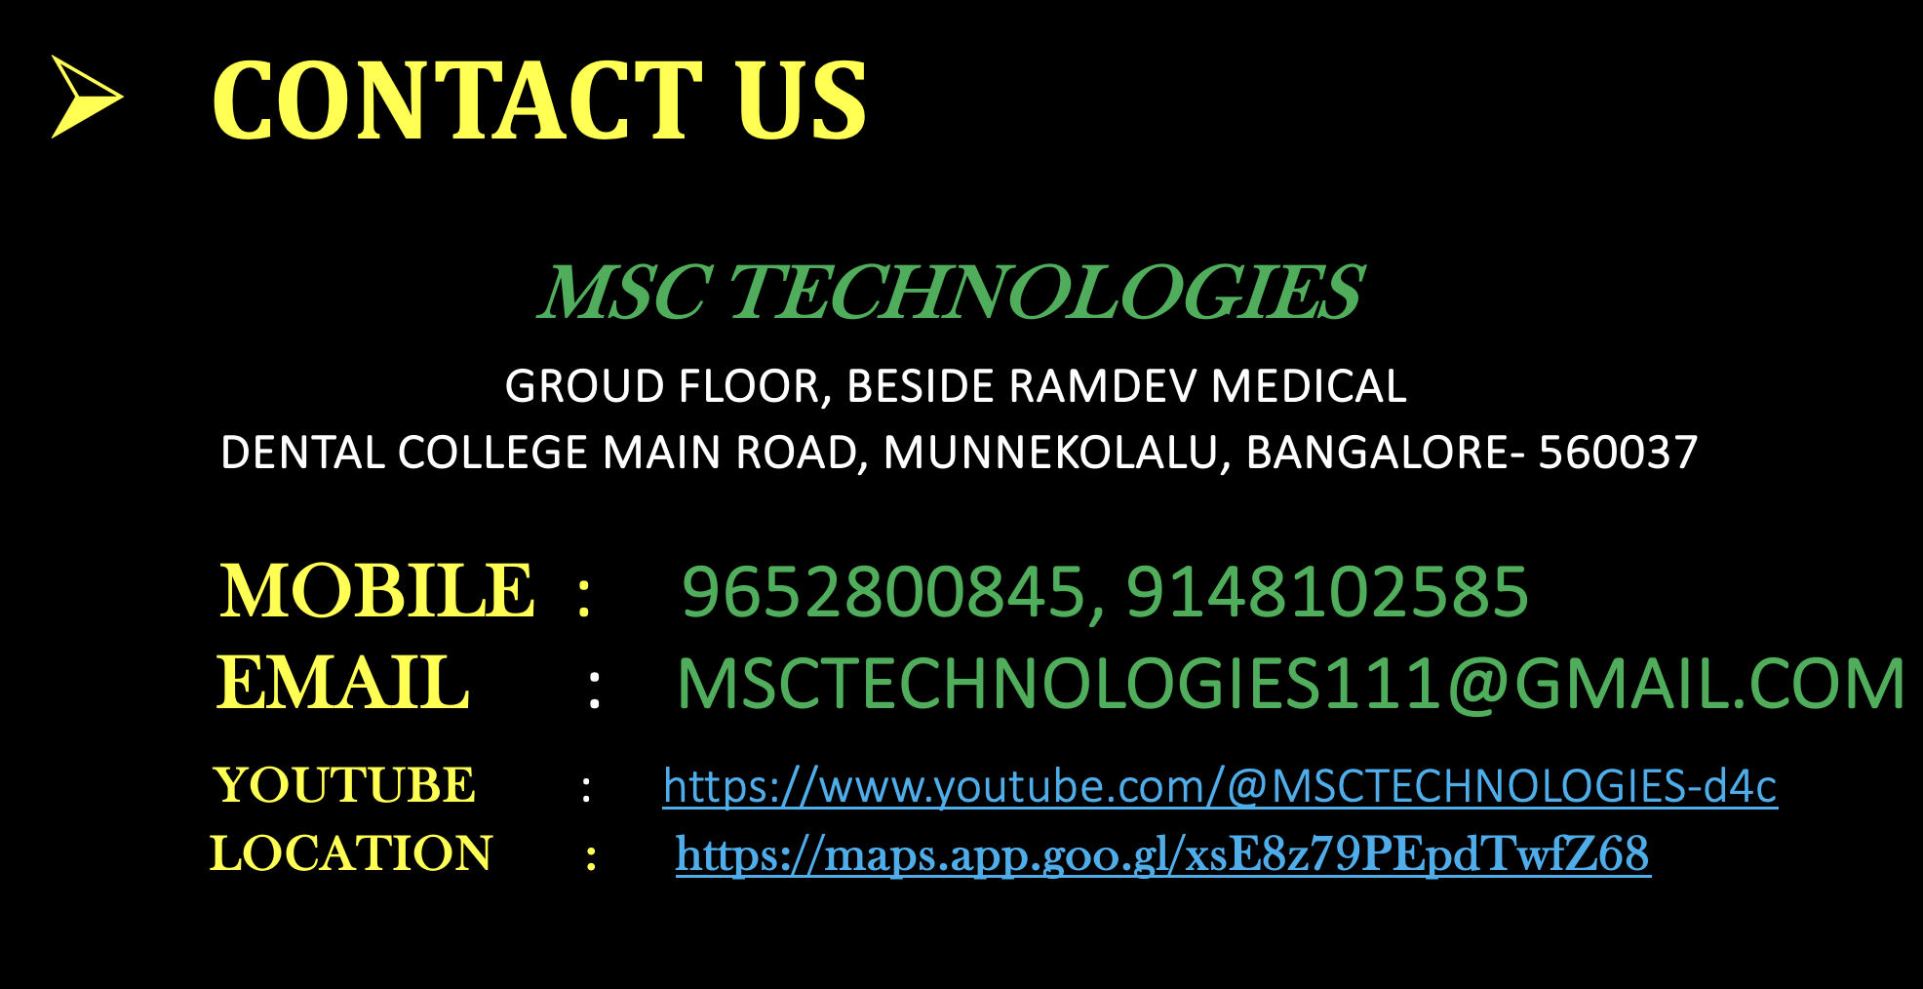
Contact US
MSC TECHNOLOGIES

