Slide 1

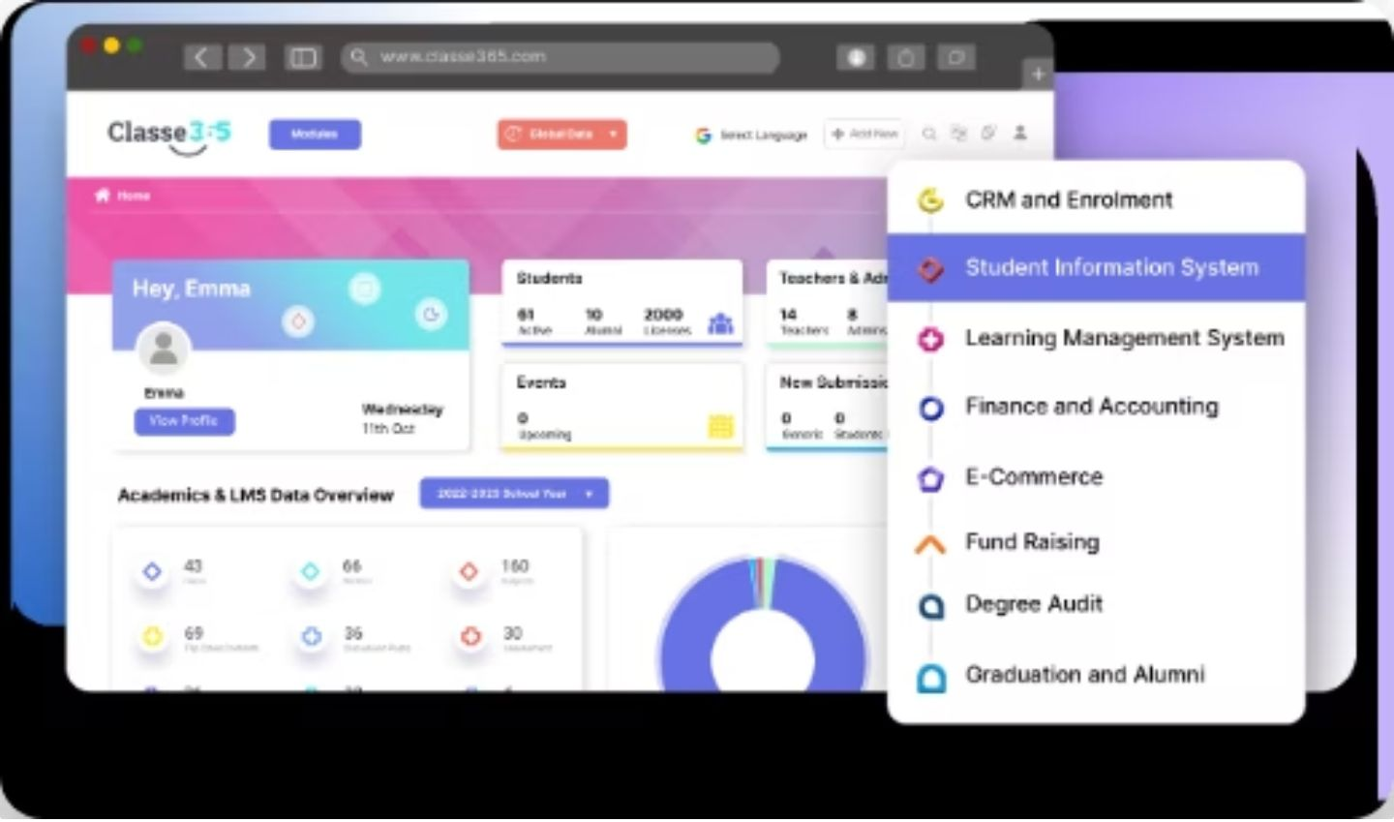
CAPSTONE PROJECT
University Grade & Attendance Tracker
A Centralized Java Application for Academic Record Management, Automated Grading, and Attendance Analytics
TEAM MEMBERS:
MARTHA HEMANTH SAI – 2620030510
PERICHARLA CHARAN VARMA - 2620030362

Slide 2
01 / PROJECT FOUNDATION
ABSTRACT
The University Grade & Attendance Tracker is a centralized Java application designed to manage student academic records, automate grade calculations, and monitor attendance. The system stores student profiles, subject marks, and attendance information in a structured way, helping standardize academic evaluation.
The application reduces the time and calculation errors associated with manual record management. It automatically calculates totals, percentages, grade points, and attendance status, while identifying attendance shortages and supporting clear academic reports.
JAVA • ACADEMIC SYSTEM
2

Slide 3
02 / CONTEXT
INTRODUCTION
Academic record management is an important part of university administration, but manual handling of student marks and attendance can be time-consuming and may lead to calculation or record-keeping errors. A centralized system can organize these records and make routine academic evaluation more consistent and efficient.
This project uses Java to develop a University Grade & Attendance Tracker that combines student profiling, automated grade calculation, attendance monitoring, and reporting. The system applies conditional statements, loops, arrays, methods, and logical rules to process academic data and determine performance and attendance eligibility.
JAVA • ACADEMIC SYSTEM
3

Slide 4



03 / PURPOSE & GOALS
PROJECT OBJECTIVES
Four capabilities turn academic records into a consistent workflow.
Centralized Profiling
Automated Grade Engine
Attendance Tracking
Transcript Generation
Standardize student records, marks, and attendance data in single dynamic arrays.
Calculate totals, percentages, GPA points, and letter grades without manual arithmetic.
Monitor subject-wise attendance and trigger automatic eligibility warnings at 75%.
Generate clean, structured performance reports for faculty review and archives.
JAVA • ACADEMIC SYSTEM
4

Slide 5

04 / EVALUATION & BALANCED ANALYSIS
ADVANTAGES & LIMITATIONS
KEY SYSTEM ADVANTAGES
Precision with less manual effort.
SYSTEM VALUE
A clearer academic record, built for repeatable evaluation.
100% Calculation Precision: Eliminates manual grading and percentage errors.
Time Efficiency: Rapidly processes multi-course marks and attendance metrics.
Automated Shortage Alerts: Instantly flags attendance below 75% threshold.
Lightweight Execution: Operates seamlessly on standard JVM without heavy overhead.
Centralized records, automated calculations, and threshold-based alerts create a dependable review workflow.
JAVA • ACADEMIC SYSTEM
5

Slide 6
05 / METHODOLOGY & ARCHITECTURE
PROJECT DEVELOPMENT
01
Requirement Analysis & Schema Design
Identified key academic parameters: subject marks, total classes, attended sessions, and evaluation thresholds.
02
Core Technology Selection
Selected Core Java (JDK 11+) and standard IDE tooling (VS Code / Eclipse) for platform-independent execution.
03
Algorithmic Logic & Business Rules Implementation
Coded mathematical grading formulas, GPA mapping, and 75% attendance threshold verification logic.
04
Verification & Boundary Testing
Validated sample inputs, edge cases (0% attendance, max marks), and formatted output display.
JAVA • ACADEMIC SYSTEM
6

Slide 7
07 / CURRICULUM MAPPING
COURSE OUTCOMES (COs) ADDRESSED
Course Outcome | CO Description | Implementation in Project
CO 1 | Problem Analysis & Logic Formulation | Converted manual record-keeping problems into clear algorithmic rules for attendance and grades.
CO 3 | Data Structures & Variable Allocation | Applied arrays to store dynamic numbers of subjects, marks, and attendance values efficiently.
CO 2 | Flow Control & Conditional Logic | Used if-else decision trees to apply grade thresholds and 75% attendance eligibility rules.
CO 3 | Modular Software Implementation | Designed reusable Java methods for calculating averages, GPA points, and formatted transcripts.
JAVA • ACADEMIC SYSTEM
7

Slide 8
08 / CONCEPT TRACEABILITY
COs Covered and Summary
Topic | Source notes | Used in code | CO
final keyword | final.txt | Constants for limits and name | CO4
Collection Framework | collection framework.txt | ArrayList and Iterator | CO6
StringBuffer | Java_StringBuffer.txt | append() for subject report | CO5
Core Java (loops, arrays, operators, switch) | Your original program | Input, calculation, grading | CO1,CO2,CO3
Result: one program that combines basic Java with the final keyword, the Collection Framework and StringBuffer.
JAVA • ACADEMIC SYSTEM
8

Slide 9
09 / PROGRAM LOGIC
Program Overview and Implementation
Takes student details: name, department, university ID
Reads grades and attendance for every subject
Calculates average grade and overall attendance %
Assigns a letter grade (A to F)
Checks eligibility for final exams (attendance >= 75% and average >= 60%)
Prints a formatted academic report
OUTPUT PREVIEW
=================================
ACADEMIC REPORT
=================================
Student Name : ...
Department : ...
SUBJECT-WISE DETAILS:
1. Java -> Grade: 85.0% ...
Average Grade: 82.50%
Letter Grade : B (Good)
Attendance : 80.00%
STATUS: Eligible for Final Exams
JAVA • ACADEMIC SYSTEM
9

Slide 10
10 / IMPLEMENTATION FLOW
How the Code Was Created: 6 Steps
01
02
03
Constants
Input
Store
final variables for university name, 75% and 60% limits
Scanner reads student info and subject details
arrays for marks and classes, ArrayList for subject names
04
05
06
Calculate
Decide
Report
totals, average, attendance % using operators and casting
if-else, switch, && and ternary for grade and eligibility
StringBuffer append() builds subject lines; printf prints report
JAVA • ACADEMIC SYSTEM
10

Slide 11




06 / TECHNICAL FOUNDATIONS
TOPICS & CONCEPTS COVERED
Arrays & Data Storage
Control Structures & Loops
Utilized 1D arrays (`double[] grades`, `int[] attended`) to store variable course marks and attendance values dynamically.
Implemented `for` loops for data iteration and multi-branching `if-else` / `switch` statements for grade mapping.
Methods & Modular Design
Scanner & I/O Handling
Structured calculations into distinct functions for GPA computation, percentage derivation, and status formatting.
Used `java.util.Scanner` for interactive terminal data entry, capturing student metadata and subject scores.
1

Slide 12
CORE JAVA / TOPIC MAP
Core Java Topics Used
Scanner & I/O
Arrays
nextLine, nextInt, nextDouble, printf
grades[], classesAttended[], totalClasses[]
Loops
Operators
for loops for input and totals
+, /, *, +=, >=, &&
Type casting
if-else
(double) sumAttended
grade category selection
switch
Ternary ?:
category to letter grade
eligibility status message
2

Slide 13
TOPIC 1 / IMMUTABLE RULES
Topic 1: final Keyword (final variable)
final variable: value cannot be changed after it is set
Used for fixed rules of the university
Changing it later gives a compile-time error
Keeps 75.0 and 60.0 in one place, no magic numbers
CONSTANTS IN THE ELIGIBILITY CHECK
static final String UNIVERSITY_NAME =
"KLU University, Hyd";
static final double MIN_ATTENDANCE = 75.0;
static final double PASS_PERCENTAGE = 60.0;
// used in eligibility check
boolean meetsAttendance =
attendancePercentage >= MIN_ATTENDANCE;
boolean passesGrades =
averageGrade >= PASS_PERCENTAGE;
3

Slide 14
TOPIC 2 / COLLECTION FRAMEWORK
Topic 2: Collection Framework (ArrayList + Iterator)
ArrayList: dynamic array that stores subject names
Grows automatically, unlike a fixed array
Iterator: moves through elements with hasNext() and next()
Used to read each subject name for the report
READING SUBJECT NAMES
ArrayList<String> subjectNames =
new ArrayList<String>();
subjectNames.add(scanner.nextLine());
Iterator<String> itr =
subjectNames.iterator();
while (itr.hasNext()) {
... itr.next() ...
}
4

Slide 15
TOPIC 3 / MUTABLE TEXT
Topic 3: StringBuffer (append method)
StringBuffer is a mutable String: it can be changed in place
append() adds text to the end of the buffer
Chained append() calls build each subject line
No new String object is created on every join
BUILDING THE SUBJECT REPORT
StringBuffer subjectReport =
new StringBuffer();
subjectReport.append(index + 1)
.append(". ")
.append(itr.next())
.append(" -> Grade: ")
.append(grades[index])
.append("\n");
System.out.print(subjectReport);
5

Slide 16
ARITHMETIC PROCESSING
Accumulation & Explicit Casting
Average Grade Calculation
Attendance Percentage
double average = totalGradePoints / totalSubjects;
((double) sumAttended / sumTotalClasses) * 100
Performs floating-point division using accumulated grade scores.
Casts integer numerator to double to avoid loss of fraction.
6

Slide 17
BUSINESS RULES
Exam Eligibility Thresholds
LOGICAL EVALUATION CODE
75%
boolean meetsAtt = attendance >= 75.0;
boolean passesG = average >= 60.0;
boolean isEligible = meetsAtt && passesG;
String msg = isEligible ? "Eligible" : "Ineligible";
Minimum Attendance
Required class participation rate across all courses.
60%
Minimum Average Grade
Passing academic performance threshold.
7

Slide 18



09 / NEXT STEPS & WRAP-UP
FUTURE SCOPE & CONCLUSION
MySQL Database
JavaFX GUI Interface
Automated Alerts
Replace volatile arrays with persistent SQL tables for multi-year academic history storage.
Develop a rich graphical user interface with visual performance charts and dashboards.
Dispatch instant SMS/Email warnings to students and guardians when attendance drops below 75%.
Empowering Higher Education with Automated Precision
Q & A
Thank you! Ready for Questions & Discussion.
8

Slide 19



CAPSTONE PROJECT REVIEW – 2
THANK YOU!
Questions, Feedback & Discussion
Martha Hemanth Sai (2620030510)
Pericharla Charan Varma (2620030362)
END OF PRESENTATION

