Slide 1
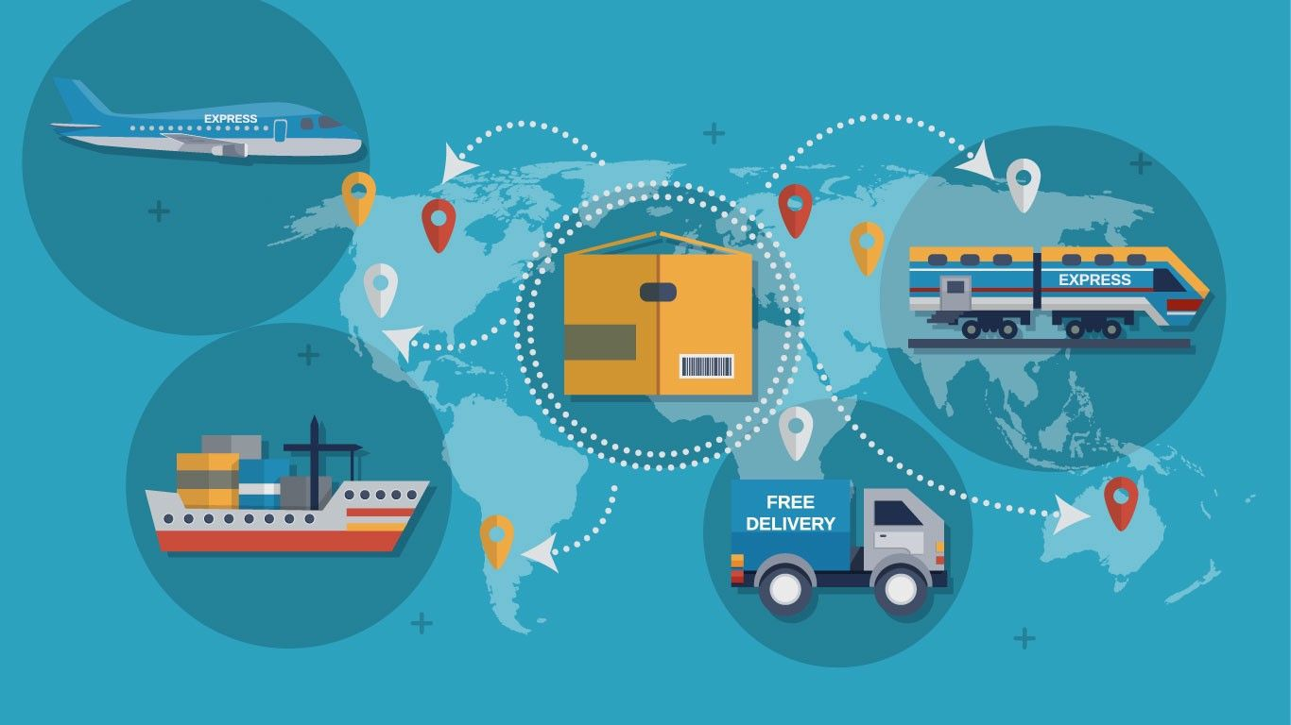
Supply Chain Disruption Prediction System
- Enhancing Supply Chain Resilience through Real-Time Monitoring, Prediction, and Automation

Slide 2

Problem Statement
Frequent disruptions in global supply chains due to natural disasters, geopolitical conflicts, transportation delays, and market volatility.
Impact: Delayed deliveries, increased costs, and reduced customer satisfaction.
Need for Action: A proactive system to monitor, predict, and mitigate risks.

Slide 3

Project Objectives
1. Develop a Global Data Monitoring & Analysis Engine to track real-time supply chain risks.
2. Build a Predictive Disruption Modeling System using machine learning and historical data.
3. Automate inventory adjustments by integrating with ERP systems (e.g., SAP).
4. Deploy a Real-Time Alert & Reporting Dashboard to notify stakeholders of potential risks.

Slide 4
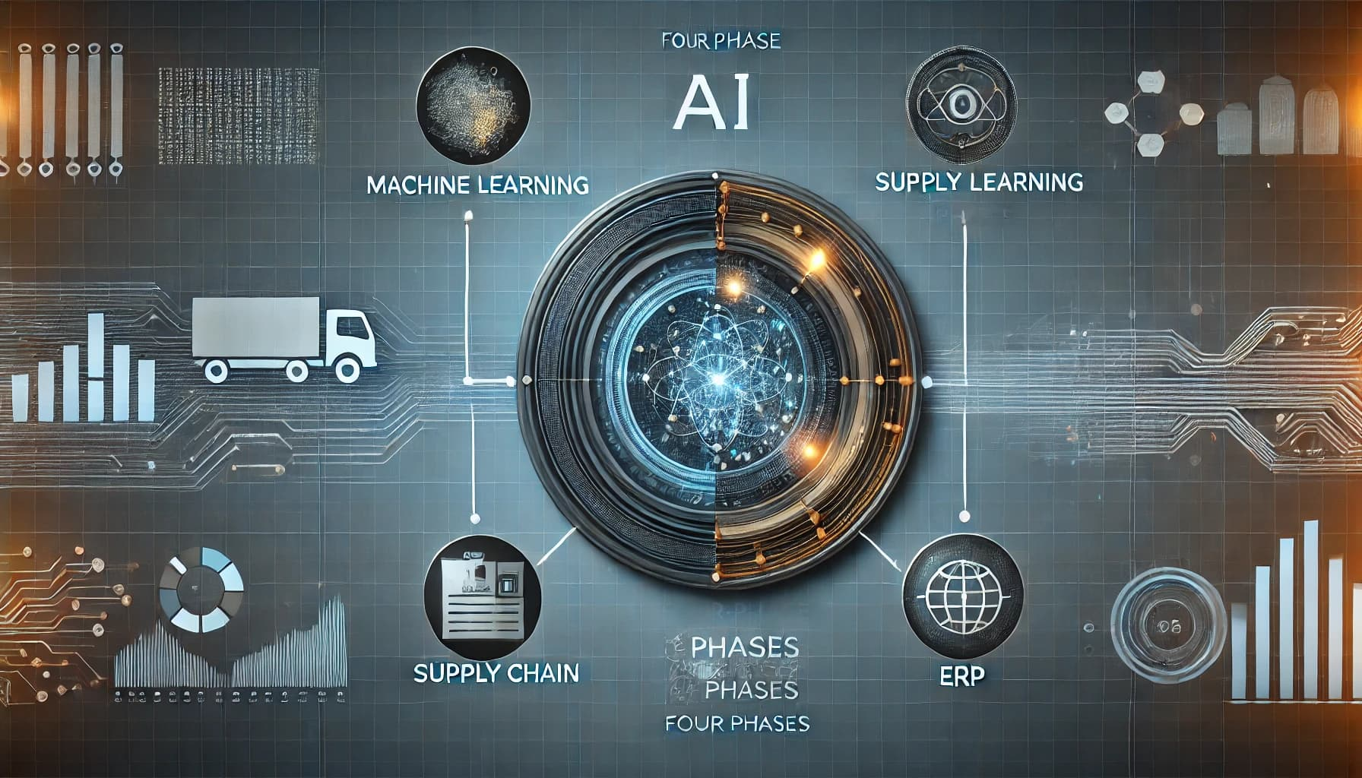
Methodology
Phase 1: Data Monitoring & Analysis
Utilize LLMs (e.g., OpenAI GPT, Meta LLaMA) to analyze data from various sources.
Sentiment analysis to identify negative trends in the supply chain.
Phase 2: Predictive Disruption Modeling
Train machine learning models on historical disruption data to forecast risks.
Phase 3: ERP Integration
Integrate predictive models with ERP systems for inventory and transportation adjustments.
Phase 4: Dashboard Deployment
Develop real-time visualizations and sync with Slack/Email for notifications.

Slide 5
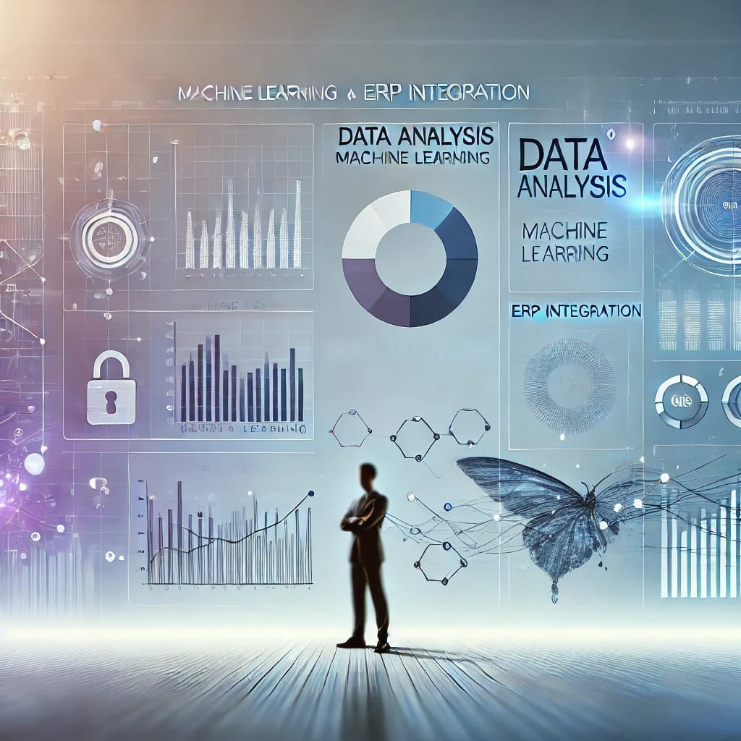
Key Technologies
Data Analysis: Python (pandas, numpy), NLP models.
Machine Learning: TensorFlow, PyTorch, scikit-learn.
ERP Integration: SAP APIs.
Visualization: matplotlib, seaborn, Dash.
Notification Tools: Slack, Email integration.

Slide 6
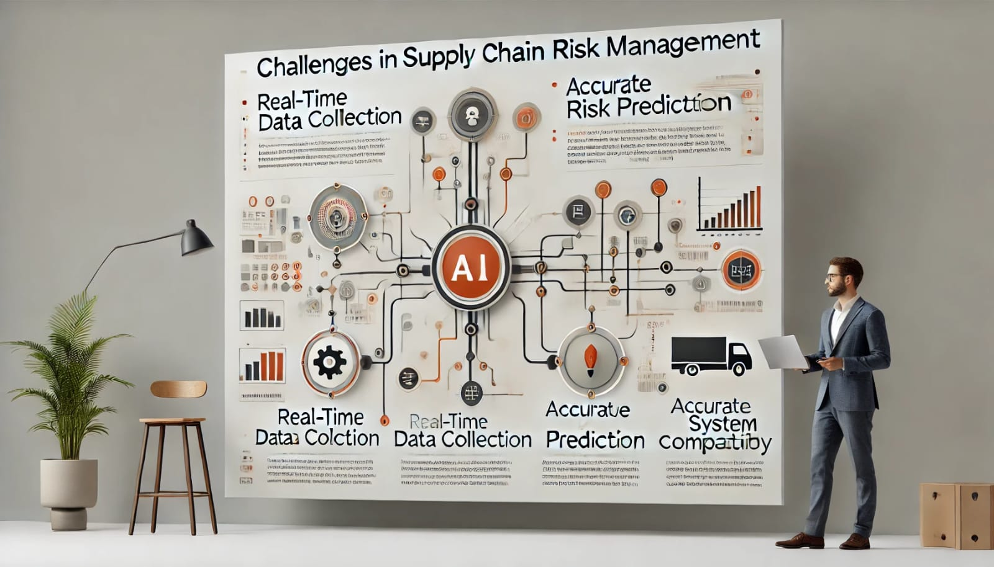
Challenges and Mitigations
Real-time data collection from diverse sources.
Mitigation: Use APIs and web scraping with robust error handling.
Accurate risk prediction with limited data.
Mitigation: Incorporate transfer learning and fine-tune models.
ERP system compatibility.
Mitigation: Work closely with ERP vendors for smooth API integration.

Slide 7

Expected Outcomes
Short-Term:
Real-time monitoring of supply chain risks.
Faster decision-making through automated alerts.
Long-Term:
Reduced supply chain disruptions.
Improved inventory management efficiency.
Enhanced customer satisfaction and cost savings.

Slide 8

Project Milestones
1. Milestone 1: Data Collection and Preprocessing.
2. Milestone 2: Global Data Monitoring & Analysis Engine.
3. Milestone 3: Predictive Modeling & ERP Integration.
4. Milestone 4: Real-Time Dashboard Deployment.

Slide 9
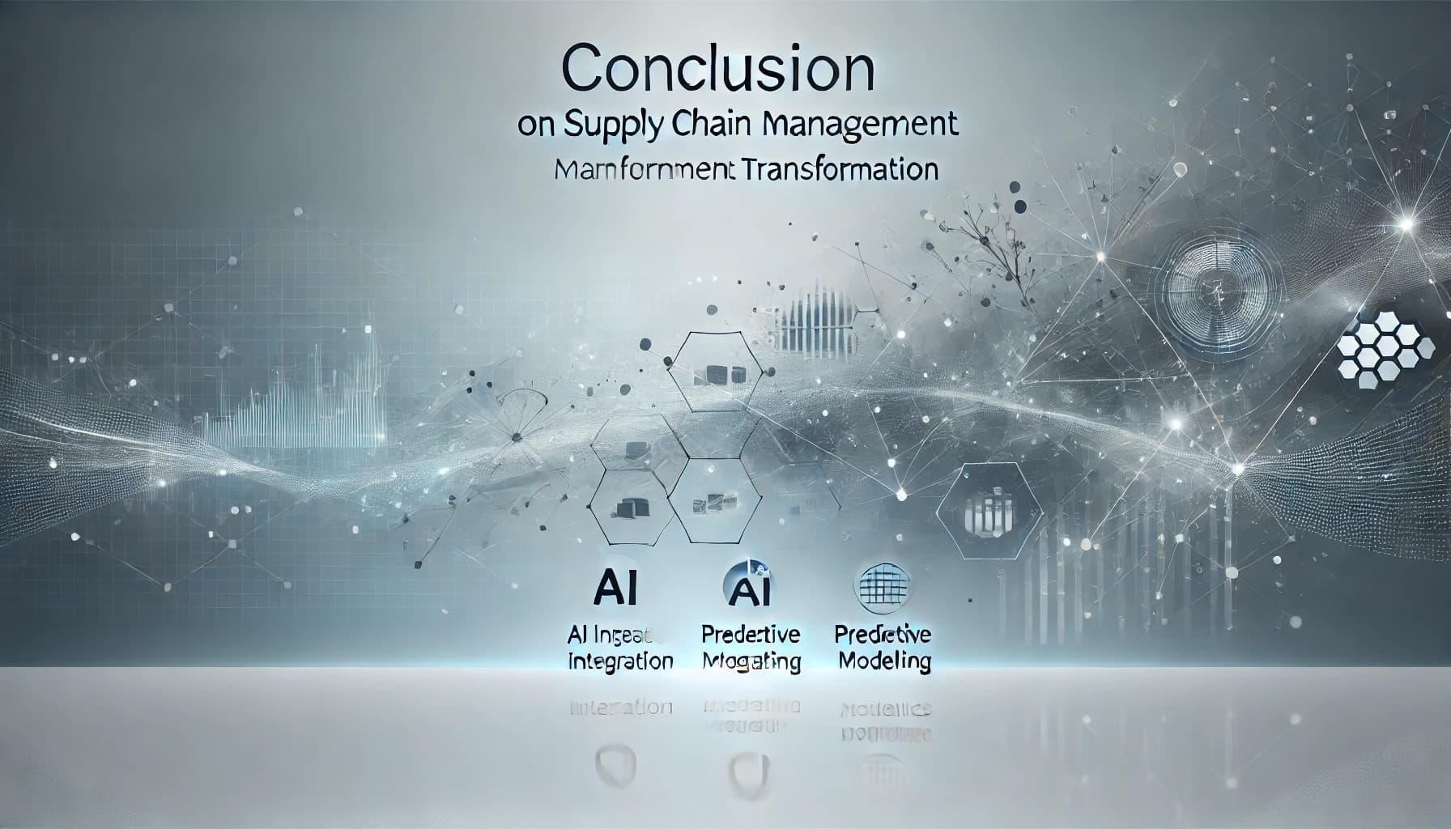
Conclusion
This system will redefine supply chain management by enabling businesses to act proactively.
By integrating AI, predictive modeling, and real-time dashboards, disruptions can be mitigated efficiently.
Let’s make supply chains more resilient and adaptive to a rapidly changing world.

