Slide 1
Supply Chain Disruption Prediction System
- Enhancing Supply Chain Resilience through Real-Time Monitoring, Prediction, and Automation

Slide 2
Project Objectives
1. Develop a Global Data Monitoring & Analysis Engine to track real-time supply chain risks.
2. Build a Predictive Disruption Modeling System using machine learning and historical data.
3. Automate inventory adjustments by integrating with ERP systems (e.g., SAP).
4. Deploy a Real-Time Alert & Reporting Dashboard to notify stakeholders of potential risks.

Slide 3
Key Technologies
Data Analysis: Python (pandas, numpy), NLP models.
Machine Learning: TensorFlow, PyTorch, scikit-learn.
ERP Integration: SAP APIs.
Visualization: matplotlib, seaborn, Dash.
Notification Tools: Slack, Email integration.

Slide 4
MILESTONE-1
Setting up the project environment
Learning and Understanding about LLM’s and API’s
Selecting the language model for preprocessing the data
Data Collection and Preprocessing: gathering data and preprocess it from news articles

Slide 5
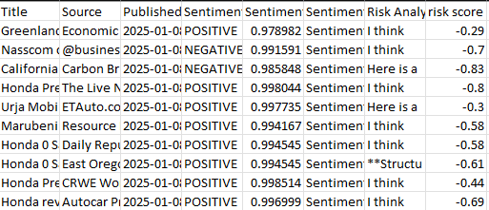
MILESTONE-2
1.Analyze text data and extract Disruptions,Risks and Sentiment
2.Using LLM’s like OpenAI GPT, Meta Llama and other models to process and categorize data
3.Assess news and reports for positive or negative sentiment
4.Aggregate the extracted data into structured format for further analysis3.

Slide 6
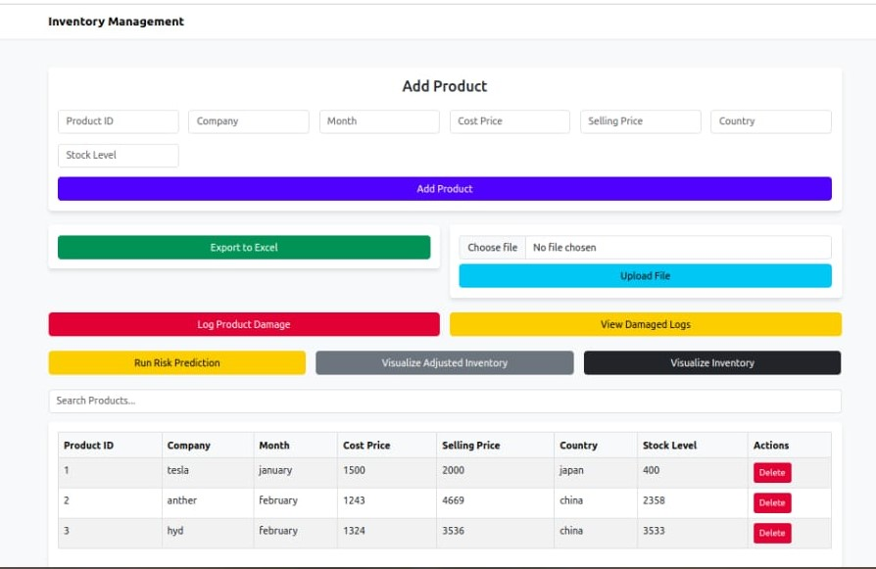
MILESTONE-3
EPR System Integration
Historical Data Utilization
Database and visualization of damaged products
Automate Inventory Adjustments
Risk prediction

Slide 7
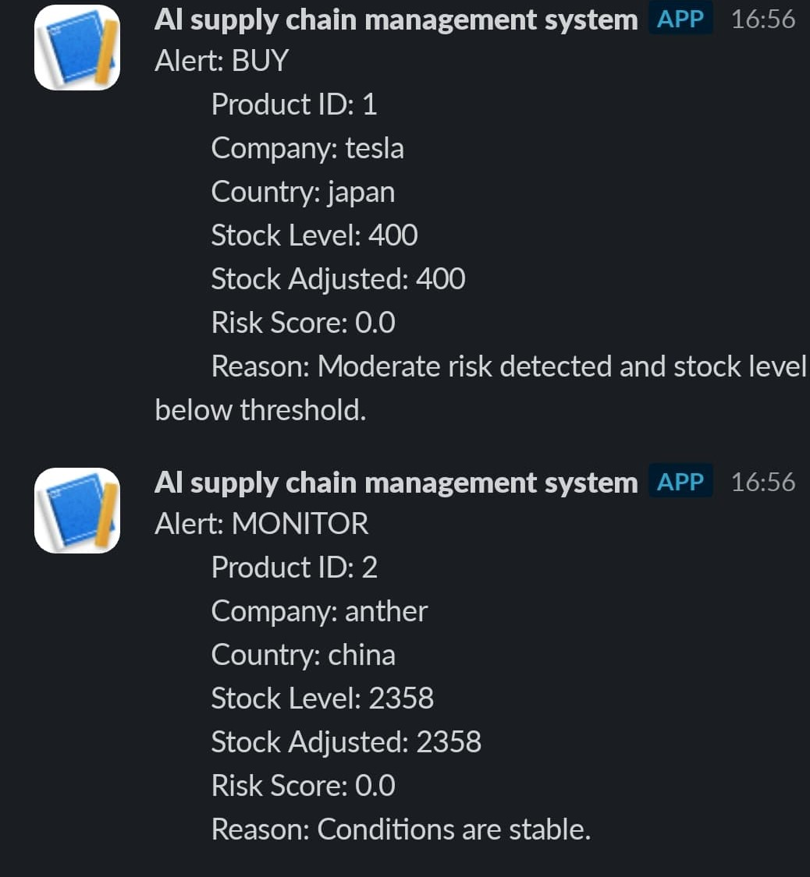
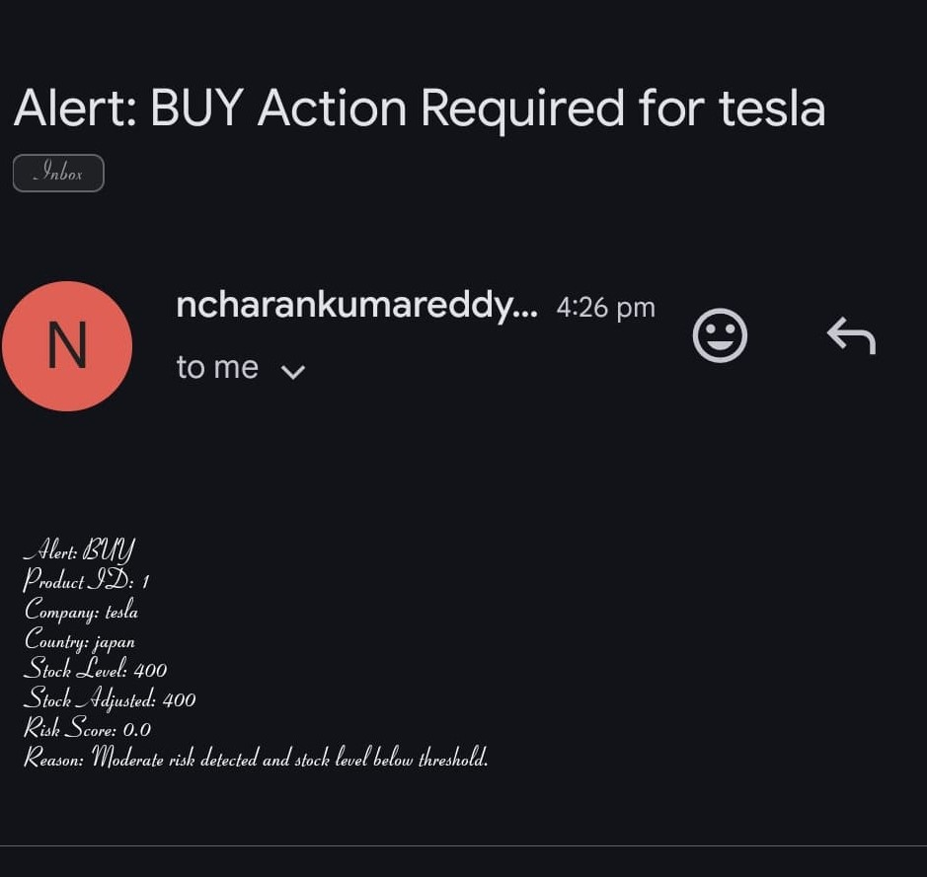
MILESTONE-4: Automated Alerts through Email and Slack

Slide 8
Expected Outcomes
Short-Term:
Real-time monitoring of supply chain risks.
Faster decision-making through automated alerts.
Long-Term:
Reduced supply chain disruptions.
Improved inventory management efficiency.
Enhanced customer satisfaction and cost savings.

