Slide 1
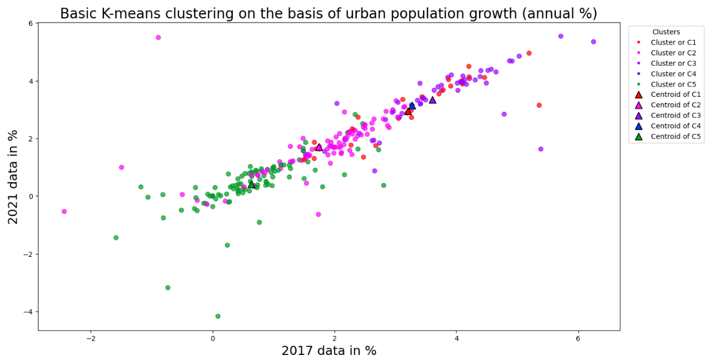
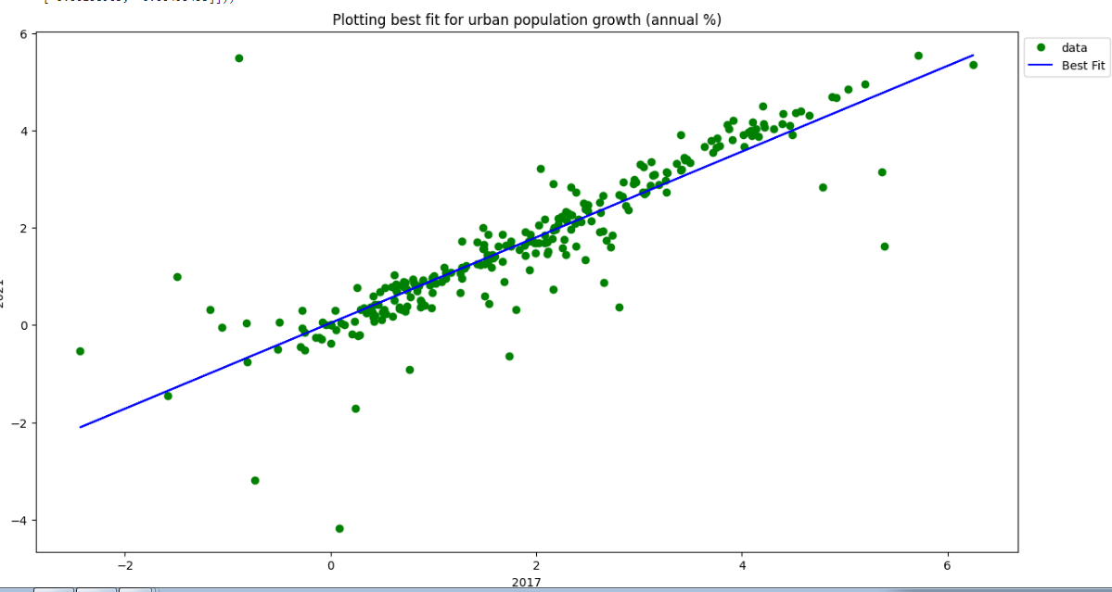
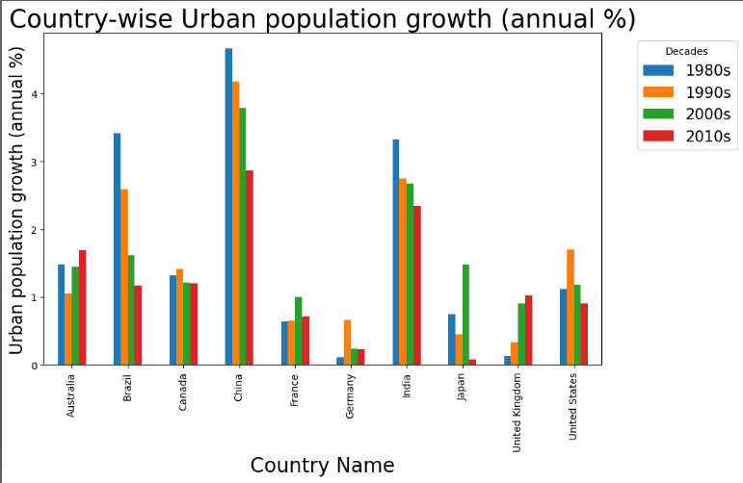
Urban Population Growth of Different Countries
Executive Summary
Basic K-means clustering on the basis of urban population growth (annual %)
Algorithm
K-means Clustering Algorithm
Dataset
World bank dataset of Urban population growth of different countries
Results
It was found that some countries experienced rapid population growth while others experienced more moderate growth.
The red cluster of the dot defines the cluster of C1, the Pink cluster of the dot defines the cluster of C2, the dark pink cluster of the dot defines the cluster of C1, the blue cluster of dot defines the cluster of C4 and at last green cluster of dot defines the cluster of C5.
Introduction
Clustering is the collection of similar functions of the data, or it can be the classification of similar data types or functions. Here there is the use of K-mean Clustering, which is the type of clustering that uses the K-mean algorithms. K-mean clustering is also called an Unsupervised Learning Algorithm. This K-mean clustering is used to classify the unlabeled datasets into different clusters. The k-mean algorithm is used to identify the k number of centroids of the dataset, and then it allocates the data to the nearest cluster keeping the centroid value as small as possible, and the means in k-means refers to the averaging of data and finding of the centroid.
Plotting best fit for urban population growth (annual %)
The green dot in the diagram represents the cluster of population, while the blue line indicates the best-fit line. This line represents the general trend of population growth, which in this case is from low to high. The cluster diagram can help identify the population growth pattern over time for a particular region. It is a useful tool for policymakers to use when making decisions about population growth, as it provides a visual representation of the data.
Country-wise Urban population growth (annual %)
The bar chart above demonstrates the urban population growth of different countries in percentages. China and India have experienced steady population growth throughout the decades, while the United States has seen more moderate growth. The chart also reveals the differences in population growth between countries.
Conclusion
After the analysis and the implementation of the K-mean clustering on the basis of the urban population growth percentage of different cities, this concludes in the results of 5 clusters which have their different centroids (centre of clusters). The five clusters are represented by red, pink, Bringle, blue and green, and their centroids are represented by their colours, respectively. In the graph there is illustrated there is minimum overlapping, and there is a visible of the different clusters and their centroids in the graph.

