Slide 1

Data-Driven Attitude Modeling and Control of Quadrotor UAV’s using Koopman Operator
22AIE448
Introduction to Drones
Team CD-14:
1. Arepalle Charan Kumar Reddy (207)
2. Polturi Aditya Pavan (344)
3. Koushik V (330)
4. Rohit kanna S (349)
5. Mahendrada Shalini (334)

Slide 2
PROBLem statement
Quadrotor attitude dynamics are nonlinear and strongly coupled, making accurate modeling difficult.
Model-based approaches require simplifying assumptions that can reduce the accuracy of the real-system model.
Data-driven approaches require suitable training data and may result in black-box models, while ensuring system stability remains challenging.
Linear control approaches may neglect important system dynamics, while MPC can involve high online computational cost.
Therefore, an accurate, data-driven, computationally efficient, and control-oriented representation of nonlinear quadrotor attitude dynamics is required.

Slide 3
Objectives
Develop a data-driven attitude model for quadrotor UAVs using Koopman operator theory.
Transform the nonlinear attitude dynamics into a high-dimensional linear model.
Design an LQR controller for stable and accurate attitude tracking.
Validate the model’s prediction capability using measured quadrotor data.
Evaluate the control performance against a PID controller.
Disturbance Observer (DOB): Develop and evaluate a disturbance observer to estimate external torque disturbances and compensate for their effects, improving the attitude-tracking performance and robustness of PID, Koopman-LQR, and Koopman-MPC controllers under simulated disturbances.
DMDc Benchmarking: Demonstrate the prediction accuracy improvement of Koopman-based models over traditional linear DMDc for quadrotor attitude dynamics.
Evaluate the robustness of Koopman model identification and multi-step prediction under varying levels of measurement noise in simulated quadrotor trajectories.
Model the nonlinear attitude dynamics from data and use the resulting linear representation for effective and stable attitude control.

Slide 4
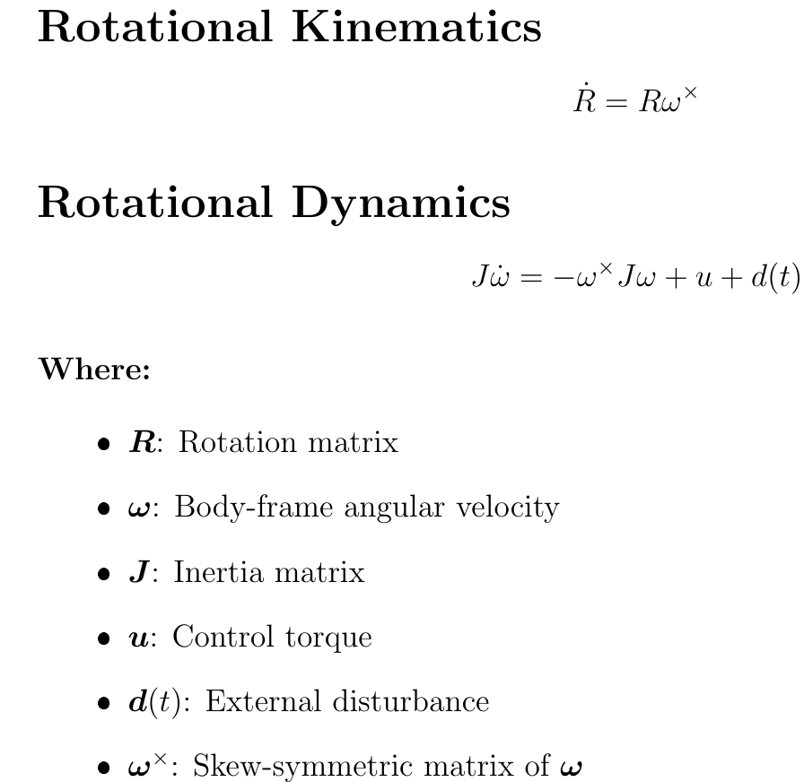
Methodology
1. Formulation of Nonlinear Quadrotor Attitude Dynamics (Newton Euler Method)

Slide 5
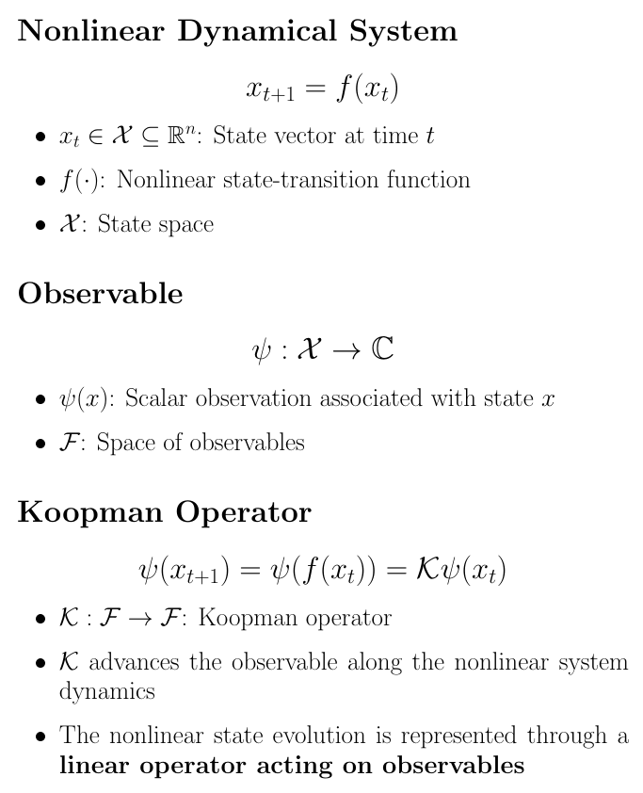
2. Nonlinear Attitude Dynamics and Koopman Representation

Slide 6
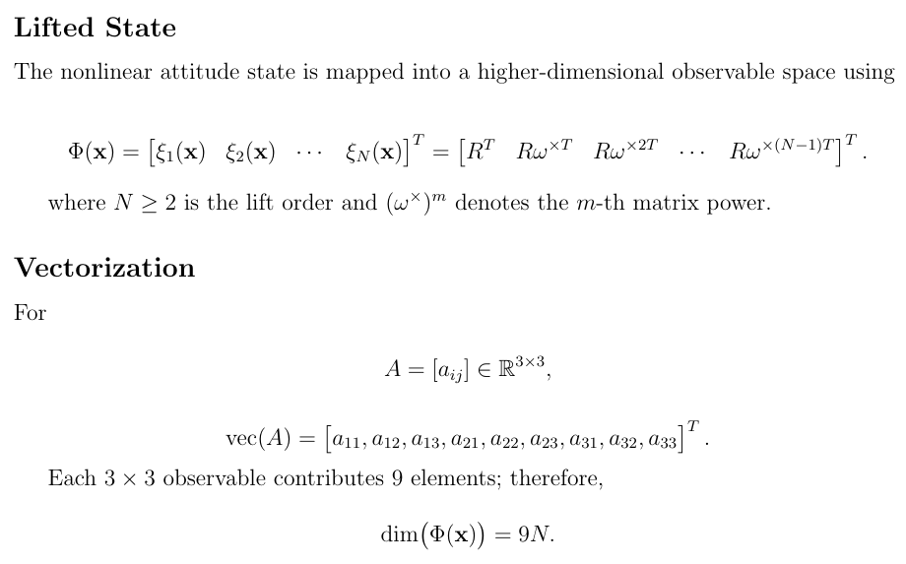
3. Koopman Lift Map and Vectorization

Slide 7
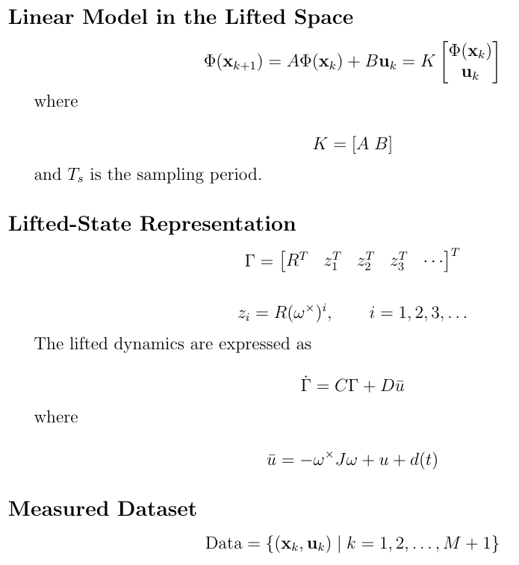
4. Finite-Dimensional Koopman Model and Data Collection

Slide 8
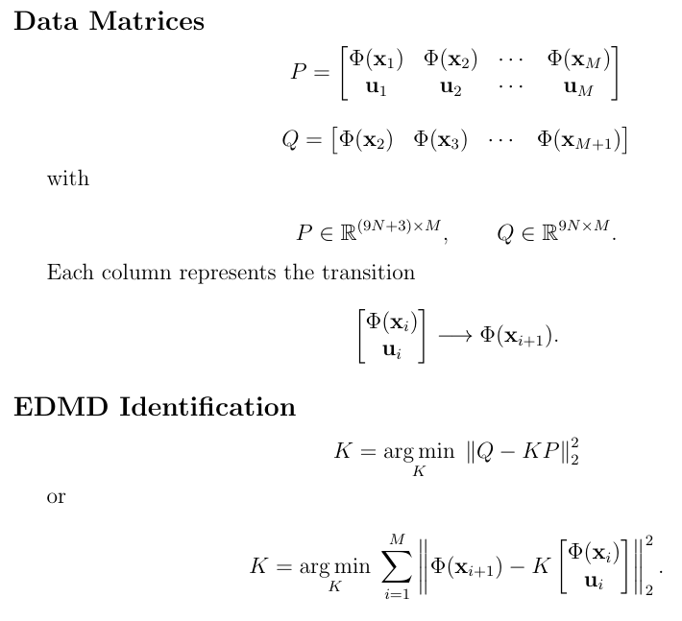
5. EDMD Data Matrices and Least-Squares Identification

Slide 9
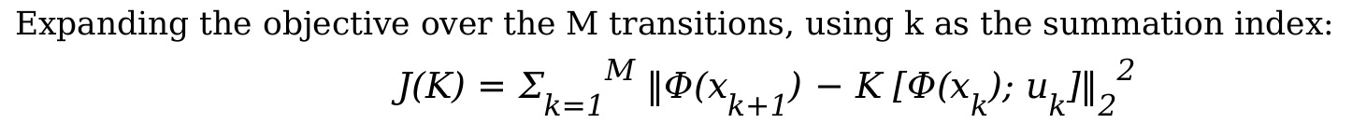
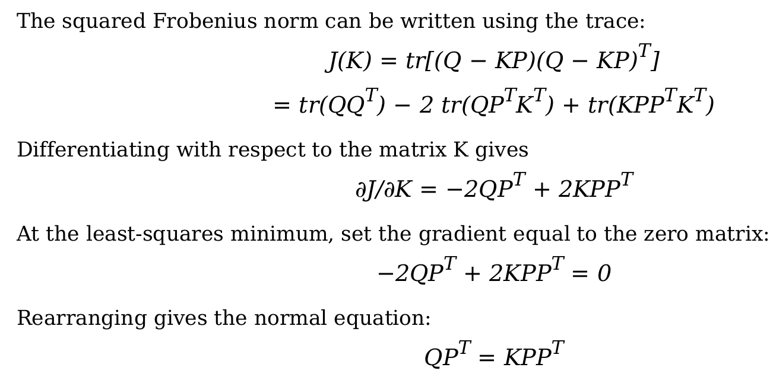


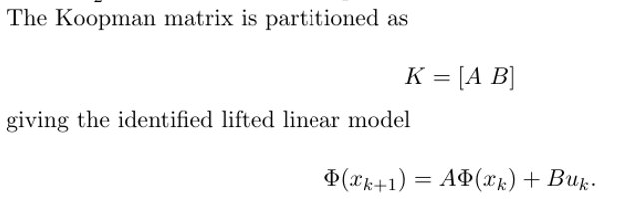

Slide 10
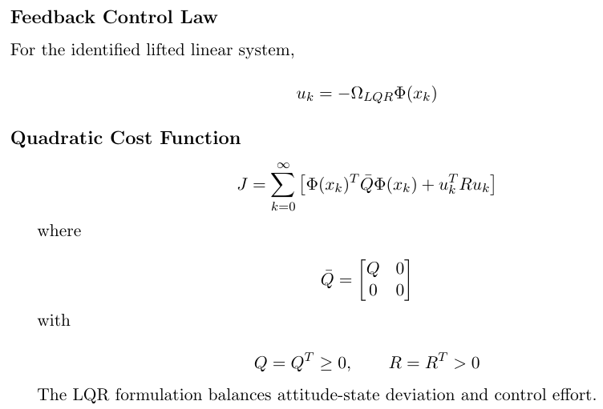
7. Koopman-Based LQR Controller

Slide 11
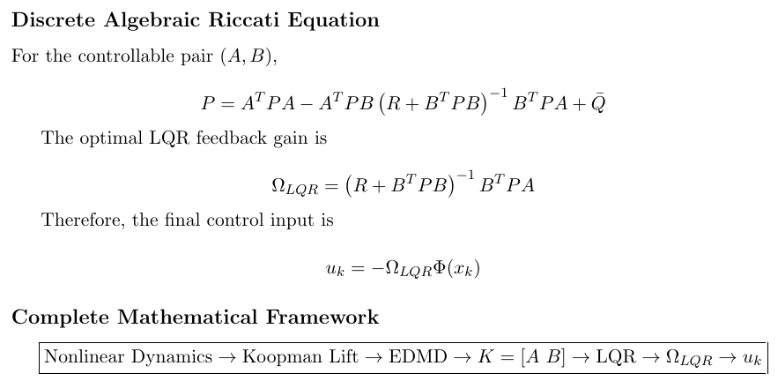
8. Riccati Equation and Optimal Control Gain

Slide 12
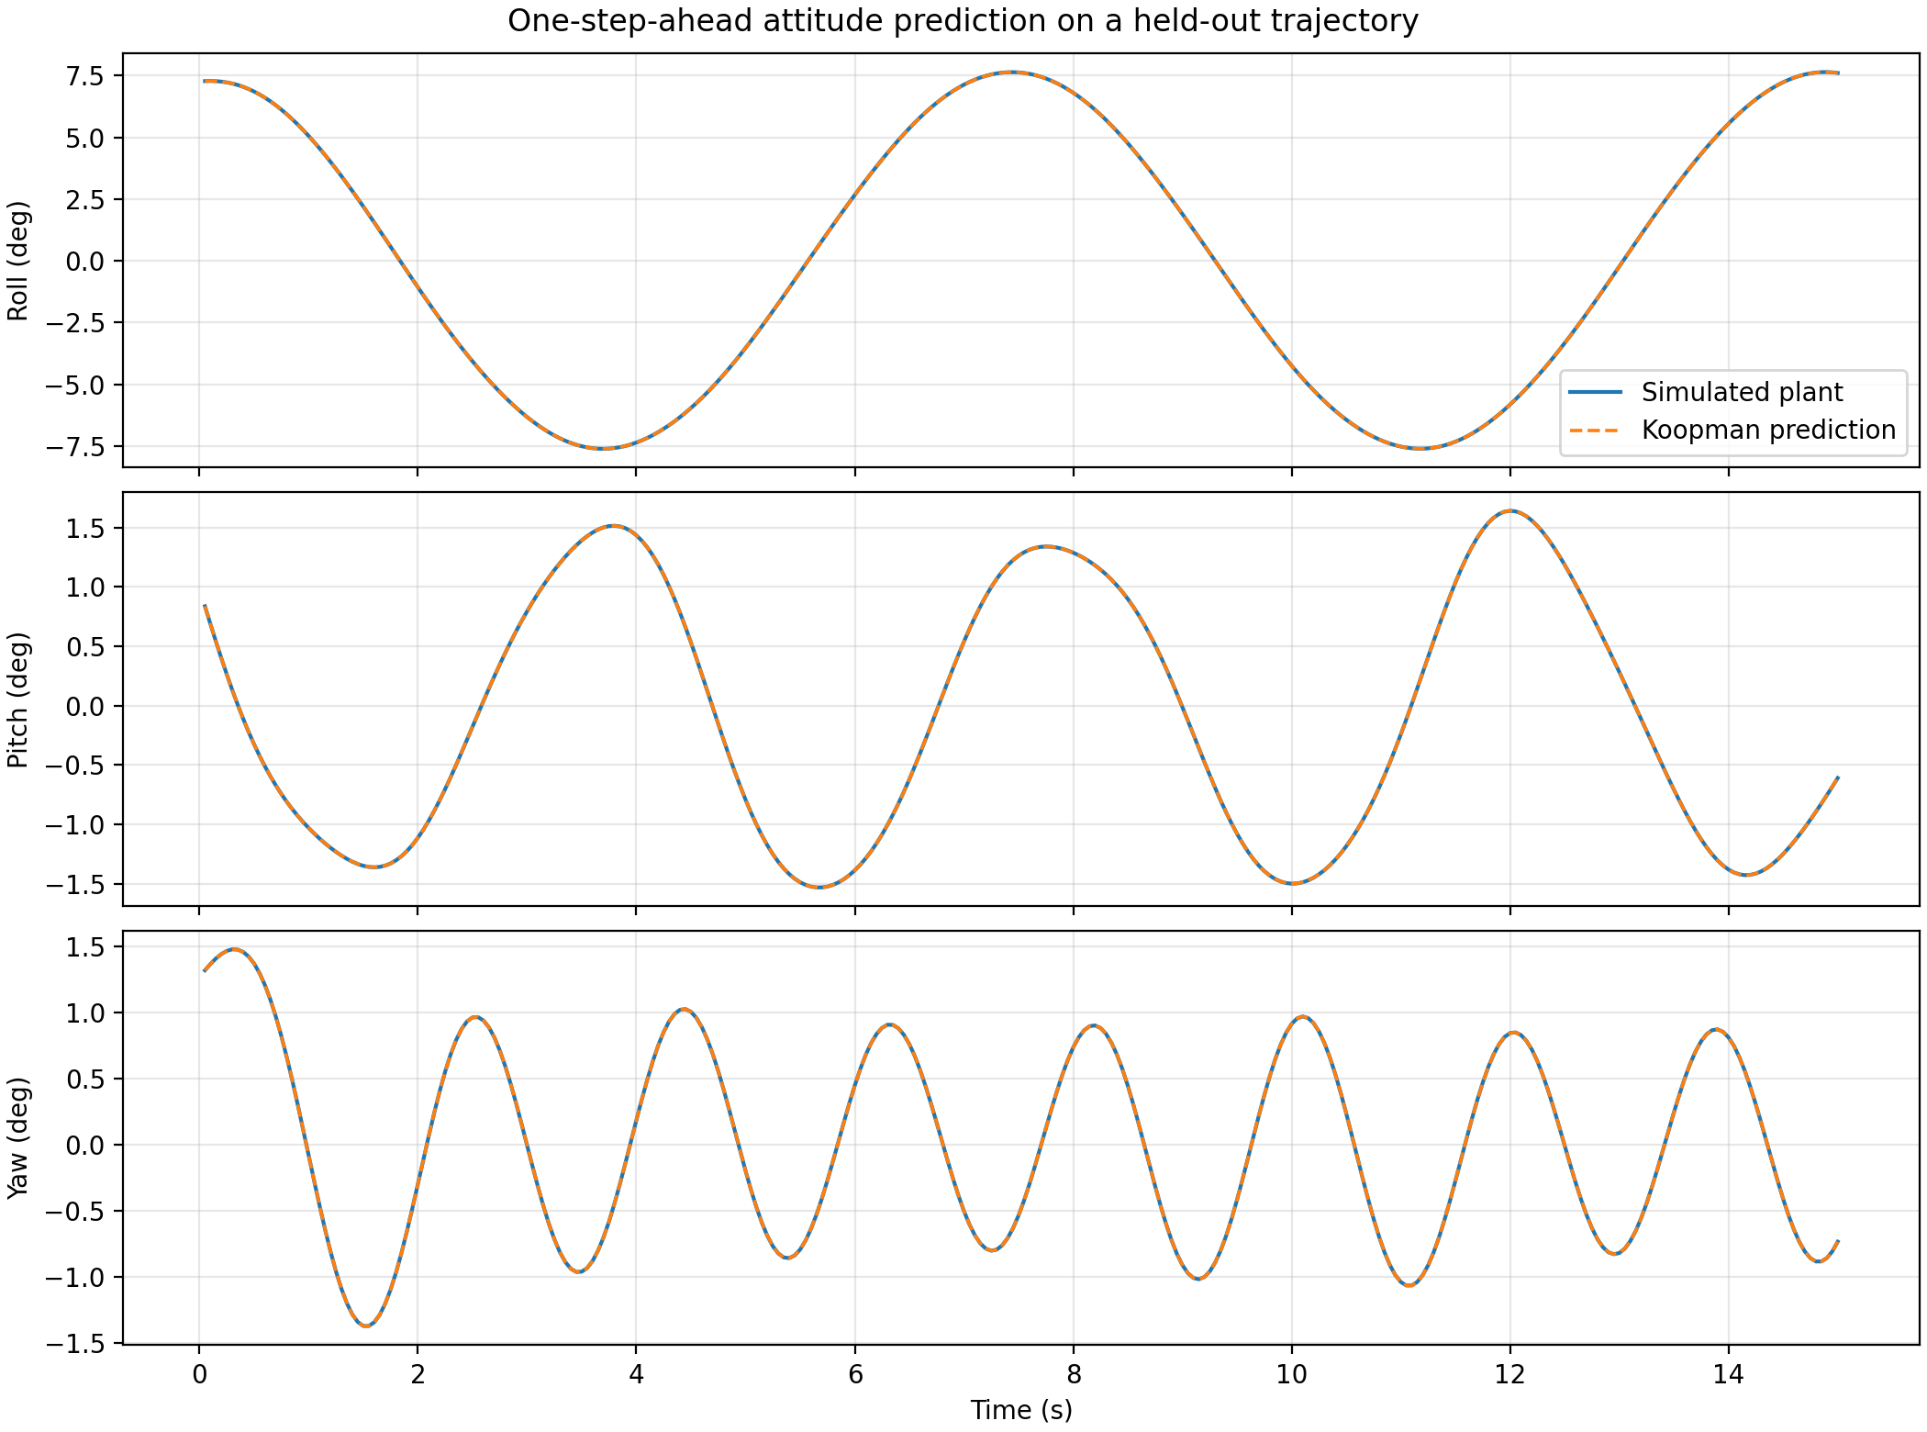
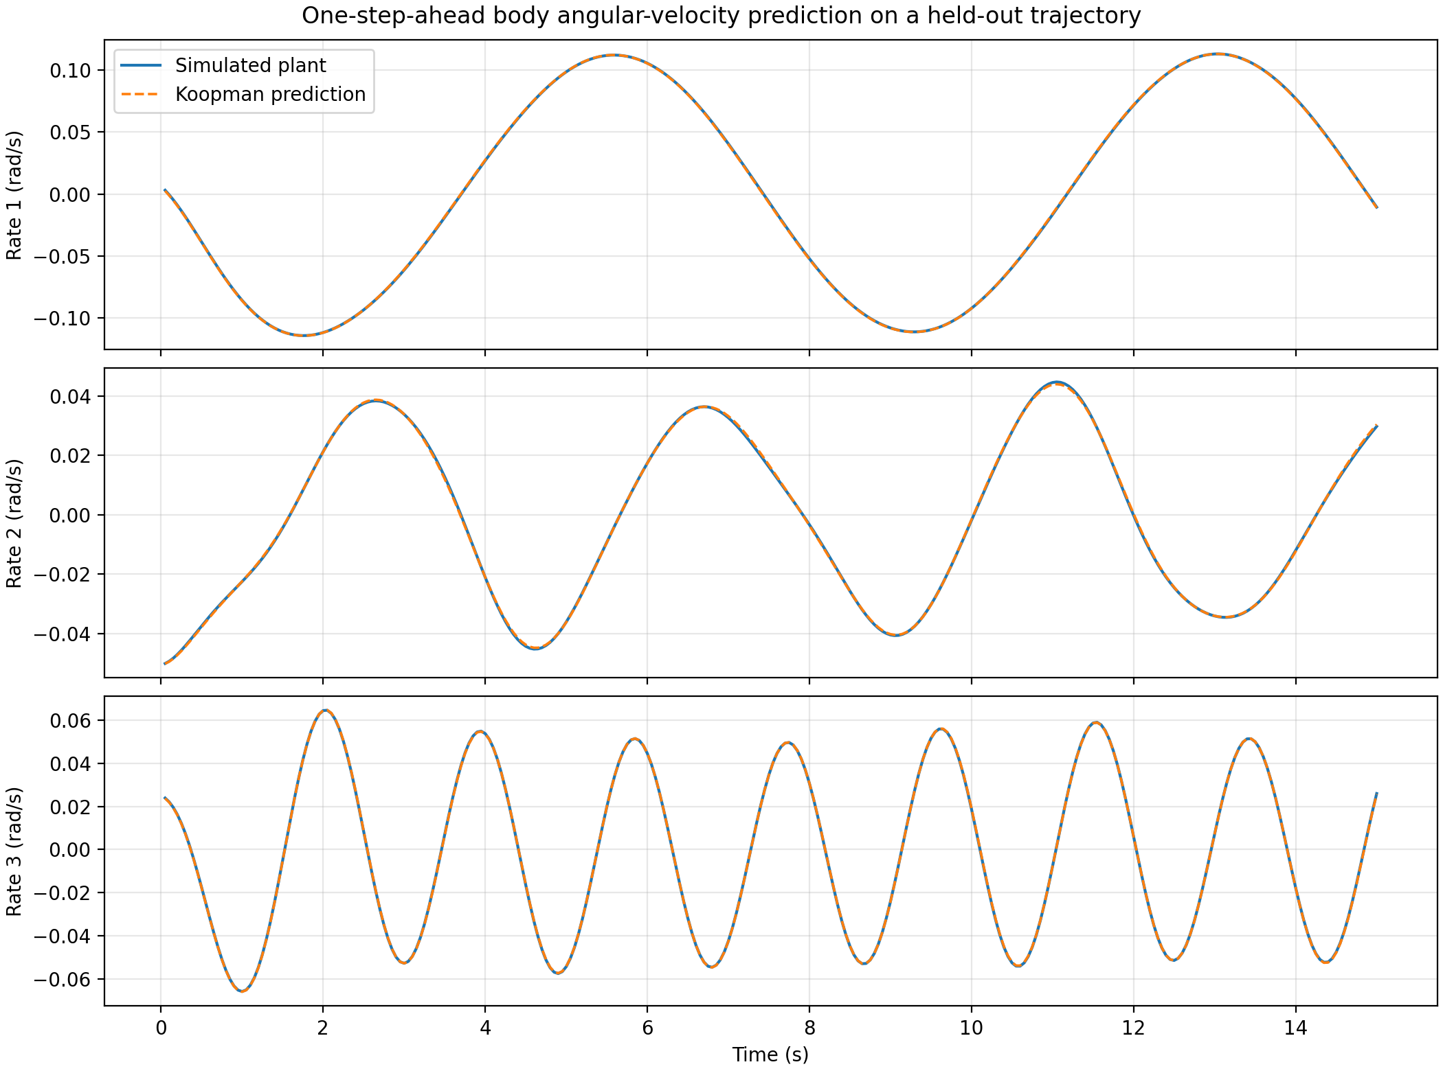
One-step-ahead attitude prediction using the identified Koopman model on a held-out trajectory
One-step-ahead prediction of the three body angular-velocity components using the learned Koopman model on a held-out trajectory.

Slide 13
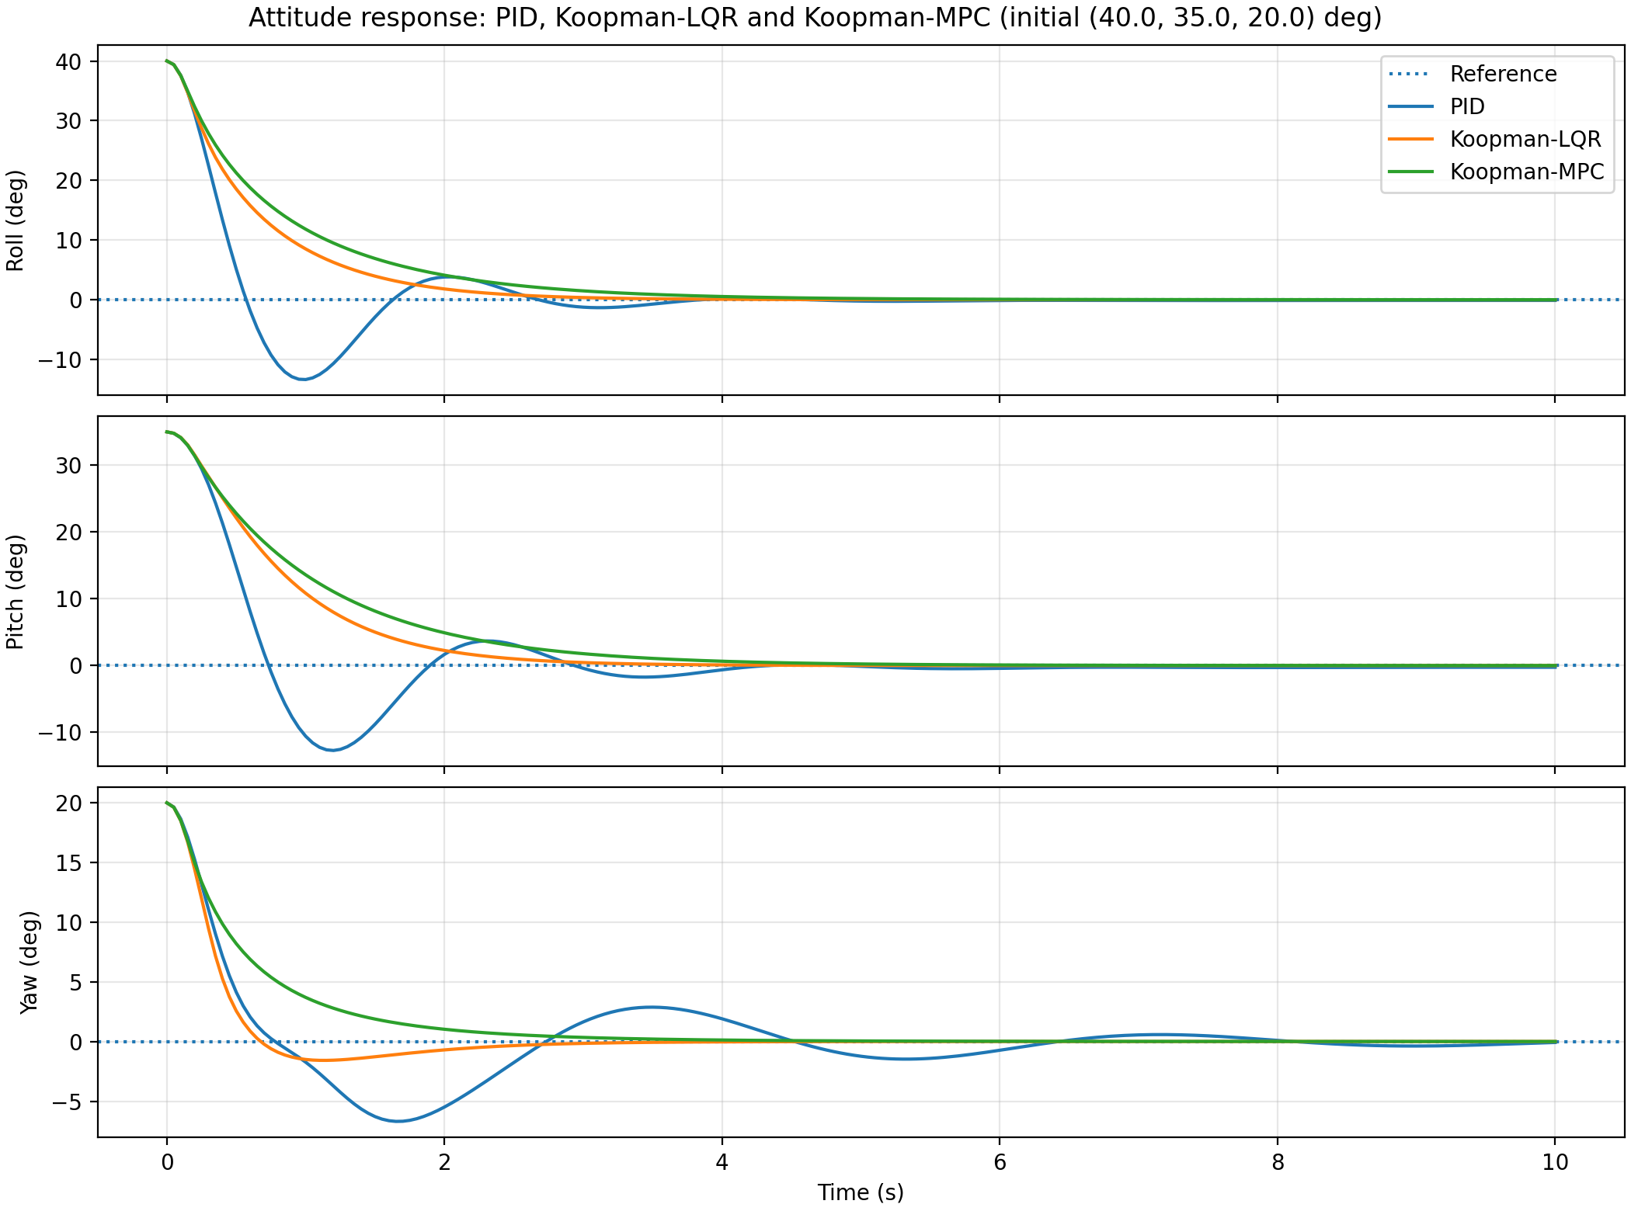
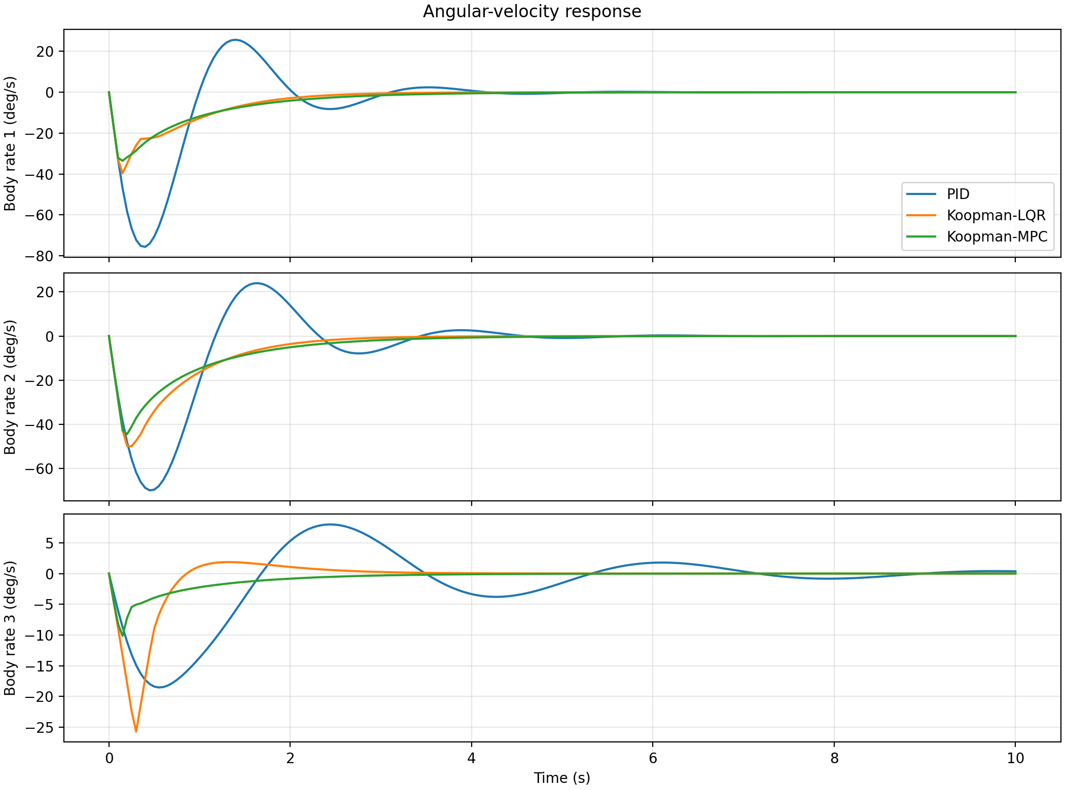
Attitude response of PID, Koopman-LQR, and Koopman-MPC controllers under a zero-attitude reference
Attitude velocity response of PID, Koopman-LQR, and Koopman-MPC controllers

Slide 14
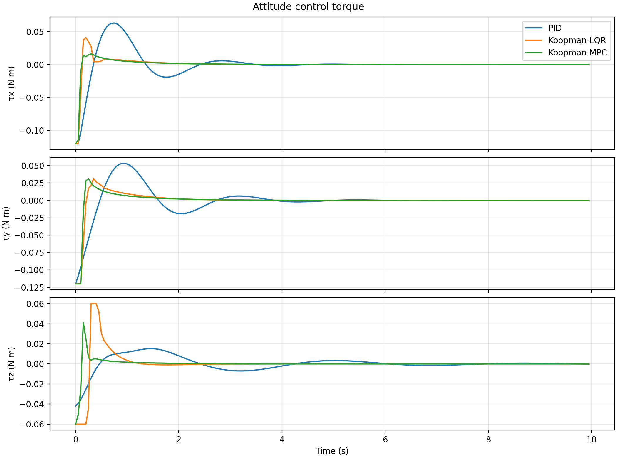
Comparison of attitude-control torque commands under PID, Koopman-LQR and Koopman-MPC controllers.

Slide 15
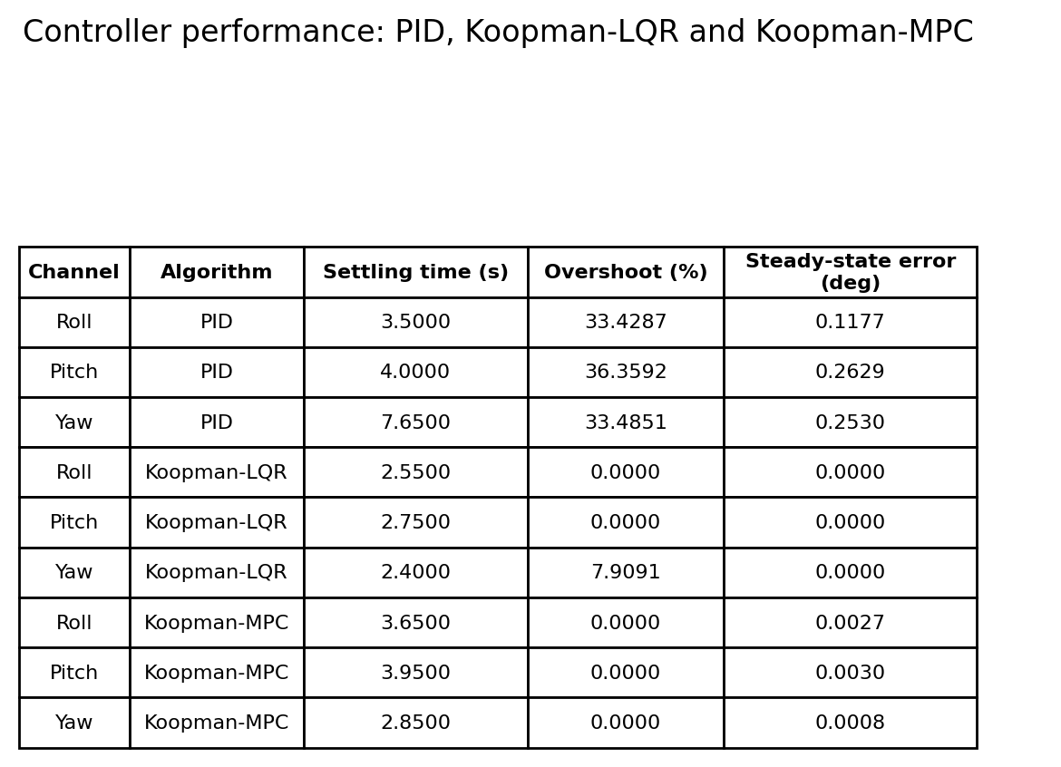

Slide 16
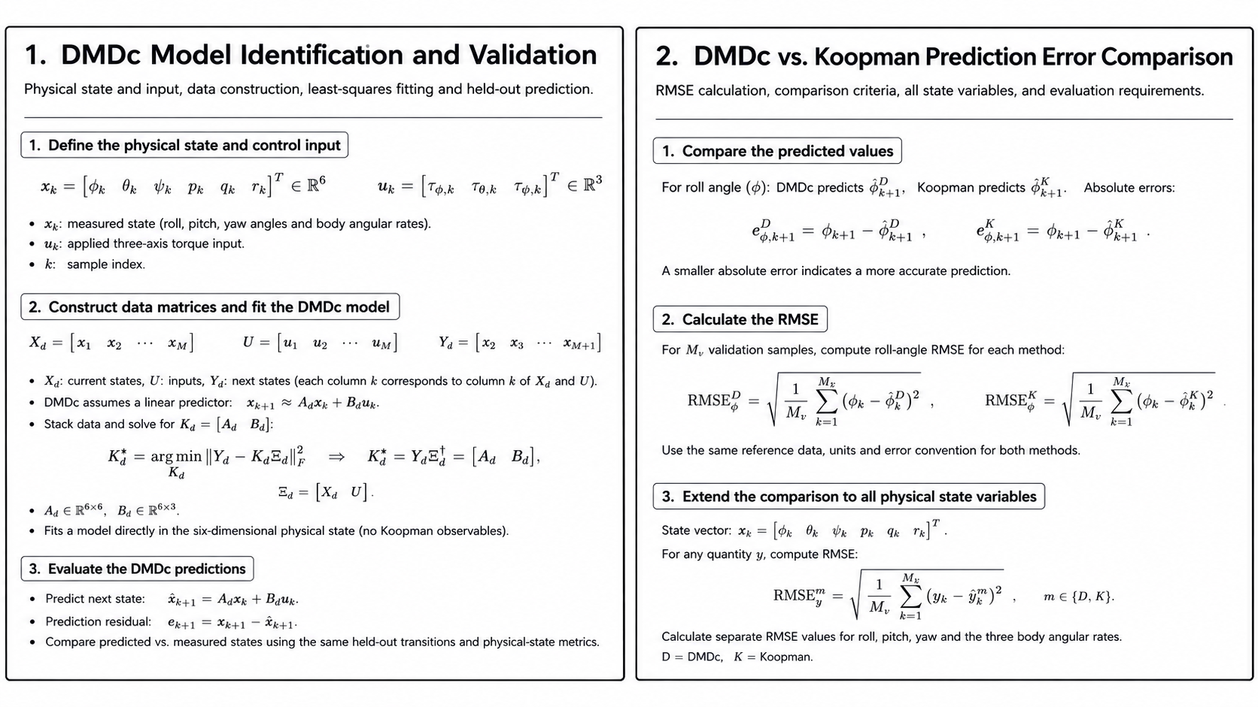

Slide 17
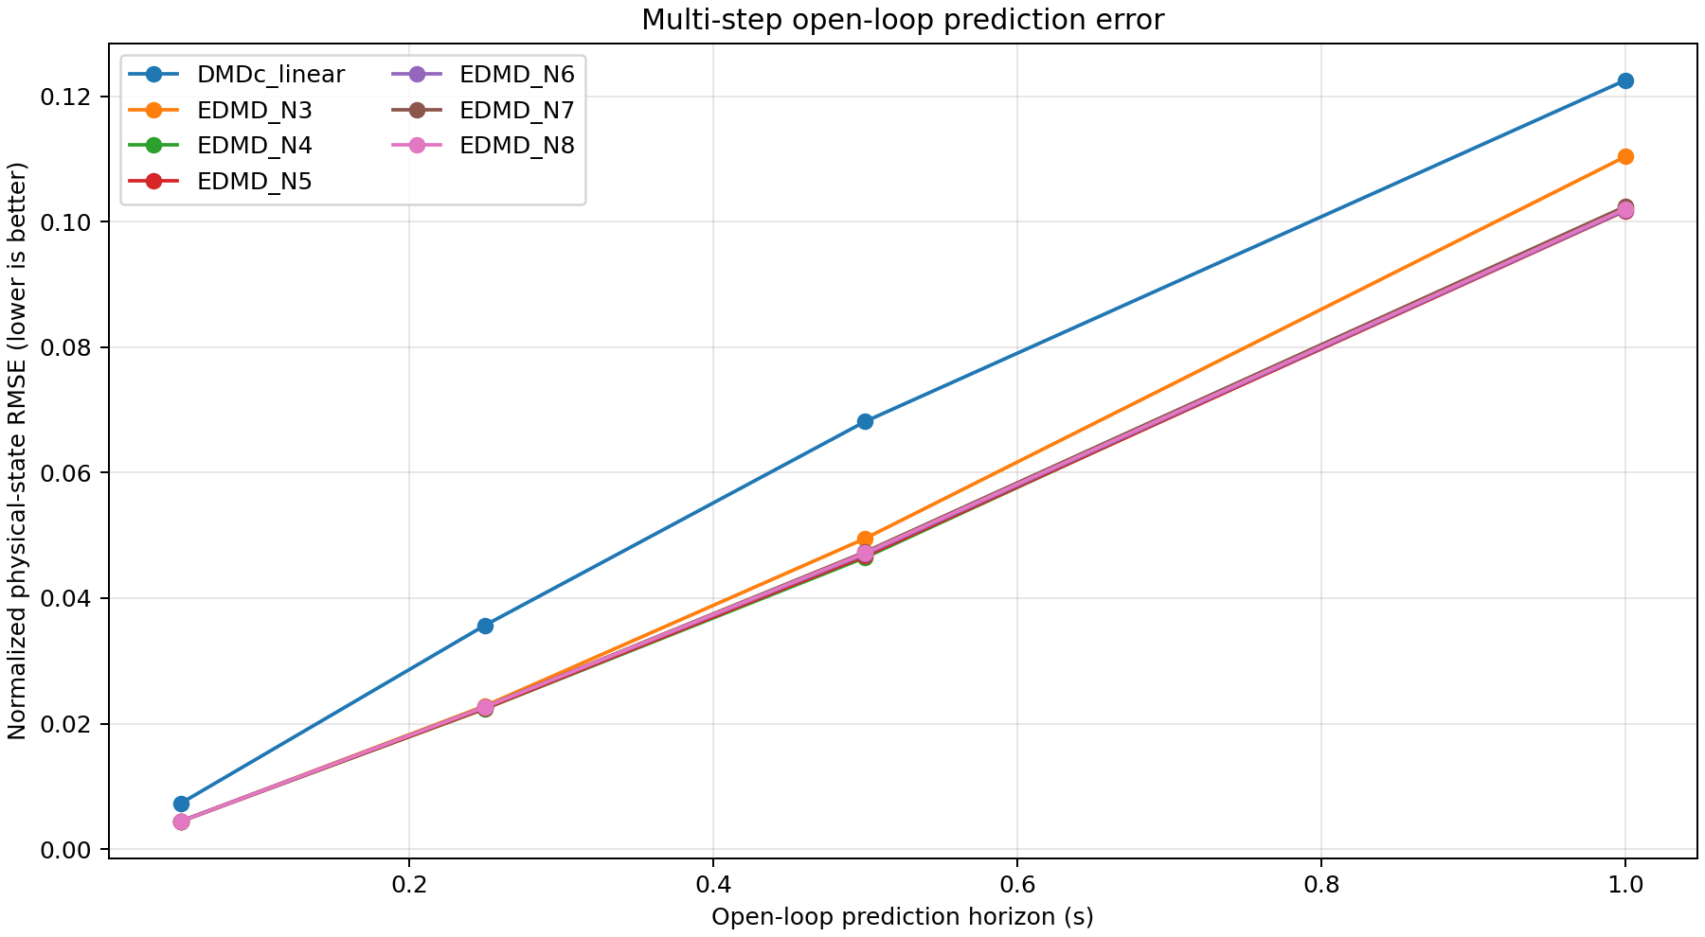
Multi-step open-loop prediction error comparison between linear DMDc and EDMD Koopman models

Slide 18
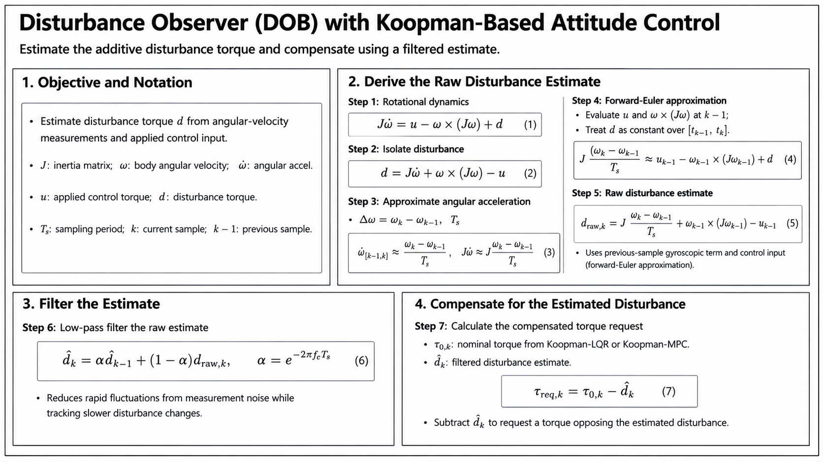

Slide 19
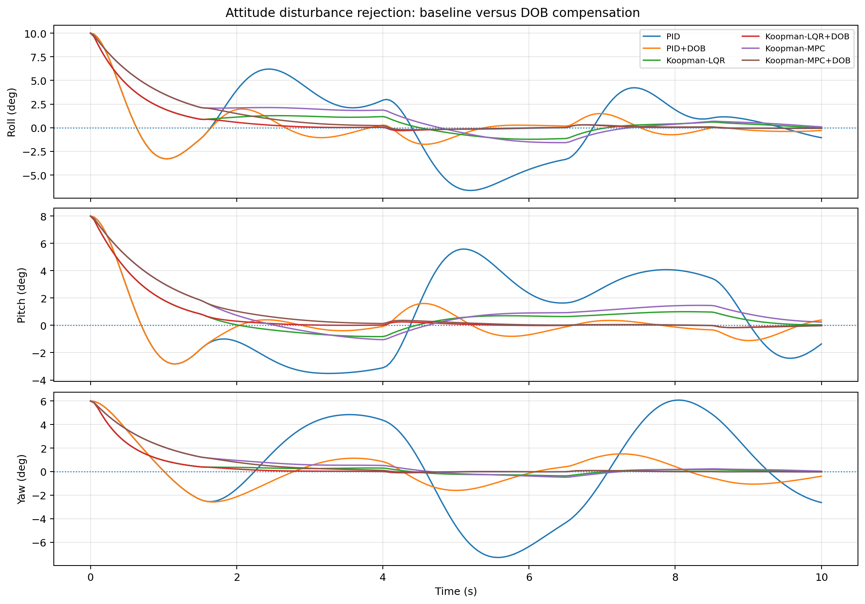
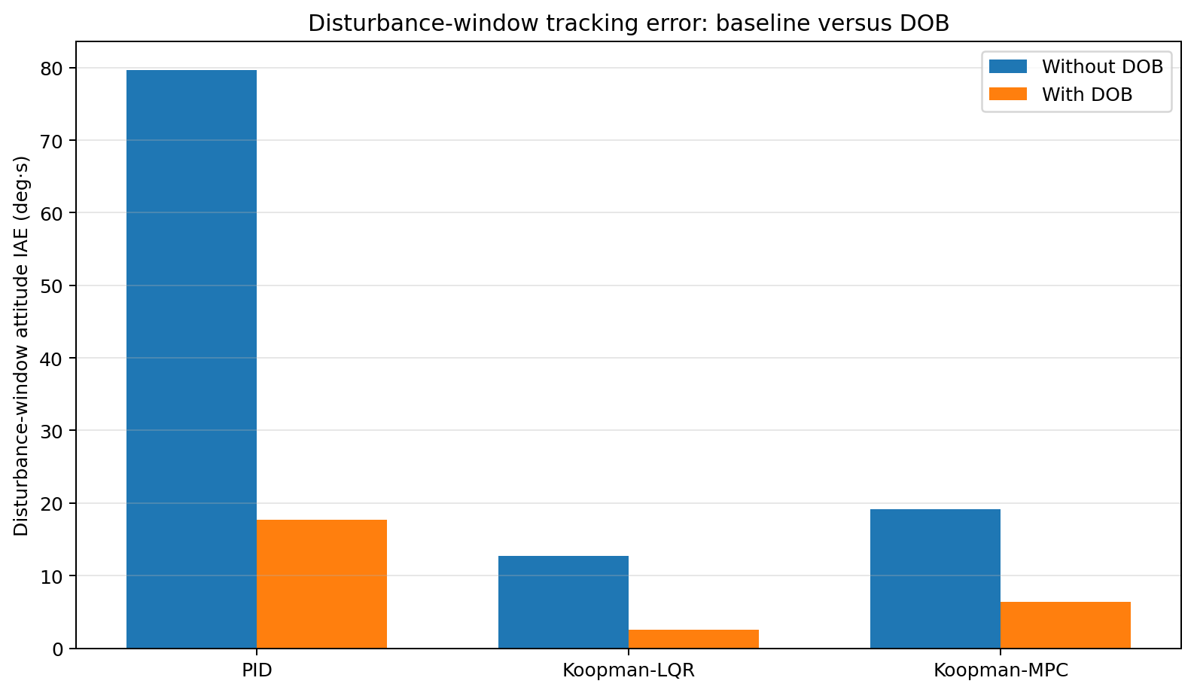
Roll, pitch, and yaw tracking responses of the evaluated controllers with and without disturbance-observer compensation under simulated external disturbances.
Comparison of attitude-tracking performance with and without disturbance-observer-based compensation for PID, Koopman-LQR, and Koopman-MPC controllers under simulated disturbances.

Slide 20
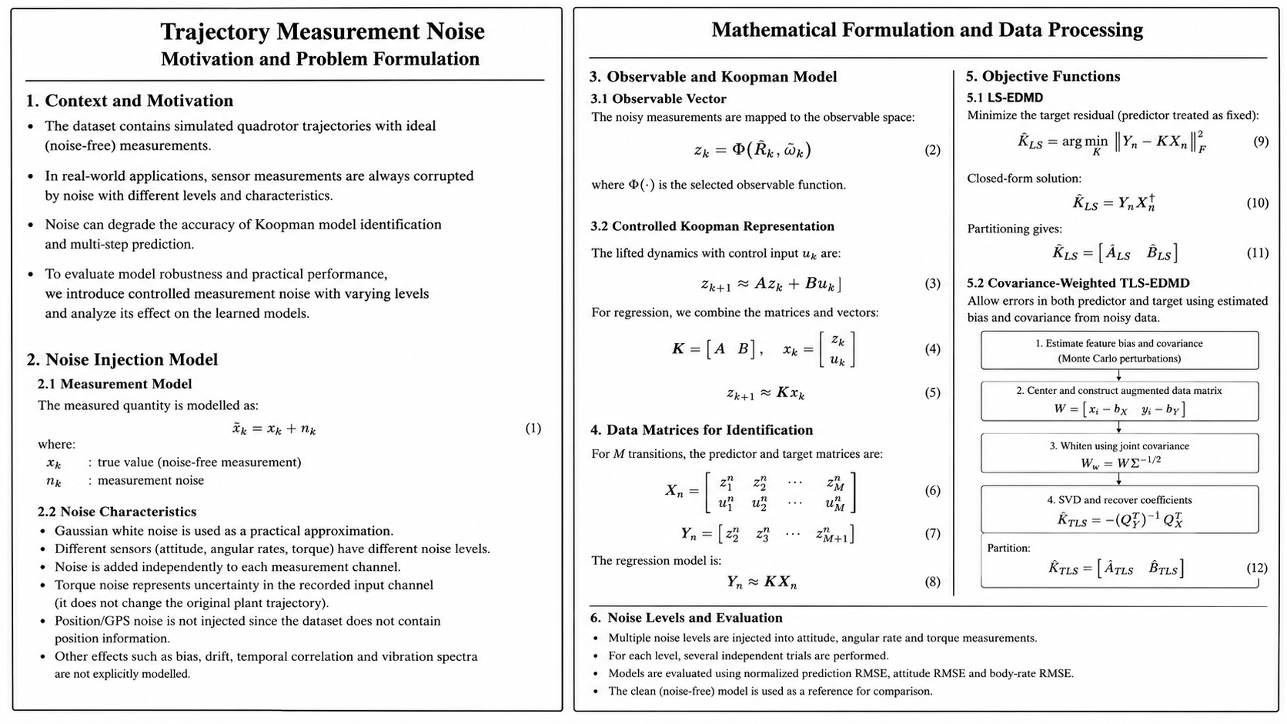

Slide 21
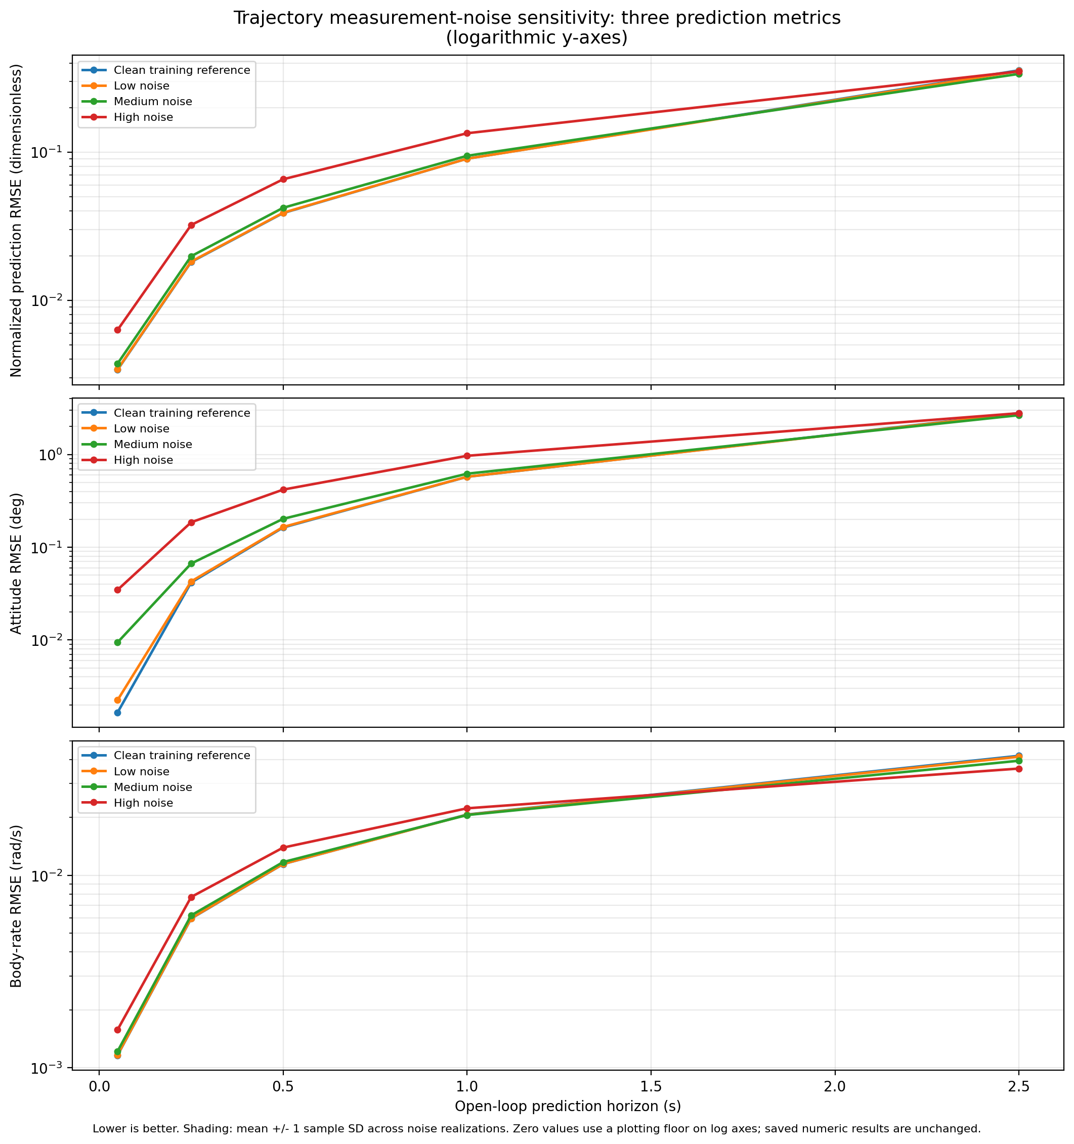
Effect of measurement-noise levels on multi-step open-loop prediction, evaluated using normalized-state, attitude, and body-rate RMSE. Errors generally increase with prediction horizon and are higher under increased noise, particularly at shorter horizons.

Slide 22
Thank you

