Slide 1
Agentic AI Hackathon: Building Intelligent Agents with IBM Granite and LangFlow

Slide 2

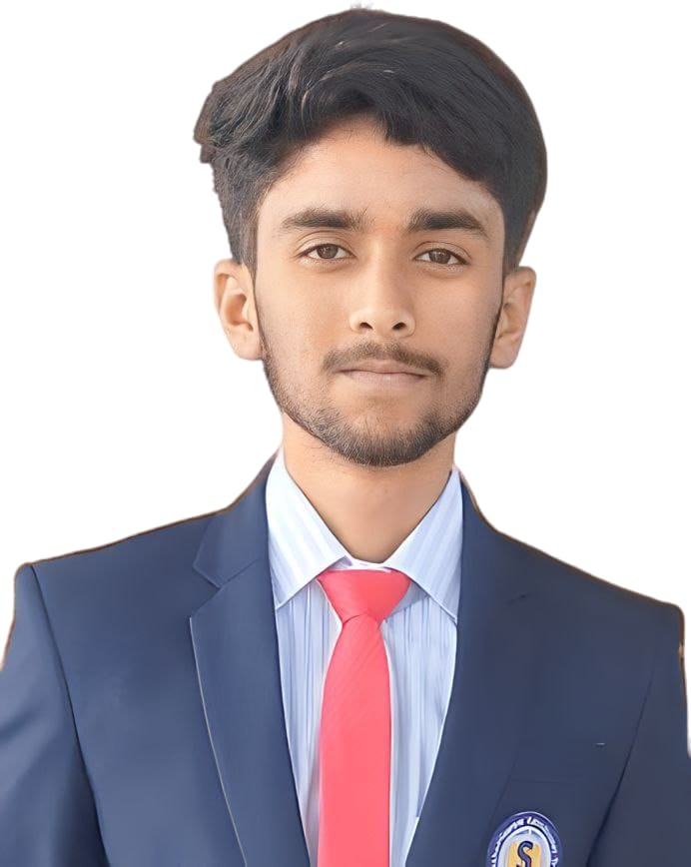
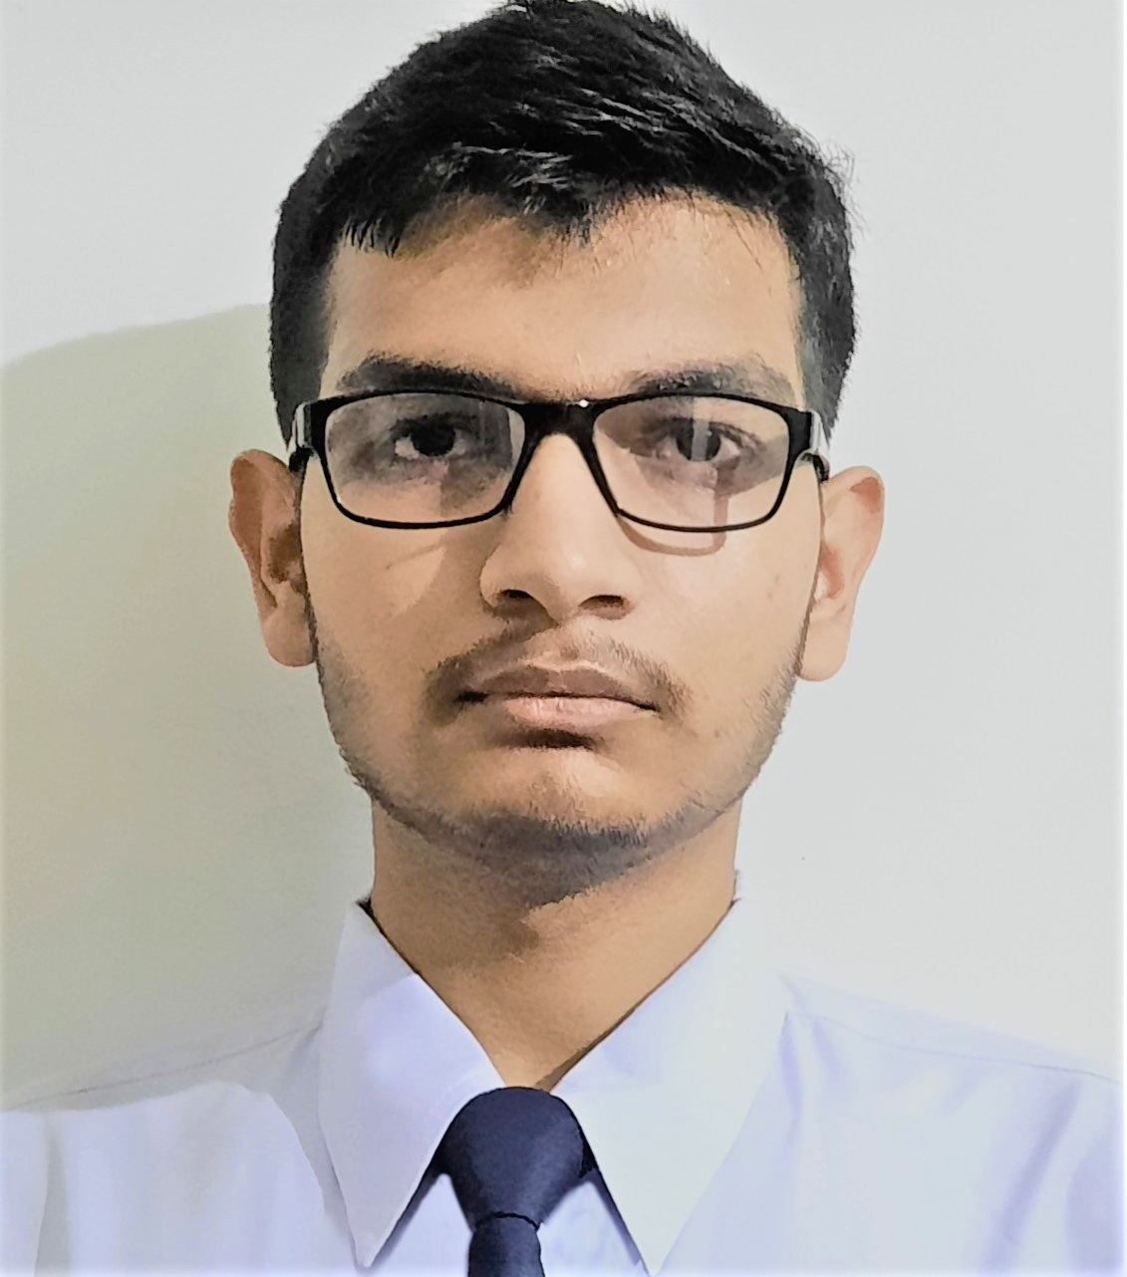
Name of the team: GreenEye
Details of Team members
TEAM MEMBER NAME | Recent Passport Photo | Email ID | Phone number [WhatsApp]
Akhil M Jain |  | akhilmjain.mca25@bmsce.ac.in | 8618383345
Charan B S |  | charanbs.mca25@bmsce.ac.in | 8050771507
Debojyoti Bhattacharjee |  | debojyoti.mca25@bmsce.ac.in | 9475145988

Slide 3
Problem statement
The Challenge: Pest and disease outbreaks can rapidly impact crop yield if not identified early. Traditional monitoring methods rely on visual inspections and historical experience, which may not capture early risk conditions driven by weather and environmental changes. There is a need for an intelligent system that can analyze environmental and crop data to assess pest and disease risk proactively.
Environmental & Crop Data Analysis Agent: An agent that processes temperature, humidity, rainfall, crop type, and seasonal data into risk assessment summaries.
Pest & Disease Risk Detection Agent: An agent that identifies favorable conditions for pest and disease development using historical patterns and agronomic thresholds.
Risk Alert & Preventive Advisory Assistant: An agent that generates risk alerts and preventive care insights.

Slide 4
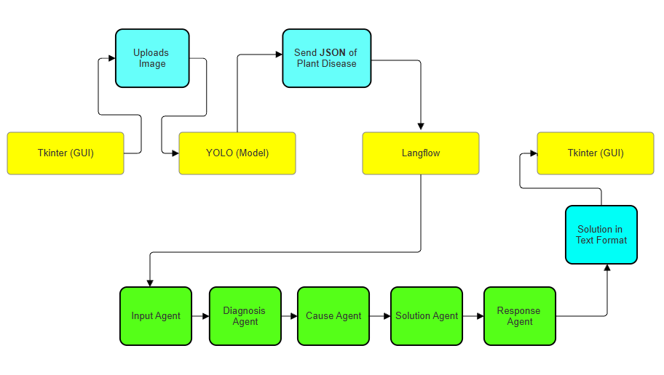
Proposed solution
Demonstration: https://drive.google.com/file/d/1sySEGjsr_5IZQQjDzbIVQ8a56XJmtD6K/view?usp=sharing

Slide 5
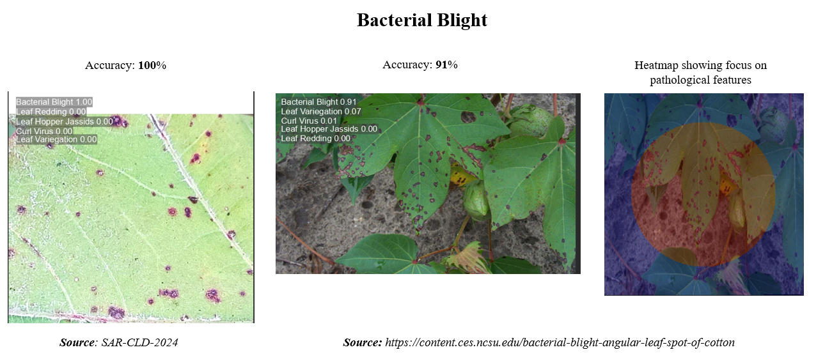
Proposed solution - What our pre-trained model YOLO Does?
Output to Langflow:
JSON: { “PLANT” : “Cotton”, “PREDICTION” : “Bacterial Blight”, “CONFIDENCE” : 0.99 }

Slide 6
Need of project
SDG 12: Responsible Consumption & Production (Target 12.4 - Chemical Management)
Insect pests alone cost the global industry $5 billion/year. We lose 1/5th of our harvest despite chemical interventions.
India is the world's 2nd largest producer, yet ranks 35th in yield efficiency. We have the land, but unmanaged pests / disease are killing our productivity.
The national goal of a $350B textile market is endangered by a stagnant 0.25% growth rate. We cannot reach 2030 targets with 2020 pest control methods.
References:
Vision 2030 For Textile Industry - Central Institute for Cotton Research (CICR) and Ministry of Textiles
International Service for the Acquisition of Agri-biotech Applications (ISAAA)

Slide 7
End user of project
Cotton Farmer:
Needs real-time detection to save crops immediately, rather than waiting days for a manual expert.
Precise spraying advice helps them save ~20% on unnecessary pesticide costs, directly increasing profit margins.
Affiliated Pesticide Brands:
Capture exclusive market share through direct, data-driven product recommendations embedded instantly in the farmer's diagnosis.
Government of India :
Agricultural Extension Officers can track pest spread across districts on a live dashboard to prevent epidemics (like Pink Bollworm).
Helps the Ministry track actual ground-level progress towards the "Vision 2030" yield targets.

Slide 8
Technology Used
Local Python Environment (Laptop/PC) to launch the Tkinter GUI
Edge Device to run the YOLO (Ultralytics) [Pre-Trained Model]
IBM Cloud (Code Engine) - Langflow API
IBM WatsonX / Granite

Slide 9
Novelty and Uniqueness
Unlike others relying on static CSV spreadsheets, we use Live Computer Vision (YOLO) to detect the actual pest in real-time—we also "see" the problem, they just calculate it.
We don't just label images; we merge instant offline vision with cloud reasoning
We process heavy images locally and send only lightweight JSON text to the cloud, solving rural connectivity issues while keeping farm data private.
Designed for India's dead zones, our core visual detection works fully offline in <50ms, ensuring protection even when the internet fails.

Slide 10
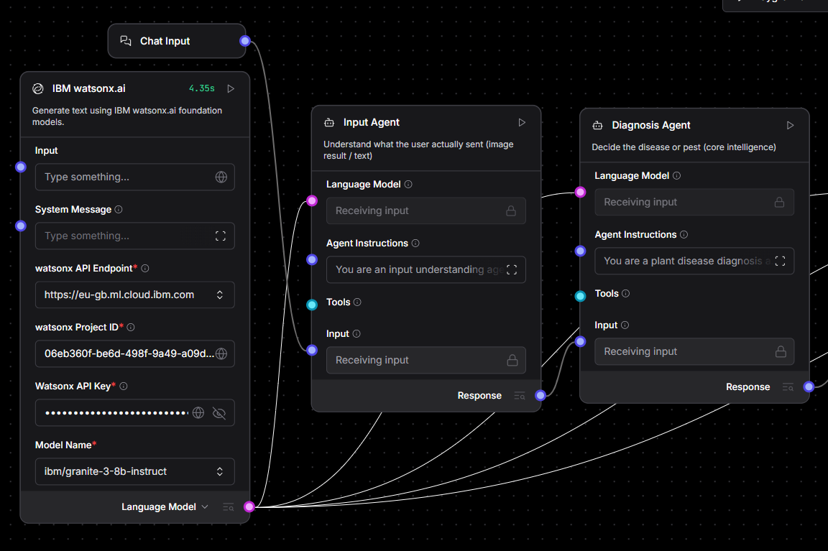
Technical flow diagram - Architecture blueprint

Slide 11
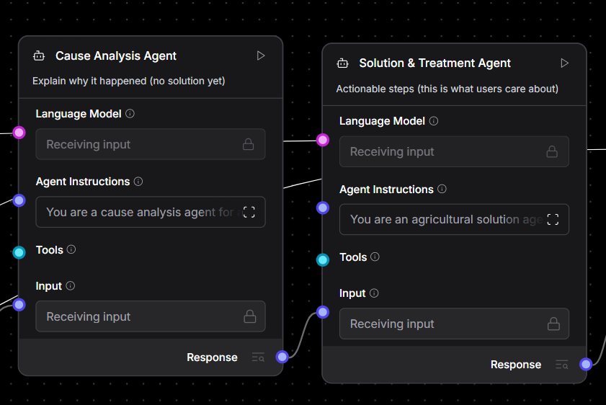
Technical flow diagram - Architecture blueprint

Slide 12
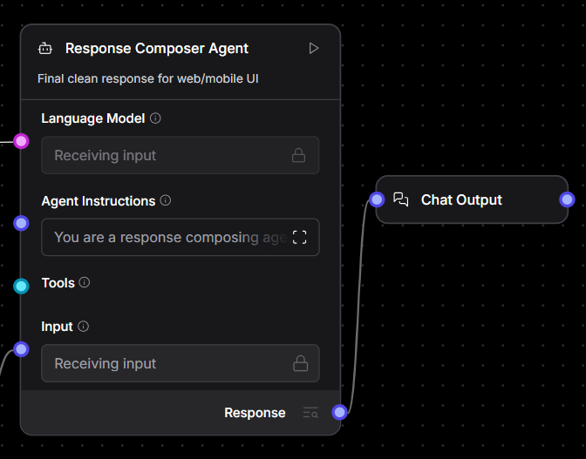
Technical flow diagram - Architecture blueprint

Slide 13
Langflow component Used
Chat Input
IBM watsonx.ai
Agent
          Input Agent: Acts as the system receptionist, formatting user images and queries into structured data for processing.
          Diagnosis Agent: Analyzes visual data using YOLO to instantly identify the specific pest name and confidence level.
          Cause Agent: Investigates the root cause by correlating the diagnosis with environmental triggers like humidity or temperature.
          Solution Agent: Consults IBM Granite agricultural databases to prescribe specific chemical or organic remedies.
          Response Agent: Synthesizes all technical findings into a single, friendly, and easy-to-read report for the farmer.
Chat Output

Slide 14
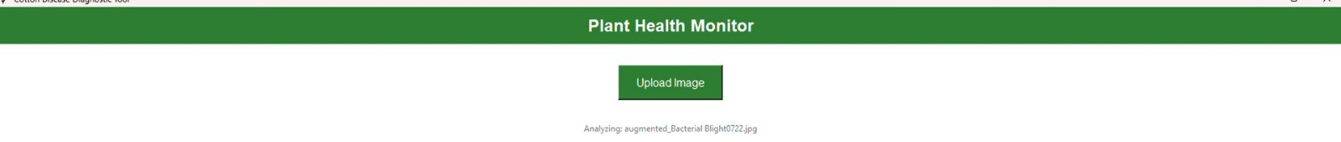
Input Screenshot

Slide 15
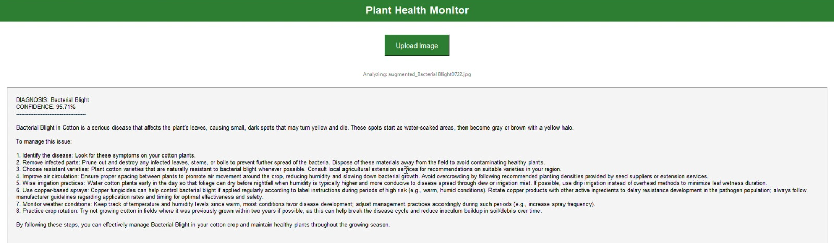
Output Screenshot

Slide 16
Future Scope
Multilingual Voice Interface: Enables farmers to interact verbally with the AI assistant in local dialects like Hindi, Kannada, and Marathi.
IoT-Driven Prediction: Integrates soil and weather sensors to correlate environmental data with pest outbreaks for precise forecasting.
Automated Precision Spraying: Connects to smart sprayers to target only infected plants, reducing chemical usage by 40%.
Live Outbreak Heatmaps: Aggregates anonymous user data to generate district-level infection maps for government early warning systems.

Slide 17
Git Hub Link
Github Repository Link:
https://github.com/CharanBS2004/GreenEye
Contains:
Problem_Statement.pdf
GreenEye.pptx
Main.py
Best.pt
Test Image (augmented_Bacterial Blight0722.jpg)
Readme.md

Slide 18
References
Zhang, Yuanjia, et al. "Accurate cotton diseases and pests detection in complex background based on an improved YOLOX model." Computers and Electronics in Agriculture 203 (2022): 107484.
Zhang, Ting, et al. "Residual swin transformer for classifying the types of cotton pests in complex background." Frontiers in Plant Science 15 (2024): 1445418.
Kiobia, Denis O., et al. "A review of successes and impeding challenges of IoT-based insect pest detection systems for estimating agroecosystem health and productivity of cotton." Sensors 23.8 (2023): 4127.

Slide 19


