Slide 1


BIOMETRICS
BATCH-03

Slide 2
BATCH-03
211FA04008-K.B.SATWIKHA
211FA04014-J.N.V.M.CHARAN
211FA04026-D.VAMSI KRISHNA
211FA04038-SD.KARIMUN

Slide 3
Table of contents
01
02
ABSTARCT
INTRODUCTION
03
04
05
ALGORITHM
SOURCECODE
CONCLUSION

Slide 4
01
ABSTRACT

Slide 5
ABSTRACT:
In this ppt, we discuss
about the Face recognition technology, it is based on the identification of facial features of an individual. We have identified the recognition equipment for taking face images which automatically processes them. This ppt describes the development stages, related technologies of face recognition and the process included in face recognition. They are:
Enrollment
Template/Feature vector
Matching score

Slide 6
INTRODUCTION
02

Slide 7
FACE RECOGNITION:
Biometric Face Recognition is the process and ability of a biometric machine to identify and recognize the face of an individual either to grant access to a secured system or to find out the details of a person by matching the face with existing data in the machine’s system. This process includes several steps.

Slide 8
They are:
Enrollment:
This process involves capturing the face of an individual concentrating on the face land marks, texture, size and shape, there by storing them in the database for future use. During this process, the faces of individuals are scanned through cameras or webcams and are converted into digital images.
Template/Feature Vector:
In this process, the digital images of the faces are converted into a mathematical representation known as a template or feature vector. This template is unique to each individual and is used for identification purposes.

Slide 9
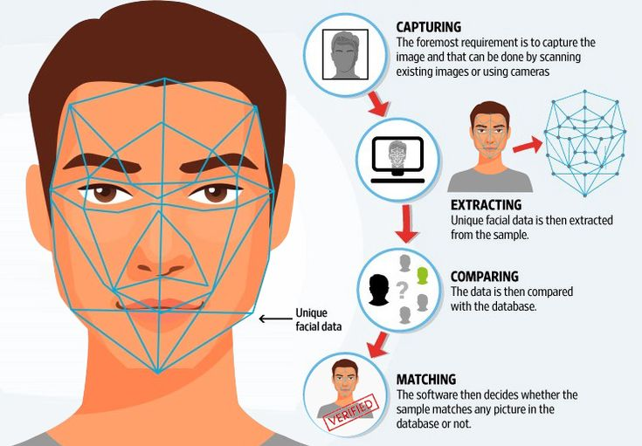
Matching Score:
This process involves comparing the template of an individual's face with the template of another individuals face. The comparison is done using either Euclidean distances or Hamming distances. The result is a matching score that indicates the similarity between the two templates.

Slide 10

IMPLEMENTATION
To implement the following code, at first we are going to store enrolled faces in a folder named “enrolled faces”, with each face image named using a unique identifier and the file extension “.jpg”(e.g., “face1.jpg”,”face2.jpg”,etc).

Slide 11
ALGORITHM
03
C

Slide 12

ALGORITHM:
1)start
2)Enroll faces and store it in a file called “Enrolled_ faces”. With each face image using a unique identifier and the file extension.
3)Preprocess the image for each enrolled face by converting it to grayscale and resizing it to a fixed size.
4)Compute the mean face and eigenfaces using PCA algorithm.
5)The mean mean face and eigenfaces are to be saved to files named “mean _face. mat” and “eigenfaces.mat” respectively.
6)To match a query face to an enrolled face, repeat steps-1 to step-4.
7)Then subtract the mean face from the query face and project the resulting face onto the eigen faces.
8)The feature vector produce by above process is then compared with feature vector of the enrolled faces using Euclidean distance.
9)End

Slide 13
SOURCE CODE
O4

Slide 14
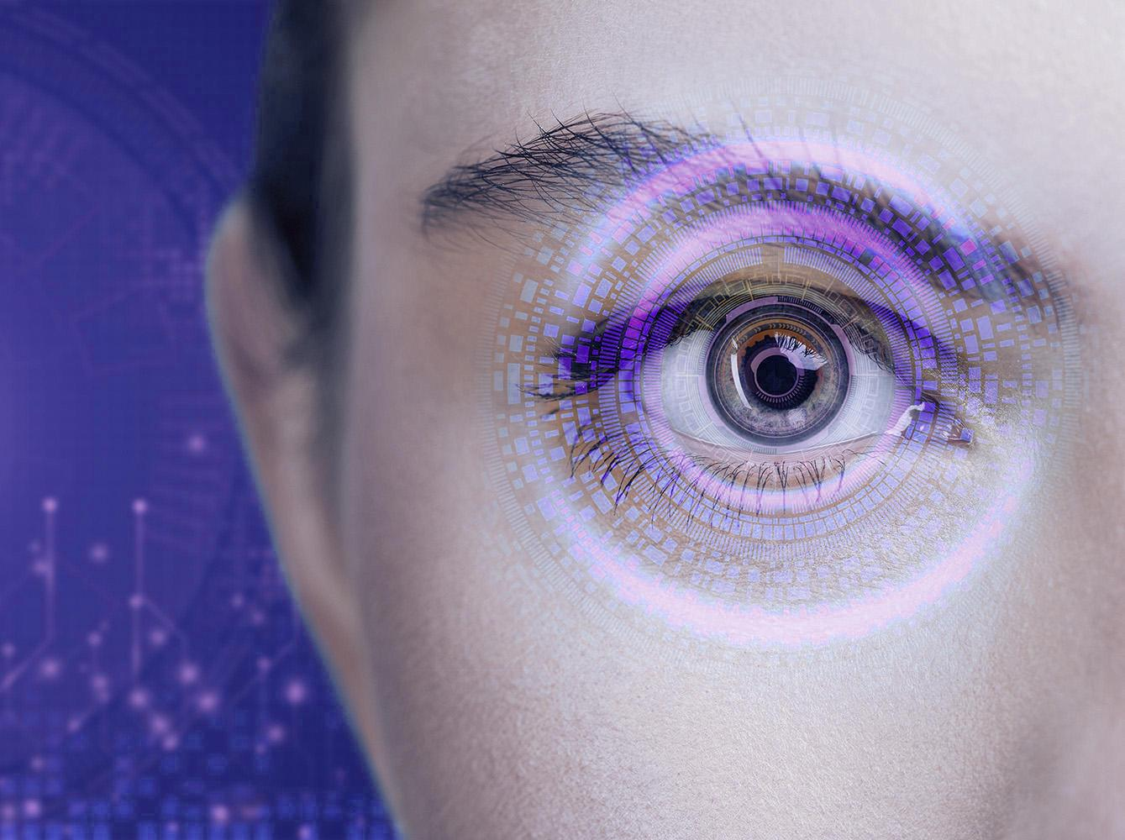
SOURCE CODE:
% Enroll faces
face_folder = 'enrolled_faces'; % Folder containing enrolled faces
face_files = dir(fullfile(face_folder, '*.jpg')); % Get all face image files in folder
num_faces = length(face_files); % Number of enrolled faces
% Preprocess faces
for i = 1:num_faces
% Load face image
face = imread(fullfile(face_folder, face_files(i).name));
% Convert to grayscale
gray = rgb2gray(face);
% Resize to a fixed size
resized = imresize(gray, [128 128]);
% Store preprocessed face in cell array
faces{i} = resized;
END

Slide 15
% Compute mean face
mean_face = mean(cell2mat(faces), 2);
% Compute eigenfaces
num_eigenfaces = 20; % Number of
eigenfaces to compute
[eigenvectors, scores] =
pca(cell2mat(faces),
'NumComponents', num_eigenfaces);
% Store eigenfaces in cell array
for i = 1:num_eigenfaces
eigenfaces{i} =
reshape(eigenvectors(:,i), [128 128]);
end
% Save mean face and eigenfaces to
file
save('mean_face.mat', 'mean_face');
save('eigenfaces.mat', 'eigenfaces');
% Match face
% Load mean face and eigenfaces
from file
load('mean_face.mat');
load('eigenfaces.mat');
% Load query face
query_face = imread('query_face.jpg');
% Preprocess query face
gray = rgb2gray(query_face);
resized = imresize(gray, [128 128]);
% Subtract mean face from query face
mean_subtracted = double(resized) -
mean_face;
% Project query face onto eigenfaces
feature_vector = zeros(num_eigenfaces, 1);
for i = 1:num_eigenfaces
feature_vector(i) = sum(sum(eigenfaces{i}
.* mean_subtracted));
end
% Load enrolled face feature vectors from
file
load('enrolled_face_features.mat');
% Compute Euclidean distances between
query face feature vector and enrolled face
feature vectors

Slide 16
05
CONCLUSION

Slide 17

CONCLUSION:
From analysing this report we can
conclude, how the verification or recognition of
face Biometrics takes place from enrolment to
checking if they have any similarities by
matching scores. We have also recognised
several matching methods which involves
comparing the extracted features of face to
detremine if tehy match

Slide 18
THANK YOU
BATCH-03

