Slide 1
MuleSoft Integration Architecture and API-led Connectivity
Enabling seamless connection through modern integration strategies
Notes:
---

Slide 2
MuleSoft Integration Overview
Notes:
Introduction to MuleSoft Integration Architecture, API-Led Connectivity Approach

Slide 3

Introduction to MuleSoft Integration Architecture
API-Led Connectivity
  MuleSoft uses an API-led approach to enable seamless connectivity across diverse systems and applications.
Anypoint Platform Lifecycle
  The Anypoint Platform manages the full API lifecycle including design, deployment, and monitoring.
Cloud and On-Premises Support
  MuleSoft supports both cloud and on-premises deployments to suit varied infrastructure needs.
Business Agility and Cost Reduction
  Adopting MuleSoft accelerates digital transformation, reduces integration costs, and improves agility.
Notes:
MuleSoft Integration Architecture is designed to facilitate seamless connectivity across diverse systems using an API-led approach. This architecture emphasizes reusability, scalability, and security, making it ideal for modern enterprise integration needs. At its core, MuleSoft leverages the Anypoint Platform to manage the entire lifecycle of APIs and integrations—from design and development to deployment and monitoring. The platform provides a unified solution that supports both cloud and on-premises deployments, enabling organizations to adapt to various infrastructure requirements. By adopting MuleSoft’s architecture, businesses can accelerate digital transformation, reduce integration costs, and improve agility in responding to changing market demands.

Slide 4

API-Led Connectivity Approach
System Layer Access
  The System Layer connects to core backend systems such as ERP, CRM, and databases for standardized data access.
Process Layer Orchestration
  The Process Layer aggregates data from multiple sources and applies business logic to produce meaningful outputs.
Experience Layer APIs
  The Experience Layer delivers APIs tailored for user interfaces like mobile and web, optimizing user experience.
Benefits of Layered Approach
  This approach enables modularity, reusability, collaboration, and simplifies integration of new technologies.
Notes:
The API-led connectivity approach in MuleSoft is structured around three distinct layers: System, Process, and Experience. The System Layer connects directly to core systems such as ERP, CRM, and databases, providing standardized access to backend data. The Process Layer orchestrates and aggregates data from multiple sources, implementing business logic to deliver meaningful information. The Experience Layer offers APIs tailored for specific user interfaces, such as mobile apps or web portals, ensuring optimal user experiences. This layered approach promotes decoupling and modularity, allowing teams to build reusable and maintainable APIs. It also enhances collaboration across development teams and simplifies the integration of new technologies into existing ecosystems.

Slide 5
Anypoint Platform Components
Notes:
Core Components of Anypoint Platform

Slide 6

Core Components of Anypoint Platform
Anypoint Studio IDE
  Anypoint Studio is an integrated development environment used to design and build Mule applications efficiently.
Anypoint Exchange Repository
  Anypoint Exchange serves as a central repository for reusable APIs, connectors, and templates, enhancing collaboration.
API Manager Security
  API Manager provides tools for API security, policy enforcement, and analytics to manage APIs effectively.
Runtime Management and Monitoring
  Runtime Manager enables deployment and monitoring of applications, while monitoring tools provide performance insights.
Notes:
MuleSoft’s Anypoint Platform comprises several key components that support the full lifecycle of API and integration development. Anypoint Studio is the integrated development environment (IDE) used to design and build Mule applications. Anypoint Exchange serves as a repository for reusable assets, including APIs, connectors, and templates, fostering collaboration and efficiency. API Manager provides tools for securing and managing APIs, including policy enforcement and analytics. Runtime Manager enables deployment and monitoring of applications across various environments. Additionally, Anypoint Monitoring and Analytics offer insights into performance, usage, and reliability, helping teams optimize their integrations. Together, these components create a robust ecosystem for building scalable and secure integrations.

Slide 7
Deployment and Security
Notes:
Deployment Models, Security & Governance

Slide 8

Deployment Models
CloudHub Deployment
  CloudHub provides a fully managed cloud platform that simplifies infrastructure management and offers scalable solutions for enterprises.
Hybrid Deployment
  Hybrid deployment combines cloud and on-premises environments, delivering flexibility, control, and seamless integration.
On-Premises Deployment
  On-premises deployment hosts Mule runtimes in local data centers, ensuring compliance with internal policies and regulations.
Consistent Performance and Governance
  MuleSoft architecture ensures consistent performance and governance across all deployment models for diverse enterprise needs.
Notes:
MuleSoft supports multiple deployment models to accommodate diverse enterprise needs. CloudHub is a fully managed cloud deployment option that simplifies infrastructure management and scalability. Hybrid deployment combines cloud and on-premises environments, offering flexibility and control. On-Premises deployment allows organizations to host Mule runtimes within their own data centers, ensuring compliance with internal policies and regulations. These deployment models enable businesses to choose the best fit for their operational requirements, security standards, and scalability goals. MuleSoft’s architecture ensures consistent performance and governance across all deployment types, making it a versatile solution for integration across industries.

Slide 9

Security & Governance
API Policy Enforcement
  MuleSoft enforces API policies including authentication, authorization, and rate limiting to secure data access.
Centralized API Gateway
  The centralized API Gateway manages traffic control, compliance, and monitoring across the API ecosystem.
Governance and Compliance
  Governance protocols ensure regulatory adherence and visibility into API usage for risk mitigation.
Risk Mitigation and Trust
  Robust security measures help businesses mitigate risks and maintain trust with users and stakeholders.
Notes:
Security and governance are integral to MuleSoft’s integration architecture. The platform allows for the enforcement of API policies such as authentication, authorization, and rate limiting. These policies help protect sensitive data and ensure that APIs are accessed securely and efficiently. MuleSoft also provides a centralized API Gateway that manages traffic control, compliance, and monitoring. This gateway enables organizations to maintain visibility and control over their API ecosystem, ensuring adherence to regulatory standards and internal governance protocols. By integrating robust security measures, MuleSoft helps businesses mitigate risks and maintain trust with users and stakeholders.

Slide 10
Integration Patterns
Notes:
Common Integration Patterns

Slide 11

Common Integration Patterns
Synchronous Integration
  Synchronous integration enables real-time request-response communication suitable for immediate feedback applications.
Asynchronous Integration
  Asynchronous integration uses event-driven messaging allowing systems to communicate without waiting for a response.
Batch Processing
  Batch processing handles large datasets efficiently, often running tasks in scheduled intervals for performance.
Notes:
MuleSoft supports a variety of integration patterns to address different business scenarios. Synchronous integration involves real-time request-response communication, suitable for applications requiring immediate feedback. Asynchronous integration uses event-driven messaging, allowing systems to communicate without waiting for responses, which is ideal for high-volume or time-insensitive processes. Batch Processing is used for handling large datasets efficiently, often in scheduled intervals. These patterns enable developers to design integrations that are optimized for performance, reliability, and scalability. By leveraging the appropriate pattern, organizations can ensure that their systems interact seamlessly and meet operational requirements.

Slide 12
Visual Representation
Notes:
MuleSoft Architecture Diagrams

Slide 13
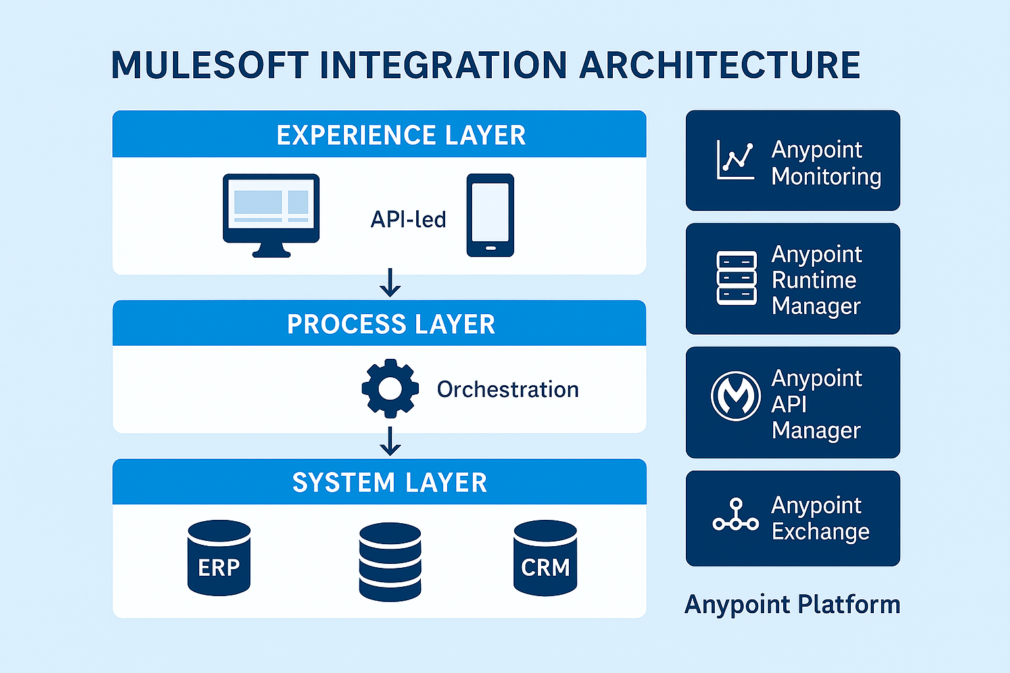
MuleSoft Architecture Diagrams
Layer | Description
Experience Layer | Provides APIs tailored for specific user interfaces like mobile and web apps.
Process Layer | Orchestrates and aggregates data from multiple sources, implementing business logic.
System Layer | Connects directly to core systems such as ERP, CRM, and databases.

