Slide 1

Sports Management

Slide 2
Code geeks
Team members
Abhiram Nagol (AbhiramNagol@my.unt.edu)
Anudeep Raj Kyatham (Anudeeprajkyatham@my.unt.edu)
Venkata Aditya Pavan Tripasuri (venkataadityapavantripasuri@my.unt.edu)
Chaitanya Maniveerjana (chaitanyamaniveerjana@my.unt.edu)
Charan Pottabathini (charanpottabathini@my.unt.edu)
Nitesh Reddy Vedulla (niteshreddyvedulla@my.unt.edu)
Sai Krishna Gattu (SaikrishnaGattu@my.unt.edu)
Manvitha Kancharla (Manvithakancharla@my.unt.edu)

Slide 3
contributions
Team members | Contribution | Technical stack
Aditya | SQL Developer | Java, SQL
Anudeep | Backend Developer | Java, SQL
Abhiram | Backend Developer | Java, SQL
Charan | Backend Developer | Java, SQL
Nitesh Reddy | Backend Developer | Java, SQL
Chaitanya | Front end Developer | HTML, CSS, ReactJS
Manvitha | Front end Developer | HTML, CSS, ReactJS
Sai Krishna | Front end Developer | HTML, CSS, ReactJS

Slide 4
Description
The project helps in identifying the upcoming and ongoing events in an organization
Also helps in identifying the team members for particular sports using the discussion forum by posting the requirements.
Technical stack
HTML, CSS, ReactJS, Java (Spring boot), SQL

Slide 5
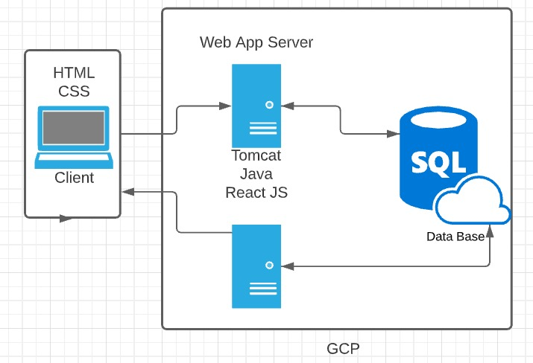
Architecture and Platform

Slide 6
Modules
User authentication
User registration
Upcoming and Ongoing events
Discussion forum

Slide 7
Managing Risks
Server crash
Server crashing and losing the data is always a risk. The plan is to make sure the data on your server is backed up. Planning to use a Backup and Disaster Recovery (BDR) solution.
Technical difficulties:
Data security, large-scale system implementation, software integration are some areas where an application is likely to run into unpredictable problems. Testing will be done to avoid these difficulties.
Poor Management
Budget overshoots and time constraints as the reasons why software projects fail, the underlying reason is always poor management. Managing hardware and human resources on timely manner can avoid the problems caused by poor management

Slide 8
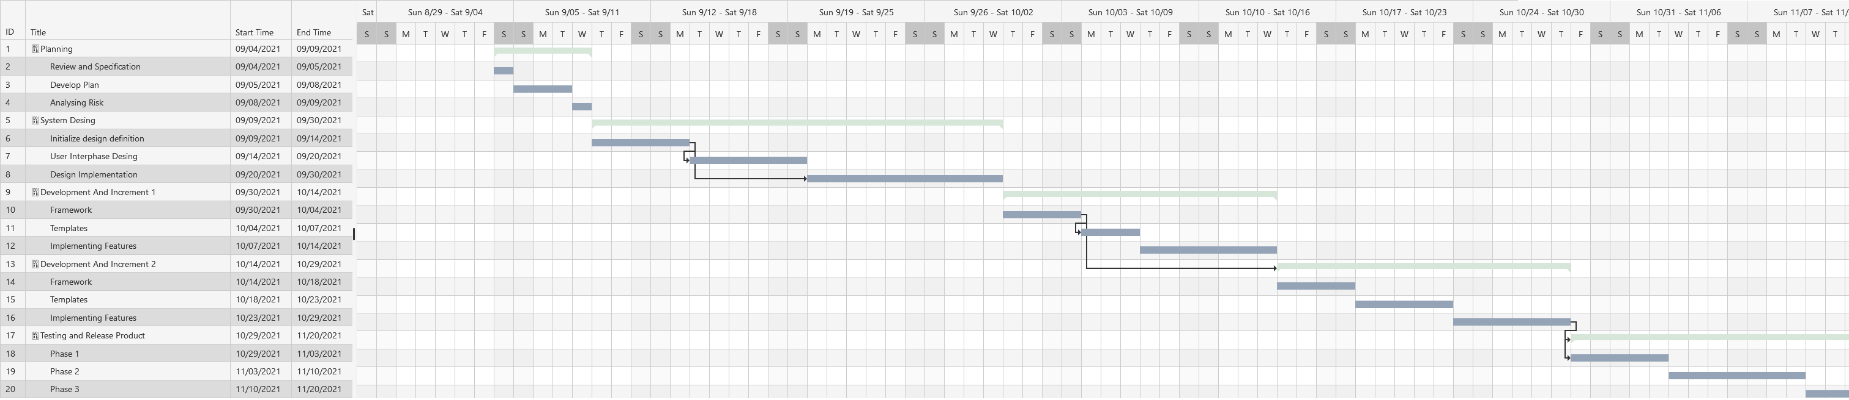
Gantt cHART

Slide 9
Thank you

