Slide 1
Benchmarking Object Detectors on
Under-Sampled Marine Biodiversity Imagery
FathomNet CLEF 2026 | Project Review 1
Charan Rasineni
B.Tech CSE | SCOPE, VIT-AP University, Amaravati
Mentor: Dr. Rajesh Duvvuru

Slide 2
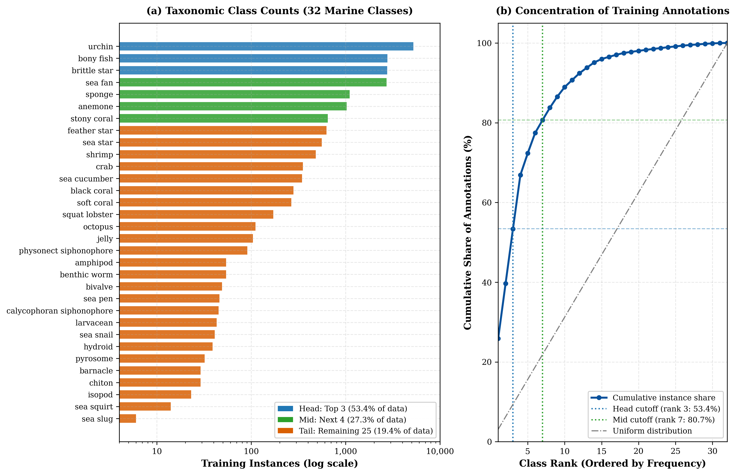
Problem Statement
Why automate marine biodiversity monitoring?
ROVs/AUVs collect terabytes of underwater imagery, far exceeding human expert capacity for manual annotation and species identification.
Underwater detection is hard:
Light attenuation & colour cast (blue-green cast, red wavelengths absorbed first)
Turbidity, backscatter, variable illumination, occlusion
Biological camouflage; many taxa are small and rare
Extreme class imbalance — few head classes dominate, long tail of rare species
Goal: build a controlled detector benchmark to guide AUV/ROV deployment.

Slide 3
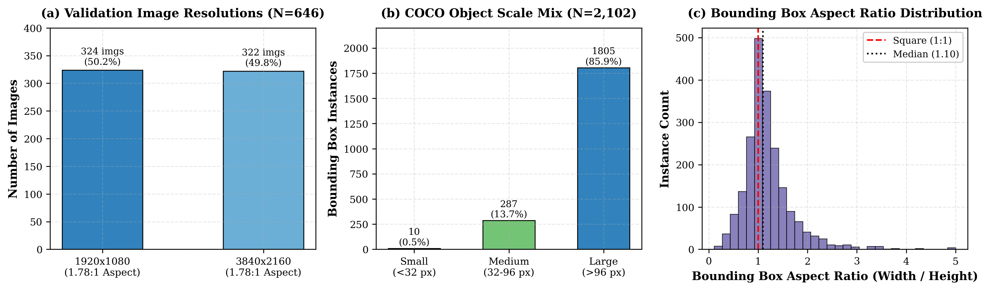
Dataset: FathomNet CLEF 2026
5,817 labelled training images
646 validation images
32 taxonomic classes
Strongly long-tailed annotation distribution
Head: bony fish, brittle star, urchin (~53% of annotations)
Tail: 25 classes incl. amphipod, bivalve, sea slug (some with only 6 instances)
Split protocol (fair comparison across all models):
• Identical stratified 90/10 train/val split, seed 42
• Same input size: 640 x 640 px
• Same COCO mAP evaluation via pycocotools
• Confidence threshold 0.001, max 300 detections/image
• Hardware: single NVIDIA T4 GPU (15 GiB)

Slide 4
Objectives & Contributions
Controlled benchmark of three detector families on underwater imagery
1. Two-stage: Faster R-CNN R50-FPN
2. One-stage: YOLOv8s
3. Transformer: RT-DETR-L
Head/mid/tail and object-size stratified error analysis
Accuracy–inference-cost–latency trade-off for ROV/AUV deployment
Documented GPU-memory ceiling for RT-DETR-L on commodity hardware (15 GiB T4)
Benchmark/comparison study — not a new architecture.

Slide 5
Methodology Overview
Faster R-CNN R50-FPN
YOLOv8s
RT-DETR-L
Two-stage detector
Region Proposal Network + RoIAlign
ResNet-50 + FPN backbone
One-stage detector
Anchor-free head, direct box + class prediction
CSPDarknet backbone
End-to-end transformer detector
Hybrid encoder + IoU-aware queries, no NMS
Training (30 epochs per model, identical data split):
• Faster R-CNN: batch 2, single precision
• YOLOv8s / RT-DETR-L: batch 4, mixed precision (AMP)
Framework-specific resizing, optimiser & augmentation rules remain; results compare representative default setups.

Slide 6
Review 1 — Plan & Next Steps
Complete dataset EDA and publish split indices (split.json)
Finish Faster R-CNN baseline training & evaluation
Launch YOLOv8s and RT-DETR-L training runs (Kaggle)
Build evaluation harness: mAP, per-class AP, latency, size-stratified AP
Review 2 target: training curves + early quantitative results
Deliverable for Review 1: problem definition, dataset, protocol, and methodology.

